Slide 1
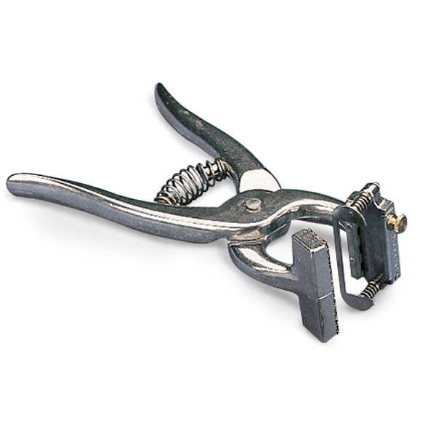
Tattooing Instruments

Slide 2
Nylon Muzzle

Slide 3
Gravity feeder/ J Tube

Slide 4
Gall Bladder

Slide 5
Short Horn

Slide 6
Yorkshire

Slide 7
Hampshire

Slide 8
Suffolk

Slide 9
Demodectic Mite

Slide 10
Horse Stongyles

Slide 11
Backhaus Towel Clamps

