Slide 1
Cecum

Slide 2
Emasculator

Slide 3
Reticulum

Slide 4
Drench gun

Slide 5
Spleen

Slide 6
Chester White

Slide 7
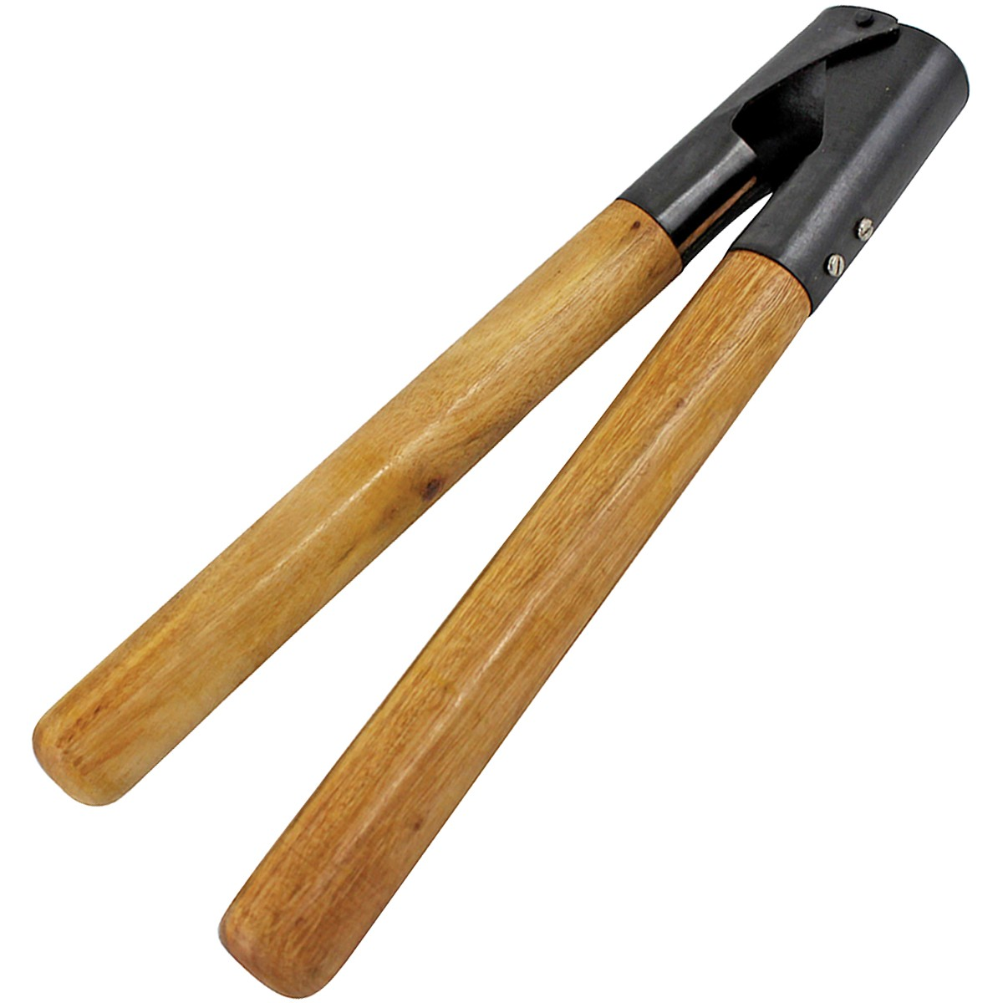
Barnes Dehorner

Slide 8
American Landrace

Slide 9
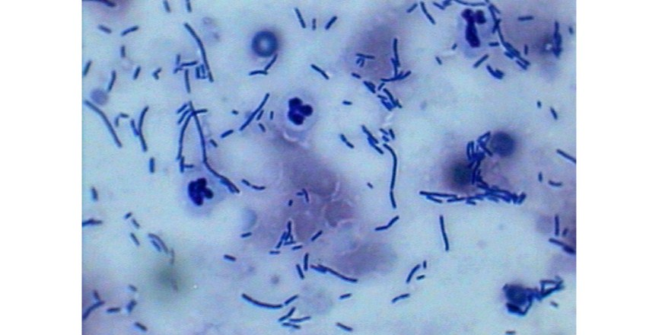
Yeast Cytology

Slide 10
Heartworm Microfilaria (Genus Dirofilaria)

