Slide 1
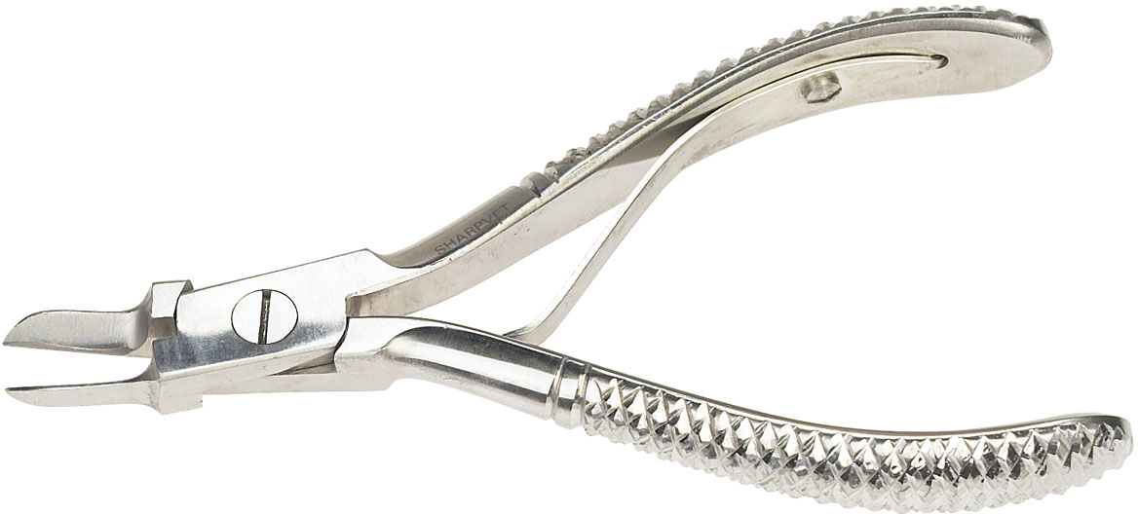
Pig Tooth Nippers

Slide 2
Trocar & Cannula

Slide 3
Trachea

Slide 4
Brain

Slide 5
Chicken- Rhode Island Red

Slide 6
Chicken- Leghorn

Slide 7
Hamster

Slide 8
Liver fluke

Slide 9
Adult Mosquito

Slide 10
Platelets

Slide 11
Eosinophils

