Slide 1
Practice #38 TEST (Breeds of Animals)
For this practice write down on a sheet of paper what you think the answer is. Grade yourself using the answer key on the last slide after you wrote your answer for each slide. Each slide is worth 5 pts. Each.

Slide 2
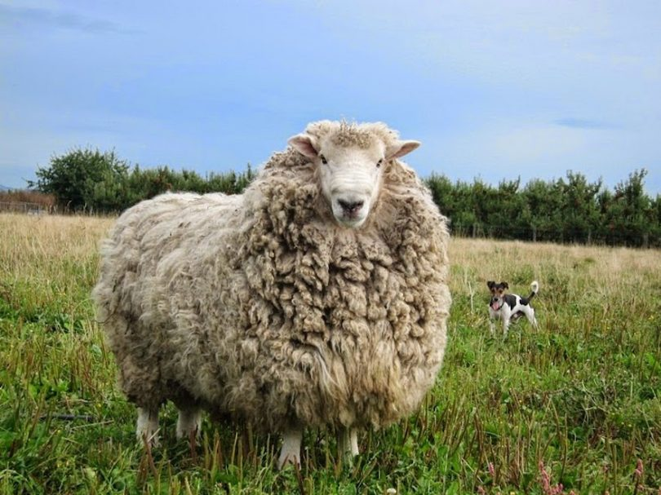

Slide 22
Answer Key
1.Merino
2. La Mancha
3. New Zealand
4. Zebra Finch
5. Abyssinian
6. Shih Tzu
7. Grey Hound
8. Bull Terrier
9. American Landrace
10. Appaloosa
11. Jersey
12. Angora
13. Guinea Pig
14. Rhode Island Red
15. Sun Conure
16. Lovebird
17. Russian Blue
18. Columbia
19. Saanen
20. Saddlebred

