Slide 1
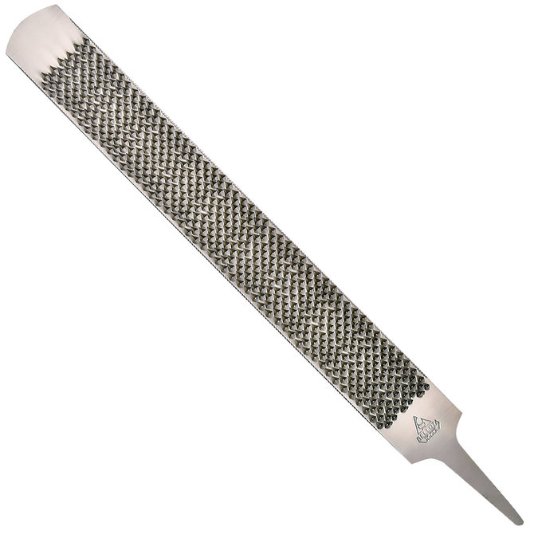
Hoof Rasp

Slide 2
Hoof Knife

Slide 3
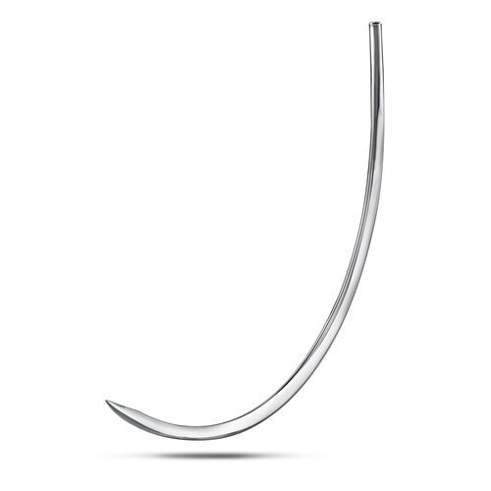
Suture Needle- Taper Suture Needle- Cutting

Slide 4
Rumen

Slide 5
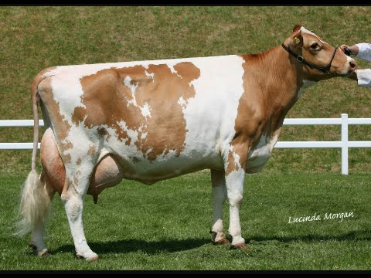
Ayrshire Guernsey (look at color difference)

Slide 6
Berkshire

Slide 7
Merino

Slide 8
Thoroughbred

Slide 9
Hookworm Egg

Slide 10
Platelets

