Slide 1
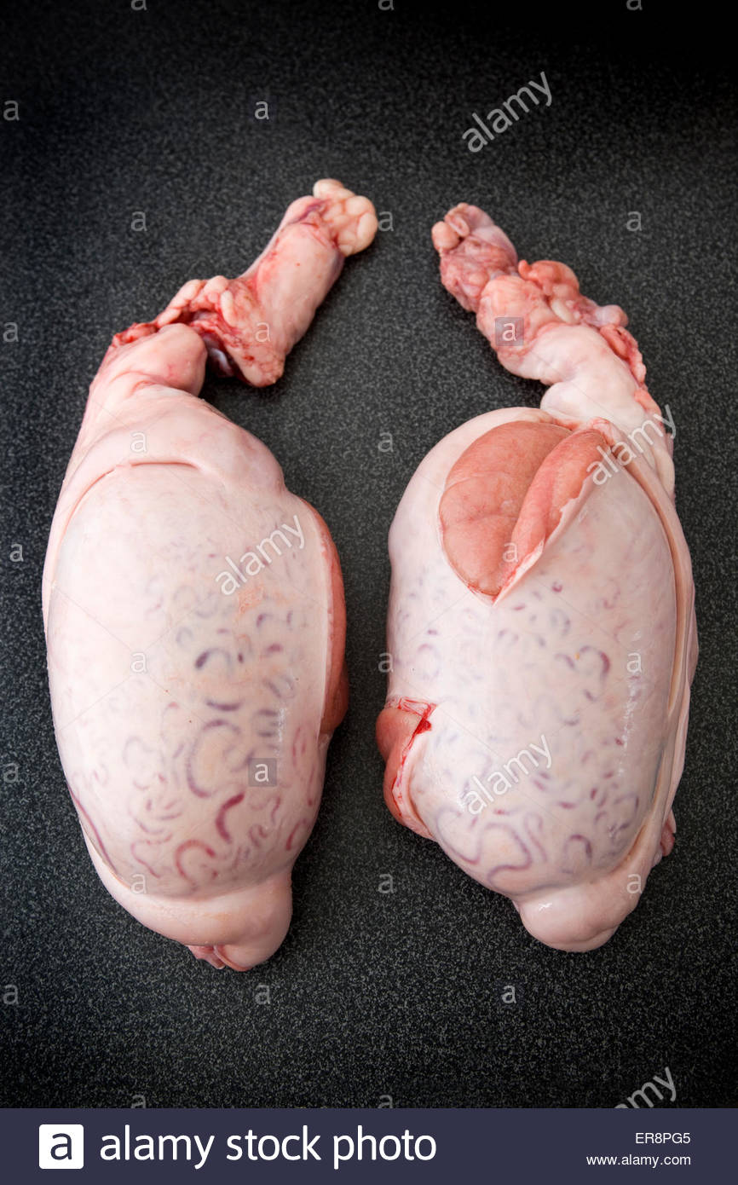
Testicles

Slide 2
Tourniquet

Slide 3
Scissors — Suture wire cutting

Slide 4
Laparoscope

Slide 5
Chinese Shar-Pei

Slide 6
Morgan

Slide 7
Suffolk

Slide 8
Struvite crystals (triple magnesium phosphate)

Slide 9
Demodectic Mite (Genus Demodex)

Slide 10
Whipworm Egg

