Slide 1
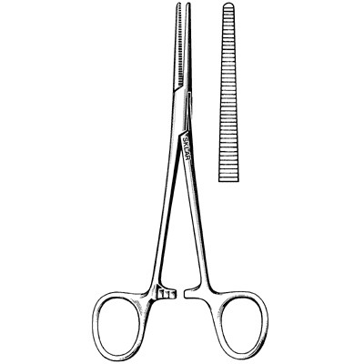
Forceps — Crile

Slide 2
Scissors — Lister bandage

Slide 3
Liver

Slide 4
Weimaraner

Slide 5
Coccidia (Genus Isospora or Eimeria)

Slide 6
Roundworm Adult

Slide 7
Tapeworm

Slide 8
Saddlebred

Slide 9
African Gray Parrot

