Slide 1
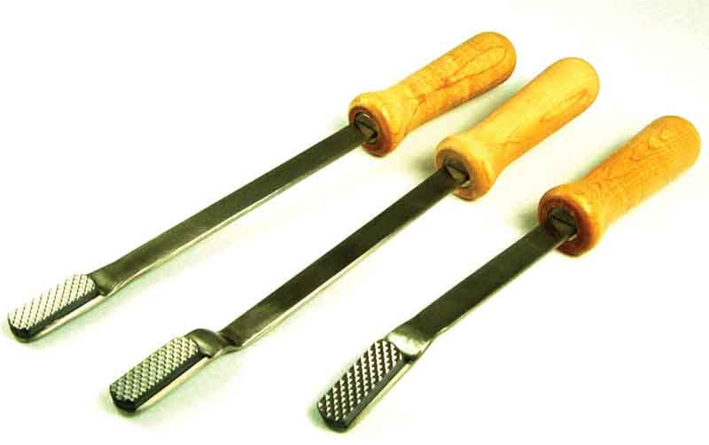
Dental Floats

Slide 2
IV Administration Set

Slide 3
Endotracheal Tubes

Slide 4
English Setter

Slide 5
Cocker Spaniel

Slide 6
Sannen

Slide 7
Siamese

Slide 8
Jersey

Slide 9
Adult Heartworm

Slide 10
Cocci

