Slide 1
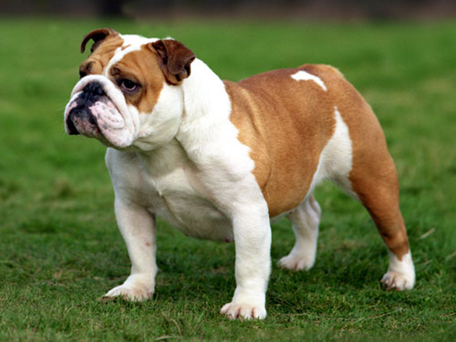
Bulldog

Slide 2
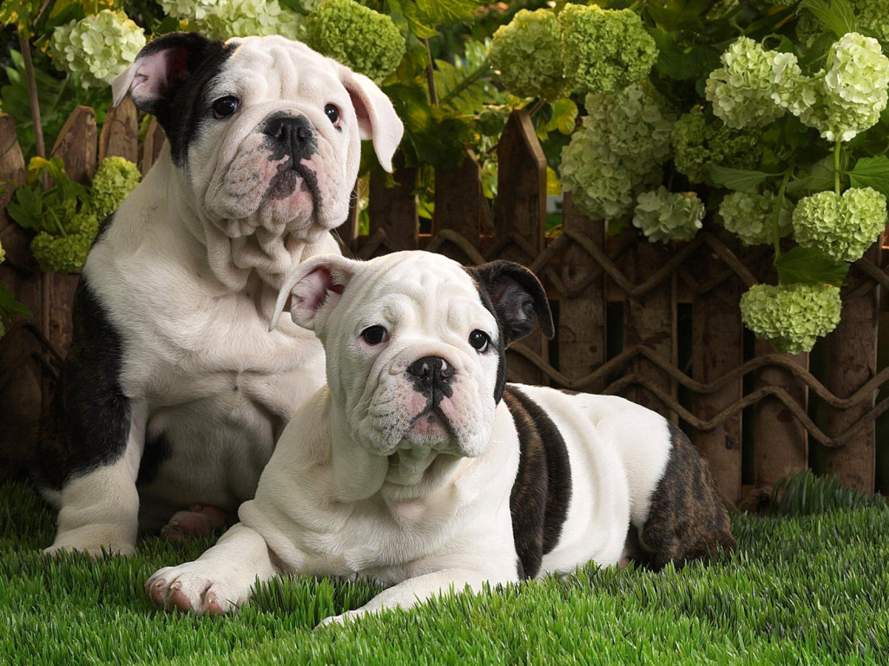
Bulldog
AKC Recognized Colors:
10 recognized colors (wide variety)
AKC Recognized Markings:
6 recognized markings
The breed we know today originated in England from dog breeders who selected for shorter legs and bigger heads
The earliest individuals of this breed were taller and used to grab a bull by the nose and hold him in place (used for actual purposes – ex. castration, and entertainment)

Slide 3
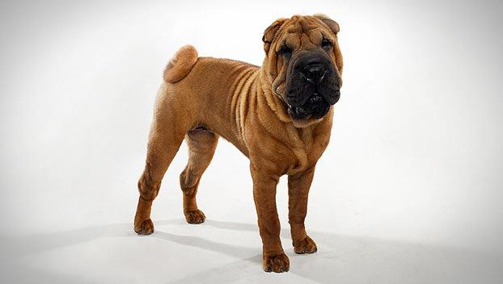
Chinese Shar-Pei

Slide 4
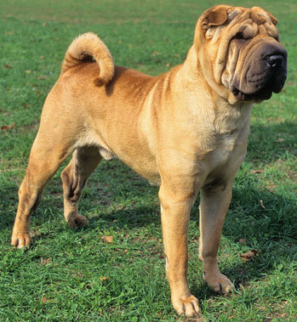
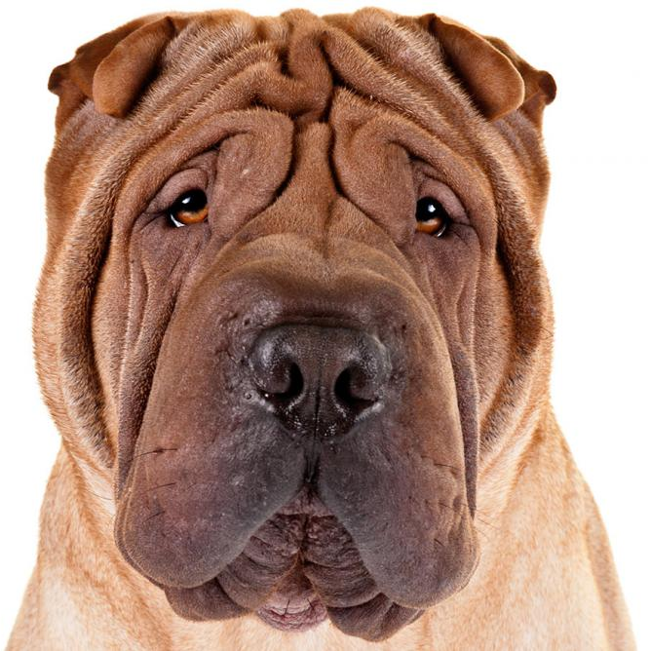
Chinese Shar-Pei
AKC Recognized Colors:
18 recognized colors (wide variety)
AKC Recognized Markings:
7 recognized markings
Originated in southern China
Wrinkly face and body, turned down ears, and curled tail
One of two breeds to have a blue tongue (the other is the Chow-Chow)

Slide 5
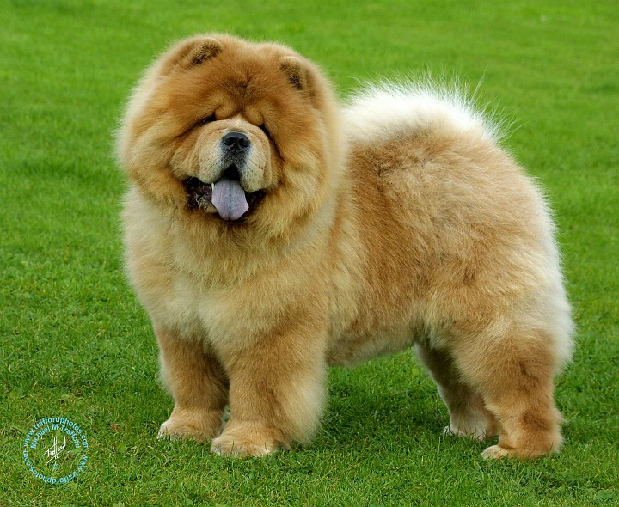
Chow Chow

Slide 6
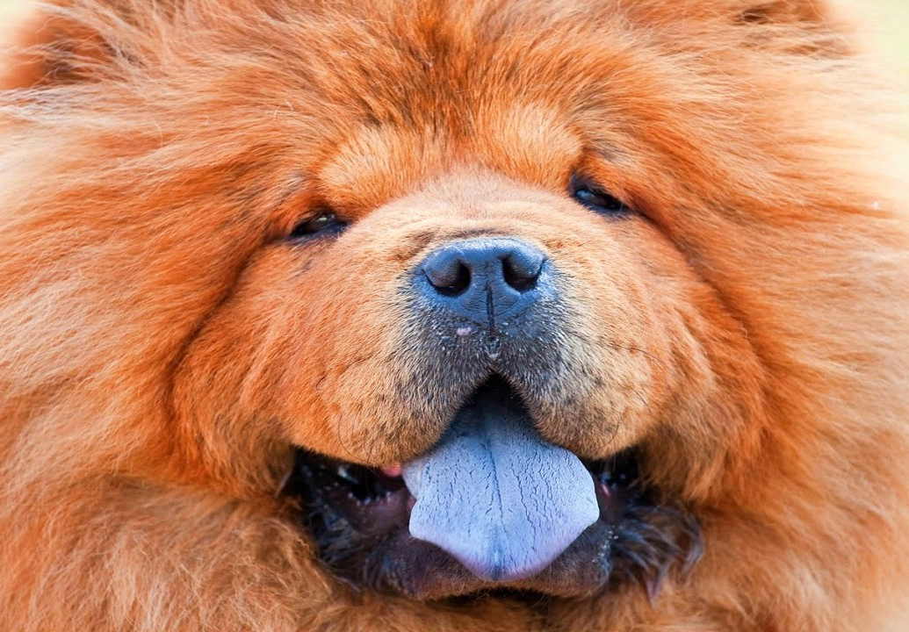
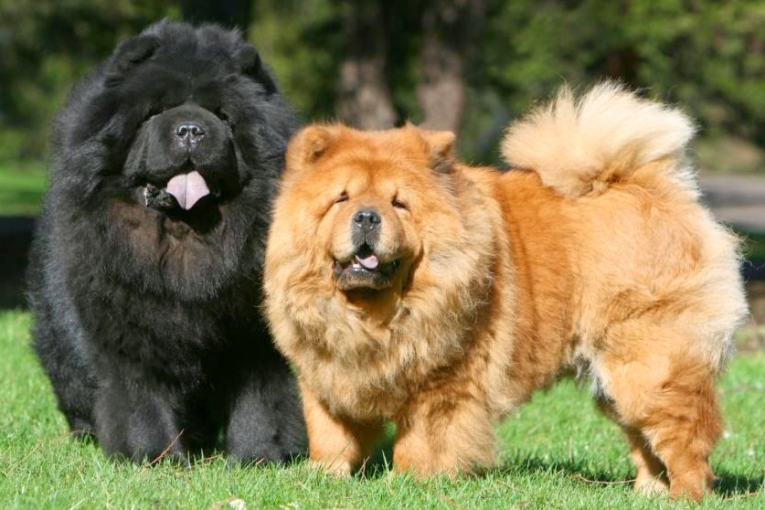
Chow Chow
AKC Recognized Colors:
Black
Blue
Cinnamon
Cream
Red
AKC Recognized Markings:
None
Originated in China (very old breed)
The second of two breeds to have a blue tongue
Likely descends from the Tibetan mastiff

Slide 7
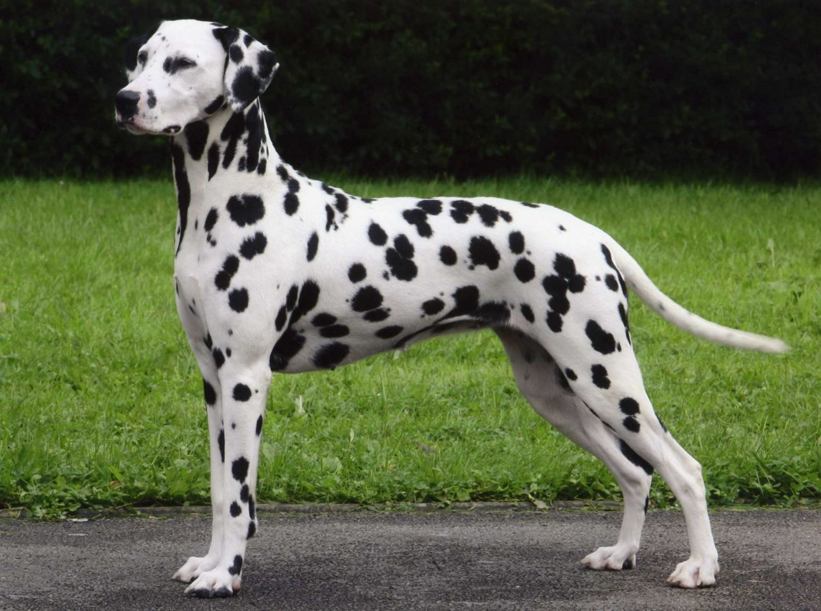
Dalmatian

Slide 8
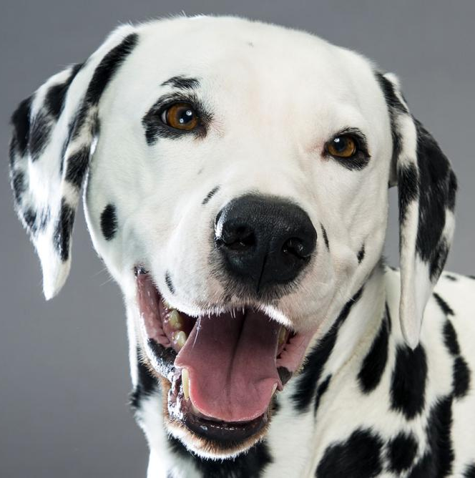
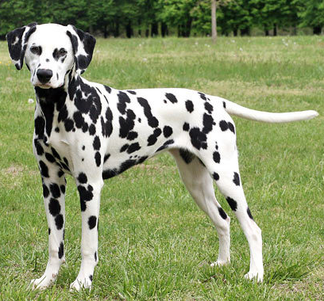
Dalmatian
AKC Recognized Colors:
White and black
White and liver brown
AKC Recognized Markings:
None
Originated in Croatia
Unique black and white spotting pattern
These dogs love to run and were often used to run alongside carriages and horseback riders, they discouraged stray dogs from tampering with the horses or carriage

Slide 9
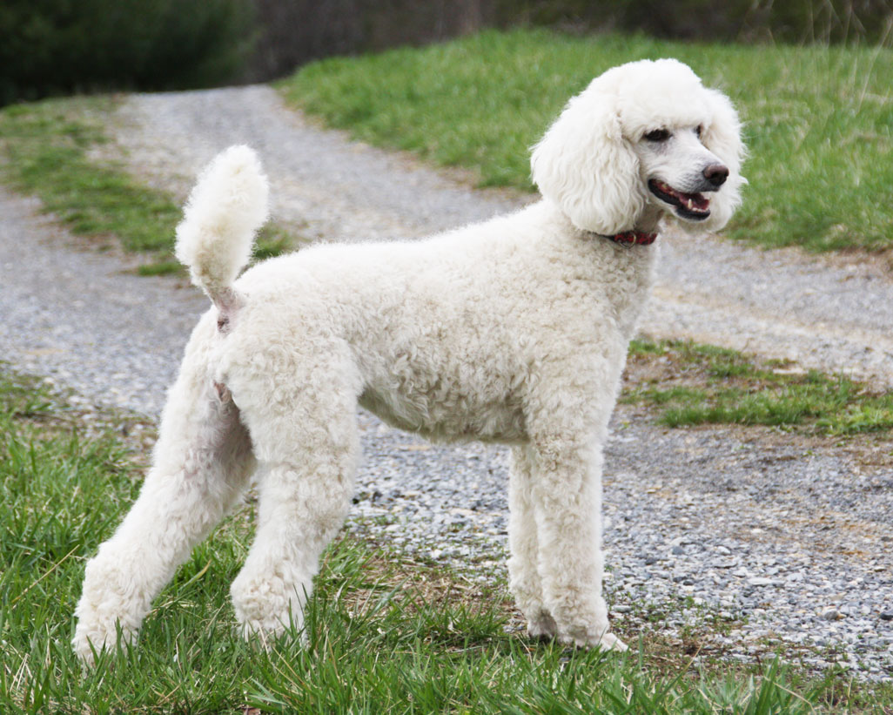
Poodle

Slide 10
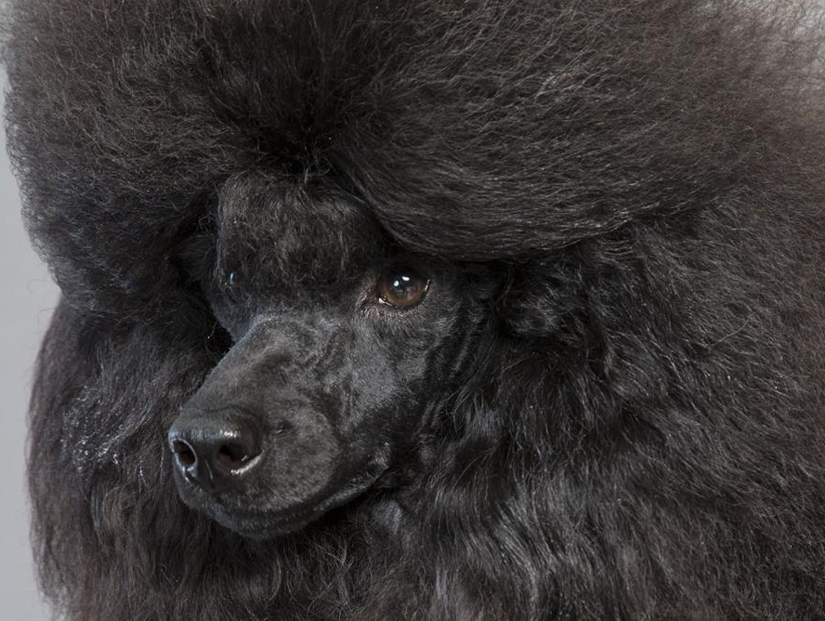
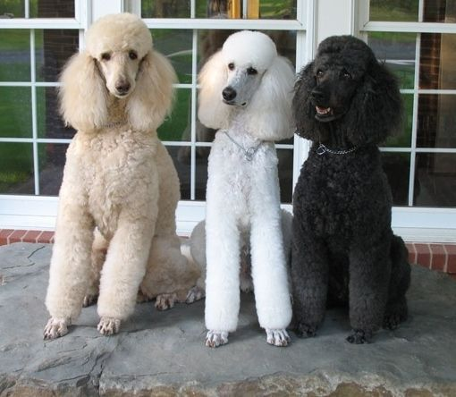
Poodle (standard)
AKC Recognized Colors:
10 recognized colors (there is a wide variety)
AKC Recognized Markings:
None
Originated in Germany
Used as water retrievers
Very popular breed (Especially in France)

Slide 11
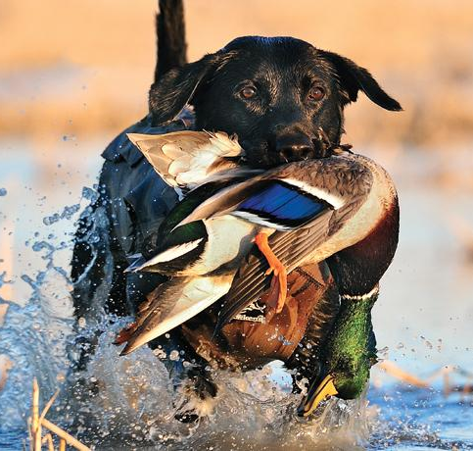
Sporting Group:
These breeds are active and alert and have good water and fowl hunting instincts
Many pointers, retrievers, setters, and spaniels are part of this group
Breeds under this group:
Brittany Spaniel
Cocker Spaniel
English Setter
German Shorthaired Pointer
Golden Retriever
Irish Setter
Labrador Retriever
Weimaraner
Notes:
http://www.akc.org/dog-breeds/groups/herding/

Slide 12
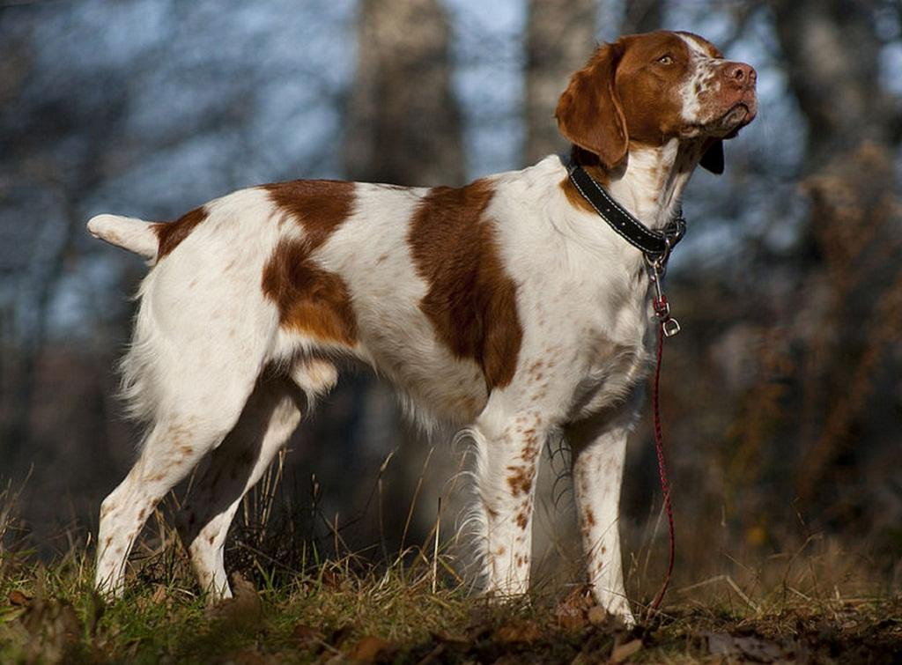
Brittany Spaniel

Slide 13
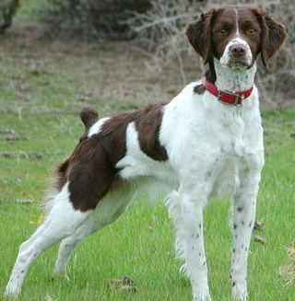
Brittany Spaniel
AKC Recognized Colors:
7 recognized colors (all variations of orange/liver)
AKC Recognized Markings:
None
Originated in France
Pointing breed (a gundog used to find game by stopping and “pointing” its muzzle toward the game)
Medium size, docked tail/tailless, dense coat

Slide 14
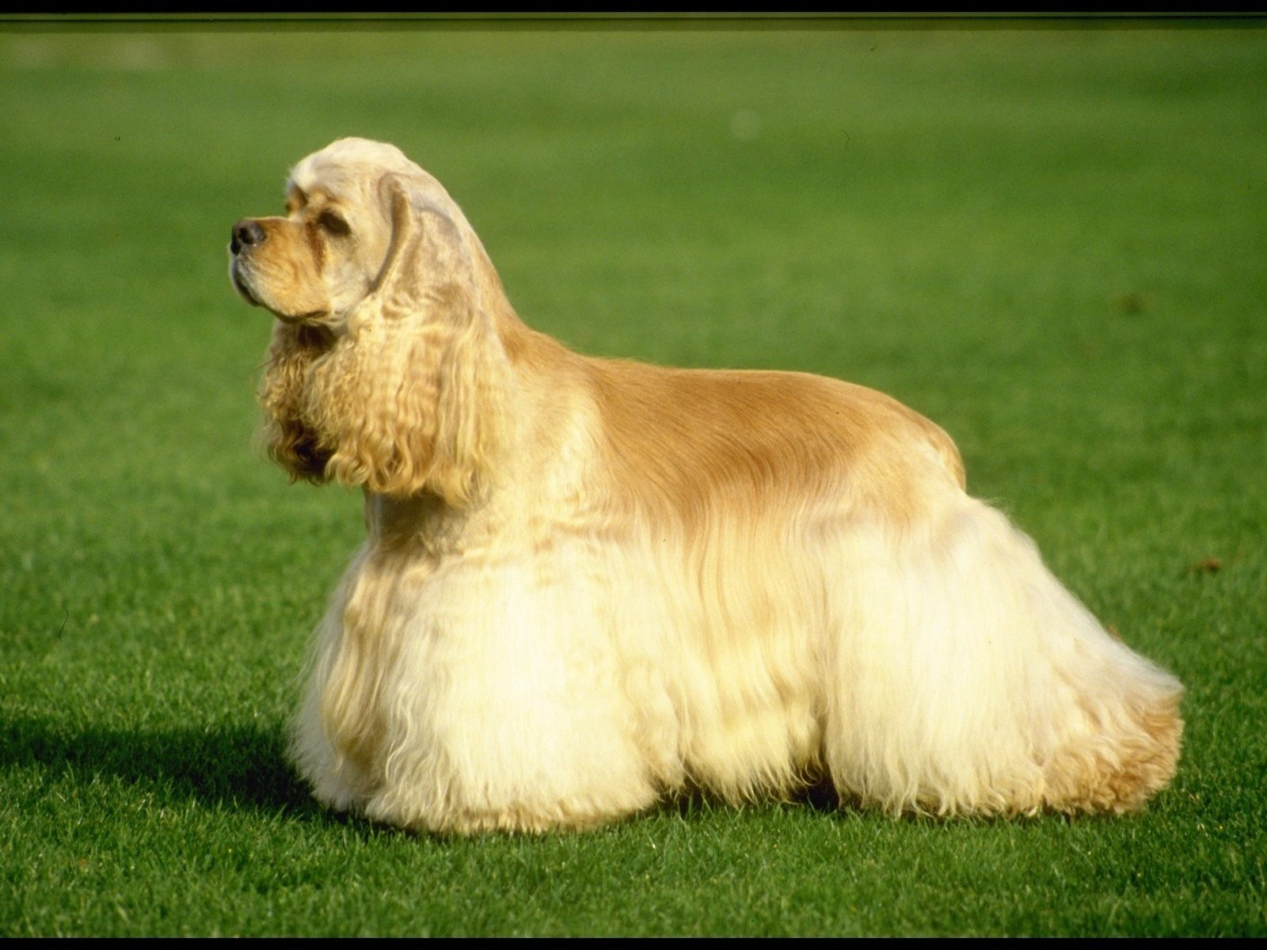
Cocker Spaniel

Slide 15
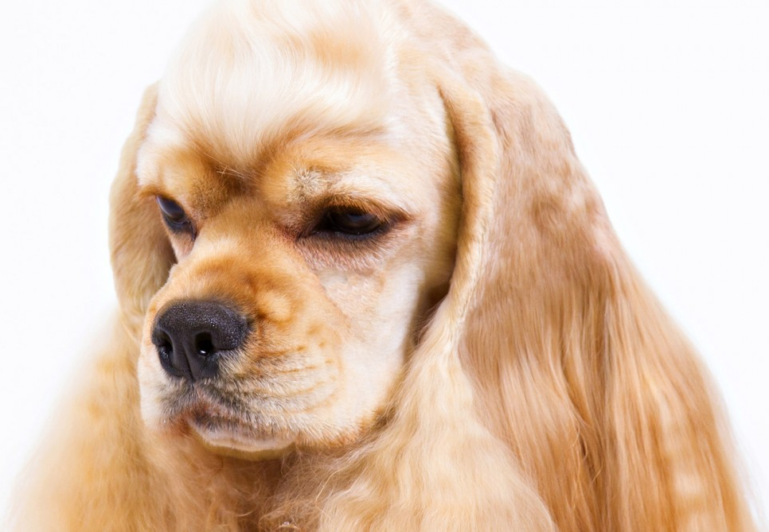
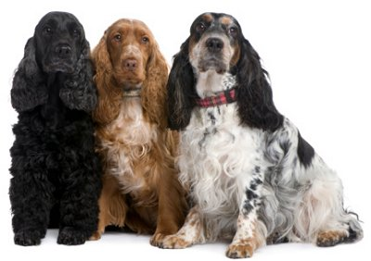
Cocker Spaniel
AKC Recognized Colors:
13 recognized colors (there is a wide variety)
AKC Recognized Markings:
Merle
Roan
Flushes out game and retrieves it
Smallest dog in the Sporting Group
Known for cheery disposition, however, poor breeding has caused an increase in bad temperaments
Most popular AKC breed until 1990

Slide 16
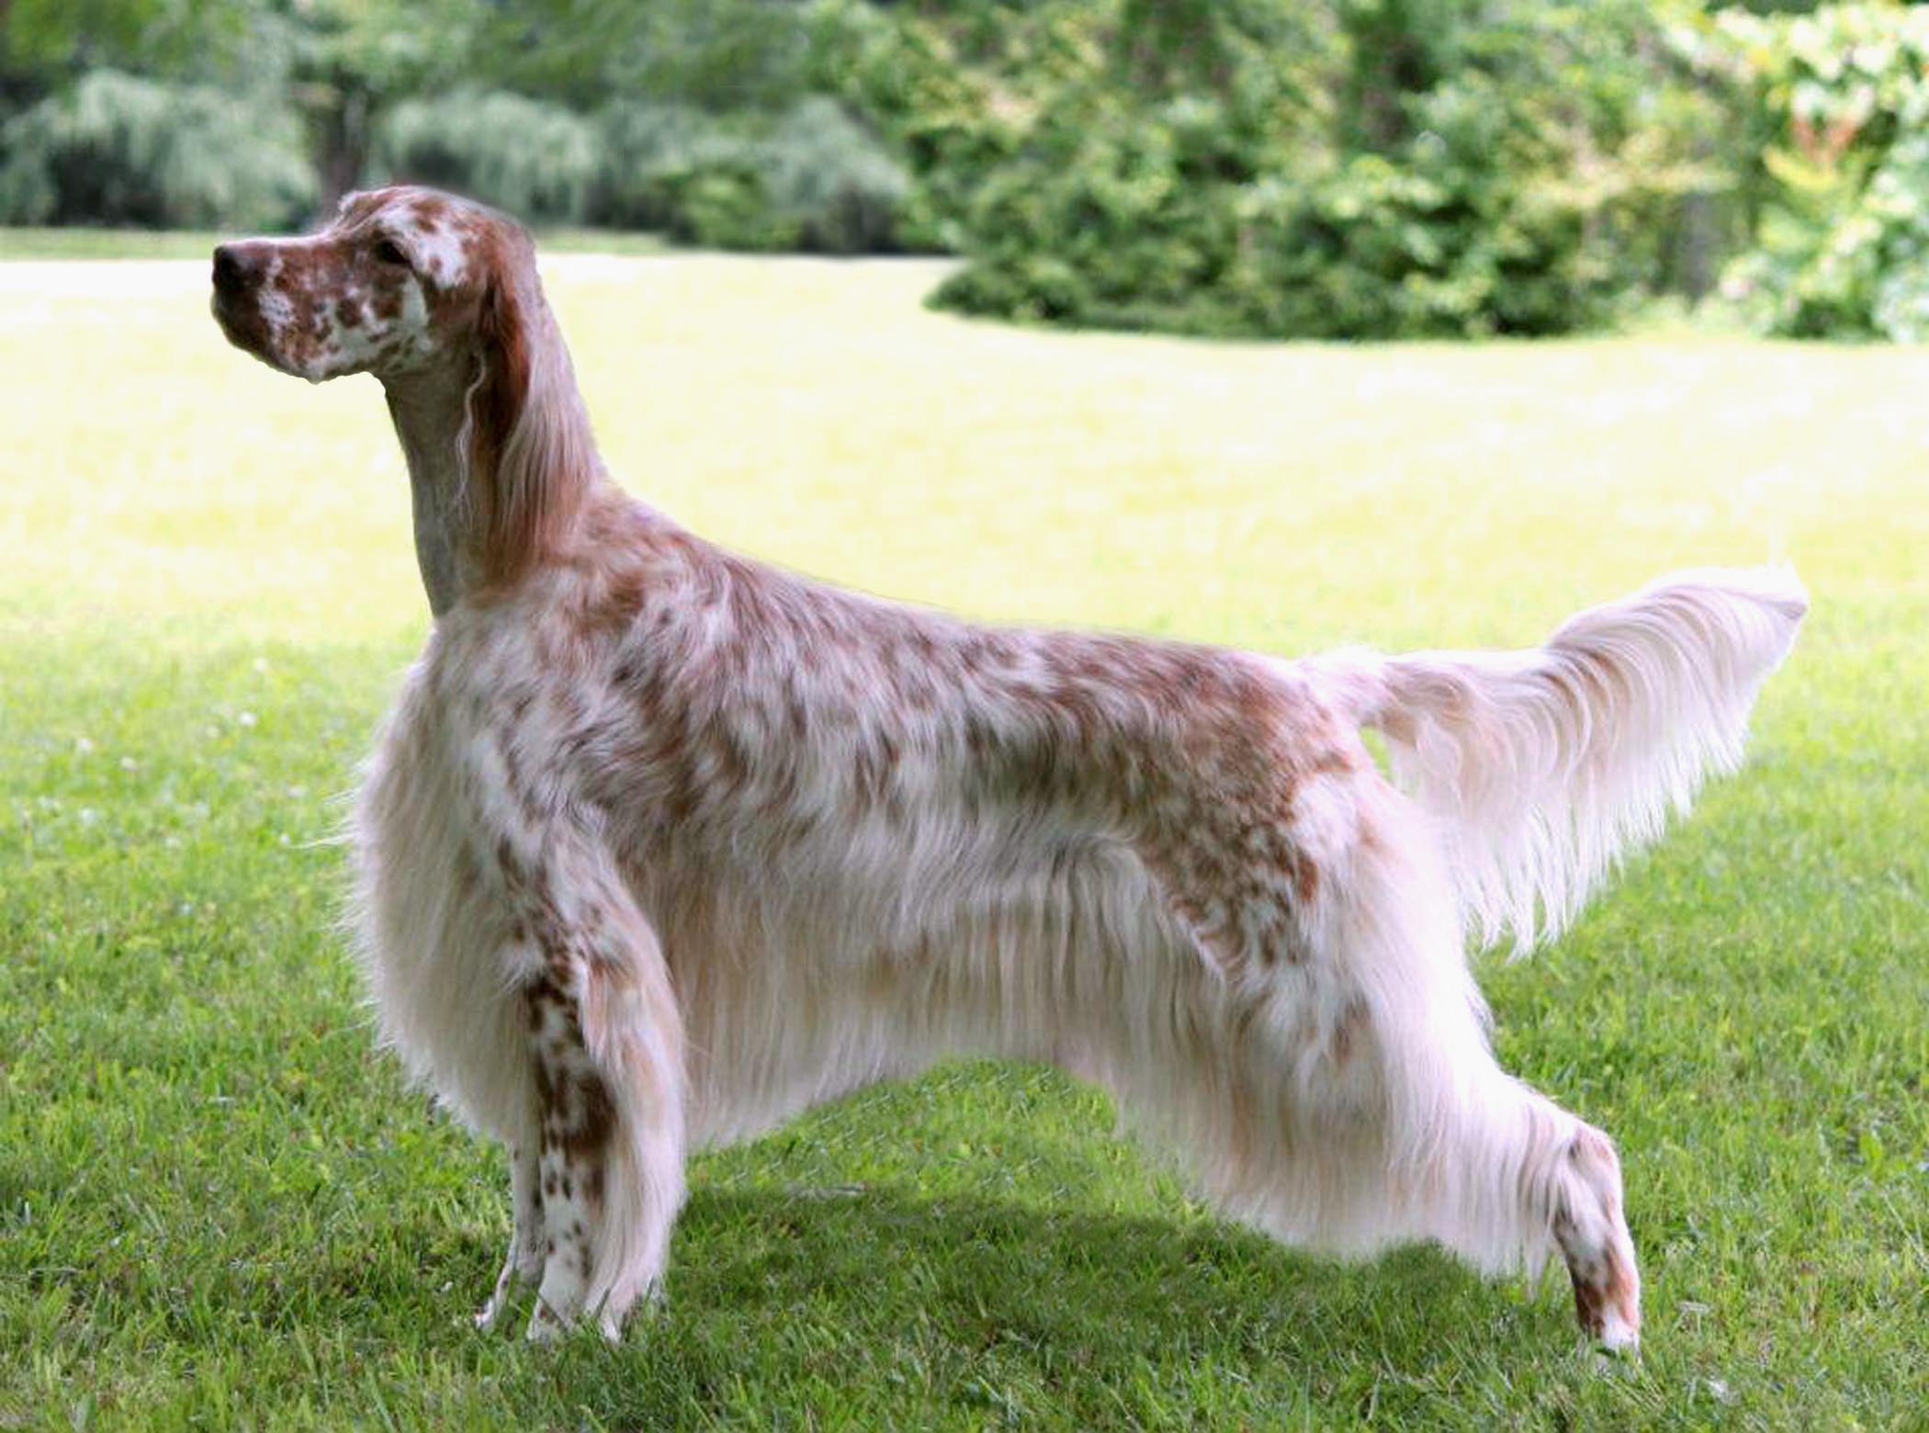
English Setter

Slide 17
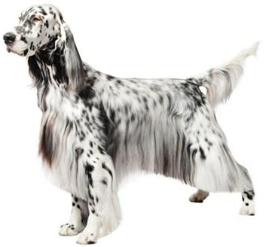
English Setter
AKC Recognized Colors:
Blue belton
Blue belton and tan (tri-color)
Lemon belton
Liver belton
Orange belton
AKC Recognized Markings:
None
Originated in England
Thought to have originated from crossing pointers and spaniels
Used as a gun dog (hunt birds)
Crouch (or “set”) when they locate birds

Slide 18
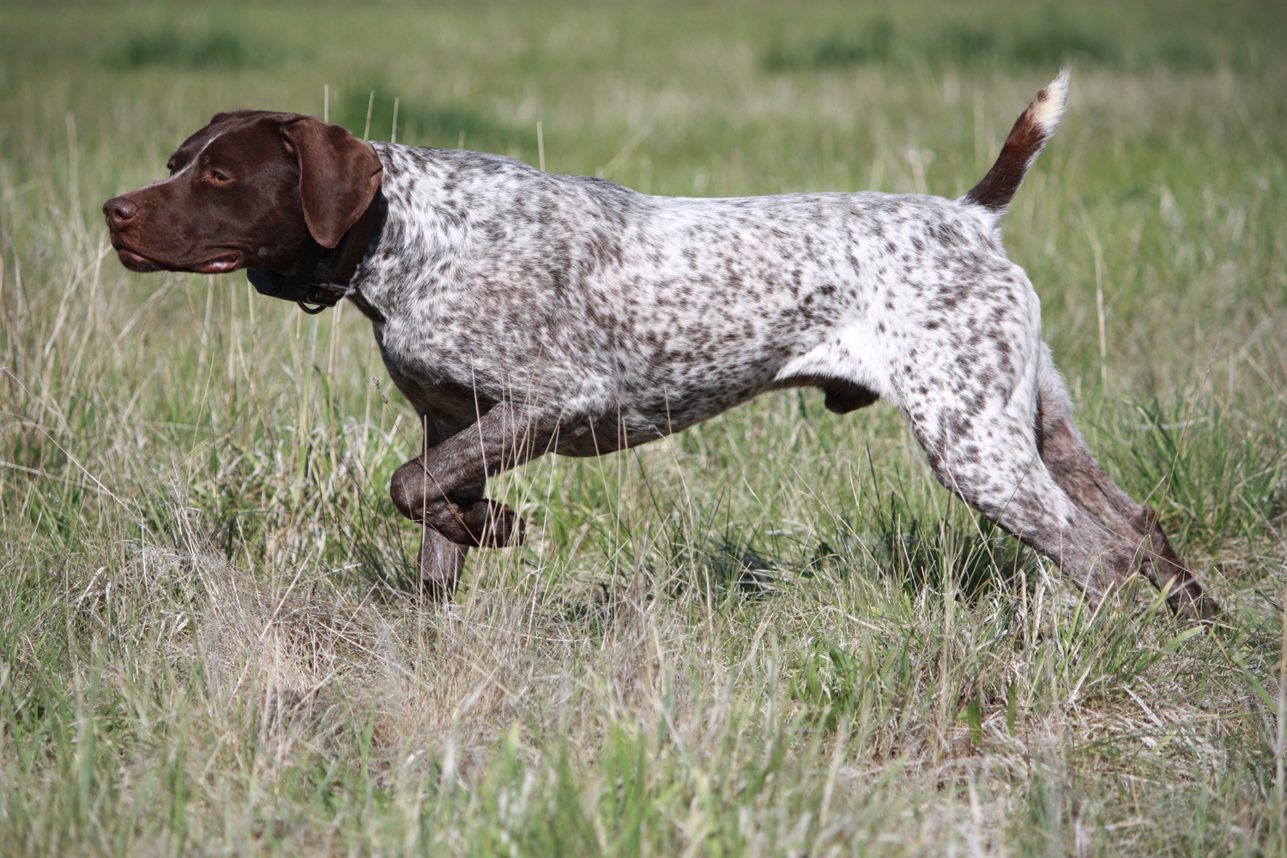
German Shorthaired Pointer

Slide 19
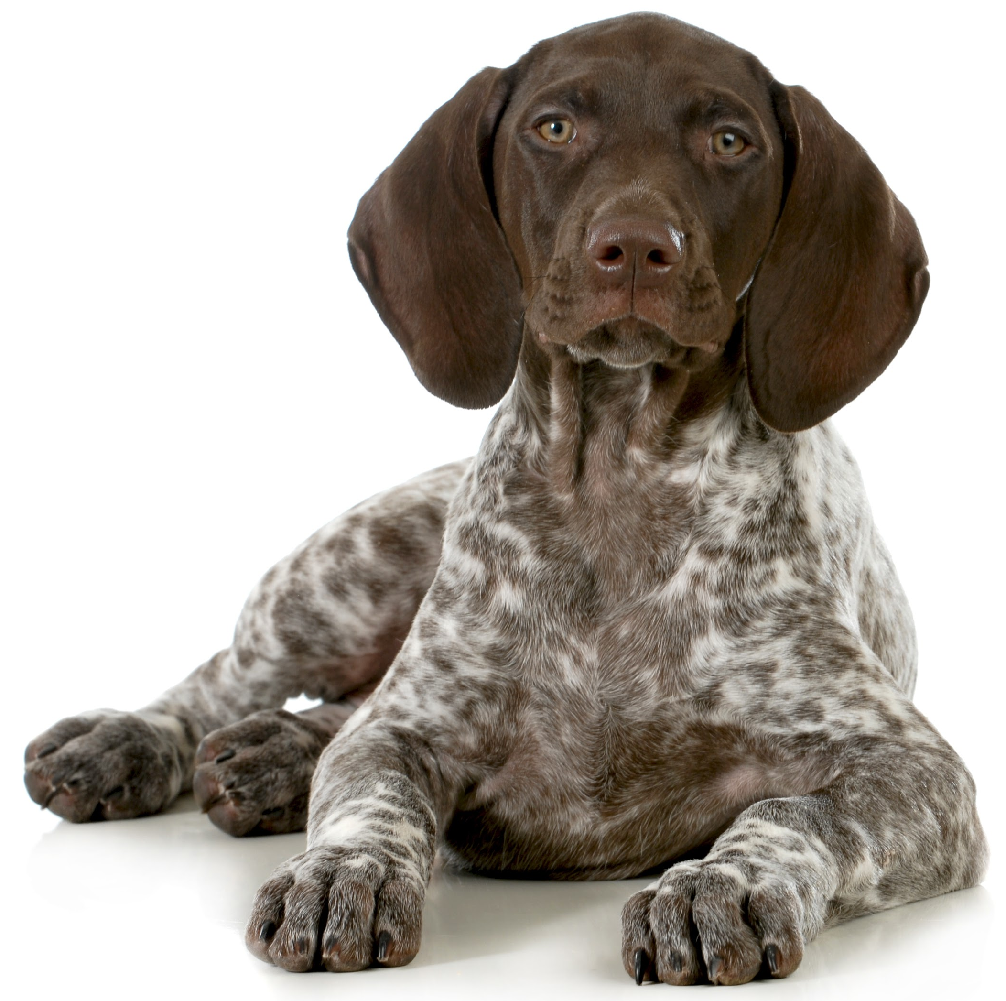
German Shorthaired Pointer
AKC Recognized Colors:
8 recognized colors (all black, liver, and white variations)
AKC Recognized Markings:
Patched
Patched & ticked
Ticked
The GSP originated in Germany
Pointing breed
Multipurpose hunting dog
Cross between bird dogs and scent hounds

Slide 20
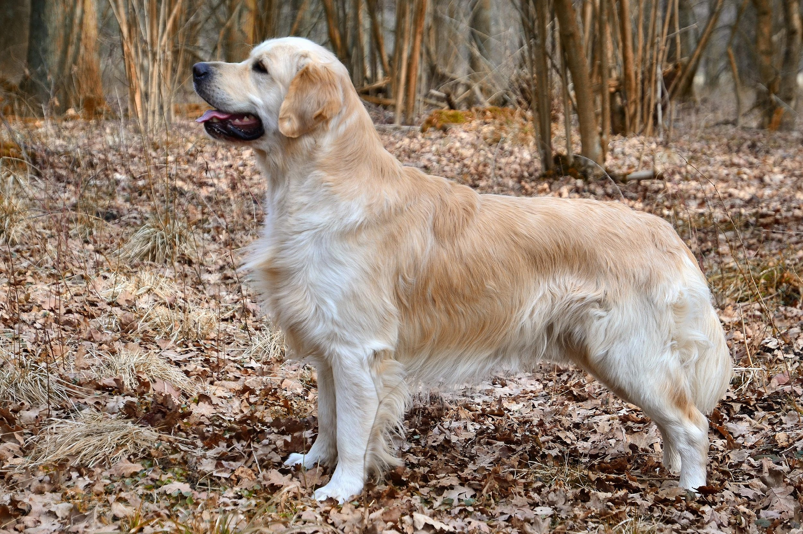
Golden Retriever

Slide 21
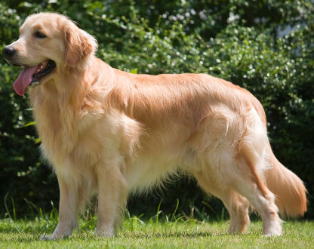
Golden Retriever
AKC Recognized Colors:
Dark gold
Gold
Light golden
AKC Recognized Markings:
None
Originated in Scotland
Versatile breed (hunting dogs, companions, and working dogs)
5th most popular AKC breed

Slide 22
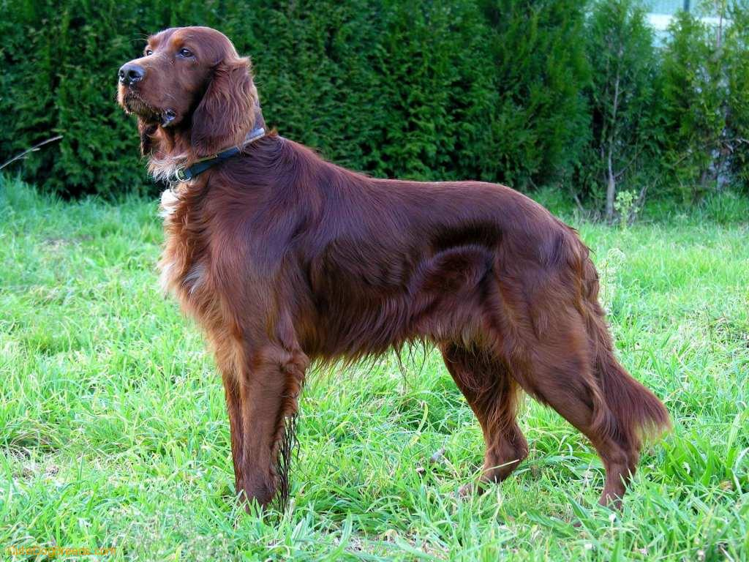
Irish Setter

Slide 23
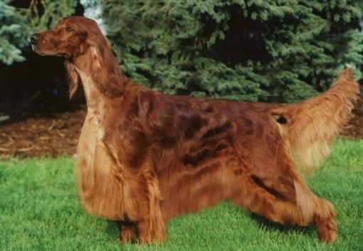
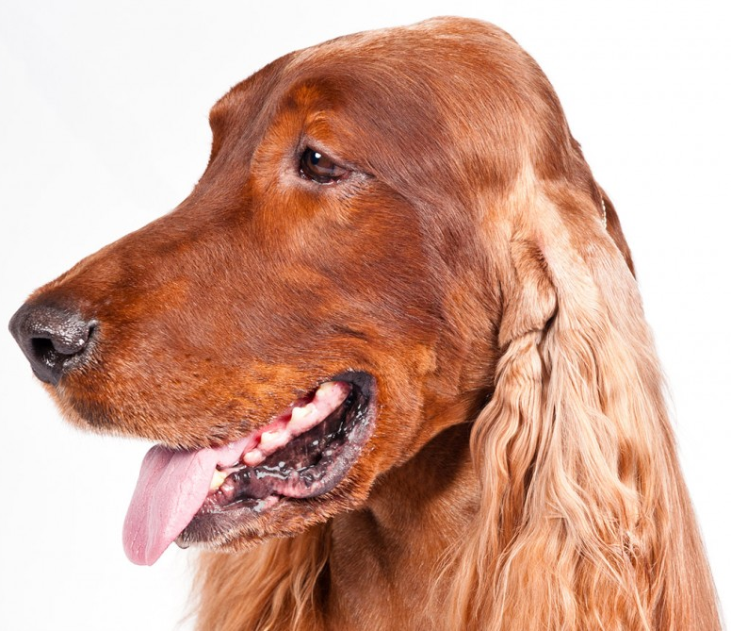
Irish Setter
AKC Recognized Colors:
Mahogany
AKC Recognized Markings:
None
Originated in Ireland
Known for solid red feathered coat (only recognized color!)
Bird dog with long ears

Slide 24
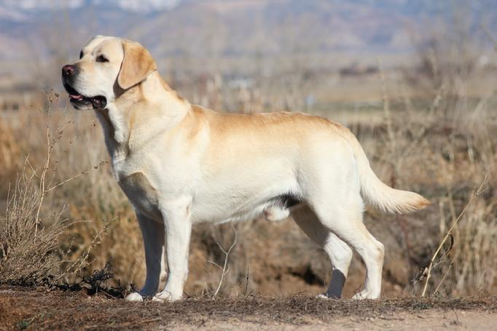
Labrador Retriever

Slide 25
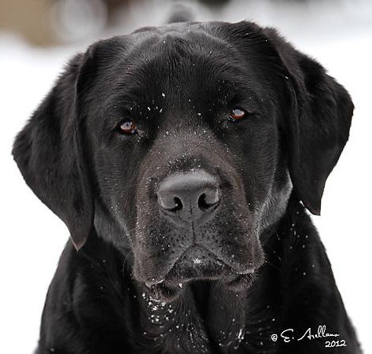
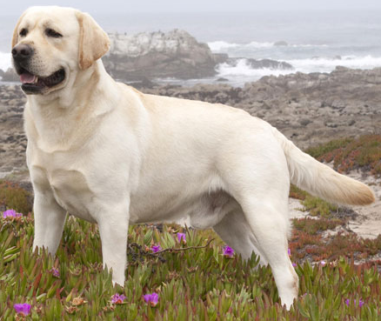
Labrador Retriever
AKC Recognized Colors:
Black
Chocolate
Yellow
AKC Recognized Markings:
None
Labs originated in Newfoundland
Only three AKC recognized colors (black, yellow, and chocolate) – silver is not recognized by the AKC
Versatile breed – avid water dog and great companion
Ranked the most popular purebred breed for the past 10 years

Slide 26
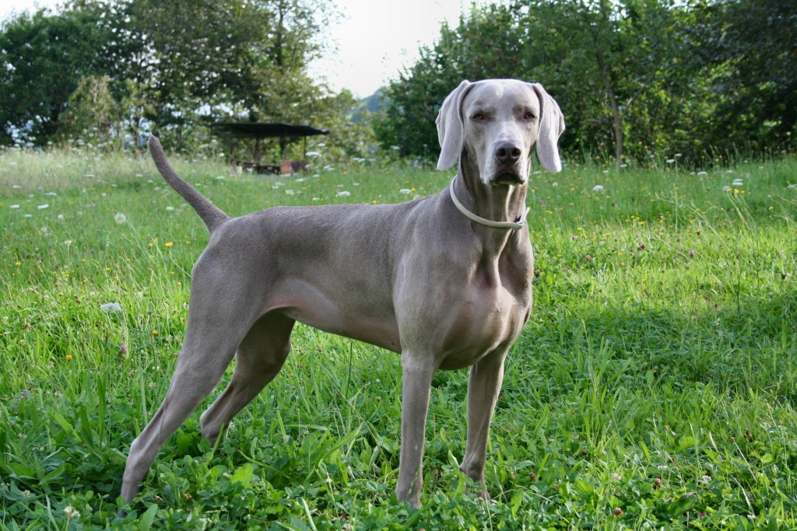
Weimaraner

Slide 27
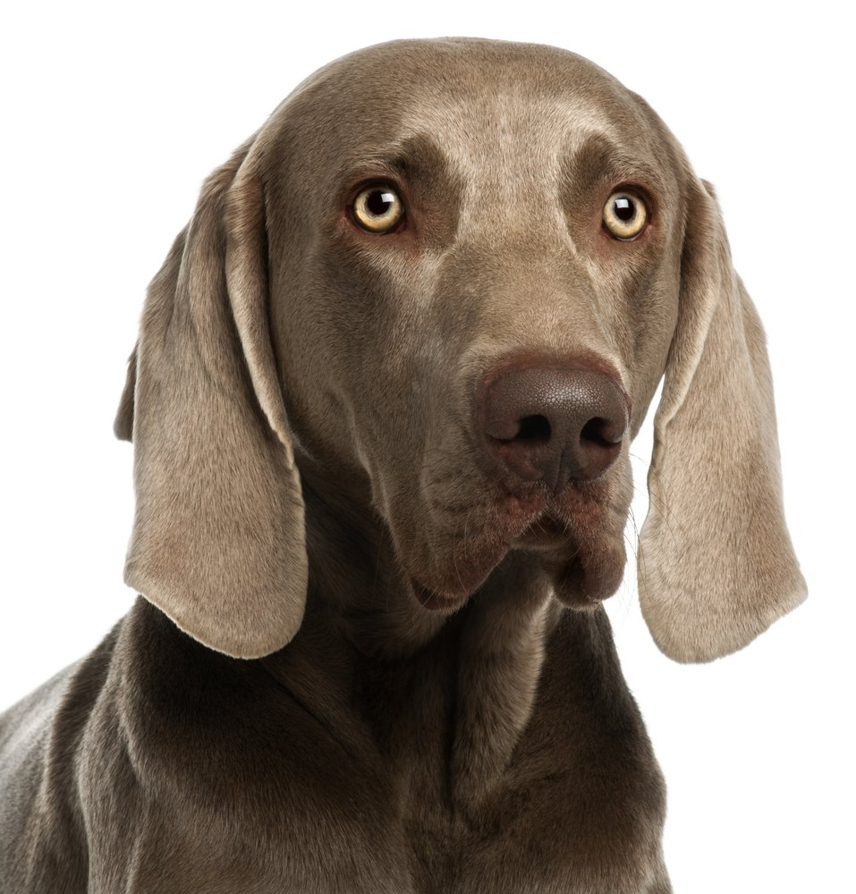
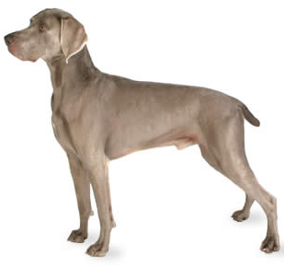
Weimaraner
AKC Recognized Colors:
Blue
Gray
Silver Gray
AKC Recognized Markings:
None
Originated in Germany
Known for silver coat
Mainly used to hunt birds and waterfoul

Slide 28
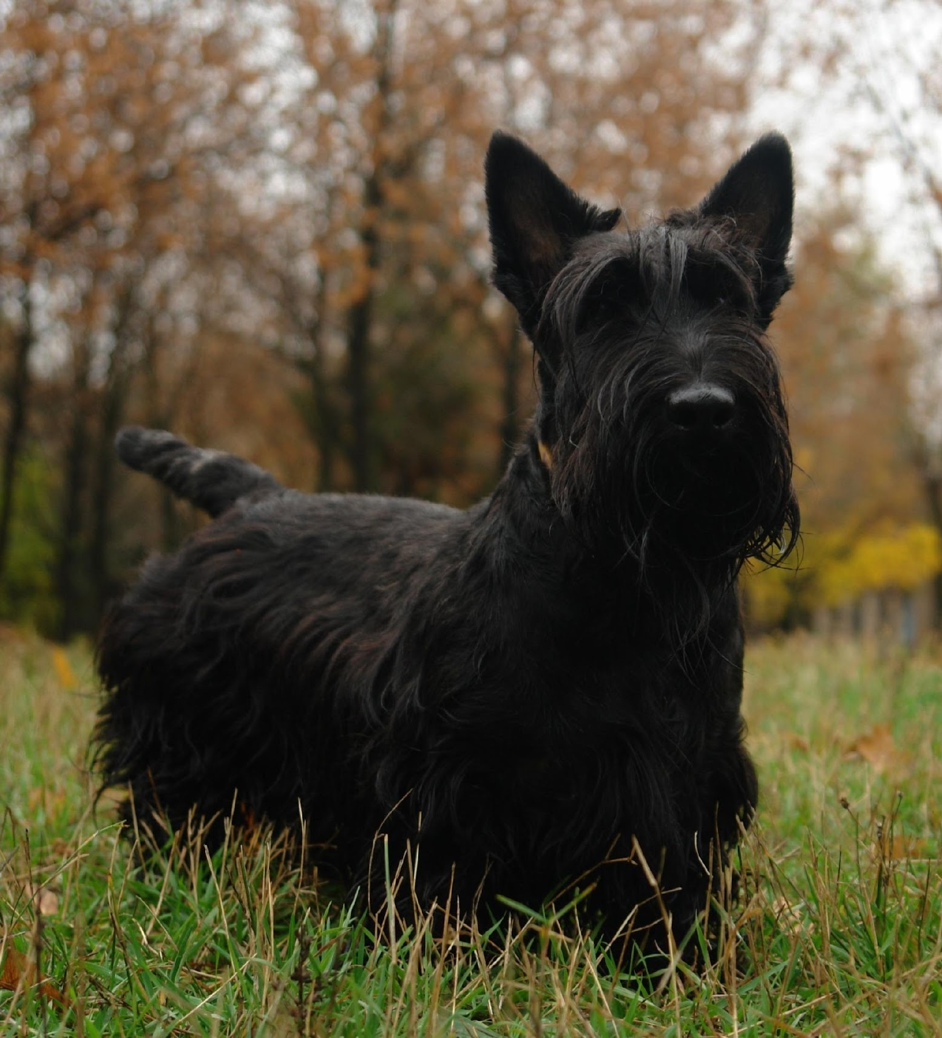
Terrier Group:
Dog breeds with a wide range in size, low tolerance for other animals, and feisty personalities
Descendants from dogs that were bred to kill pests
Breeds under this group:
Bull Terrier
Cairn Terrier
Parson Russell Terrier
Scottish Terrier
West Highland White Terrier
Notes:
http://www.akc.org/dog-breeds/groups/herding/

Slide 29
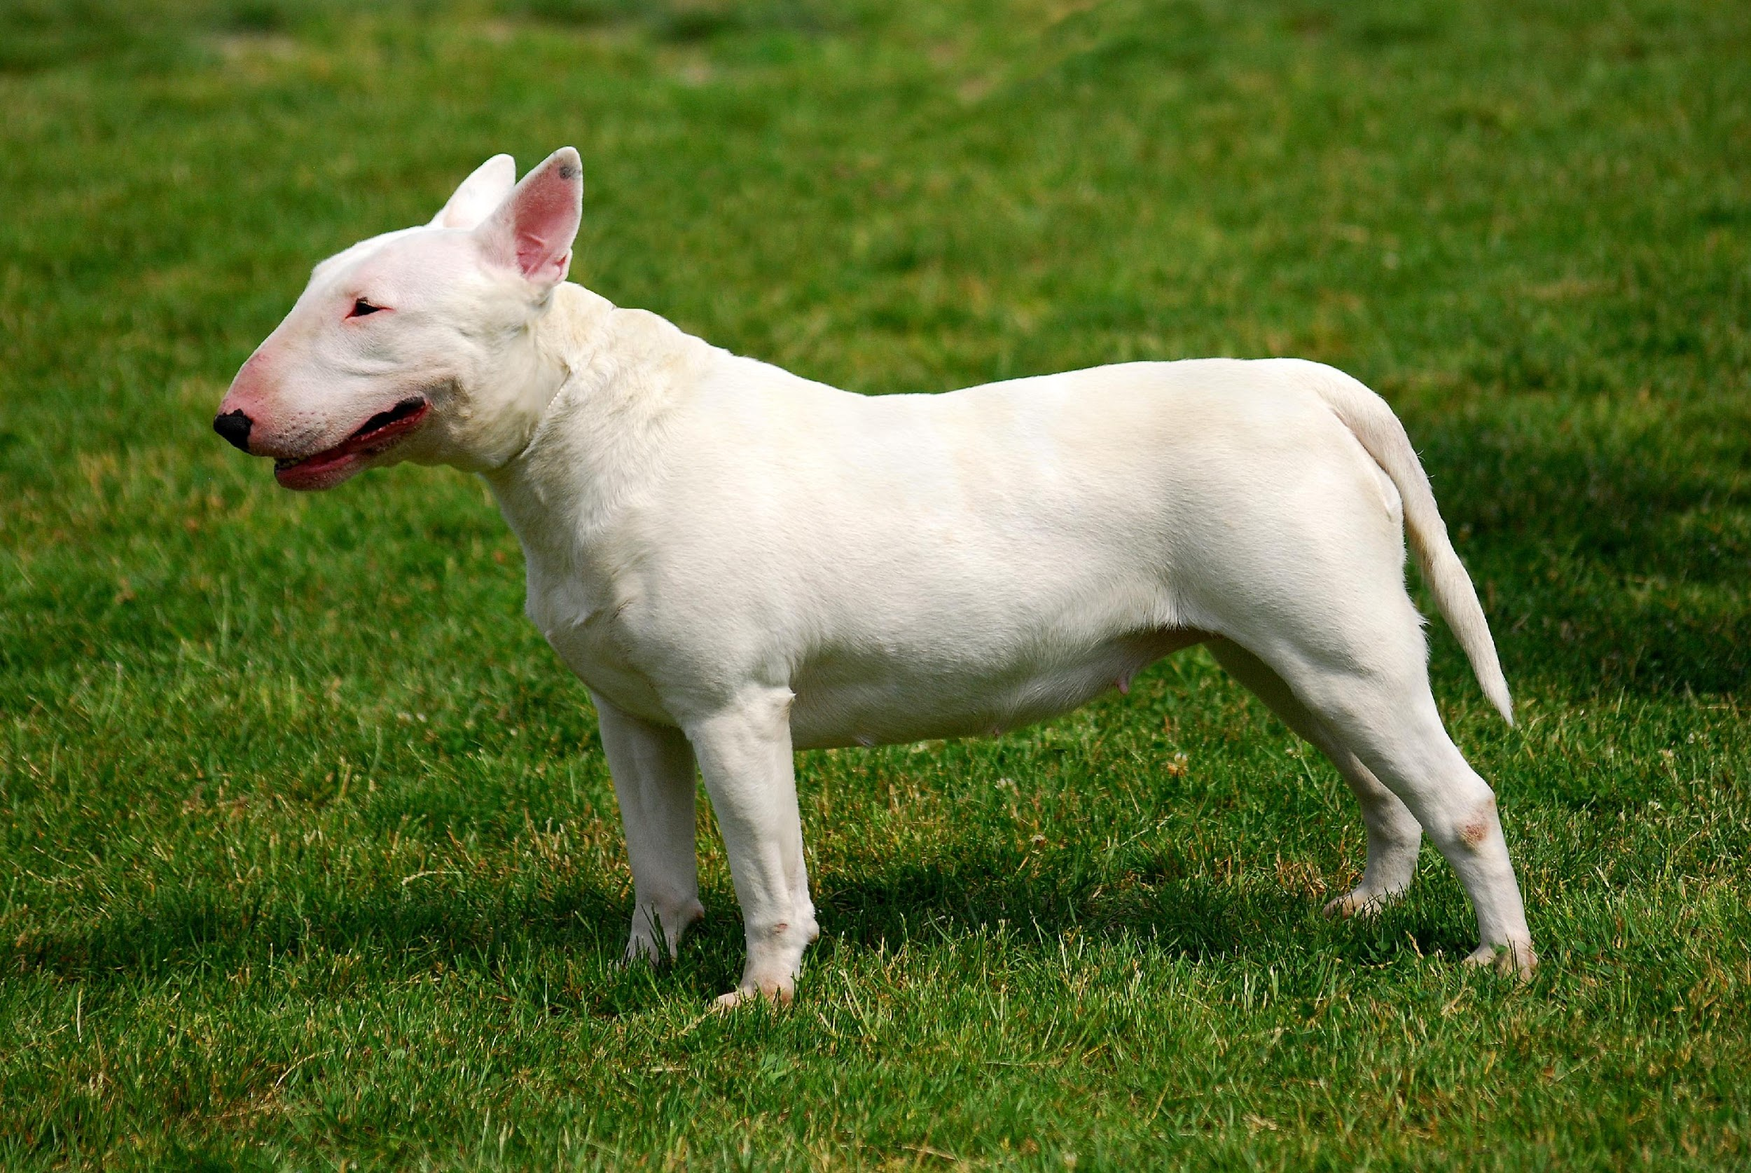
Bull Terrier

Slide 30
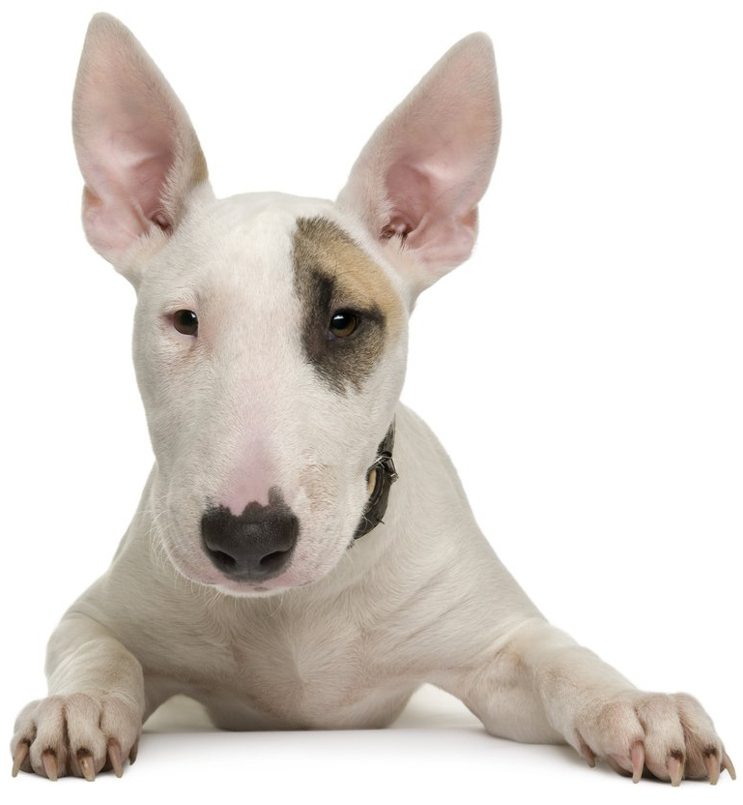
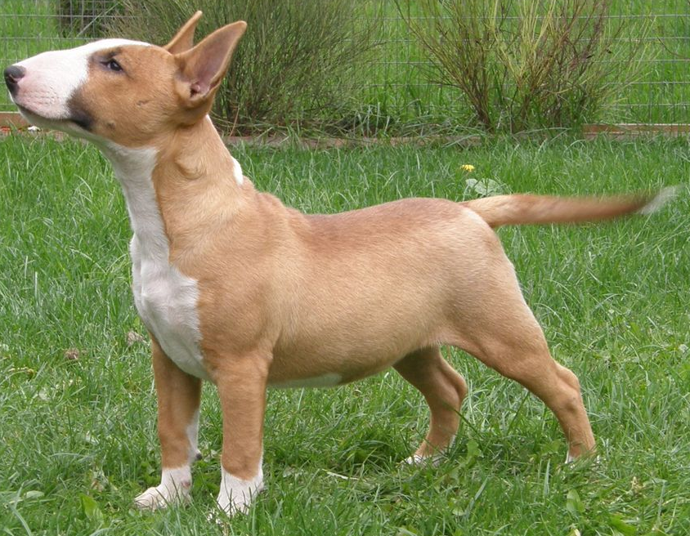
Bull Terrier
AKC Recognized Colors:
13 recognized colors (there is a wide variety)
AKC Recognized Markings:
None
Originated in England (crossing bulldogs and terriers)
White and colored varieties
Strong muscle (from bulldog) and hunting instinct (from terrier), roman nose and large, erect ears

Slide 31
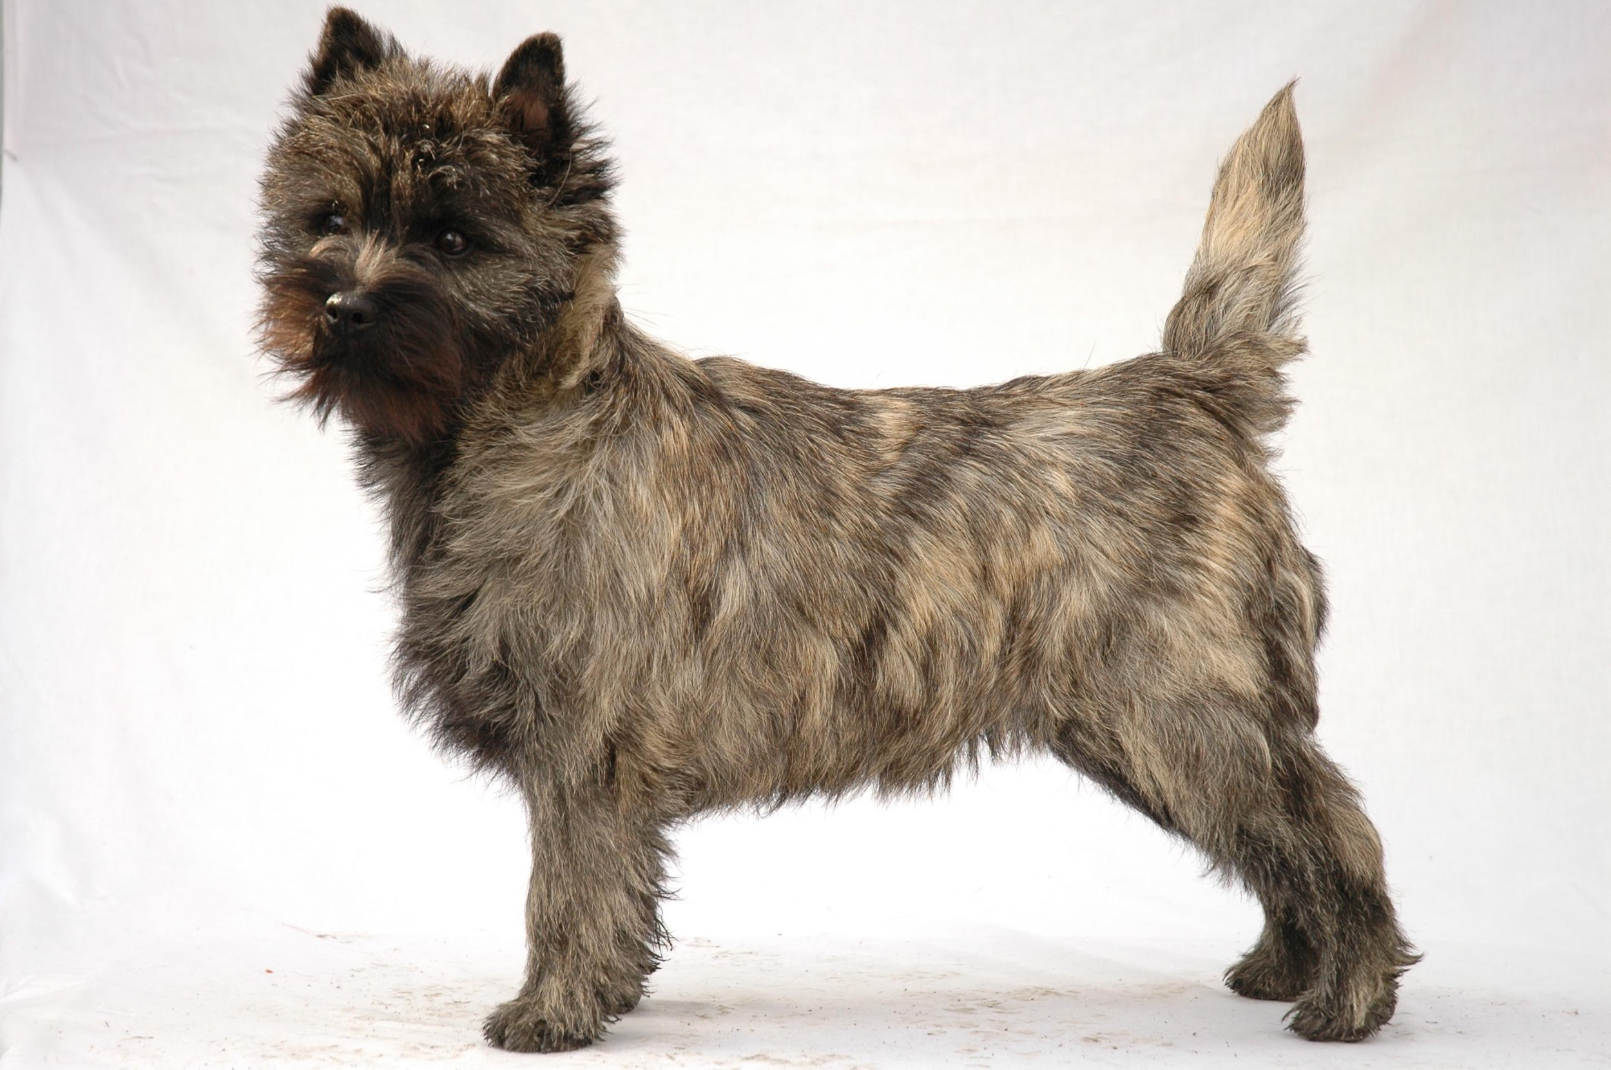
Cairn Terrier

Slide 32
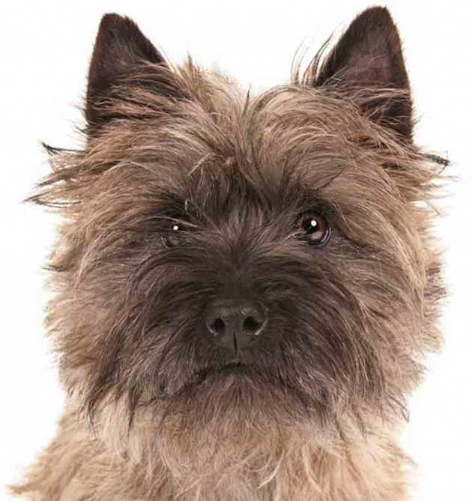
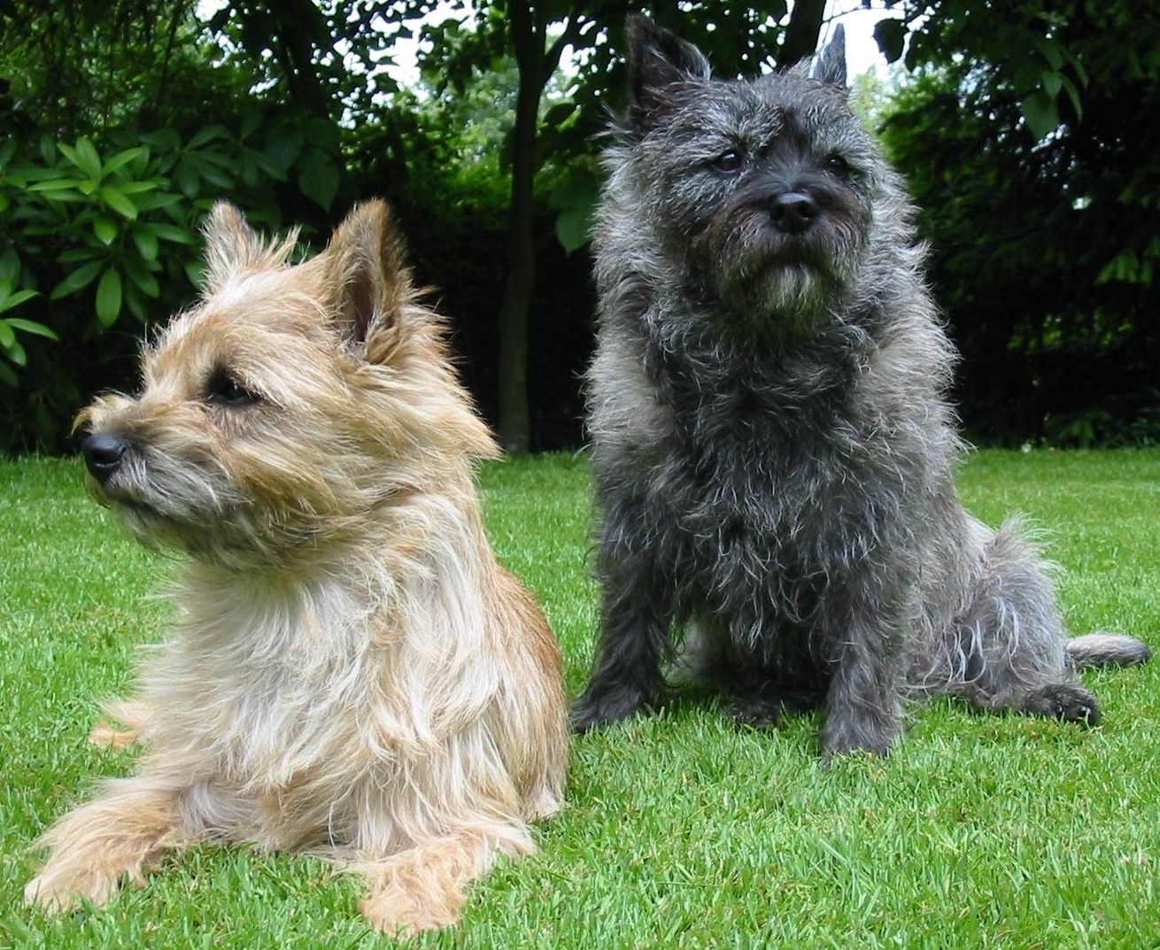
Cairn Terrier
AKC Recognized Colors:
11 recognized colors (there is a wide variety)
AKC Recognized Markings:
Black markings
Black mask
Black points
Originated in Scotland
Coat color can change over time (usually becomes darker as they get older)

Slide 33
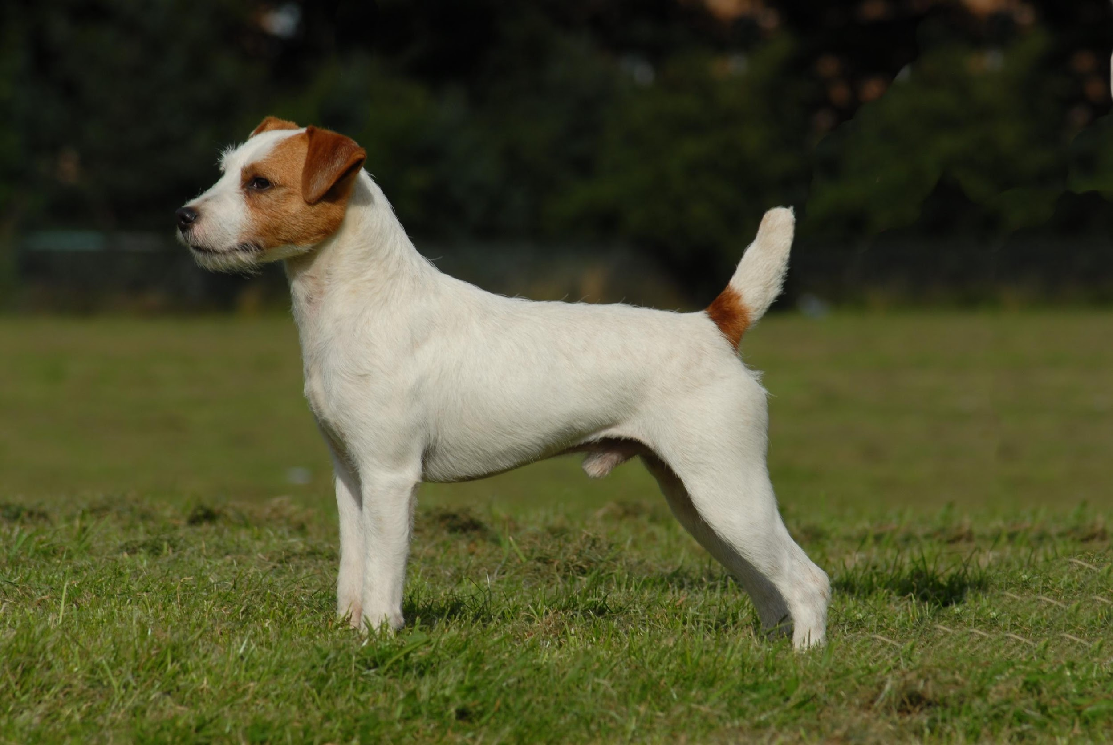
Parson Russell Terrier

Slide 34
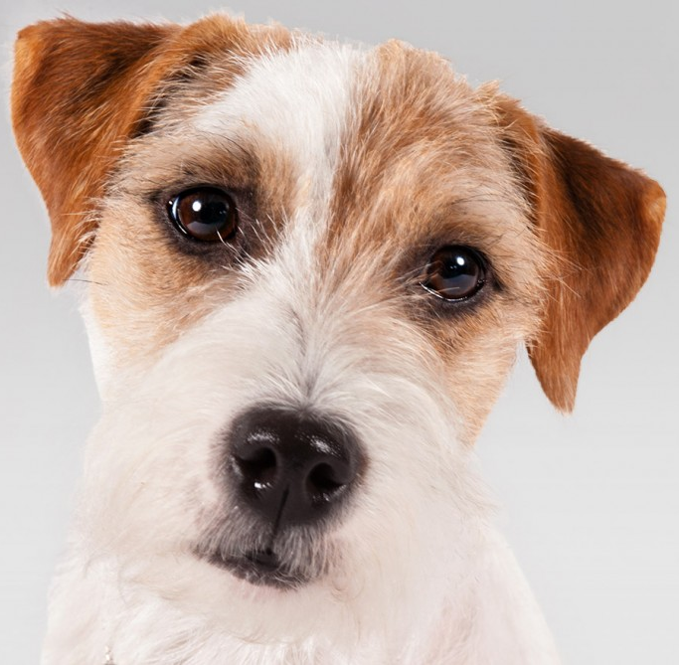
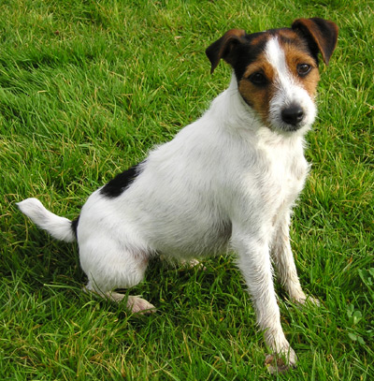
Parson Russell Terrier
AKC Recognized Colors:
White
AKC Recognized Markings:
Black
Brown
Cream
Tan
Tri-color
Originated in England
Strong hunting instincts
Main body color is white with colored markings common

Slide 35
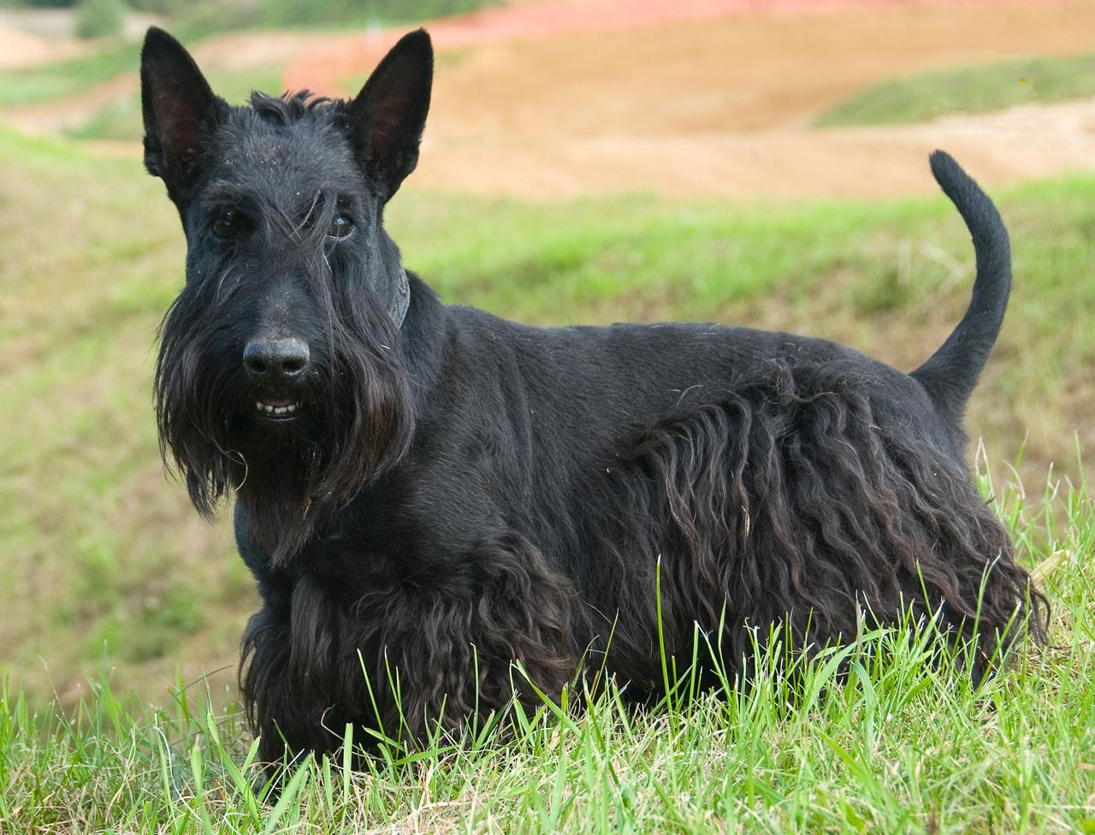
Scottish Terrier

Slide 36
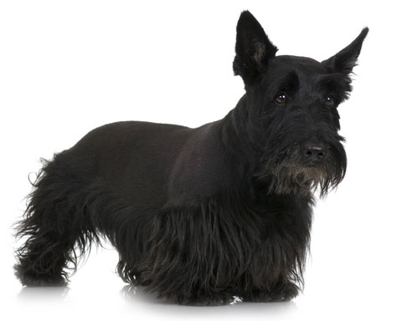
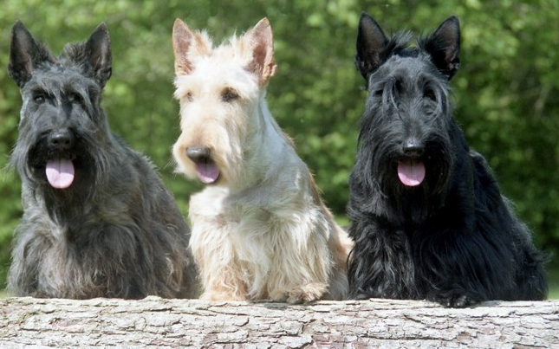
Scottish Terrier
AKC Recognized Colors:
Black
Black brindle
Brindle
Red brindle
Silver brindle
Wheaten
AKC Recognized Markings:
None
The Scottie originated in Scotland and England
Purpose was to dig out and kill vermin
Short legs and long body
Most common color is black

Slide 37
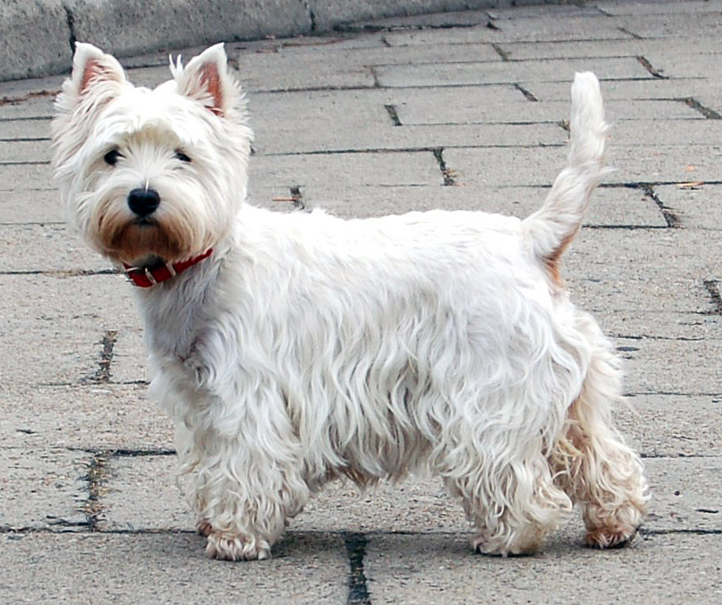
West Highland White Terrier

Slide 38
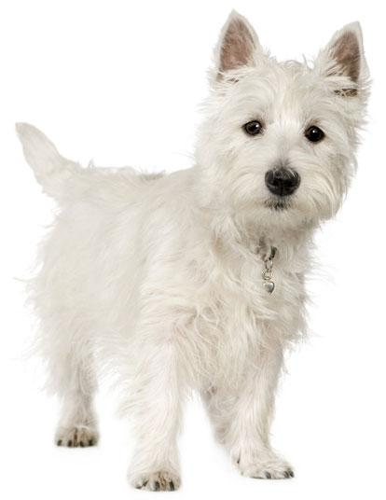
West Highland White Terrier
AKC Recognized Colors:
White
AKC Recognized Markings:
None
Westies originate from Scotland
Small game hunters
Originally found in multiple colors, now white is the only recognized color

Slide 39
Toy Group:
Breeds with a small size and sweet personalities with the purpose of pleasing their owner with their company
Many of these breeds are protective of their owner/s
Breeds under this group:
Cavalier King Charles Spaniel
Chihuahua
Miniature Pinscher
Papillon
Pekingese
Pomeranian
Poodle
Pug
Shih Tzu
Yorkshire Terrier
Notes:
http://www.akc.org/dog-breeds/groups/herding/

Slide 40
Cavalier King Charles Spaniel

Slide 41
Cavalier King Charles Spaniel
AKC Recognized Colors:
Black and tan
Black and white
Blenheim
Ruby
AKC Recognized Markings:
Tan
Bred to be companions, these dogs were favored by royals (especially King Charles of England)
Sweet and affectionate personalities who love to be around people
Long, feathered coat and medium size
19th most popular breed

