Slide 1
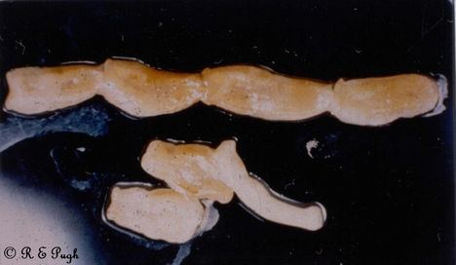

Slide 26
Taenia tapworm segment
Whipworm egg
Giardia
Demodectic mite
Sarcoptic mite
Sucking lice
Hookworm egg
Flea
Biting lice
Eosinophils
Taenia tapeworm egg
Roundworm egg
13. Rod Bacteria
14. Platelets
15. Calcium oxalate crystals
16. Epilitheal cells
17. Neutrophils
18. Flea tapeworm egg
19. Cocci
20. Yeast cytology
21. Flea larva
22. Coccidia
23. Adult heartworm
24. Adult round worm
25. Whip worm

