Slide 1
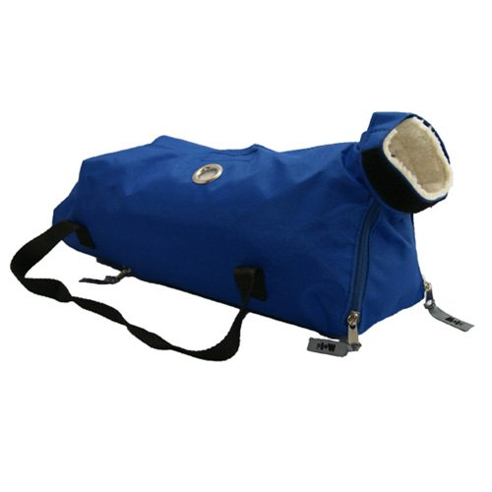
Cat bag

Slide 2
Electric Dehorner

Slide 3
Endoscope

Slide 4
Cavalier King Charles Spaniel

Slide 5
New Foundland

Slide 6
New Zealand

Slide 7
Hereford

Slide 8
Red blood cells

Slide 9
Epithelial cells

Slide 10
Taenia Tapeworm Egg (Family Taeniidae; Genus Taenia)

Slide 11
Cavalier King Charles Spaniel

Slide 12
Quarter horse

Slide 13
Plymouth Rock Chicken

Slide 14
Abyssinian

Slide 15
Cornish chicken

