Slide 1
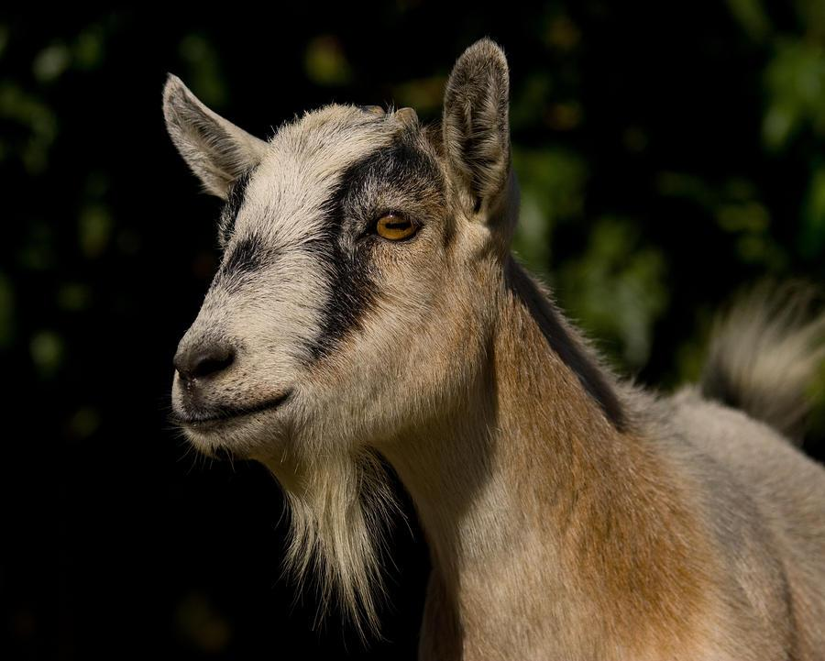
Goat Breeds

Slide 2
Goat Breeds
You will need to be able to identify the following goat breeds:
Alpine
Angora
Boer (NOT boar!)
LaMancha
Nubian
Saanen
Toggenburg
All goats are naturally horned!

Slide 3
Buttermilk the Goat:

Slide 4
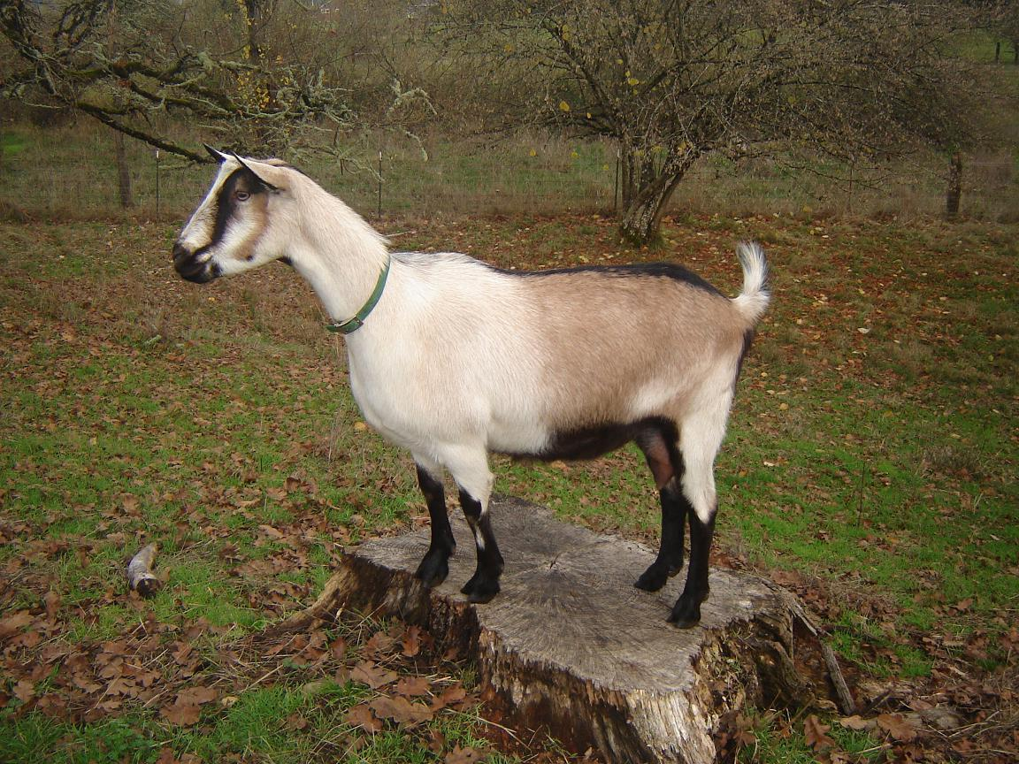
Alpine

Slide 5
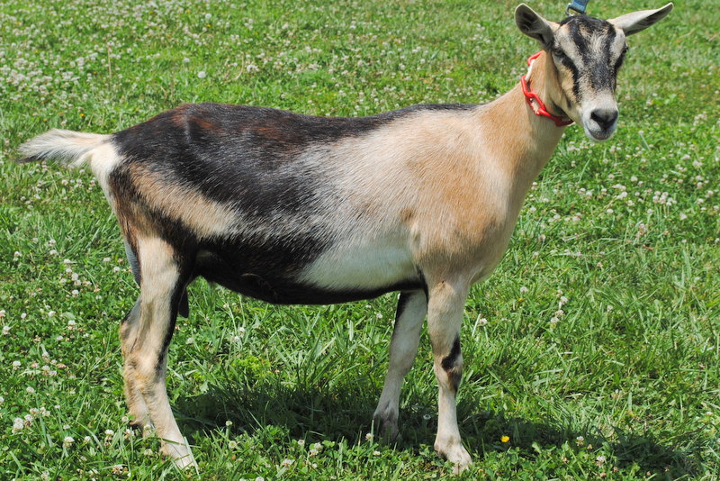
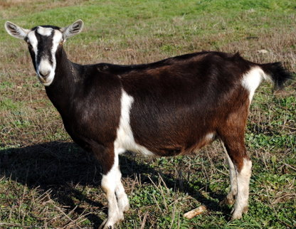
Alpine (French Alps)
Medium-large size (>135lbs - female, >170lbs - male)
Erect ears with straight face
Many color variations
Dairy goat breed

Slide 6
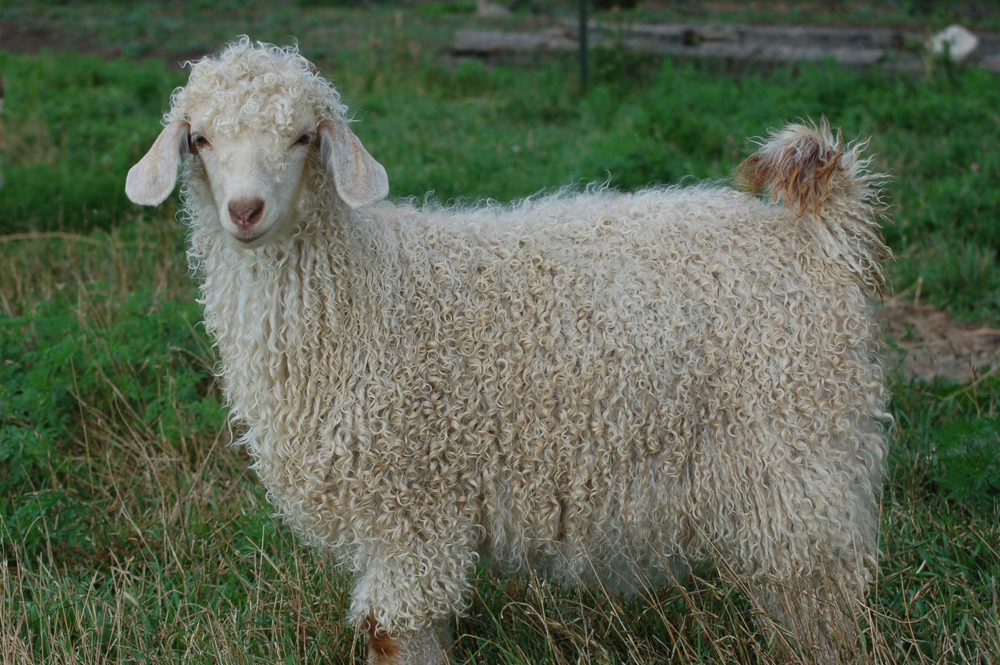
Angora

Slide 7
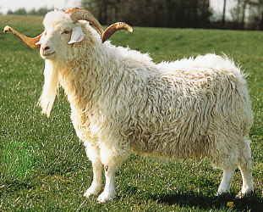
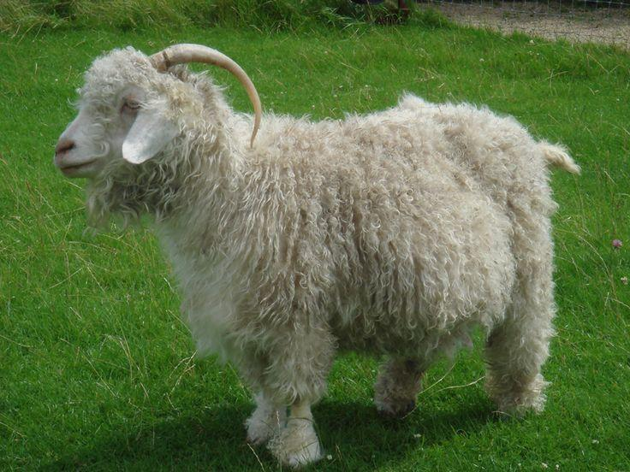
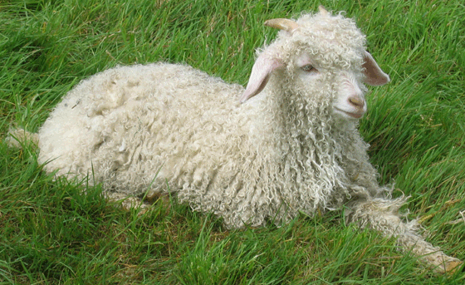
Angora (Turkey)
Lop ears
White hair
Known for mohair production
Mohair is thinner and smoother than wool

Slide 8
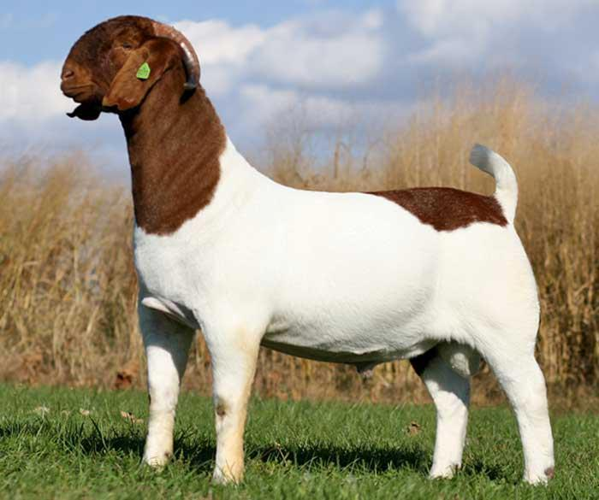
Boer

Slide 9
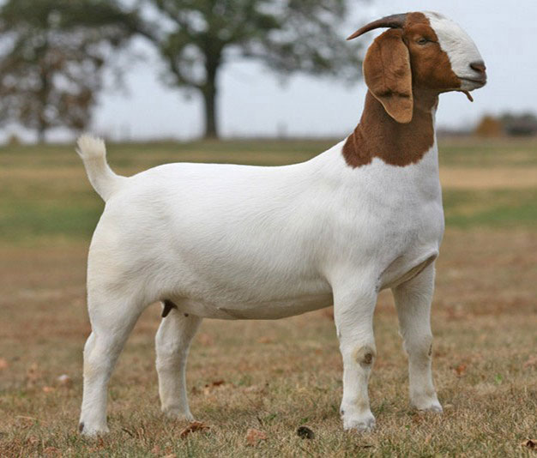
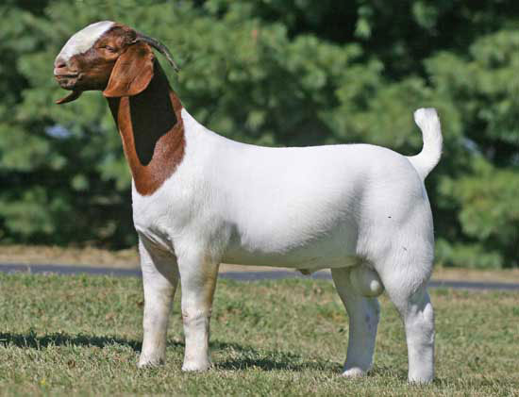
Boer (South Africa)
Lop ears
Large size, often grow to be 300lbs!
Brown/red on head and around neck with a predominantly white body
Meat breed

Slide 10
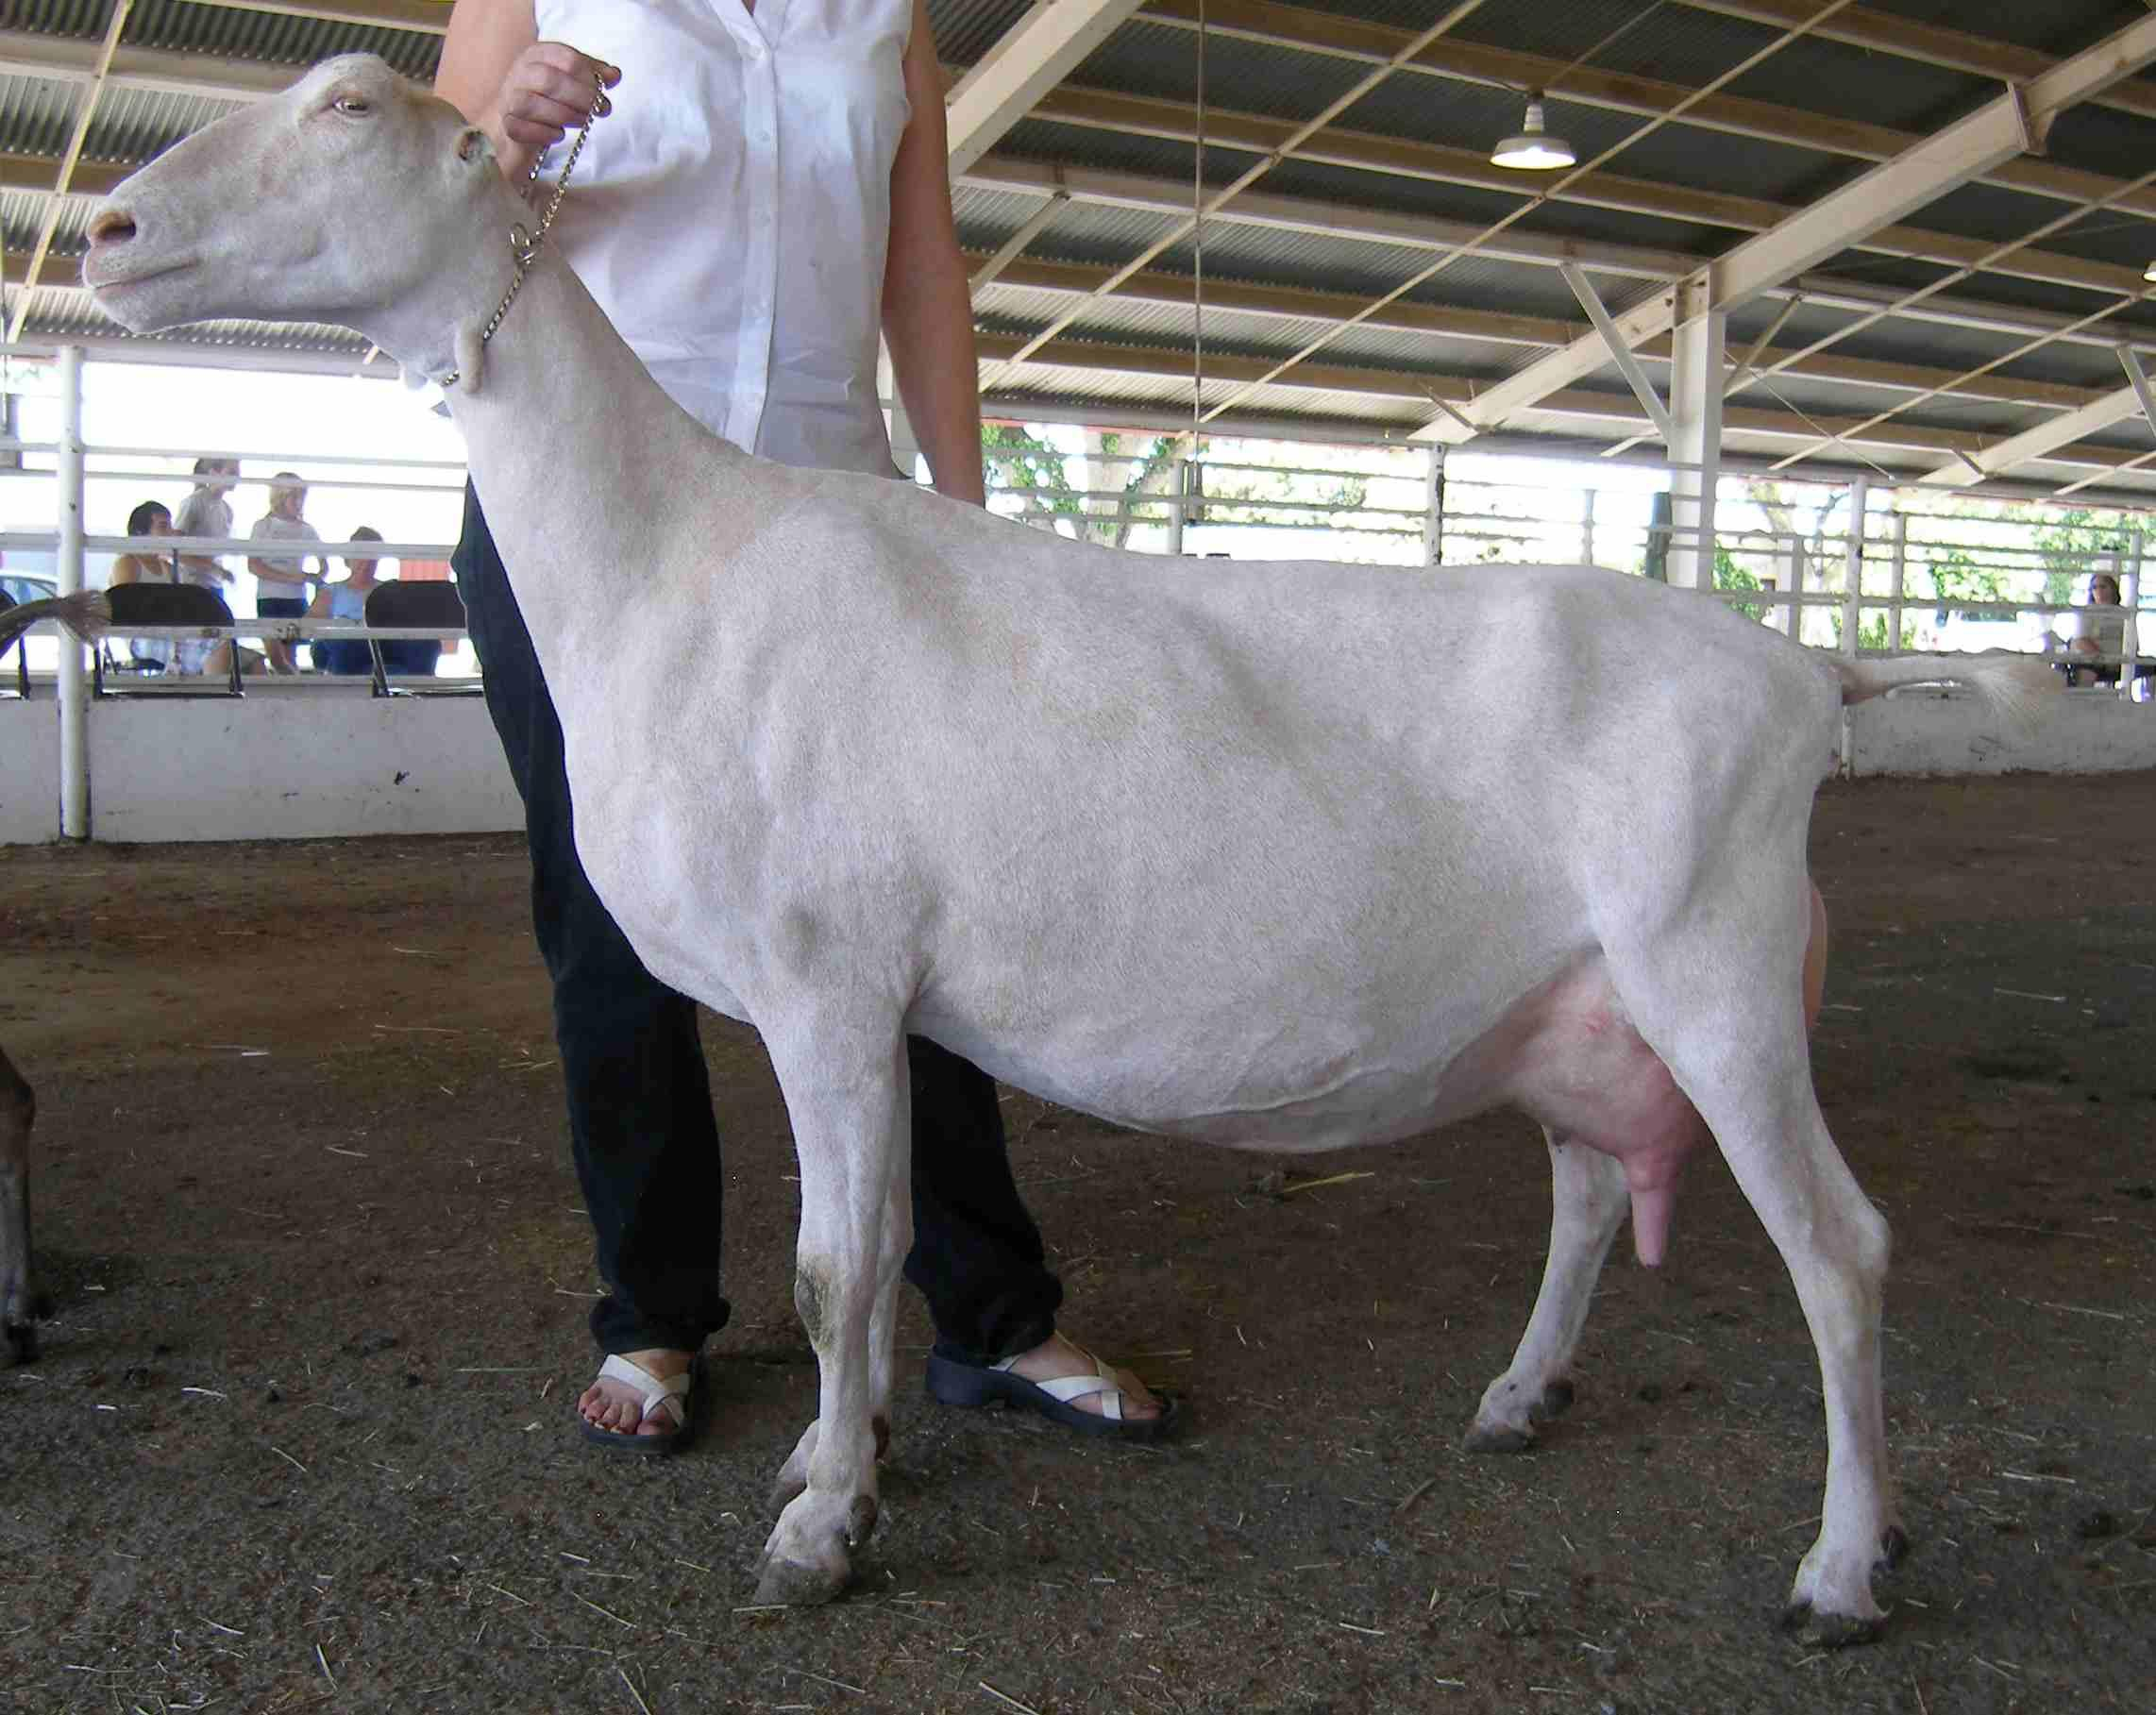
LaMancha

Slide 11
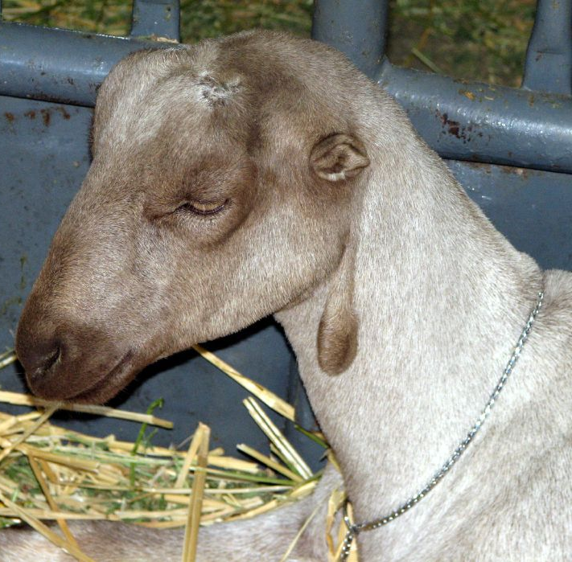
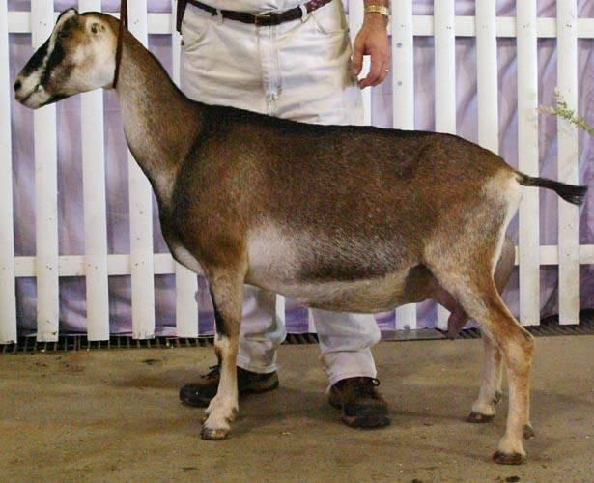
LaMancha (USA - Oregon)
Originated from Spanish breeds
Distinctive ears, either “gopher ears” or “elf ears”
Both types of ears are nonexistent or very short
Variety of colors seen
Dairy goat breed

Slide 12
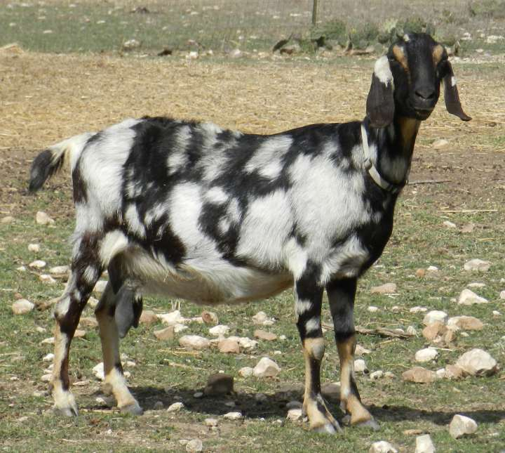
Nubian

Slide 13
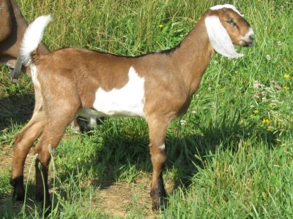
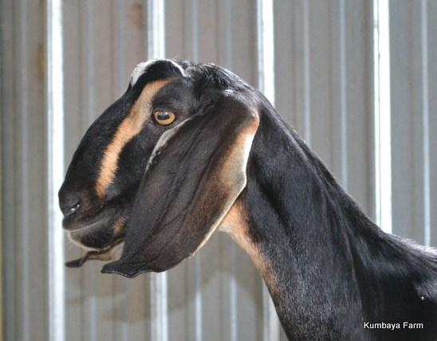
Nubian (England)
Medium-large size (>135lbs - female, >175lbs - male)
Lop ears with convex (roman) nose
Many color variations
All-purpose breed (used for milk and meat)

Slide 14
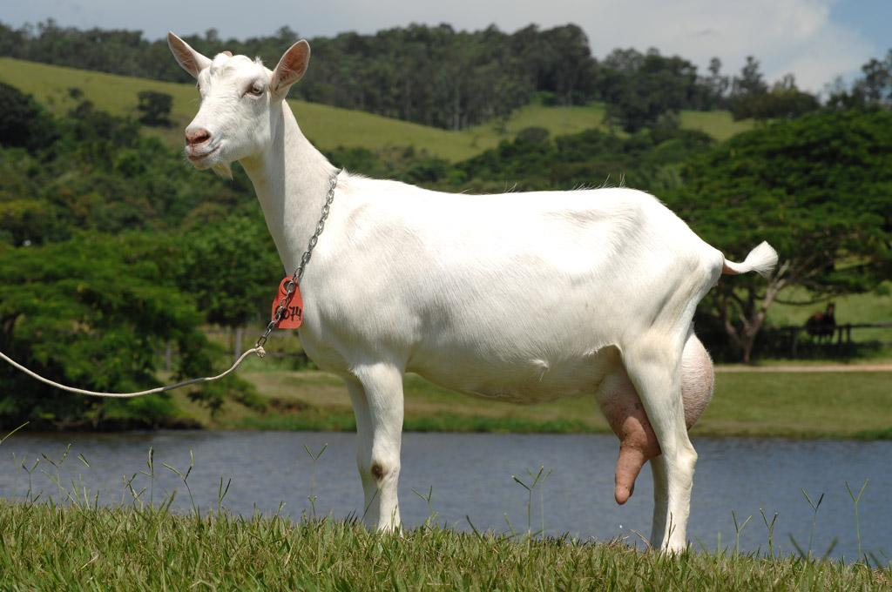
Saanen

Slide 15
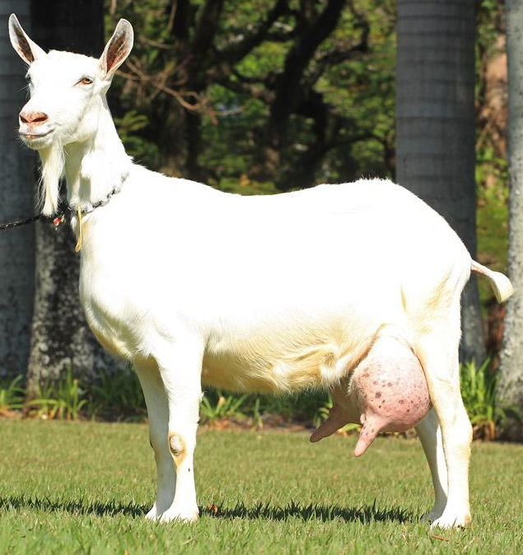
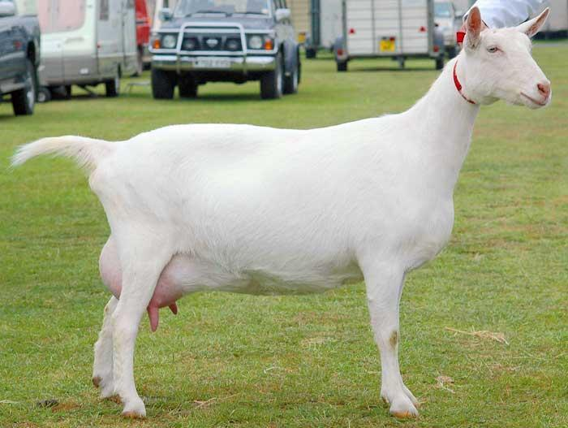
Saanen (Switzerland)
Erect ears with straight or dished face
White or light cream in color (white preferred)
Dairy goat breed

Slide 16
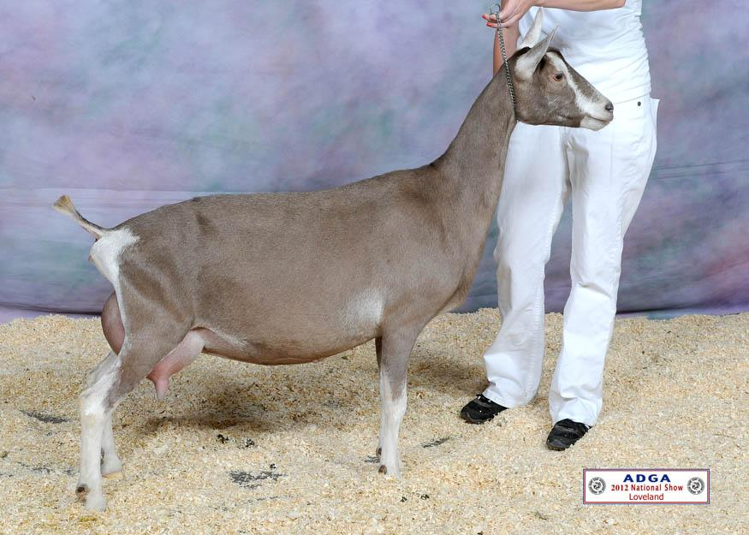
Toggenburg

Slide 17
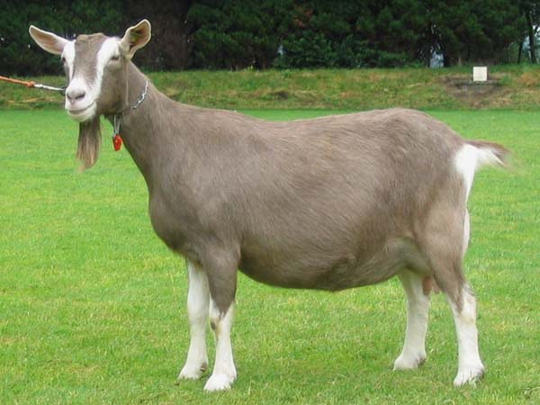
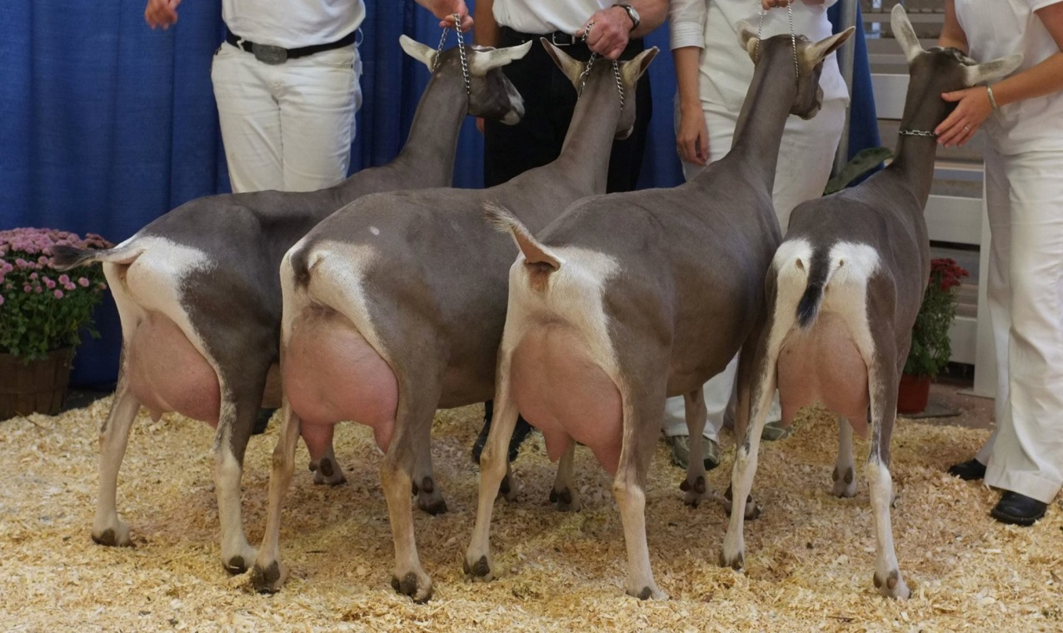
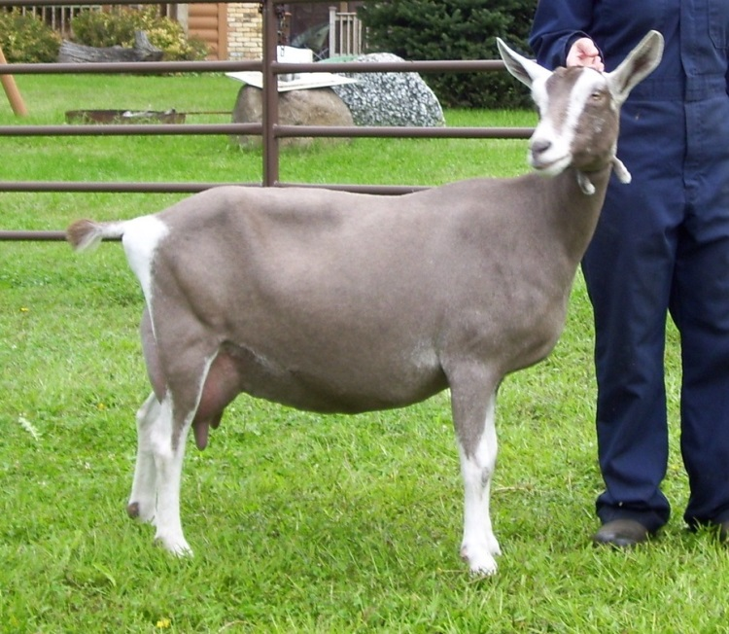
Toggenburg (Switzerland)
Erect ears with straight or dished face
Light fawn to chocolate color with distinct white markings on the ears, two white stripes down the face, hind legs from hocks to hooves, forelegs from knee down, triangle on each side of the tail
Dairy goat breed

Slide 18
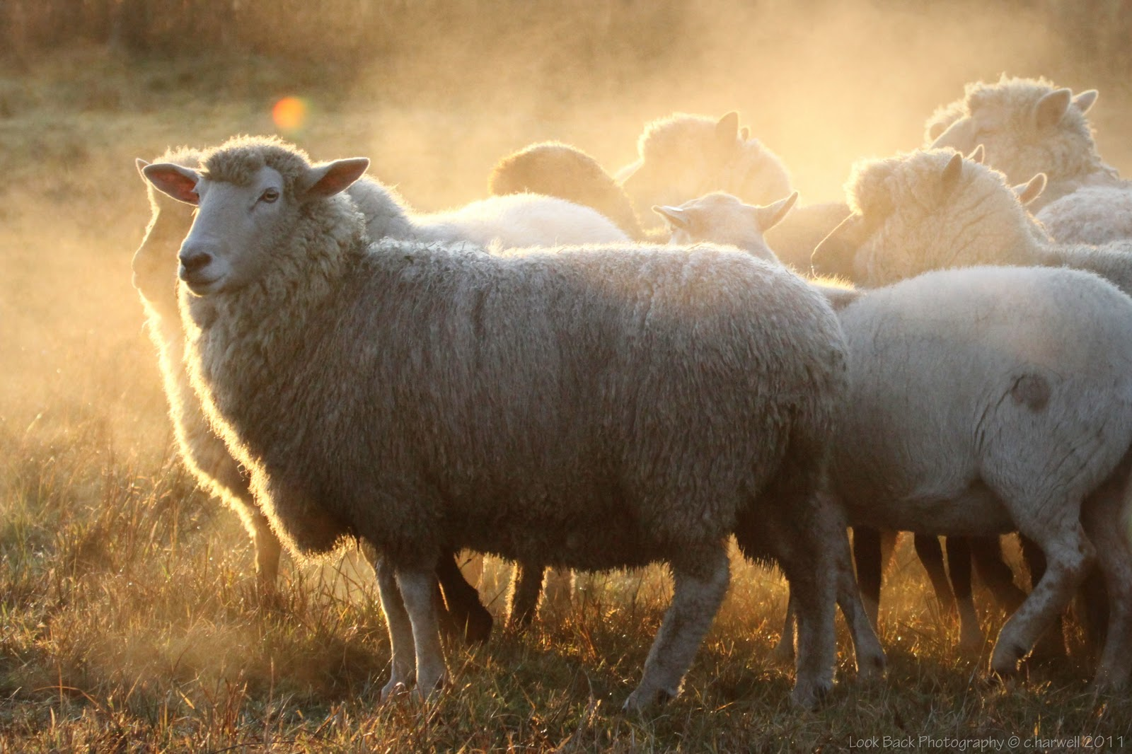
Sheep Breeds

Slide 19
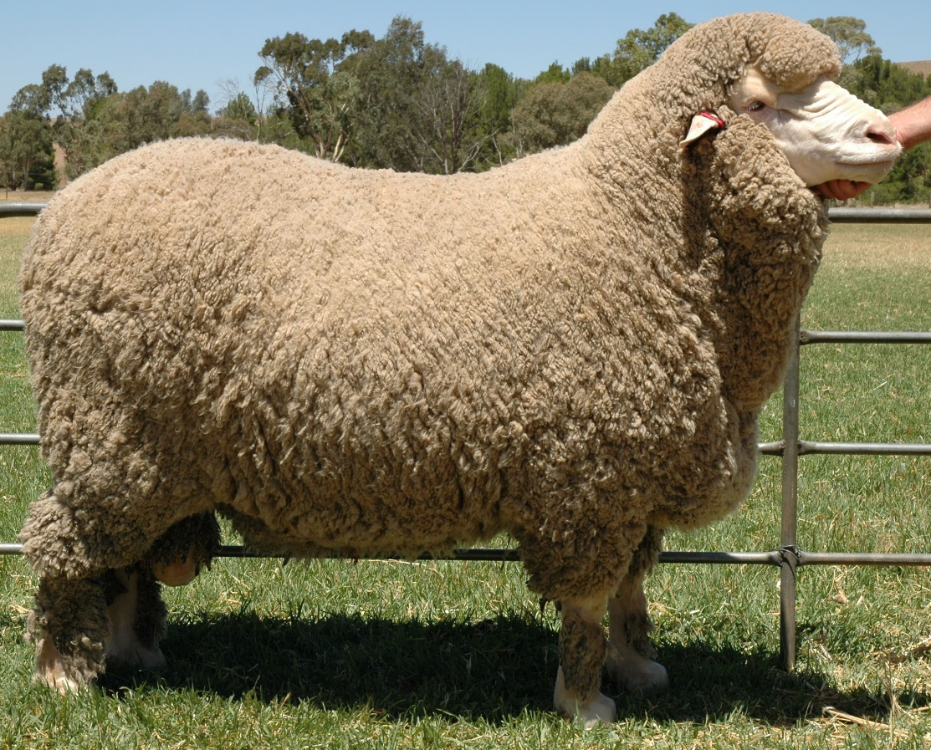
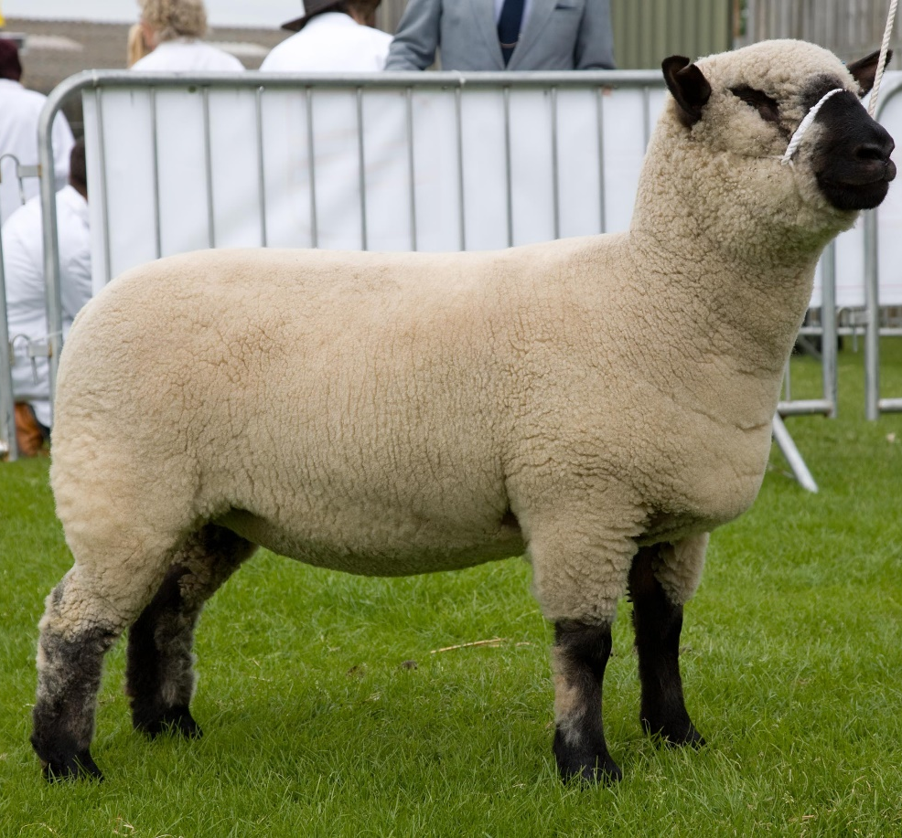
Sheep Breeds
Two easy ways to distinguish between swine breeds:
White face (dam breed) vs. Black face (sire breed)
Fine wool vs. medium wool vs. long wool

Slide 20
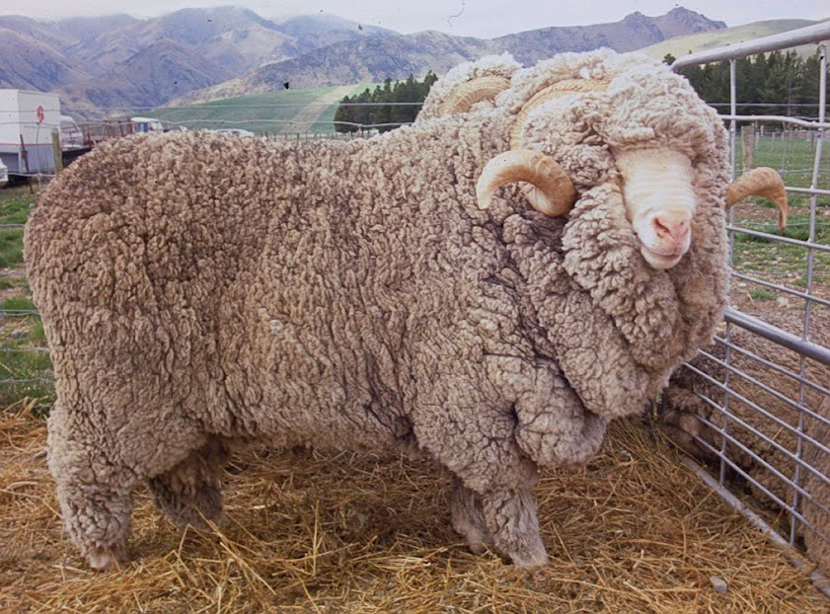
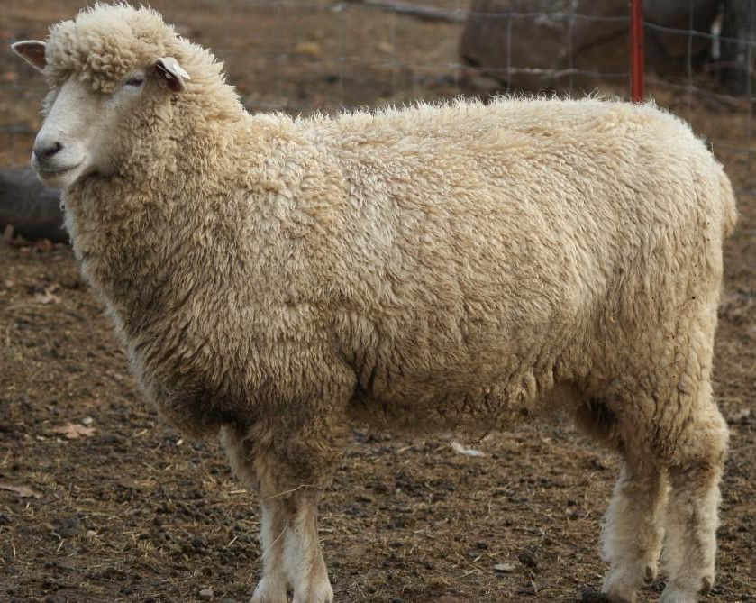
Fine Wool Breeds
These breeds are known for their excellent wool quality and are often used for wool production
Breeds you will need to identify include:
Merino
Rambouillet

Slide 21
Merino

Slide 22
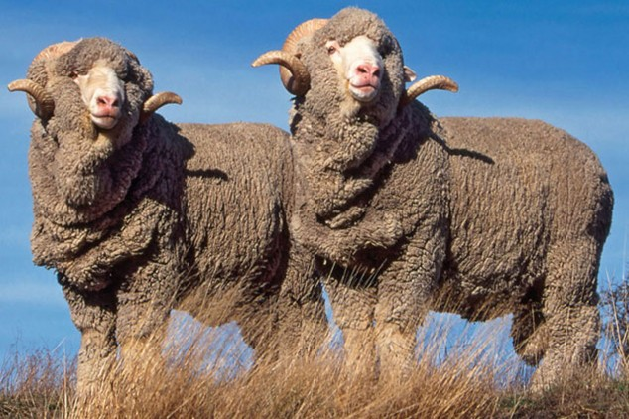
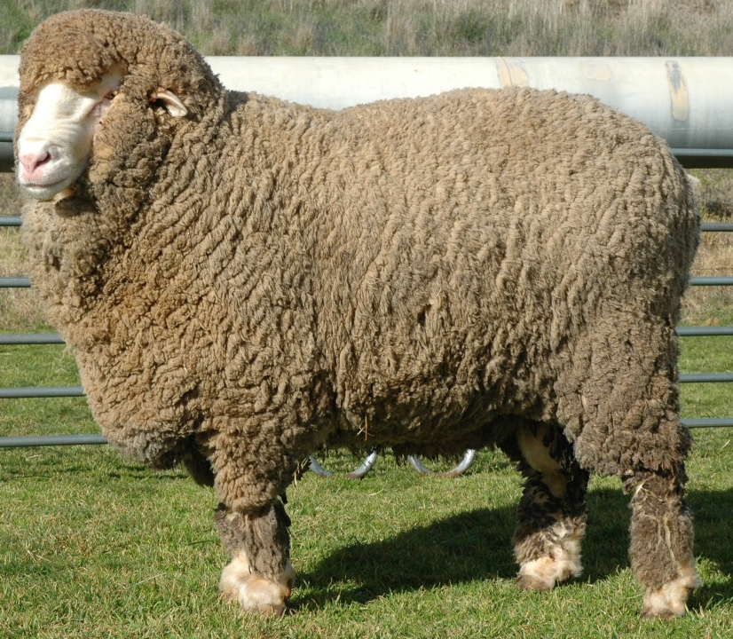
Merino (Spain)
Most dominant breed in the sheep industry worldwide
White face, wool on legs
Typically smaller than other wool breeds and slow growing
Long, fine wool (often prized)

Slide 23
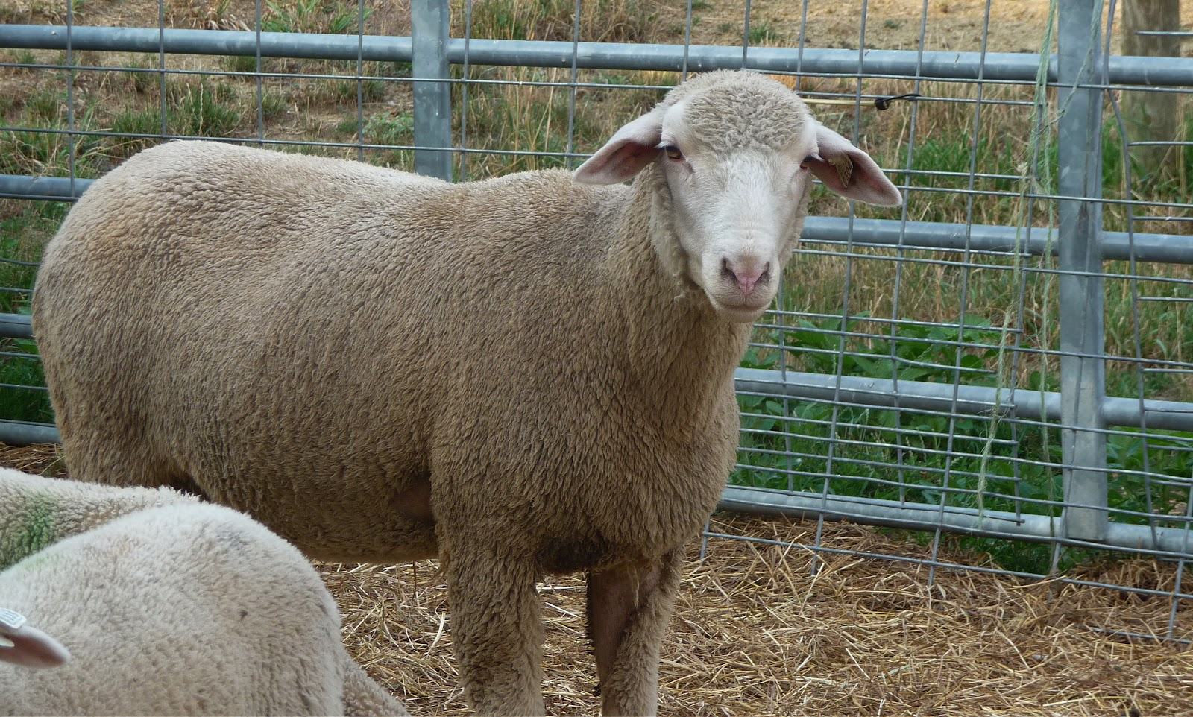
Rambouillet

Slide 24
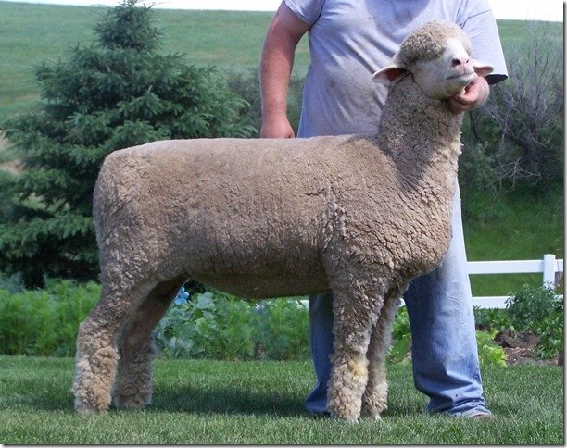
Rambouillet (France)
Descendant of the Merino, but larger and faster growing
Dual purpose breed (used for wool and meat)
White face with wool on legs
Rams horned and ewes polled or scurred

Slide 25
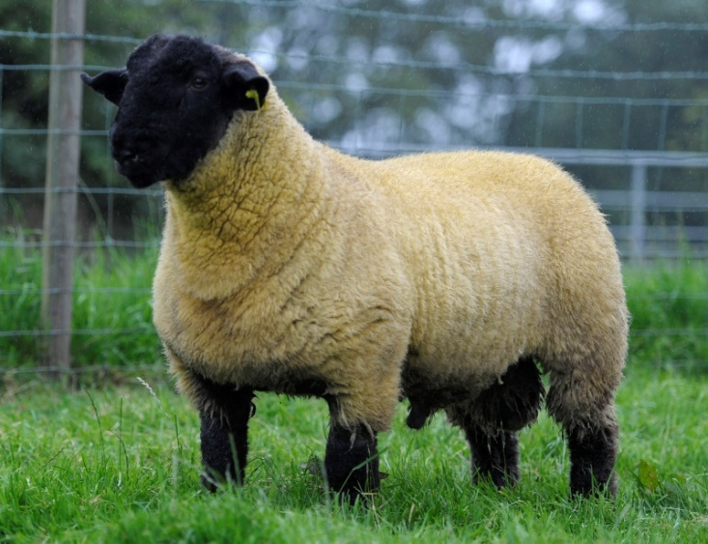
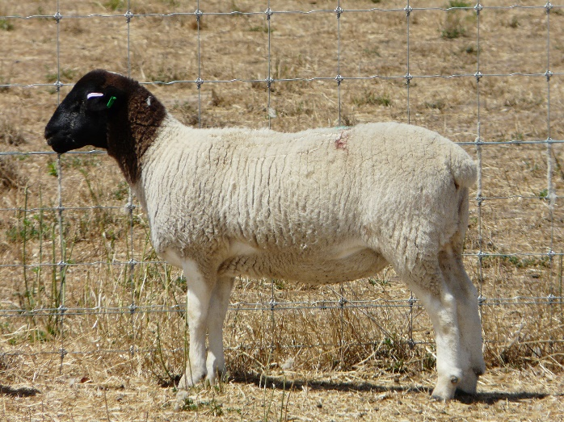
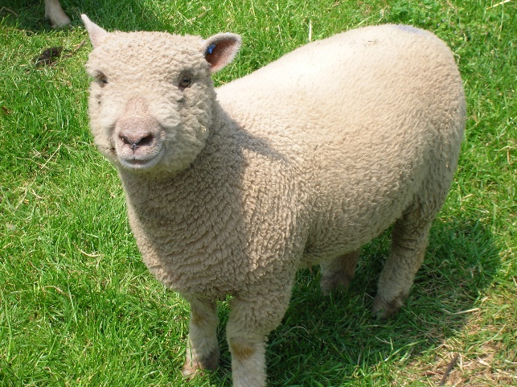
Medium Wool (Meat) Breeds
These breeds are known for their excellent growth characteristics and are often used for meat production
Breeds you need to identify include:
Columbia
Dorper
Dorset
Hampshire
Southdown
Suffolk
All medium wool breeds are polled!

Slide 26
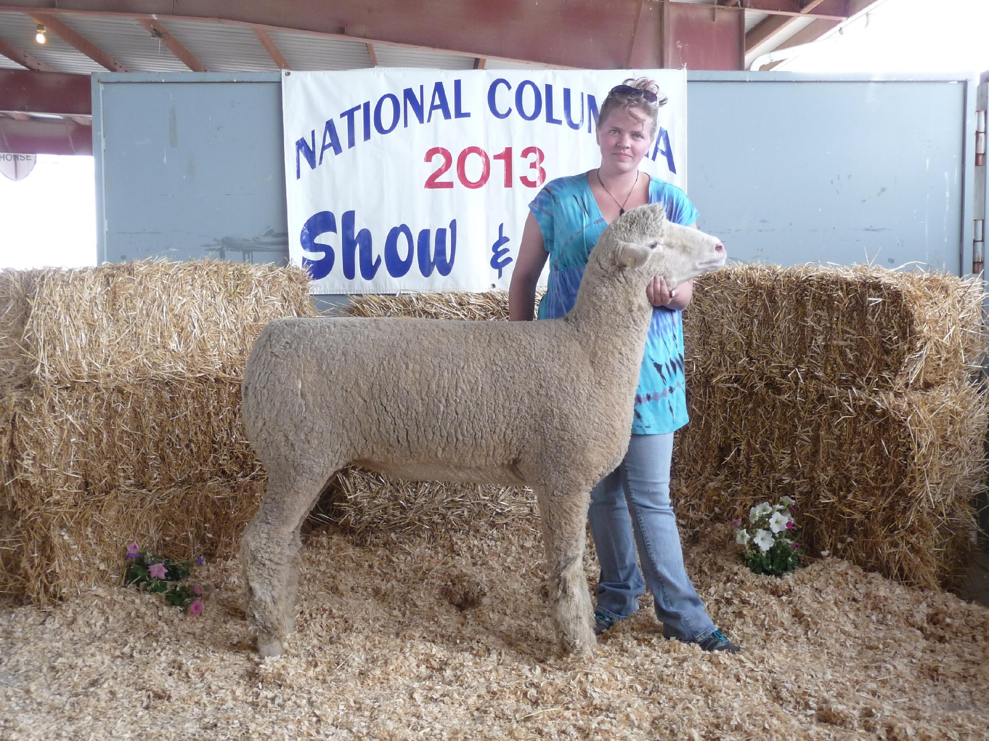
Columbia

Slide 27
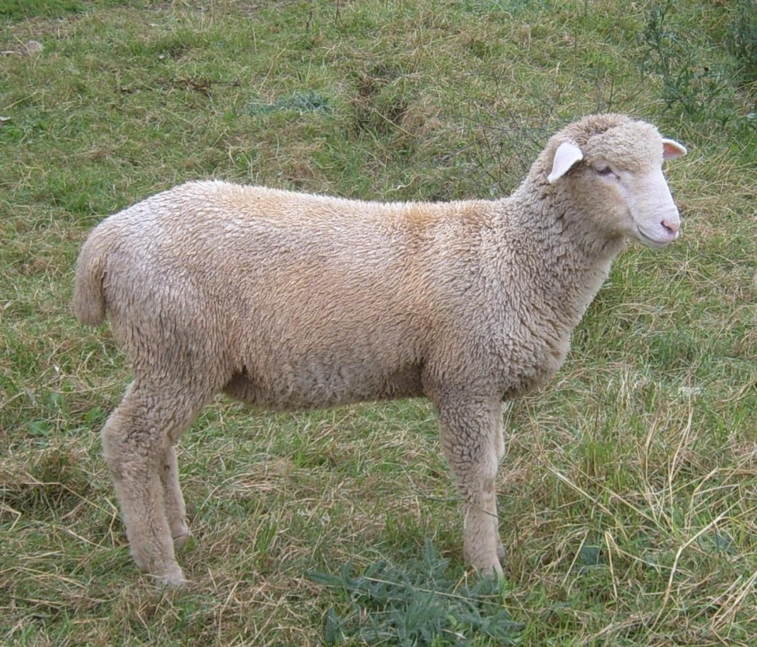
Columbia (USA)
Wool cap on head
White face with wool on legs

Slide 28
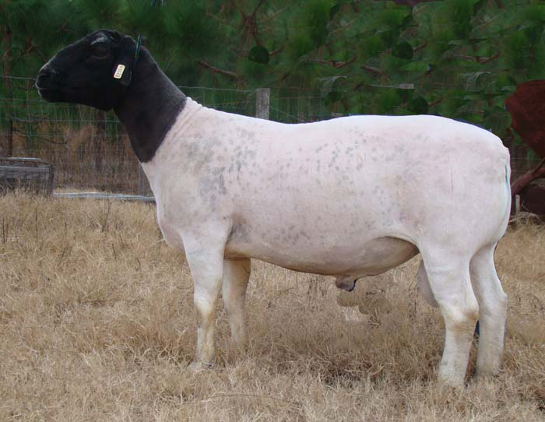
Dorper

Slide 29
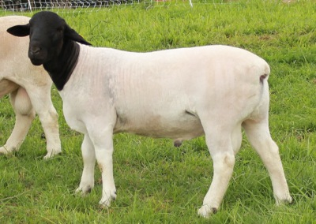
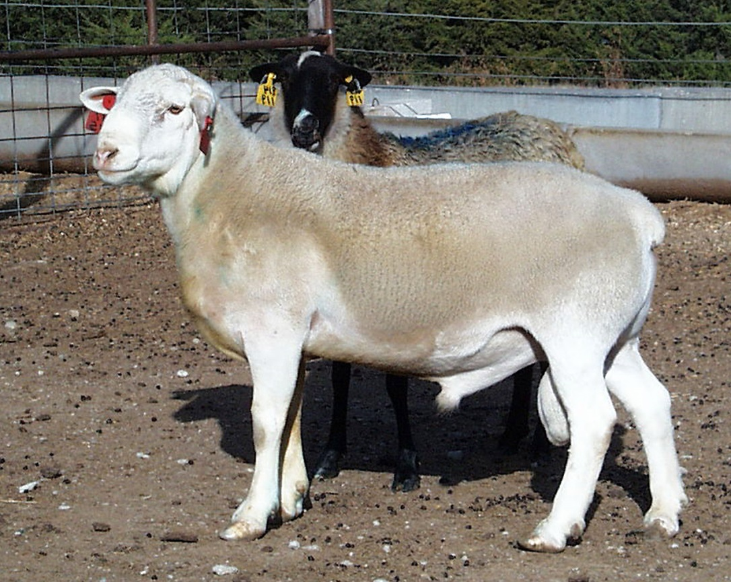
Dorper (South Africa)
Black or white head with white body
Hair breed (does not require shearing)

Slide 30
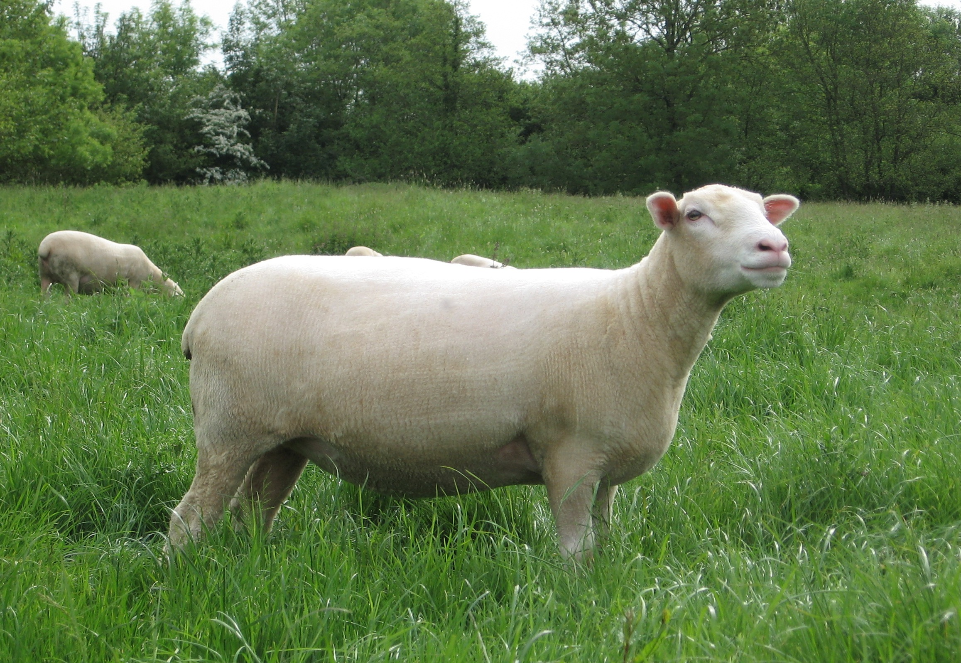
Dorset

Slide 31
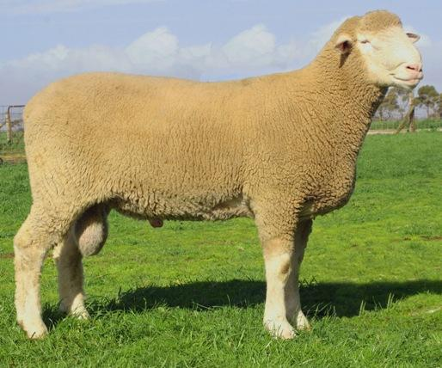
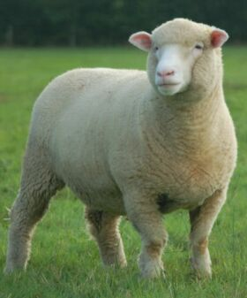
Dorset (England)
White face with wool on the legs
Known to be able to breed out of season

Slide 32
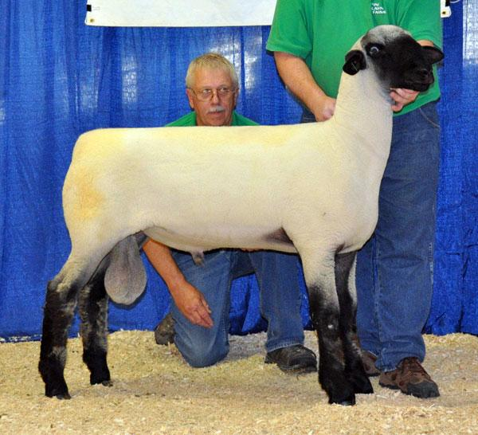
Hampshire

Slide 33
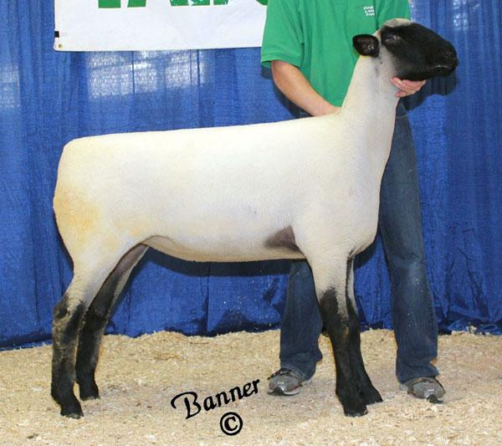
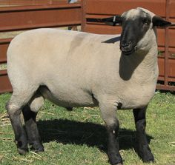
Hampshire (England)
White body with black face, legs, and sometimes belly
Large wool cap present on head
One of the most popular sire breeds in sheep production

Slide 34
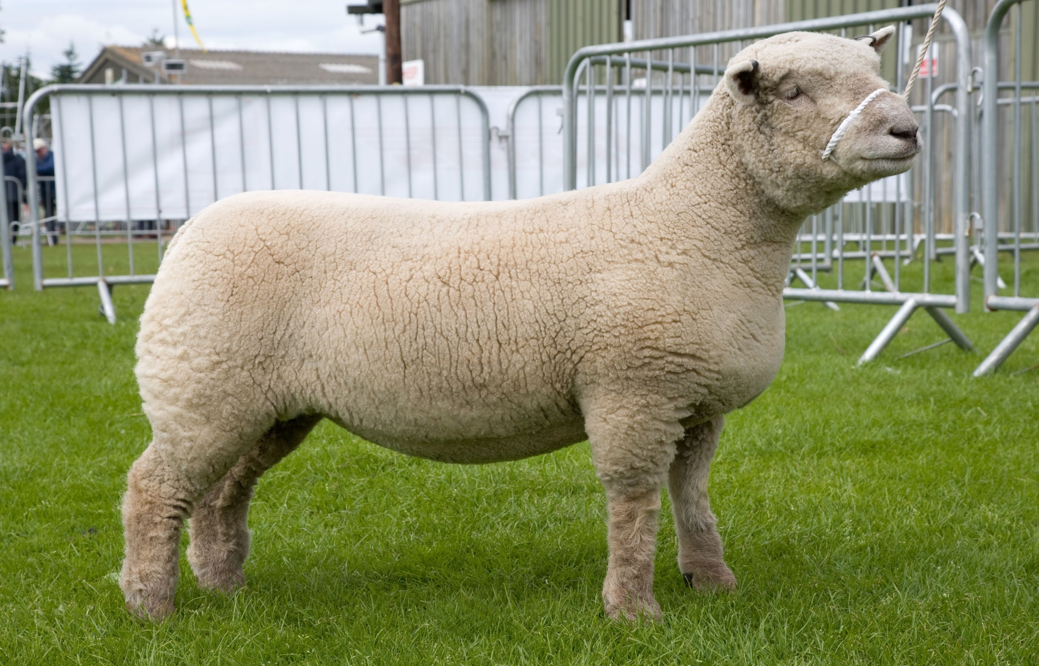
Southdown

Slide 35
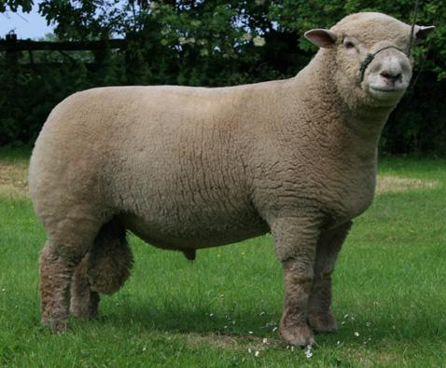
Southdown (England)
White color with tan/gray face (NOT black)
One of the oldest breeds
Both the face and legs are covered with wool

Slide 36
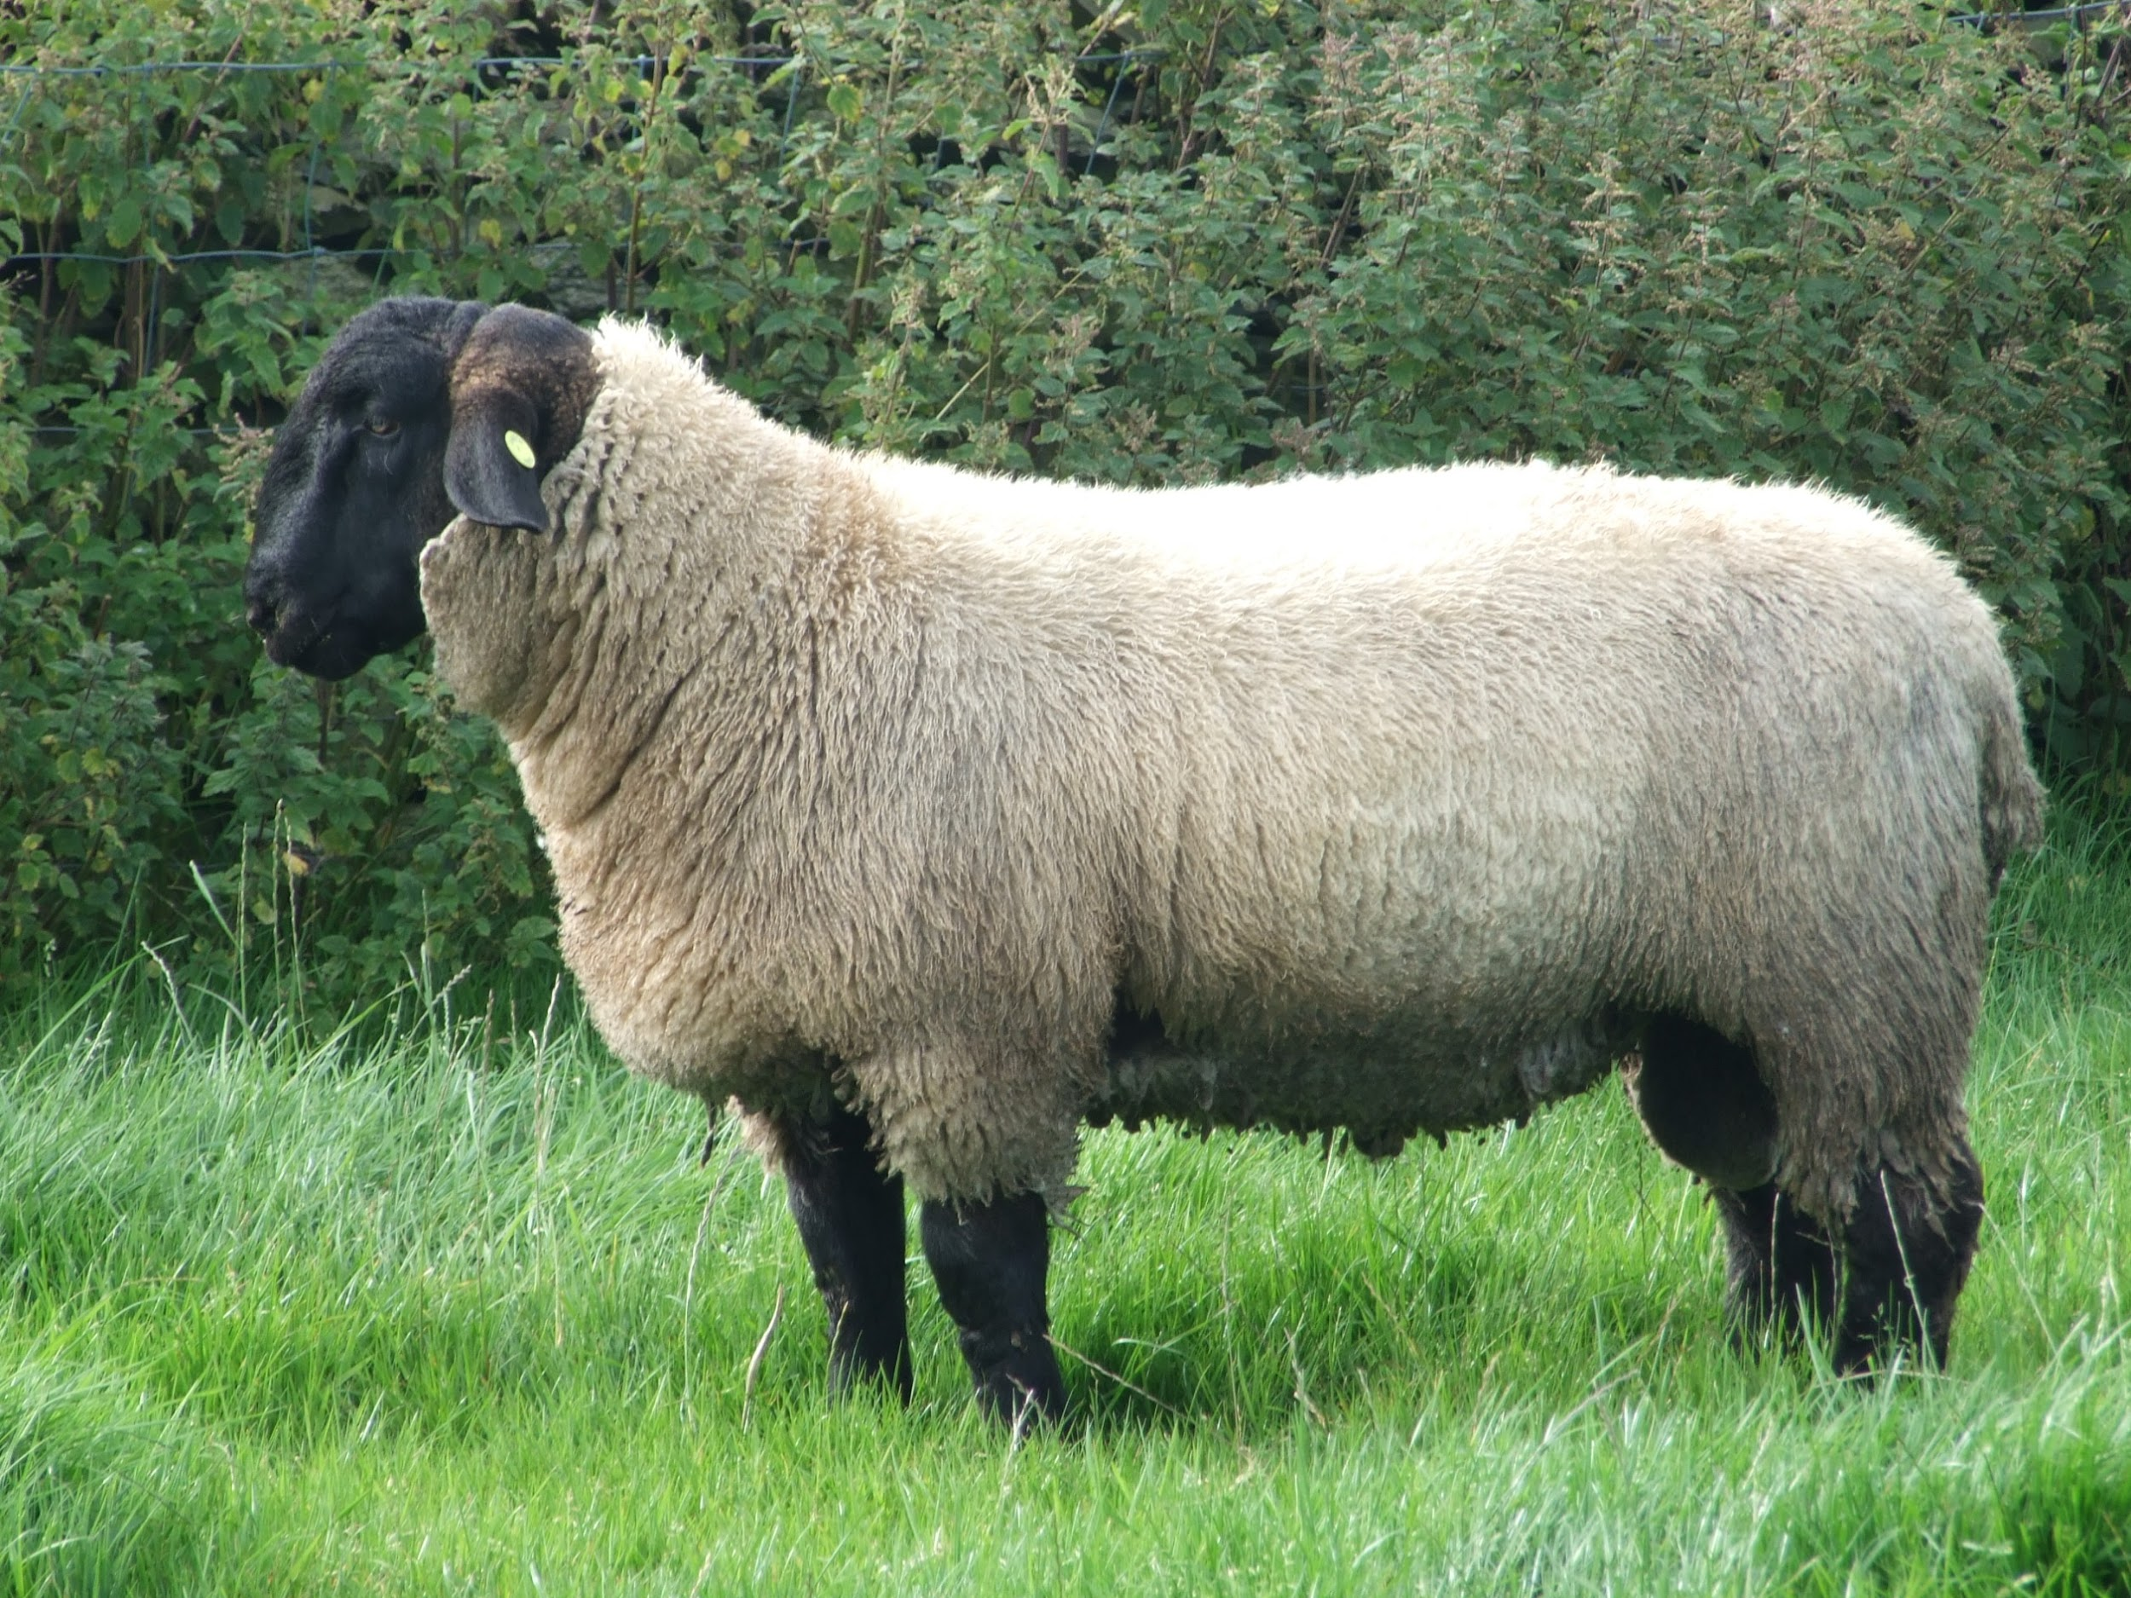
Suffolk

Slide 37
Suffolk (England)
White body with black face, legs, and sometimes belly
Small wool cap on head or no wool cap
No wool on legs

