Slide 1
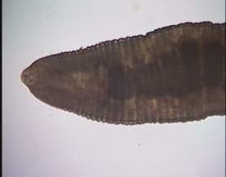
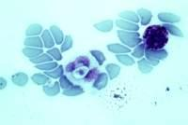
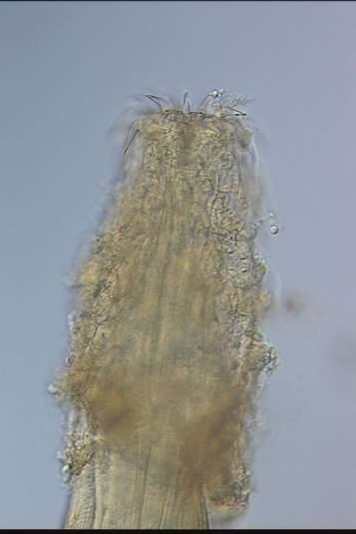
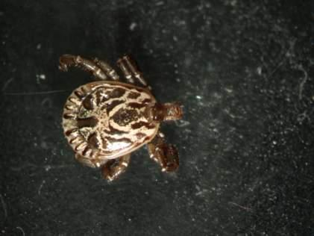
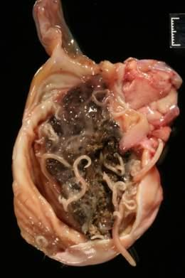
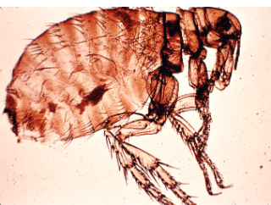
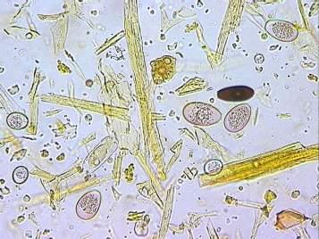
PARASITES CRITTERS IN OR CRITTERS

Slide 2
PARASITES, SO WHAT?
Dr. Tom Craig
Department Veterinary Pathobiology
Texas A&M University

Slide 3
WHO ARE PARASITES? EUKARYOTIC ORGANISMS THAT LIVE IN OR ON A HOST AND MAY CAUSE DISEASE
Arthropods: ticks, mites, flies, fleas, lice
Helminths: nematodes (cylindrical or round worms), cestodes (tapeworms), trematodes (flukes)
Protozoa: amoeba, flagellates, ciliates, apicomplexa
Lets find out about them

Slide 4
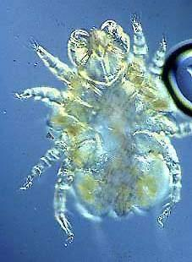
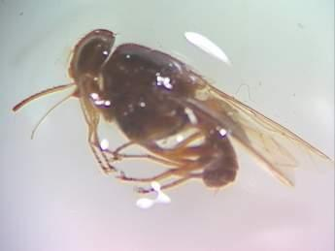
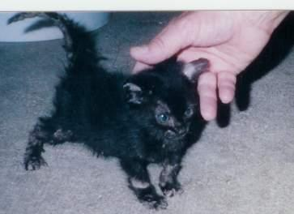
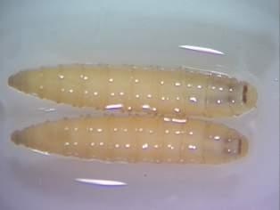
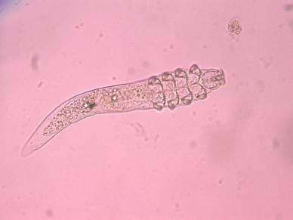
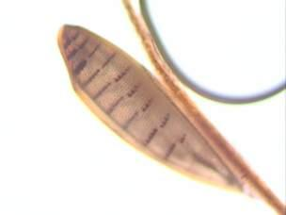
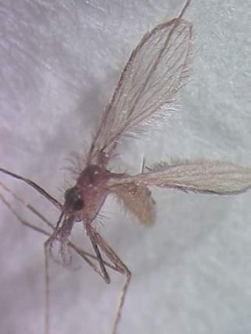
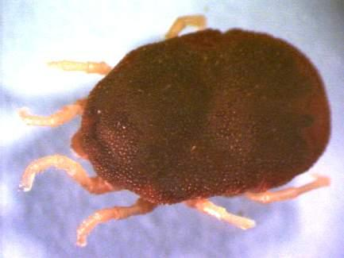
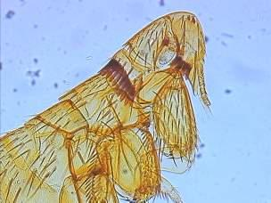
ARTHROPODS

Slide 5
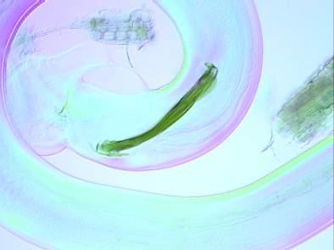
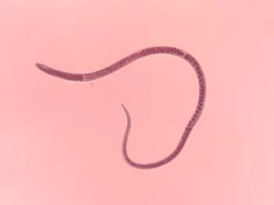
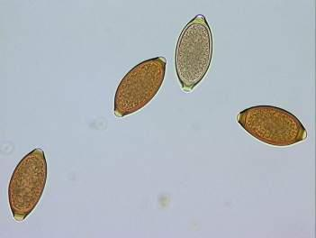
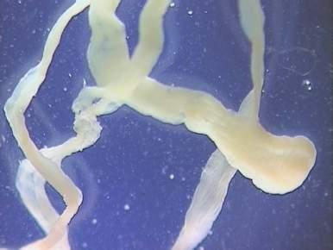
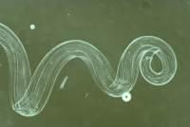
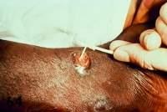
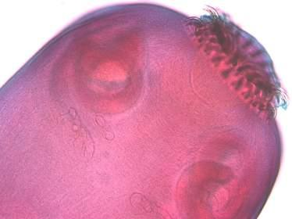
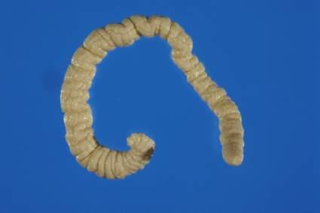
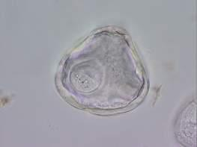
HELMINTHS

Slide 6
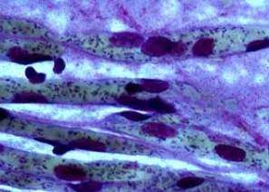
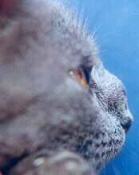
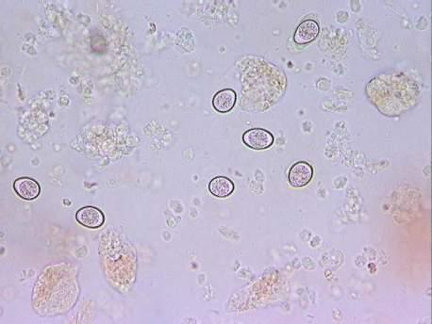
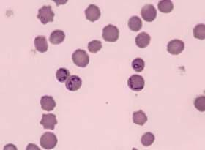
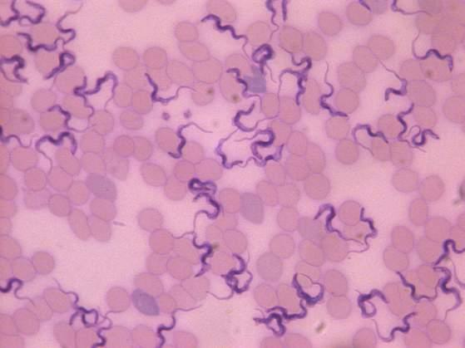
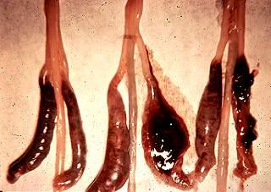
PROTOZOA

Slide 7
PARASITES LIVE ON OR IN A HOST
A host is a animal that provides a living for a parasite: the host could be a pig, a person or poultry
Parasites are specific : which species of host, where in or on the body they live, how they make a living, what kind of damage they do
Hosts may tolerate parasites, become resistant to, co-exist with, or suffer from and even die because of them
Infection with parasites does not mean disease!
Disease occurs with excessive numbers of parasites
The numbers required to cause disease varies with host, parasite, and environment

Slide 8
LIFE CYCLES : THE ESSENCE OF PARASITOLOGY
The steps from one generation to the next:
Where?
What do they look like?
What do they do? How they make a living and what happens to the host
How do they survive? Inside and away from the host
What can we do to prevent disease?

Slide 9
HOW DO WE KNOW IF THERE ARE PARASITES PRESENT
Look for parasites:
Ectoparasites may be readily seen or you may have to scrape the skin
Internal parasites release their reproductive products into the blood, urine or feces; Microscopic evaluation after separation of parasitic reproductive products from host
Postmortem examination looking in specific tissues for presence of parasites
Evidence of past or present infection:
Looking for antibodies, changes in serum chemistry, parasite secretions

Slide 10
FOR DIAGNOSIS OF PARASITES YOU NEED TO ANSWER THREE THINGS
1. Host: What is the species, sex and age of host
2. Parasite: Are we looking for something grossly visible or microscopic , where do we look? Organ, tissue or what comes from them
3. Environment: Where does the host live and make a living? Climate, time of year, food intake, where they rest, who else lives there

Slide 11
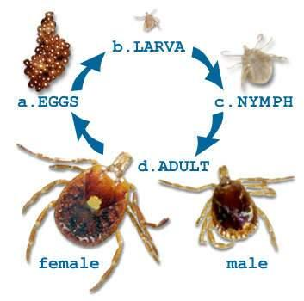
IXODIDAE- HARD TICK AMBLYOMMA AMERICANA
Small mammal, bird or reptile
Soil
Small mammal, bird, or reptile
Many species of animals

Slide 12
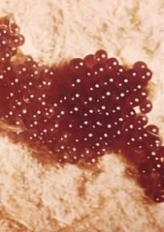
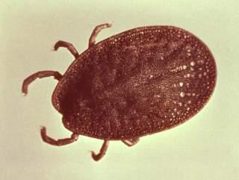
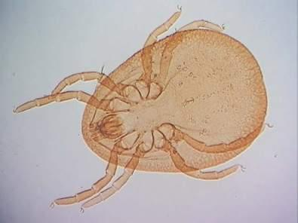
ARGASIDAE – SOFT TICKS
Egg
environment
Larva
Adult
Nymph
Found in environment of poultry

Slide 13
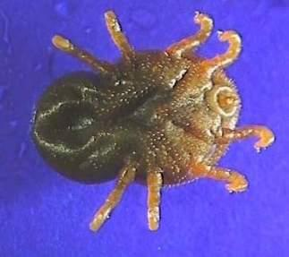
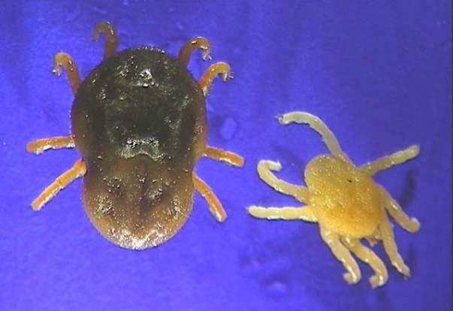
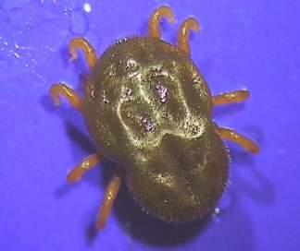
OTOBIUS MEGNINI NYMPHS
Deep in ear canal of cattle and anyone else handy
ventral
dorsal

Slide 14
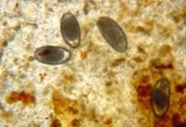
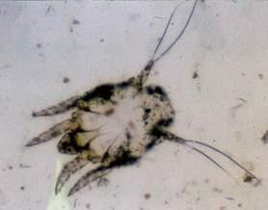
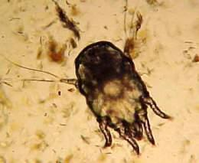
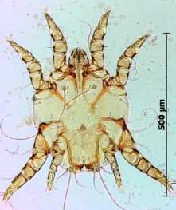
OTODECTES - EAR MITE
Eggs
Larva
Nymph
Found on the surface of the cat ear canal
Adult

Slide 15
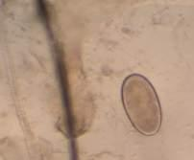
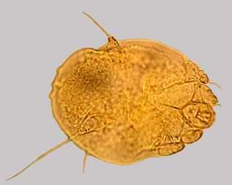
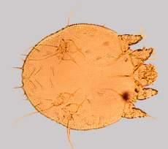
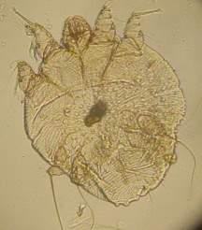
SARCOPTES SCABEI - MITE
Egg
Nymph
Larva
Found in the skin of many animal species
(dogs, pigs, people)
Adult

Slide 16
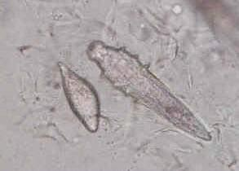
DEMODEX CANIS - MITE
Egg
Larvae
Egg
Larva
Adult
Found in hair follicles of dogs

Slide 17
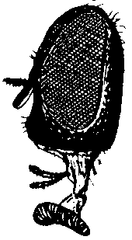
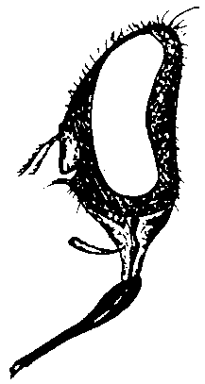
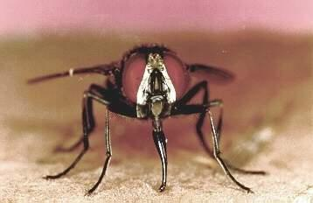
Premise flies: Musca domestica Stomoxys calcitrans
house fly stable fly

Slide 18
PASTURE FLIES: HAEMATOBIA IRRITANS (HORN FLY)
~1/8" long - half the size of a house or stable fly
palps almost as long as proboscis

Slide 19
GASTEROPHILUS INTESTINALIS- BOT FLY OF HORSE
Larva
Horse Tongue and Stomach
Egg
Horse hair
Pupa
Pasture Soil
Adult female
Near horses

Slide 20
CTENOCEPHALIDES FELIS- CAT FLEA
Eggs
Hair of cat or dog
Larva
Floor cracks, rugs, carpets and animal bedding
Pupae
Silk cocoons
Adult
Hair of dog or cat

Slide 21
ANOPLURA – SUCKING LICE
Egg
Hair of swine, cattle or others
Nymph
Skin of swine or cattle
Adult
Skin of swine or cattle

Slide 22
MALLOPHAGA - CHEWING LICE
Nymph
Adult
Egg
on feathers of birds (primarily) or hair of mammals

Slide 23
Eggs
Dog feces
Ancylostoma caninum
Adults
Small intestine of dogs
Anemic Puppy
Larva
Dog feces/soil
penetrate skin
Larva
transmitted to pups in milk

Slide 24
STRONGYLUS VULGARIS – LARGE STRONGYLE OF THE HORSE
Eggs
Feces of horse
Larvae Found in soil, are ingested go to the intestine crawl out of intestine
travel to the blood vessels develop for months then return to intestine as adults
Adult
cecum and colon of horse

Slide 25
STEPHANURUS DENTATUS - KIDNEY WORM OF SWINE
Egg
Passed through urine
Larvae
Direct: ingestion or skin penetration of larvae Indirect: earthworms
Adult
Once inside, larvae migrate to the liver. Eventually they migrate through the peritoneal cavity and encyst in the perirenal fat near kidneys and mature to adults.

Slide 26
STRONGYLOIDES WESTERI INTESTINAL THREADWORMS OF HORSE
Egg-adult female lives in small intestines of foals Larvated eggs passed in feces
Larva
Skin penetration, or passed in milk to young foals
Adult female
Small intestine of foals

Slide 27
DIROFILARIA IMMITIS-HEARTWORM OF DOGS
Larva
Mosquito
Microfilaria
Blood
Adults
Heart

Slide 28
TOXOCARA CANIS- ROUND WORM OF DOGS
Egg
Soil contaminated with feces
Egg containing larva eaten by dog
Larva
Egg hatches canine intestinal tract
Larva goes to lungs, then tissues uterus if the dog is pregnant, or mammary glands if host recently whelped
Adults
Canine intestine where they mate.

Slide 29
TRICHURIS VULPIS- WHIPWORM
Egg
Ingested by dog and hatch in small intestine
Larva
Penetrate into the intestinal wall of dog, then re-enter the lumen after 2-10 days, then passes down to the dog’s cecum
Adult
Mucosa of cecum and large intestine in dog

Slide 30
DIPYLIDIUM CANINUM- TAPEWORM DOG AND CAT
Egg ingested
by larvae flea
Egg basket
Dog/Cat feces
Adult
Dog/cat small intestine

Slide 31
TAENIA PISIFORMIS- DOG TAPEWORM
Proglottids
When the dog eats the rabbit they begin to form in the small intestine
Eggs
Eliminated in feces and ingested by a rabbit and hatches in small intestine
Larvae
Burrows through the intestinal wall and travels to the liver via the blood

Slide 32
FASCIOLA HEPATICA - LIVER FLUKE OF CATTLE AND SHEEP
Egg
Feces
Cercariae
Snail
Miracidium
Adult
Liver
Metacercariae
Vegetation

Slide 33
GIARDIA INTESTINALIS
Cyst
Trophozite
Found in feces of many animal species

Slide 34
ISOSPORA- DOG AND CAT PROTOZOA
Oocyst
Feces
Sporulated oocyst
environment
Sporulated oocyst
eaten by dog or cat
merogony, gamogony, syngamy in intestinal epithelial cells

Slide 35
GOT PARASITES WHAT SHOULD WE DO?
KILLUM ALL!
Maybe not?
Control disease, live with the enemy
Parasites like bacteria evolve to become resistant to the agents that were very effective against them
Parasites stimulate a protective immune response if no exposure no protection

Slide 36
USE OF ANTHELMINTICS OR PESTICIDES
Treat them what needs it
A. Sick animals: Disease may be clinical or economic B. At risk animals ie. young animals weaning or making a living from pasture C. Those animals under stress ie. First calf heifers D. When conditions are becoming suitable for transmission ie. high exposure to parasites following wet warm weather conditions E. Those with the most worms (20% of the herd has 80% of the worms)
Make sure the drug works where you are using it (worms can’t read the label)
.

Slide 37
EVALUATION OF WORM NUMBERS; EGG COUNTS OR ANEMIA
Count the number of eggs in a portion of feces expressed in eggs / gram feces > 2,000 treat
Anemia: Associated with numbers and persistence of infection with Haemonchus
Proportion of erythrocytes (red blood cells) in blood
Color of mucous membranes: pink or white
guess?
FAMACHA color chart

Slide 38
SELECTIVE TREATMENT FAMACHA

Slide 39
USE OF ANTHELMINTIC COMBINATIONS
Widely used in some countries has been used in US to some success
Problem in Australia now uses combination of ivermectin, albendazole and levamisole
Will fail unless 100% effective; We have succeeded in producing super Super worms on some farms
Super worms are more widely available than refugia worms

Slide 40
MANAGEMENT PROCEDURES TO STOP, REDUCE OR REMOVE RESISTANT WORMS FROM A FARM
Strategic treatment with effective anthelmintic in winter (lambing or kidding)
Use dry lots, annual pastures, crop (hay) aftermath for susceptible animals
Have resistant animals harvest pastures after susceptible animals, do not treat these animals as the survivor worms will become the refugia

Slide 41
BOVINE BABESIOSIS
The first dean of the College of Veterinary Medicine Dr. Mark Francis came to Texas because of a tick transmitted parasitic disease "Texas Cattle Fever"
Babesia bigemina

Slide 42
FEVER TICK CONTROL
Dr. Francis showed killing ticks prevented transmission
Dipping cattle every two weeks eradicated ticks by 1940's: they are back!
Situation 2012

