Slide 1
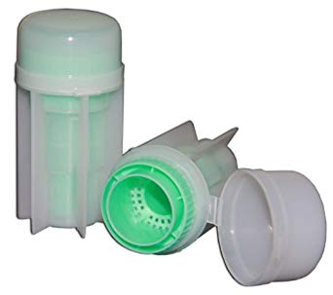
Fecalyzer

Slide 2
Staple Remover

Slide 3
Heart

Slide 4
Pembroke Welsh Corgi

Slide 5
Burmese Mountain Dog

Slide 6
Love Birds

Slide 7
American Land Race

Slide 8
Rod (Bacteria)

Slide 9
Black Legged Deer Tick

Slide 10
Flea Tapeworm Eggs

