Slide 1
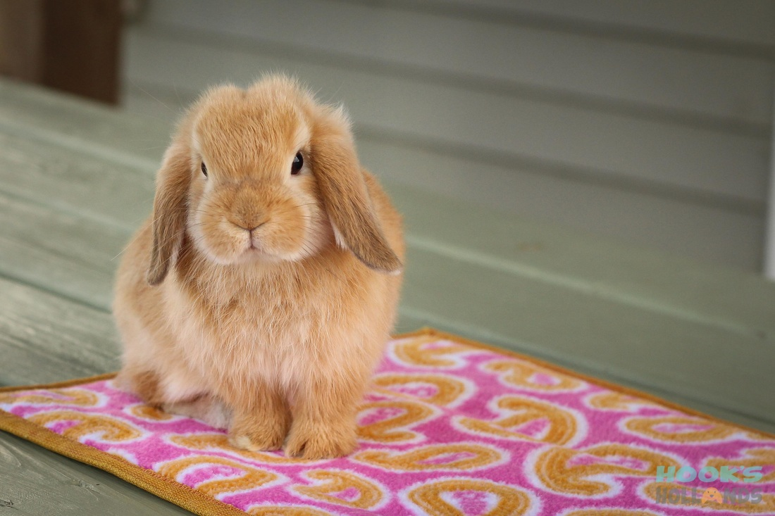
Holland Lop

Slide 2
Netherland Dwarf

Slide 3
Reticulum

Slide 4
Gall bladder

Slide 5
Needle holder — Olsen-Hegar

Slide 6
Forceps — Allis tissue

Slide 7
Bandaging material — vet wrap

Slide 8
Forceps — Kelly

Slide 9
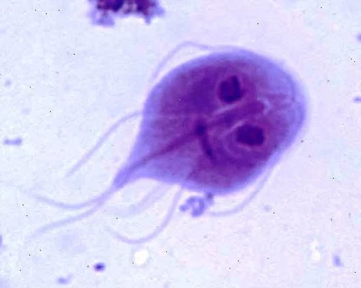
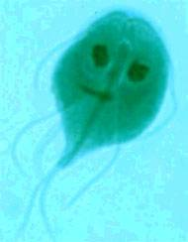
Giardia

Slide 10
Calcium oxalate crystals

