Slide 1
Dog Breeds
© Partnership for Environmental Education and Rural Health at
College of Veterinary Medicine & Biomedical Sciences, Texas A&M University
Funding support from the National Institutes of Health Office of Research Infrastructure Programs (ORIP)

Slide 2
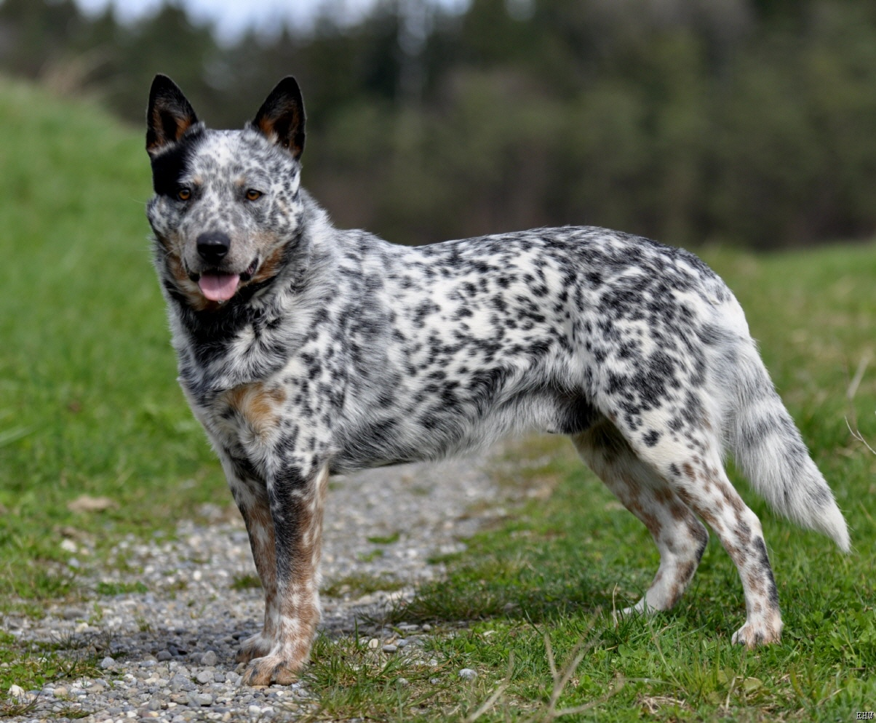
Australian Cattle Dog

Slide 3
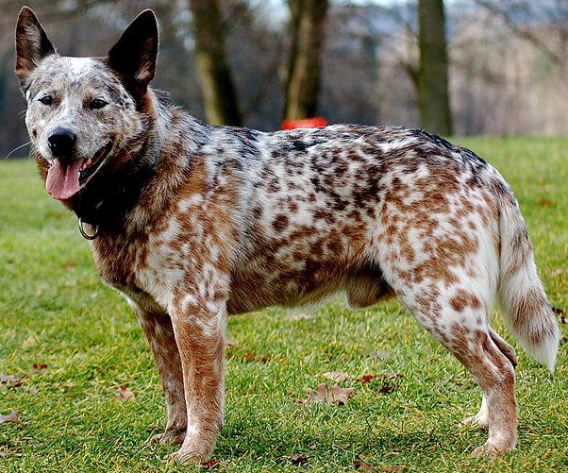
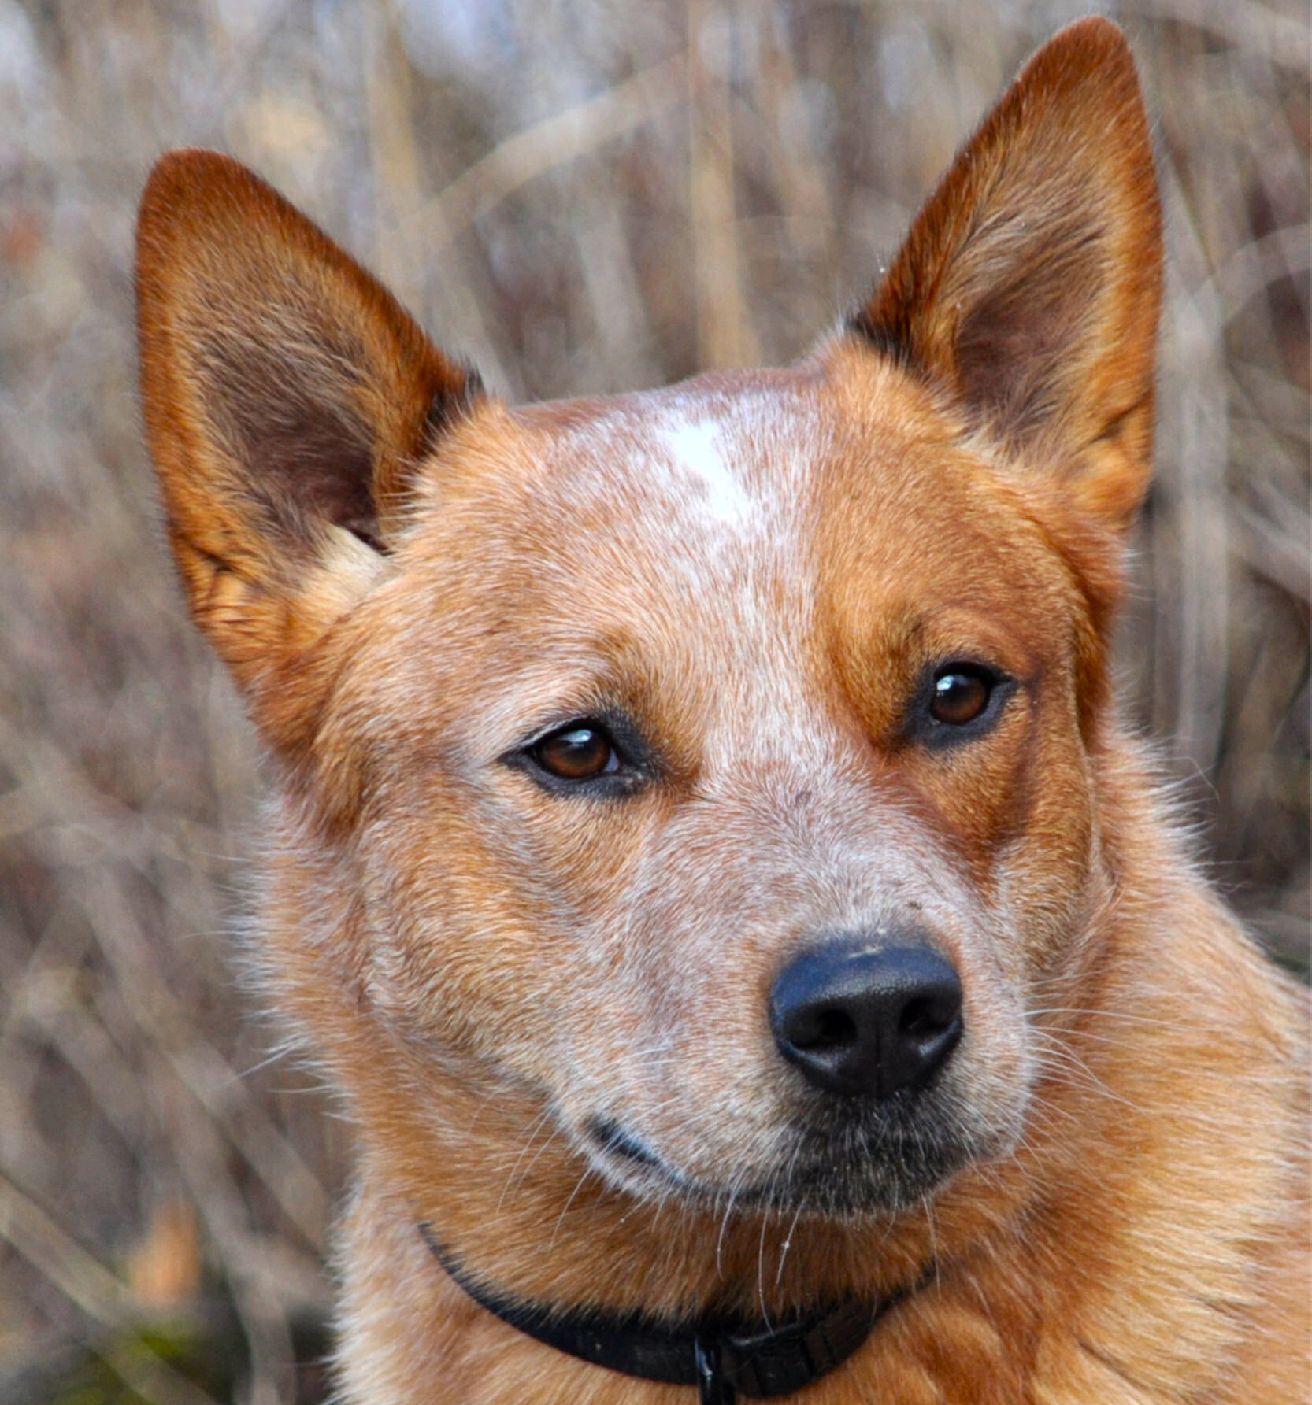
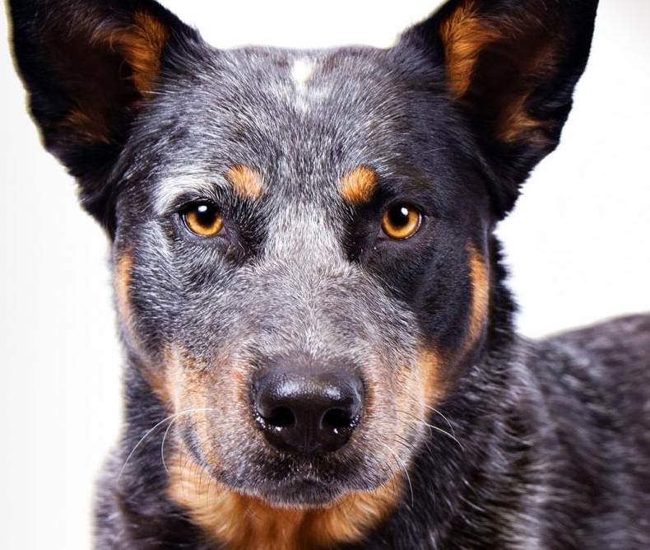
Australian Cattle Dog
AKC Recognized Colors:
Blue
Blue mottled
Blue speckled
Red mottled
Red speckled
AKC Recognized Markings:
Black and tan
Red
Tan
As their name implies, these dogs originate from Australia and are often used to herd cattle
Many people refer to this breed as “blue heeler” or “red heeler”
This breeds ancestor was cross-bred to a Dalmatian, giving many individuals in this breed the unique speckled pattern

Slide 4
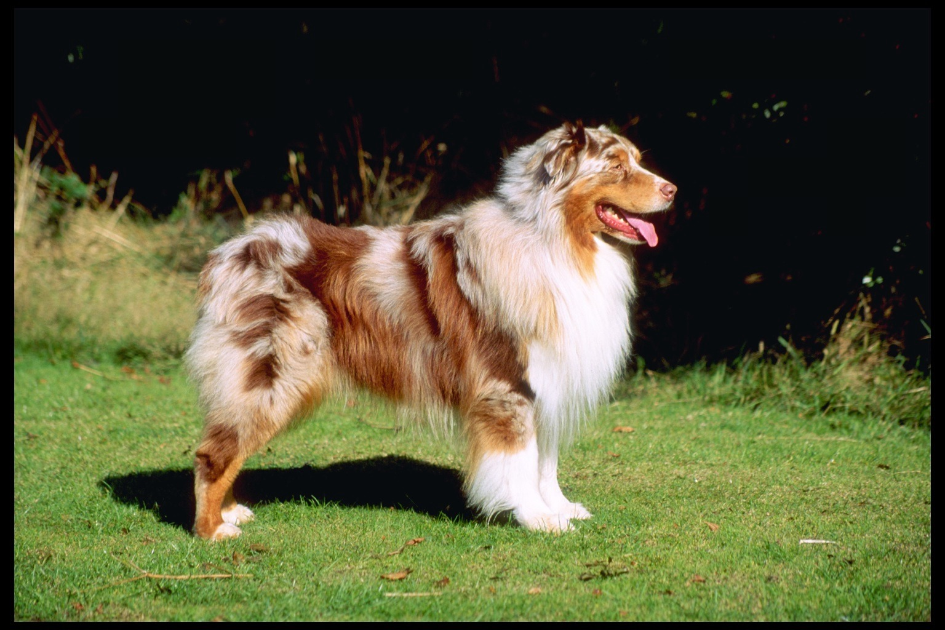
Australian Shepherd

Slide 5
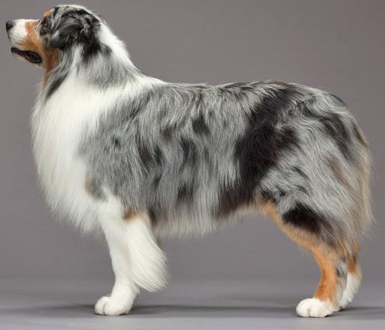
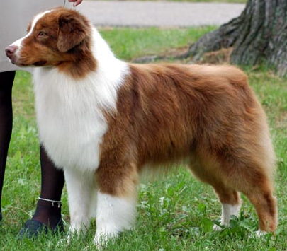
Australian Shepherd
AKC Recognized Colors:
Black
Blue merle
Red
Red merle
AKC Recognized Markings:
Tan points
White
White marking and tan points
Aussies originated in the western United States (despite its name!)
Medium length coat that is very thick
Docked tail or naturally bobbed
Often used at rodeos, ranches, and farms to herd horses, cattle, sheep, and ducks

Slide 6
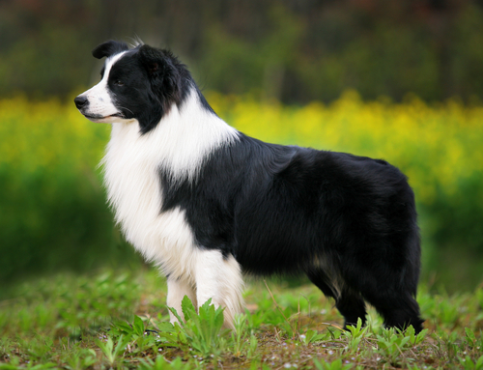
Border Collie

Slide 7
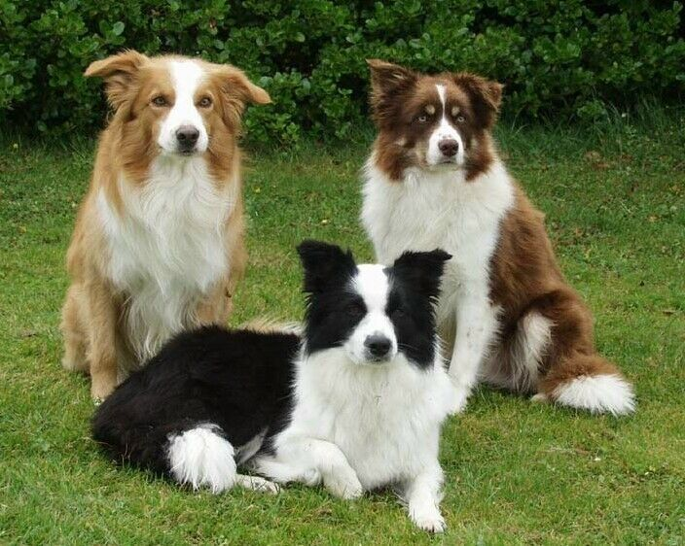
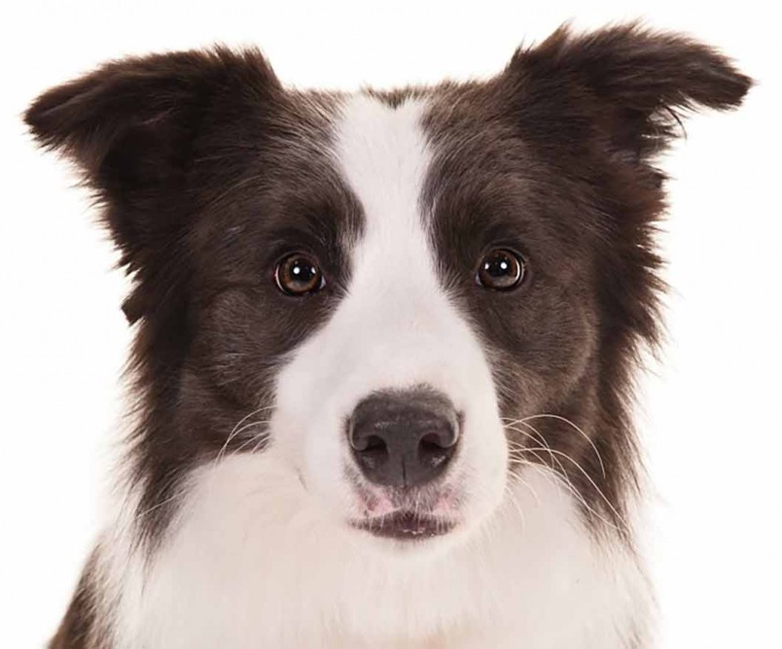
Border Collie
AKC Recognized Colors:
17 recognized colors (there is a wide variety)
AKC Recognized Markings:
7 recognized markings
Originated on the border between Scotland and England
Highly intelligent and energetic
Strong herding instincts, often herd cattle and sheep (many believe they are the best herding breed)
This breed does NOT have a docked tail (AKC standard)
Notes:
Many students mix up Border Collies and Australian Shepherds (Aussies have a docked tail where BC do not!)

Slide 8
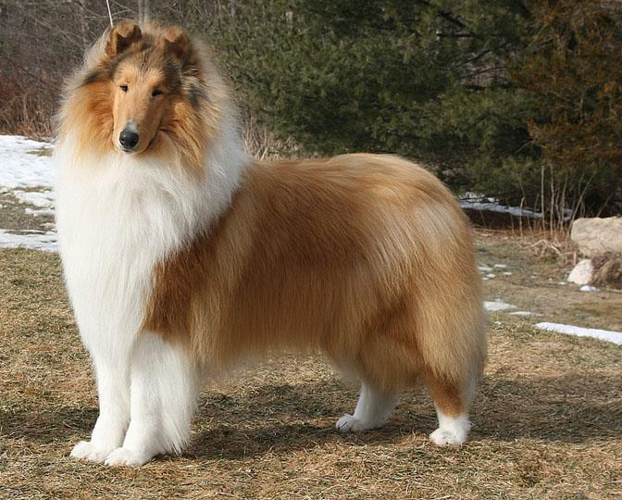
Collie

Slide 9
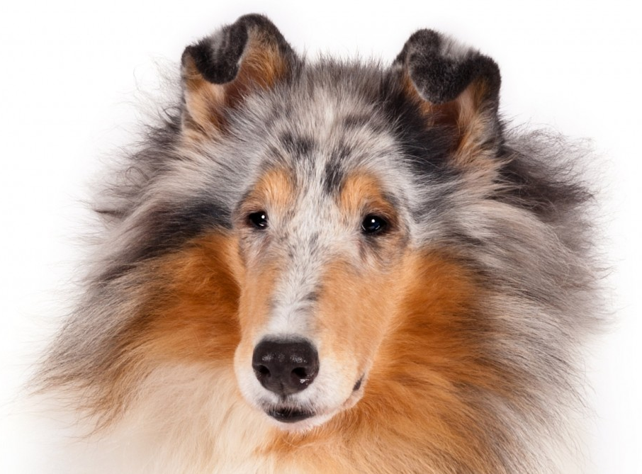
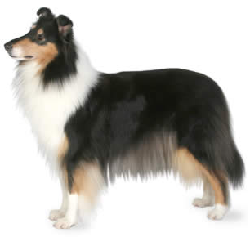
Collie
AKC Recognized Colors:
10 recognized colors (there is a wide variety)
AKC Recognized Markings:
Black and tan
Blue merle
Sable
Sable merle
Originated in Scotland/Northern England
Medium size (50-70lbs), long and pointed snout
Traditionally used to herd cattle and sheep
Notes:
Many students confuse Collies and Shelties, shelties are much smaller (less than 30lbs).

Slide 10
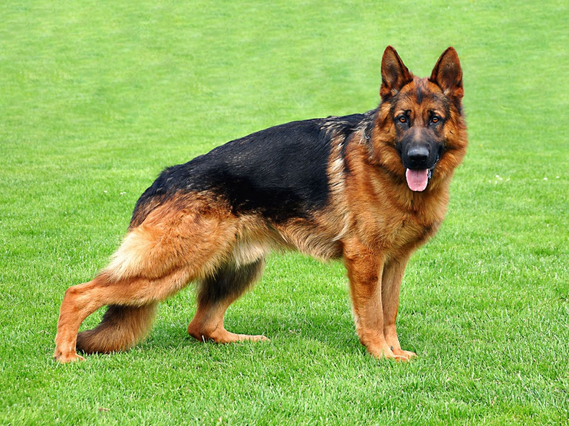
German Shepherd Dog

Slide 11
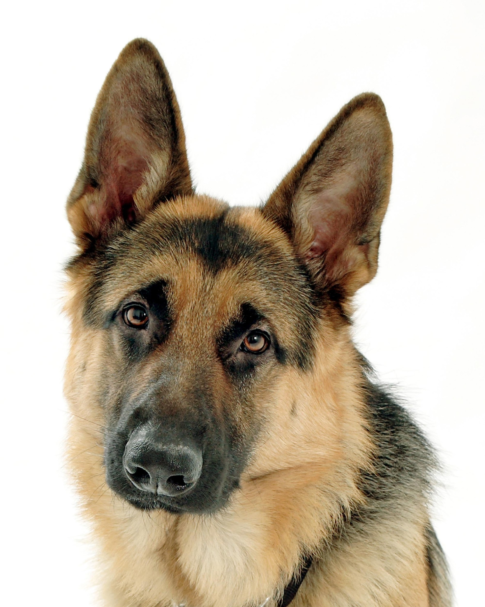
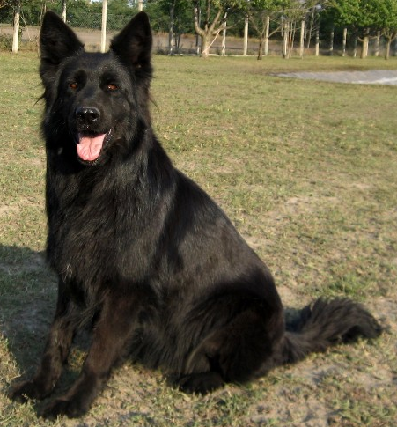
German Shepherd Dog
AKC Recognized Colors:
11 recognized colors (there is a wide variety)
AKC Recognized Markings:
No recognized markings
GSD originated in Germany to herd sheep
Large size (50-90lbs) and a medium energy level
Today, this breed is often used for police work, disability services, search-and-rescue, and military work.

Slide 12
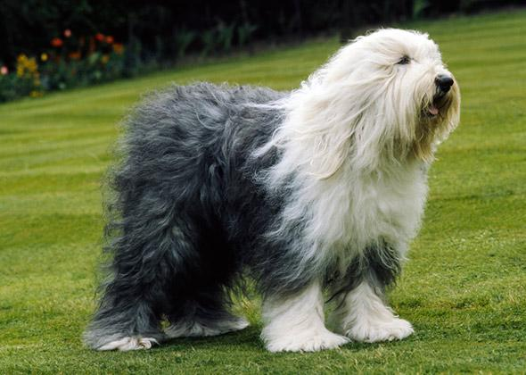
Old English Sheepdog

Slide 13
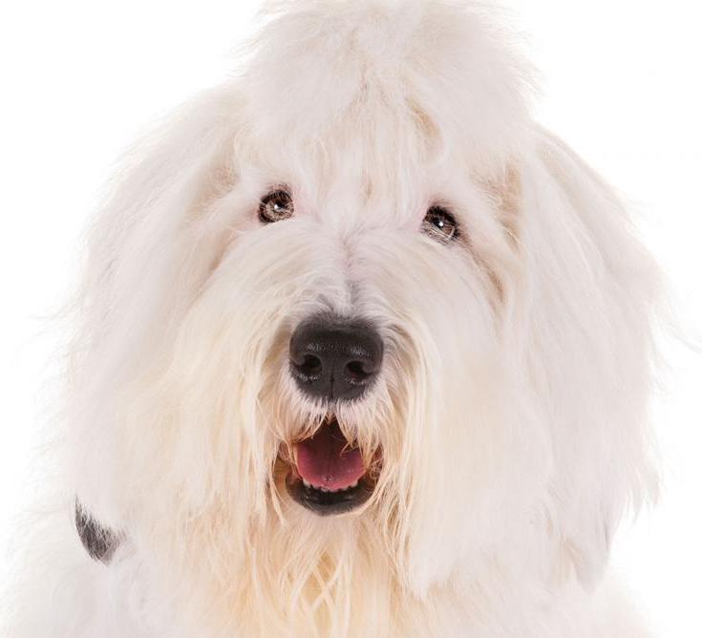
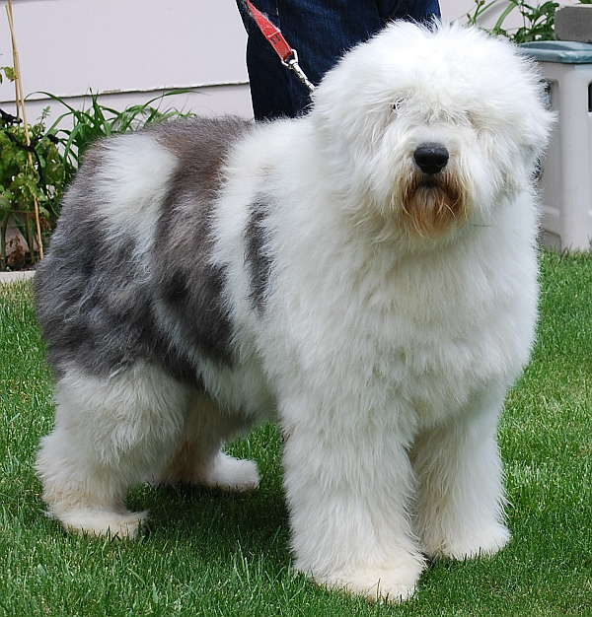
Old English Sheepdog
AKC Recognized Colors:
Blue and white
Blue grey & white
Blue merle & white
Grey and white
Grizzle & white
AKC Recognized Markings:
No recognized markings
Developed in England
Large size (60-100lbs) and medium energy level
This breed helped farmers drive cattle and sheep to the market
Long, shaggy coat

Slide 14
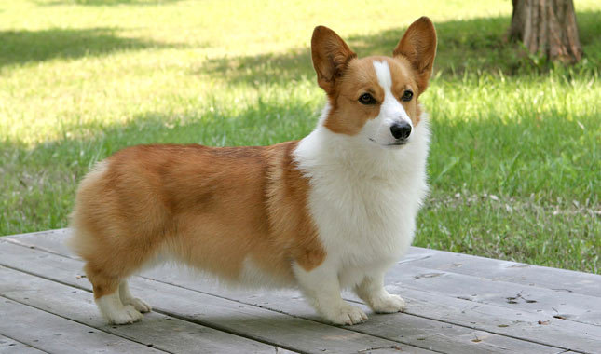
Pembroke Welsh Corgi

Slide 15
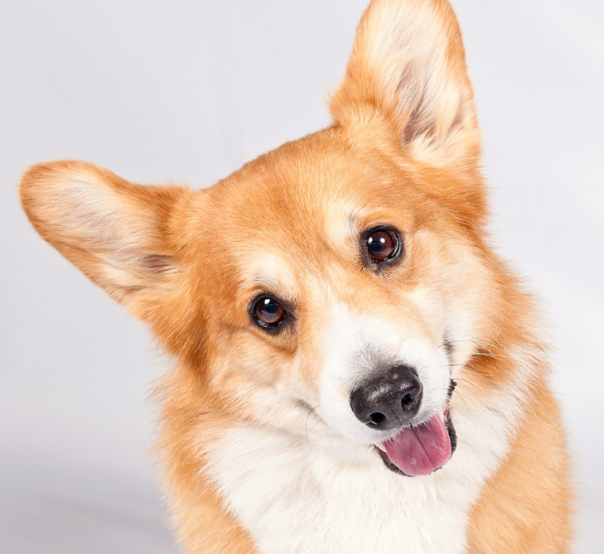
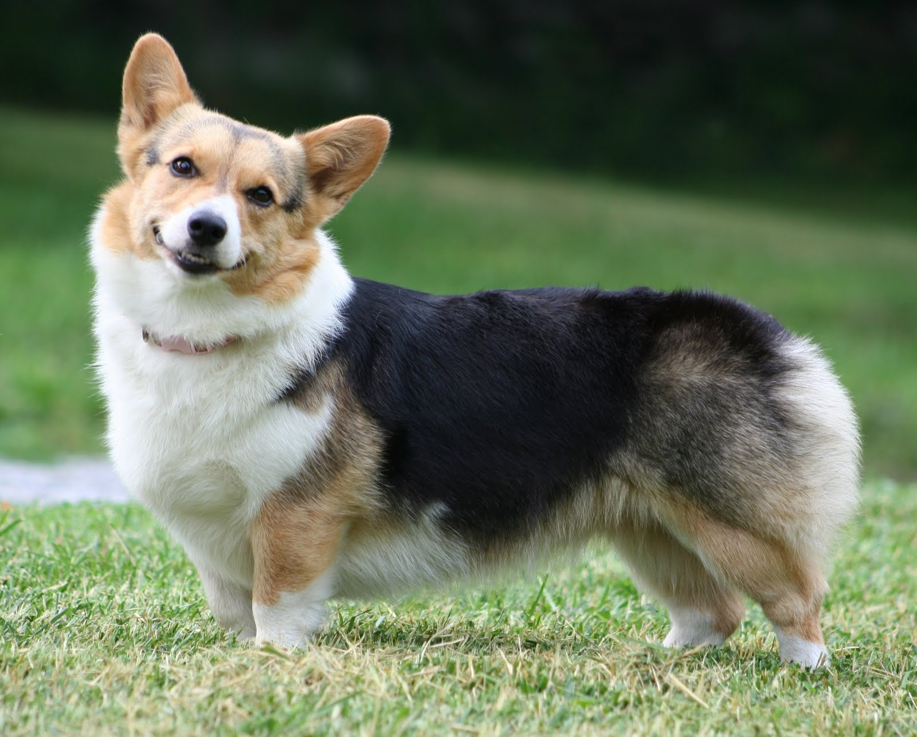
Pembroke Welsh Corgi
AKC Recognized Colors:
Black and tan
Fawn
Red
Sable
AKC Recognized Markings:
White
Originated in Wales (British decedents of Viking dogs)
Medium energy and size (25-30lbs)
Were used for herding cattle and sheep
Long body with short legs and big, erect ears (being low to the ground was an advantage when the cows would kick at the dogs!)

Slide 16
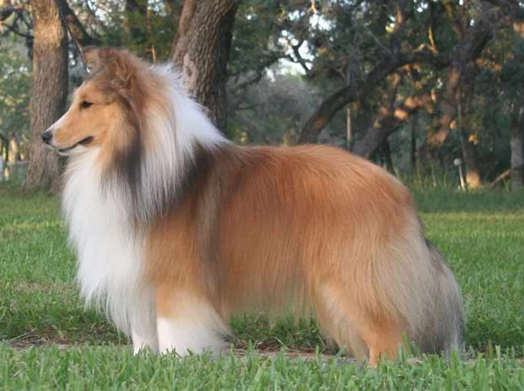
Shetland Sheepdog

Slide 17
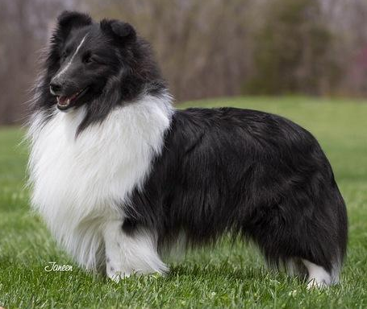
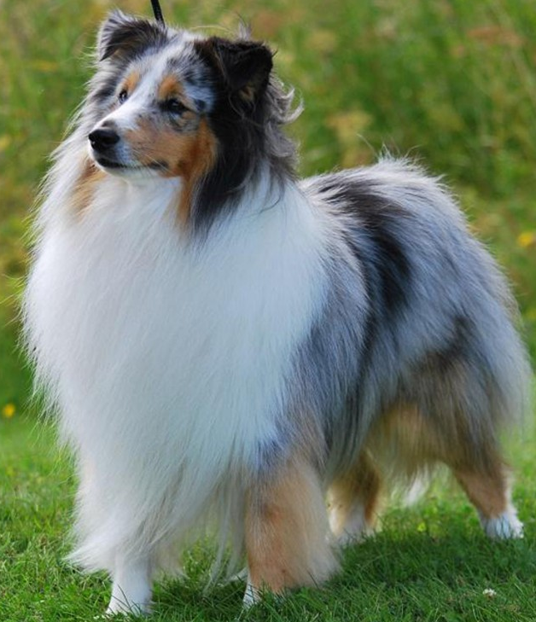
Shetland Sheepdog
AKC Recognized Colors:
Black & white
Black, white & tan
Blue merle & white
Blue merle, white, & tan
Sable & white
Sable, merle, & white
AKC Recognized Markings:
None
Shelties originated on the Shetland Islands to herd sheep
They are medium sized (<30lbs)
Pedigree is not well known, but likely a descendent of the Scottish Collie and the King Charles Spaniel
Notes:
Not a miniature collie, it is recognized as its own breed.

Slide 18
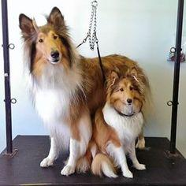
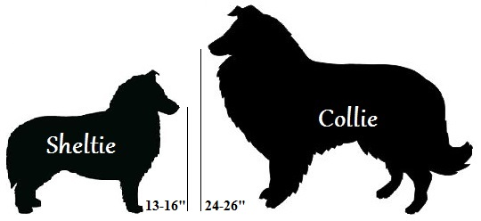
Sheltie vs. Collie
Shelties are NOT miniature Collies, they are their own breed
Example: the head shape is different (Shelties have a slight elevation at the forehead, where Collies do not have this elevation)

Slide 19
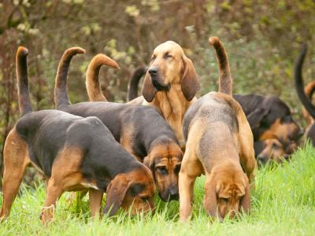
Hound Group:
Most breeds in this group are used for hunting, so many of these breeds have acute senses
Some make a distinct sound, called “baying”
Breeds under this group:
Afghan Hound
Basenji
Basset Hound
Beagle
Black and Tan Coonhound
Bloodhound
Dachshund
Greyhound
Rhodesian Ridgeback
Notes:
http://www.akc.org/dog-breeds/groups/herding/

Slide 20
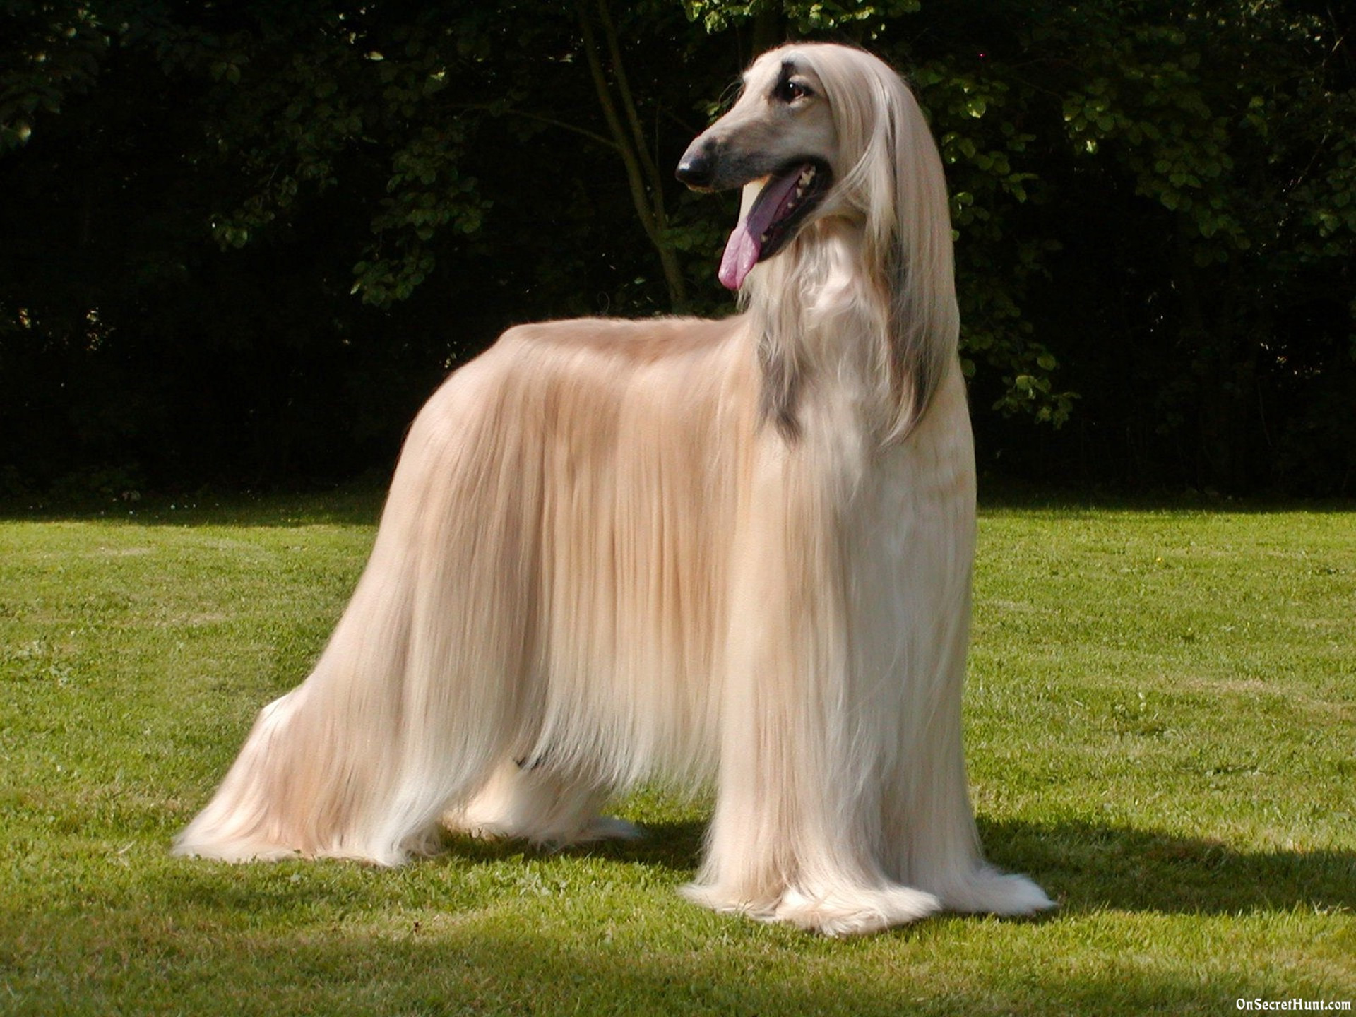
Afghan Hound

Slide 21
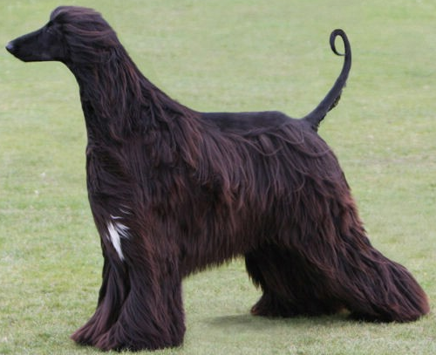
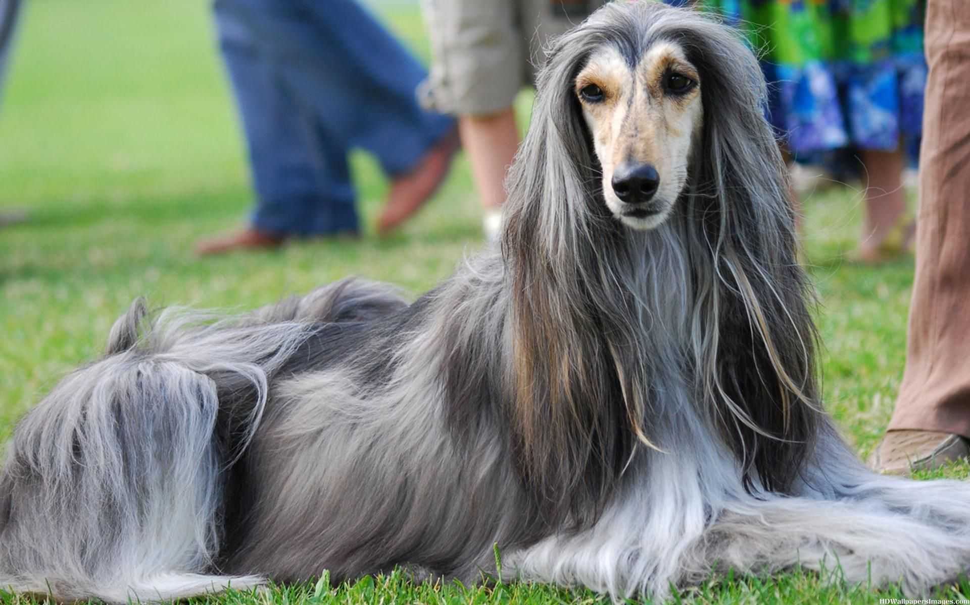
Afghan Hound
AKC Recognized Colors:
9 recognized colors (there is a wide variety)
AKC Recognized Markings:
5 recognized markings
As the name suggests, the Afghan hound originated from Afghanistan
Thick, fine, silky coat with a tail that has a curl at the end
No longer used for hunting, but was used by Afghan tribes to hunt gazelles

Slide 22
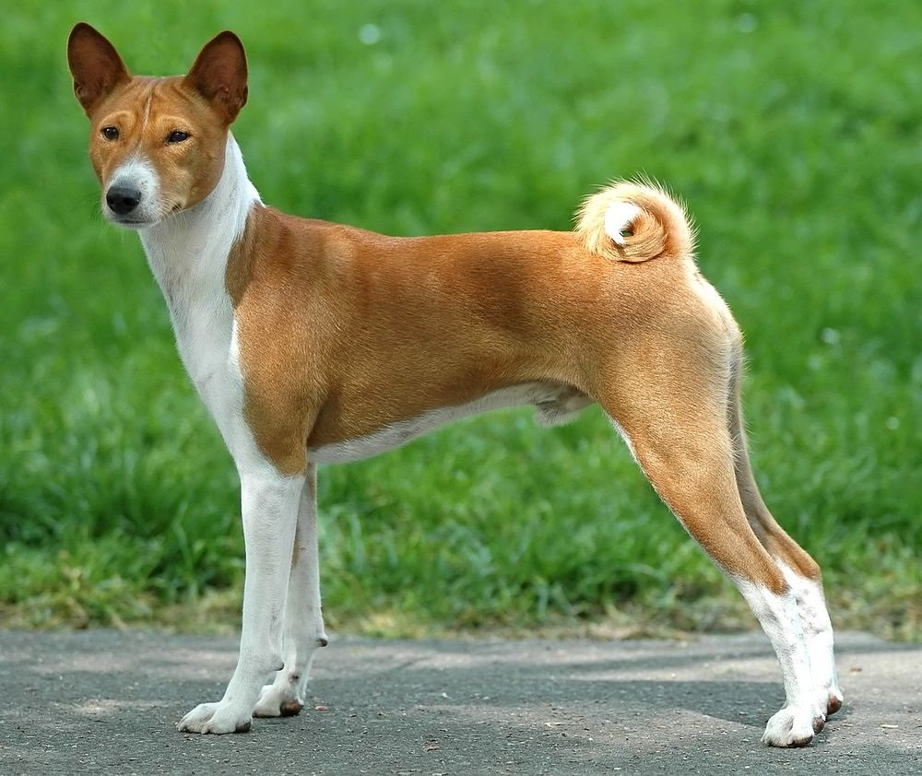
Basenji

Slide 23
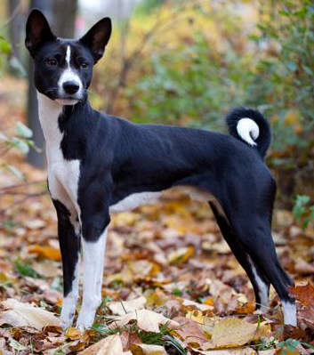
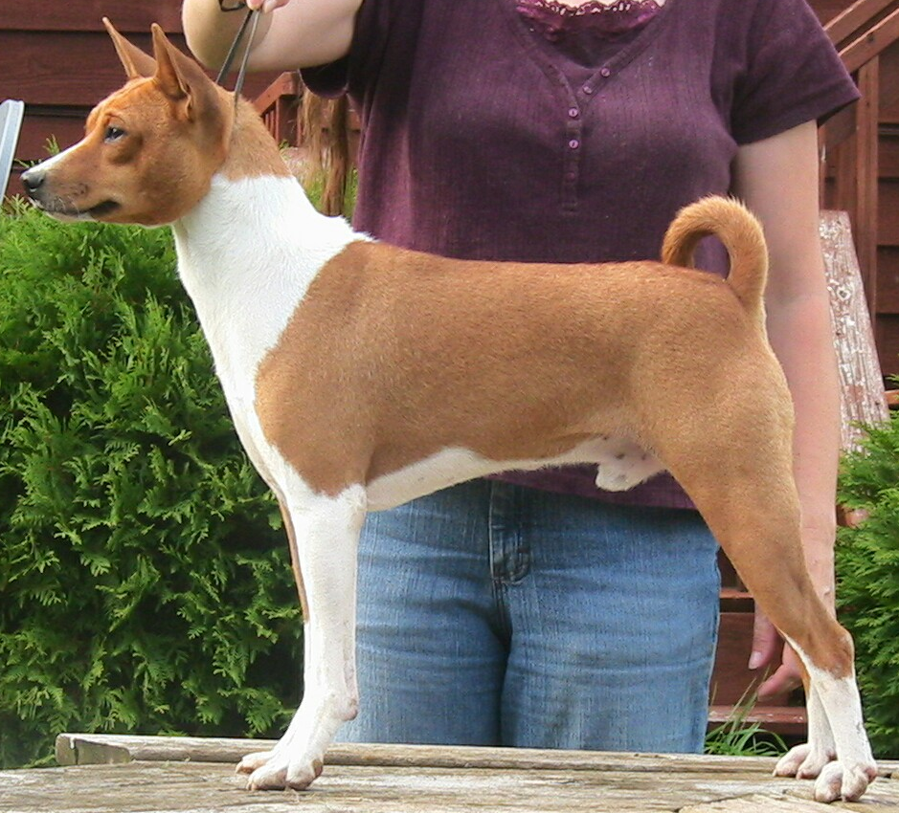
Basenji
AKC Recognized Colors:
Black & white
Black, tan, & white
Brindle & white
Red & white
AKC Recognized Markings:
Brindle
Modern breed originated in central Africa
This breeds job is to find large game and flush it out into nets
Large, erect ears and tail is curled onto their back

Slide 24
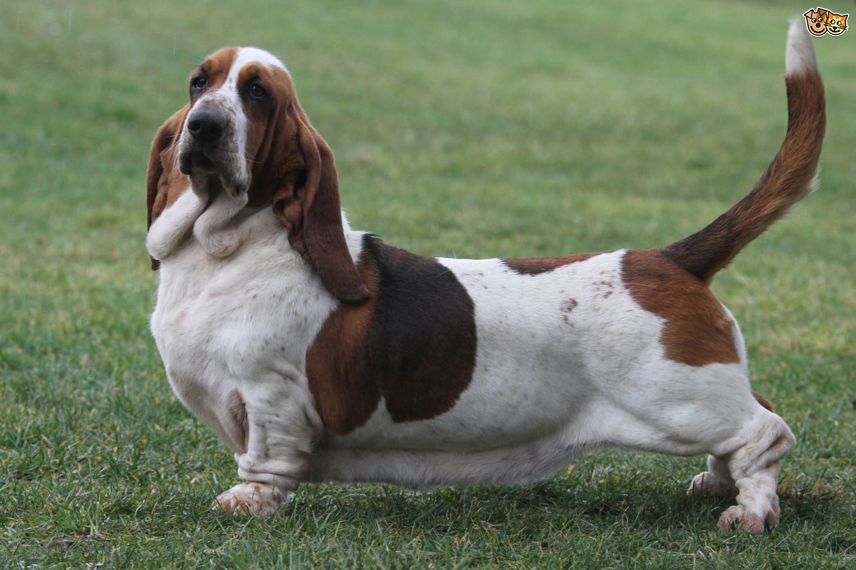
Basset Hound

Slide 25
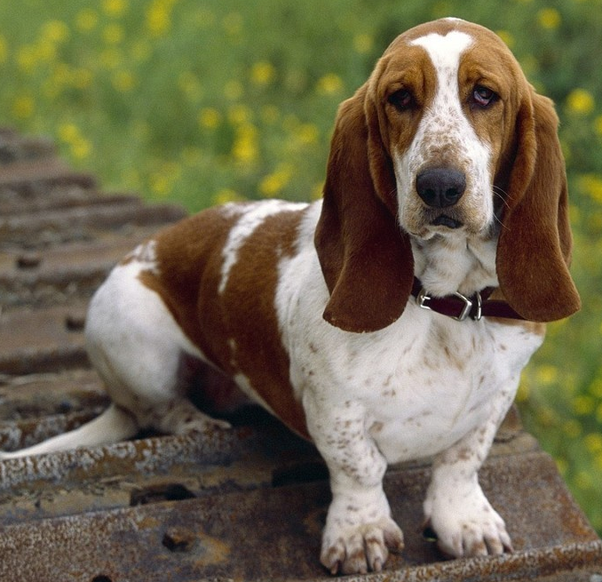
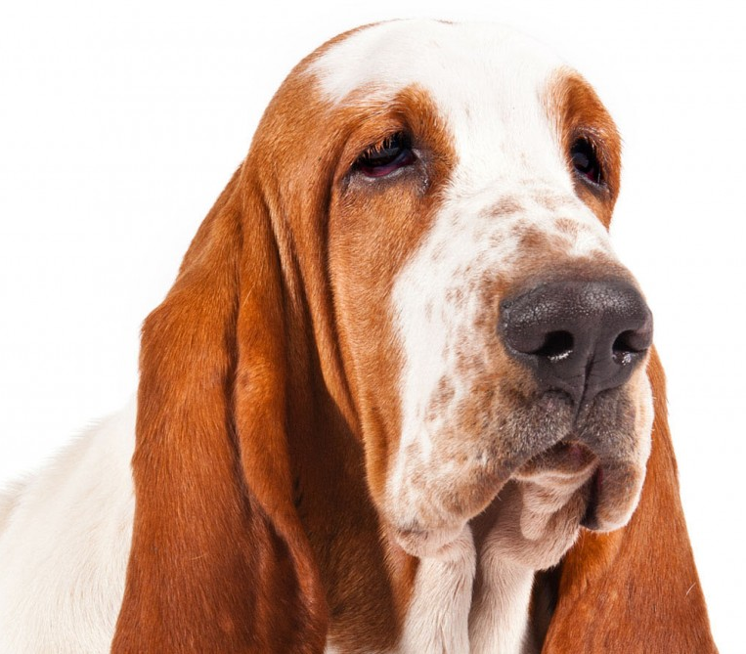
Basset Hound
AKC Recognized Colors:
9 recognized colors (all have at least some white)
AKC Recognized Markings:
None
Basset hounds originated in France
They have a long body and ears with short legs
Powerful scenting ability
Used for small game and people that hunt on their feet (as apposed to on horseback)

Slide 26
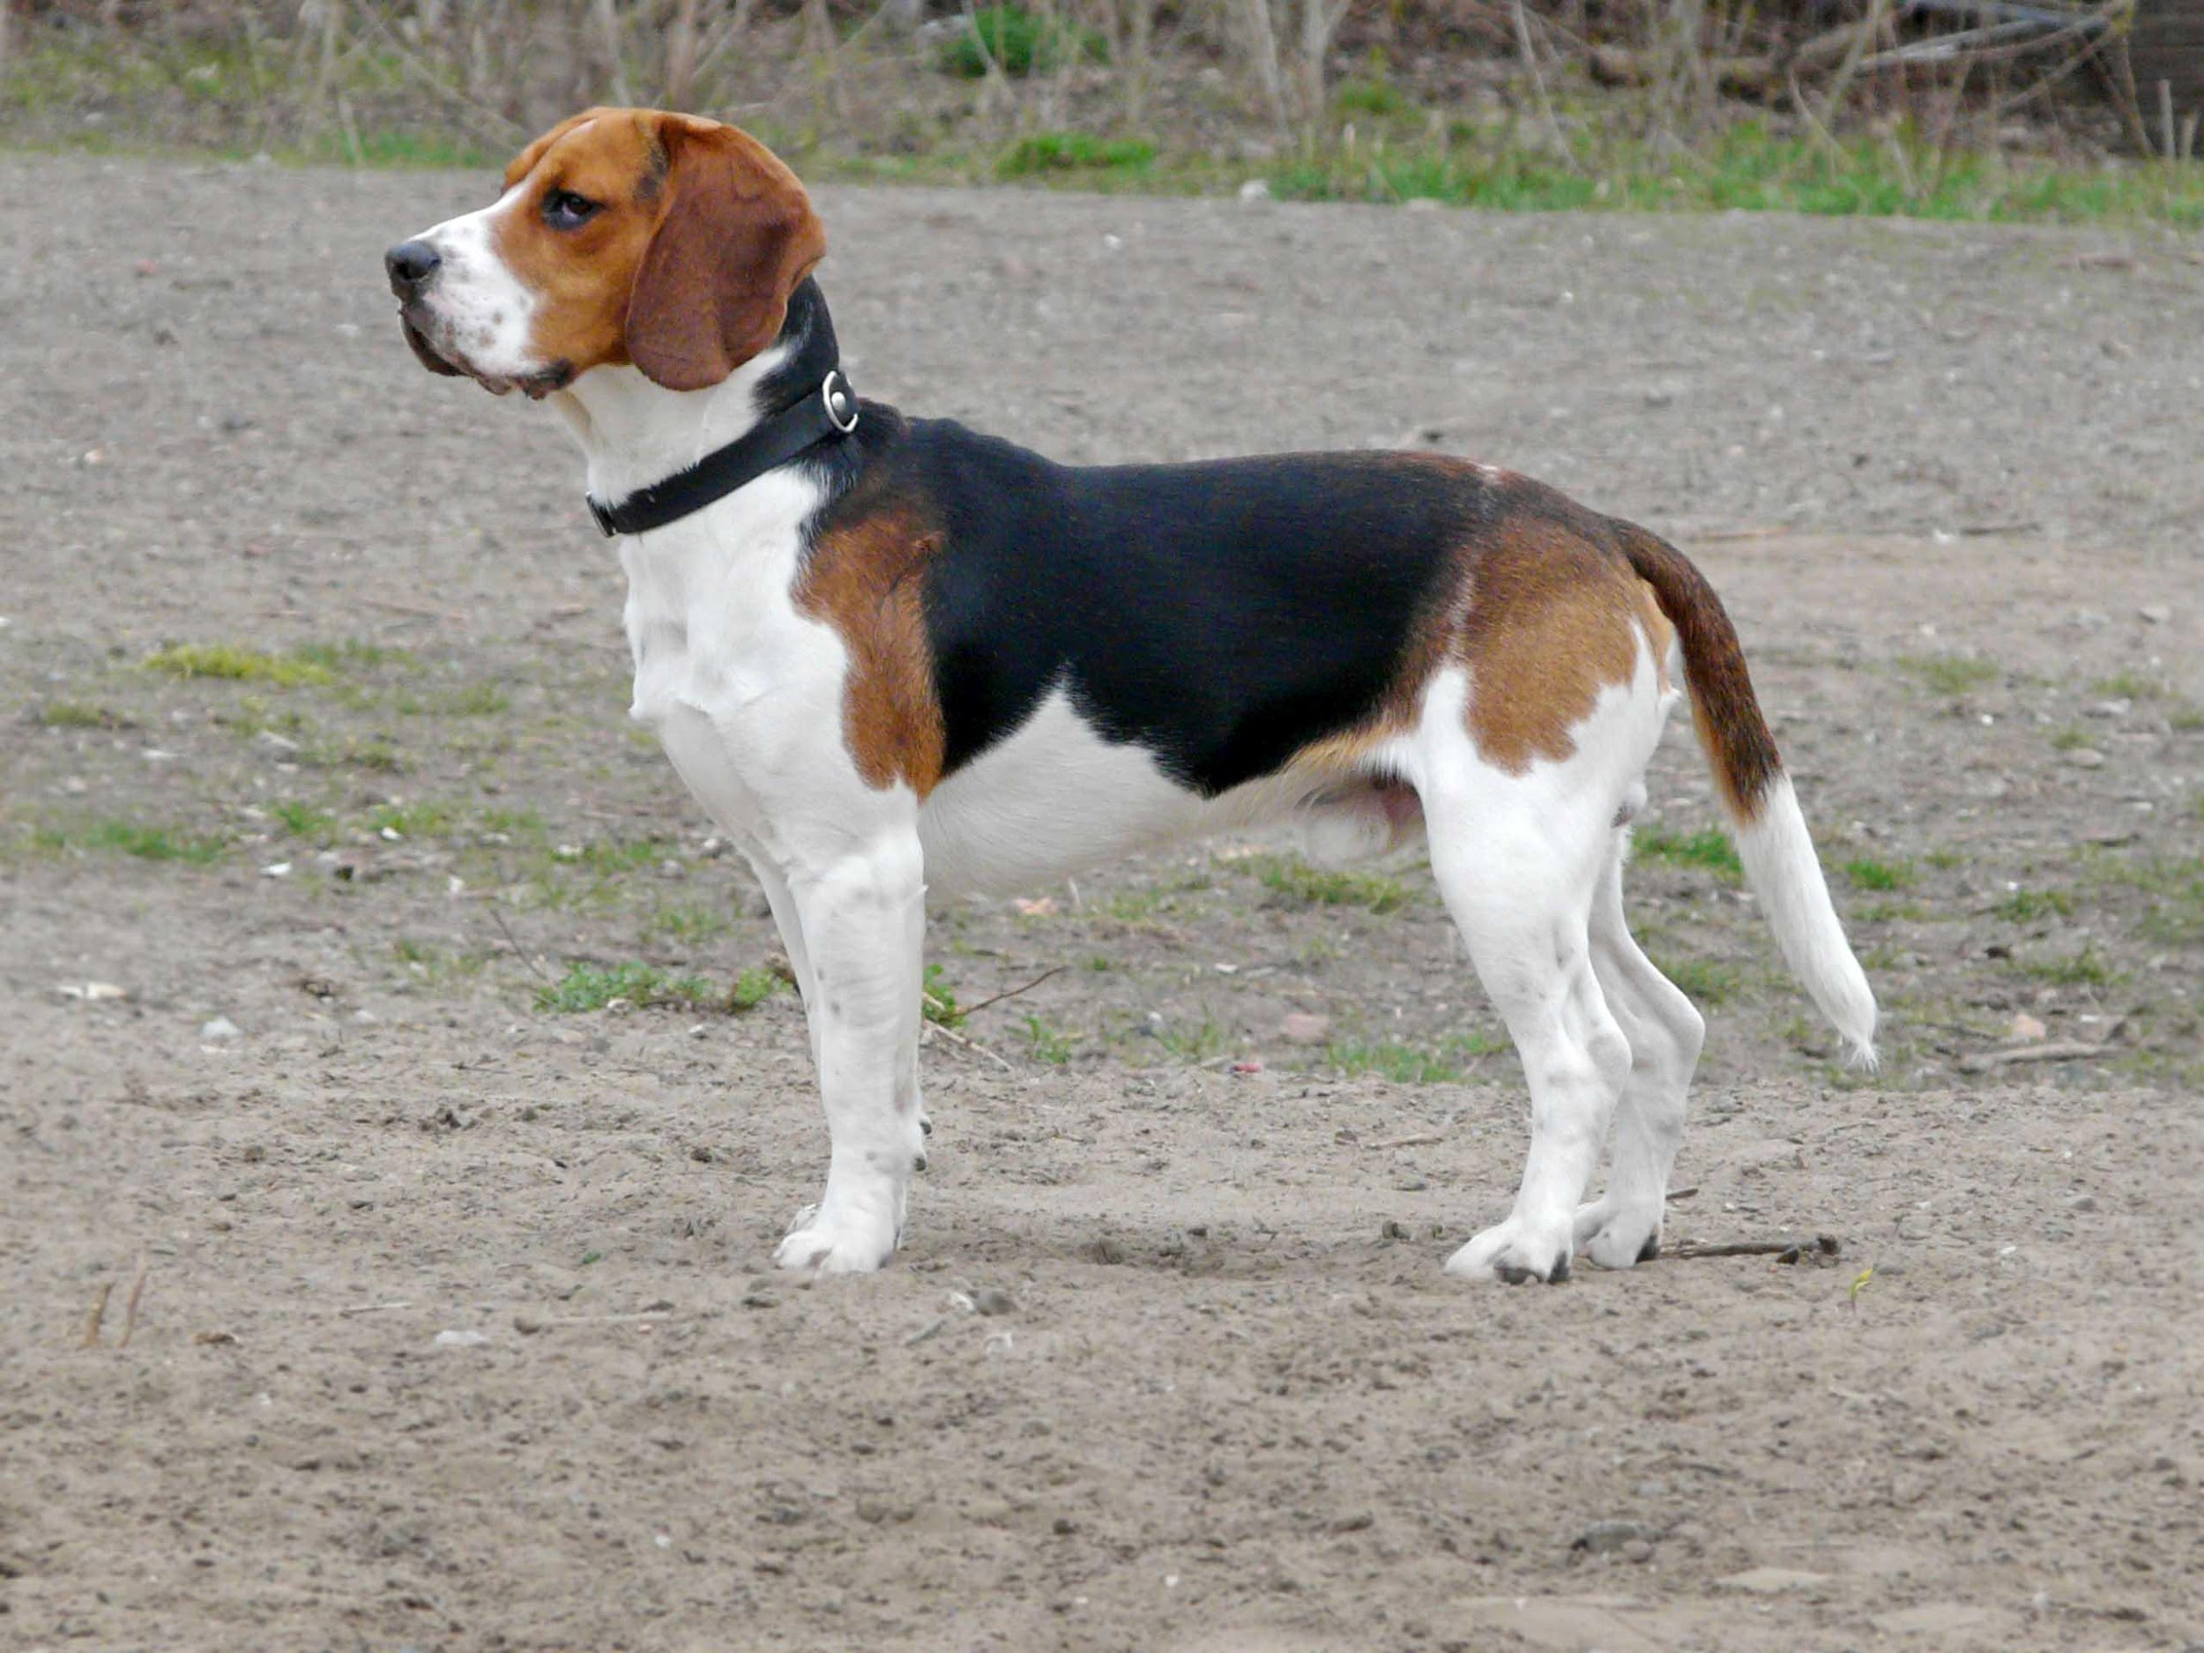
Beagle

Slide 27
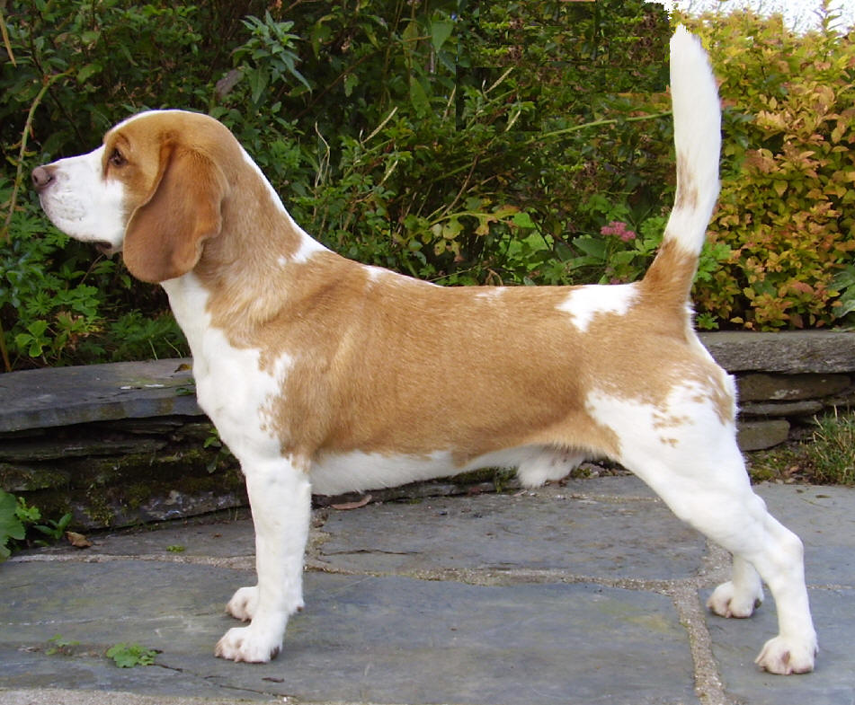
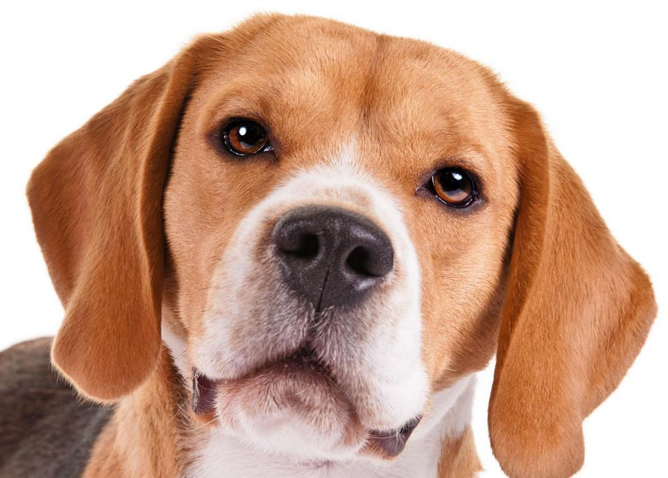
Beagle
AKC Recognized Colors:
11 recognized colors (there is a wide variety)
AKC Recognized Markings:
Ticked
Originated in England to hunt deer and hare (rabbits)
Scent hounds (use their nose to hunt)
Often bay when the catch scent of game

Slide 28
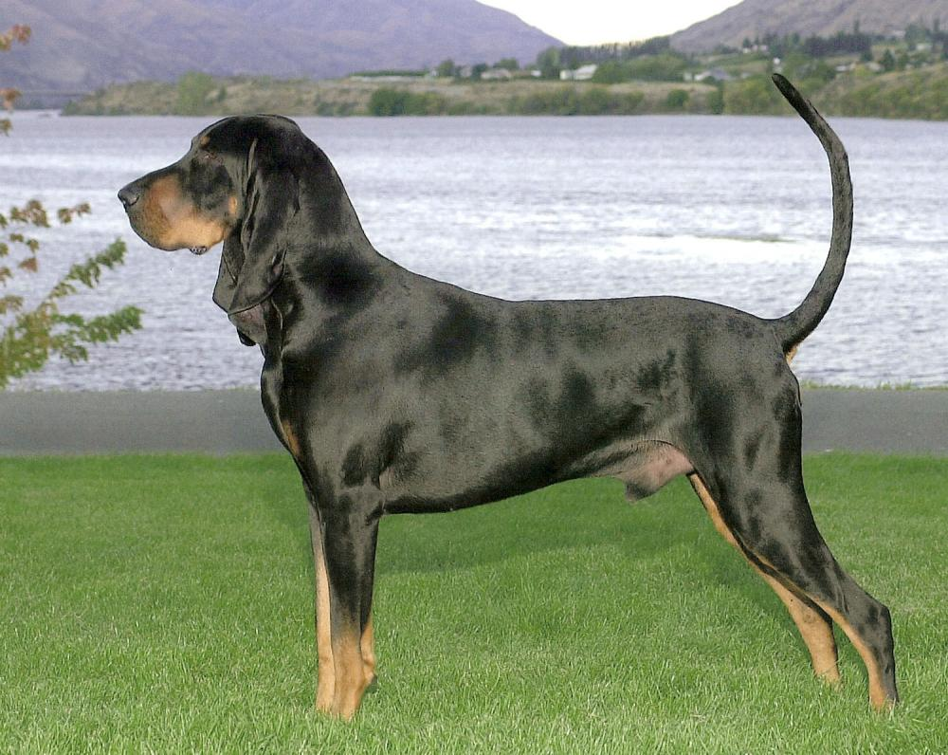
Black and Tan Coonhound

Slide 29
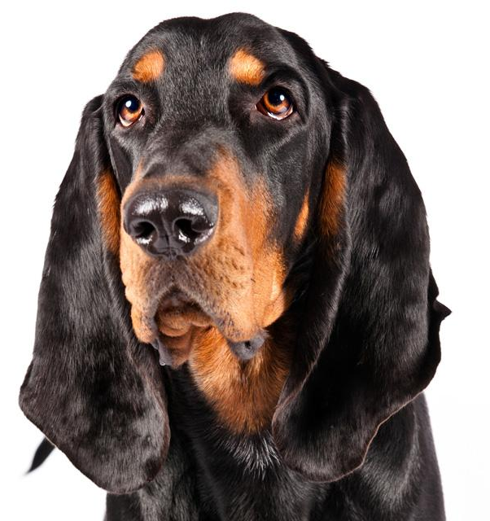
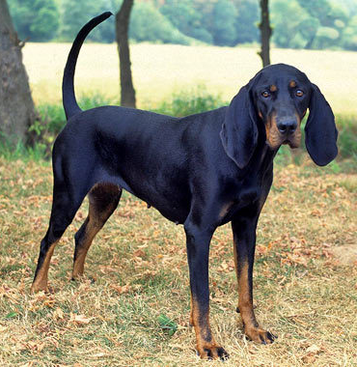
Black and Tan Coonhound
AKC Recognized Colors:
Black and tan
AKC Recognized Markings:
None
Originated in Southern America
Long ears with black and tan coat
Very good at following scent (scent hound)
Often used for trailing and treeing raccoons (like the name suggests)

Slide 30
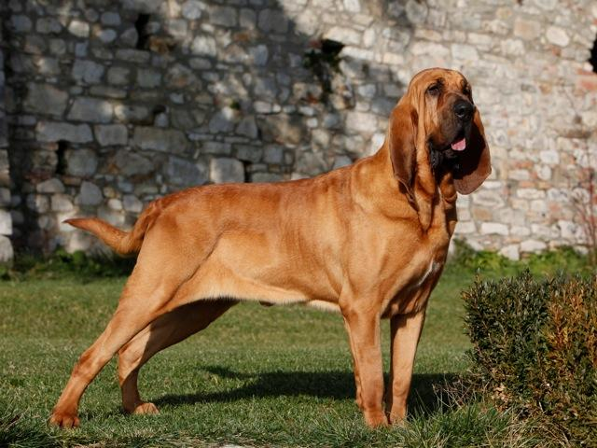
Bloodhound

Slide 31
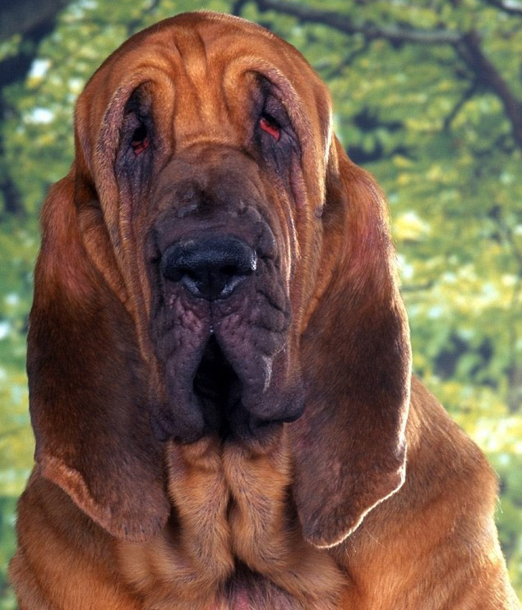
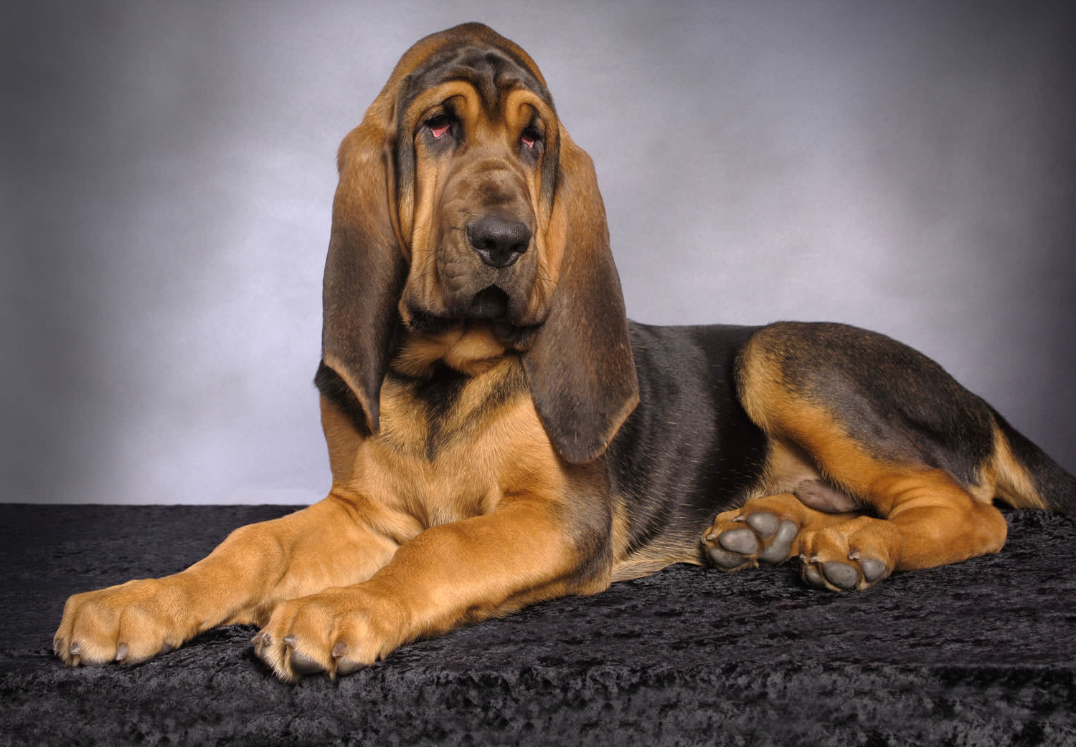
Bloodhound
AKC Recognized Colors:
Black and tan
Liver and tan
Red
AKC Recognized Markings:
None
Originated in France and is the largest scent hound
Originally used to hunt deer and wild boar, and to track people
Large, loose jowls, large snout, and long ears

Slide 32
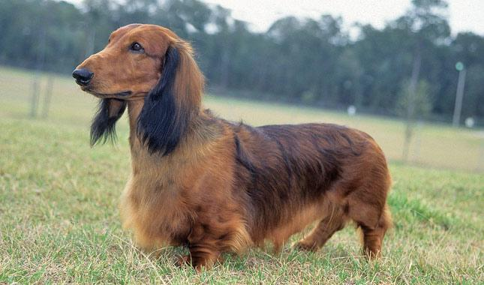
Dachshund

Slide 33
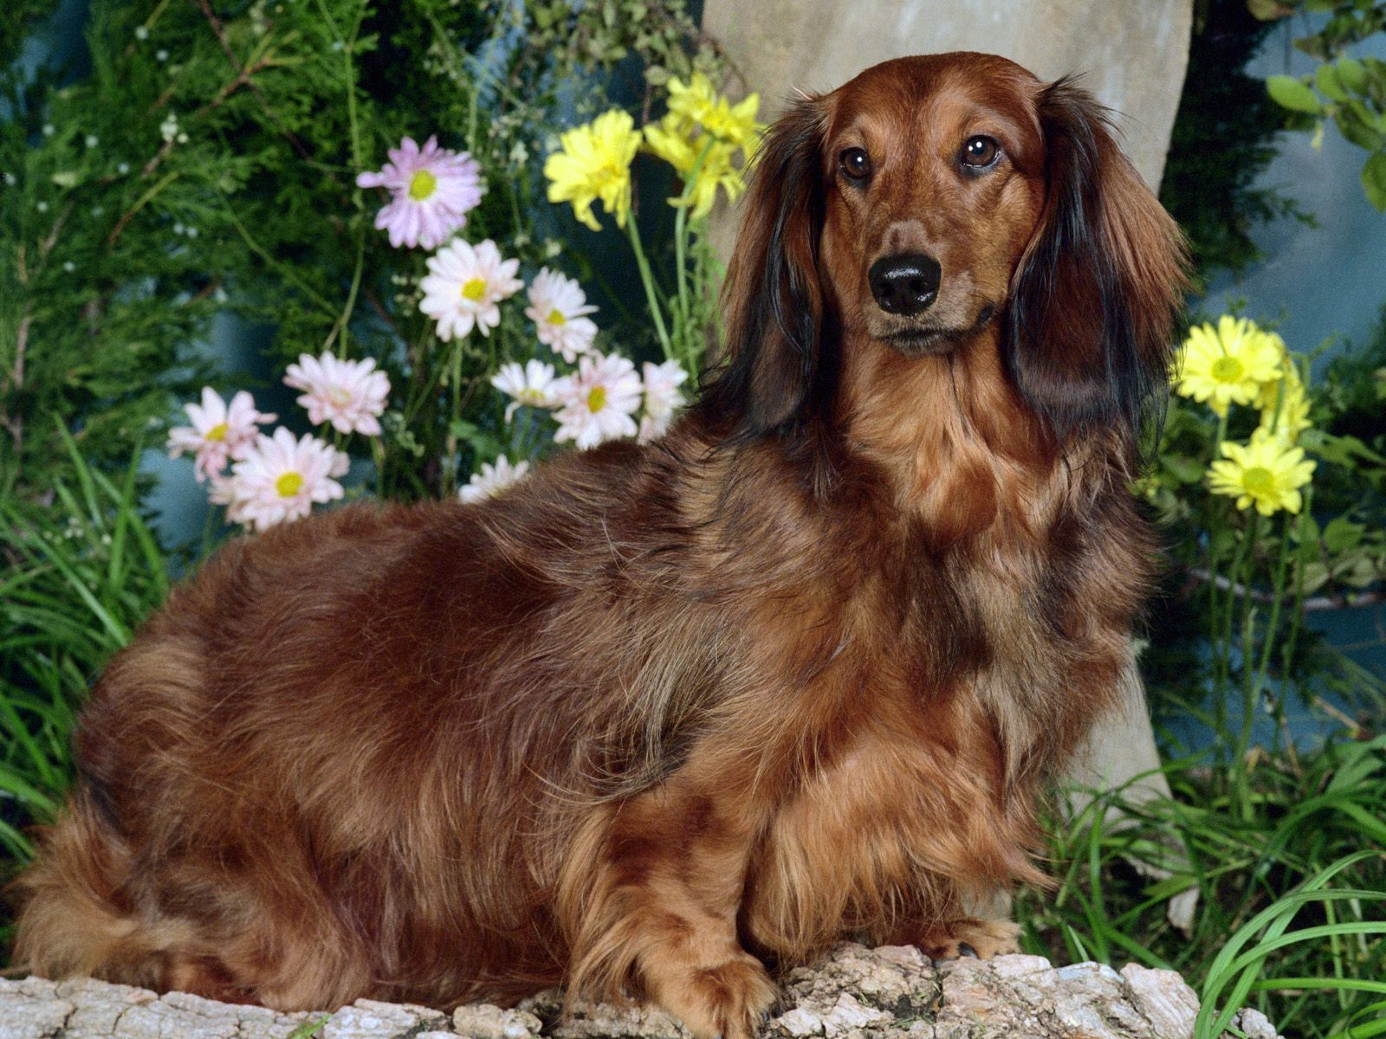
Dachshund
AKC Recognized Colors:
12 recognized colors (there is a wide variety)
AKC Recognized Markings:
Brindle
Dapple
Sable
“Weiner dogs” or Doxins originated in Germany
They have long bodies and ears, short legs, and can have either a long or short coat
Used to hunt many species, including otters, rabbits, badgers, and other burrowing pests
Good scenting ability and loves to dig

Slide 34
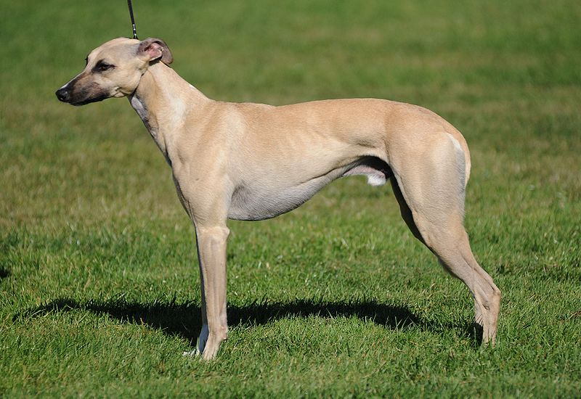
Greyhound

Slide 35
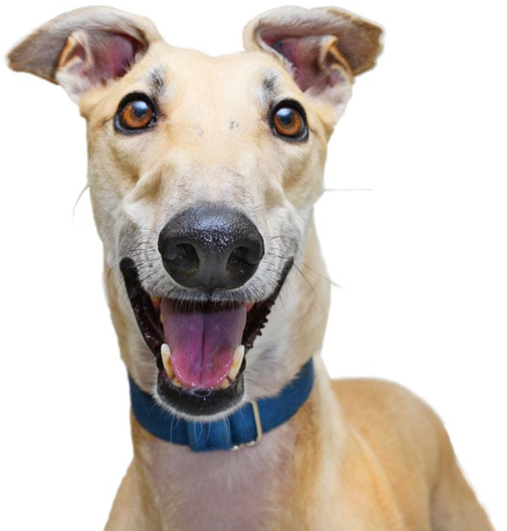
Greyhound
AKC Recognized Colors:
15 recognized colors (there is a wide variety)
AKC Recognized Markings:
Black mask
Parti-color
Solid
Ticked
One of the oldest breeds
Very lean bodies and fast (often used for dog racing)
Sight hounds (use their sight to hunt)
Used to hunt rabbits (mainly), wild boar, stag, deer, and fox

Slide 36
Rhodesian Ridgeback

Slide 37
Rhodesian Ridgeback
AKC Recognized Colors:
9 recognized colors (all variety of wheaten)
AKC Recognized Markings:
None
Developed in Rhodesia (now called Zimbabwe)
Distinctive hair pattern (creating a ridge on its back)
Used to distract lions, allowing hunters to shoot
Also used as bird dogs and guard dogs for livestock and family

Slide 38
Non-Sporting Group:
This group varies drastically in size, coat, temperament, and appearance
Kind of a “Miscellaneous” grouping of breeds
Breeds under this group:
Bichon Frise
Boston Terrier
Bulldog
Chinese Shar-Pei
Chow Chow
Dalmatian
Poodle
Notes:
http://www.akc.org/dog-breeds/groups/herding/

Slide 39
Bichon Frise

Slide 40
Bichon Frise
AKC Recognized Colors:
White
White & apricot
White & buff
White & cream
AKC Recognized Markings:
None
Originated in France
Small size and charming personality
Were often used as circus dogs and street performers
Known for their fluffy white coat

Slide 41
Boston Terrier

Slide 42
Boston Terrier
AKC Recognized Colors:
Black & white
Black, brindle, & white
Brindle & white
Seal & white
Seal, brindle, & white
AKC Recognized Markings:
None
The “American Gentleman” originated in Boston, Massachusetts (America)
Little dogs with round heads, large and erect ears, and screw tails

