Slide 1
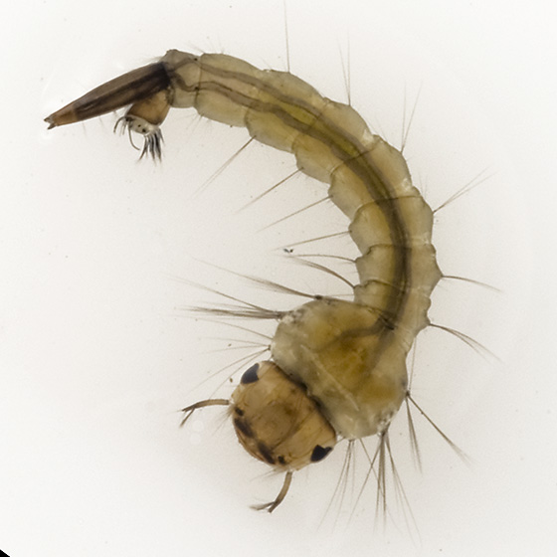
Mosquito Larva

Slide 2
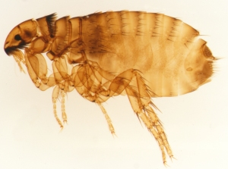
Flea

Slide 3
Ear mite

Slide 4
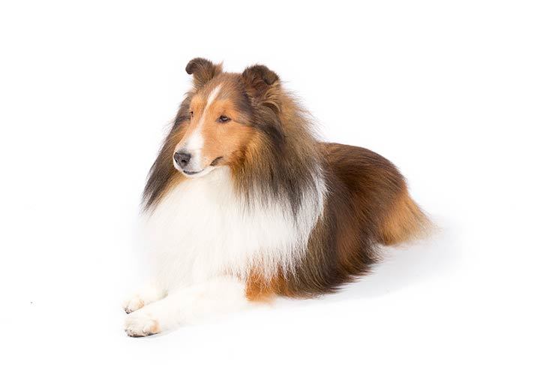
Shetland Sheep Dog

Slide 5
Angora Goat

Slide 6
Omasum

Slide 7
Spleen

Slide 8
Forceps — Alligator

Slide 9
Chemical indicator strips

Slide 10
Balling gun

