Slide 1
Horse Breeds
© Partnership for Environmental Education and Rural Health at
College of Veterinary Medicine & Biomedical Sciences, Texas A&M University
Funding support from the National Institutes of Health Office of Research Infrastructure Programs (ORIP)

Slide 2
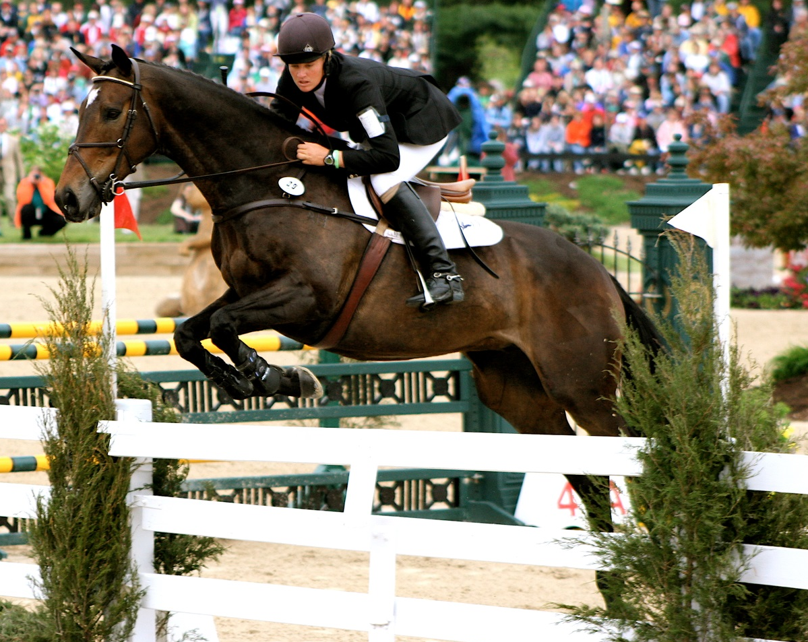
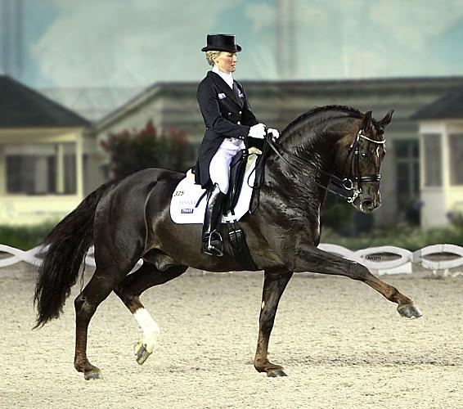
Light Horses:
The majority of riding horses are in this category (widely used for recreation and show)
Most breeds in this group range from 14.2-17.2hh
All breeds in this category originated from Arabian type horses
Two types:
Hot-blooded
Warm-blooded
Notes:
The students don’t have to identify which breeds are light horses, just be able to identify the breeds listed

Slide 3
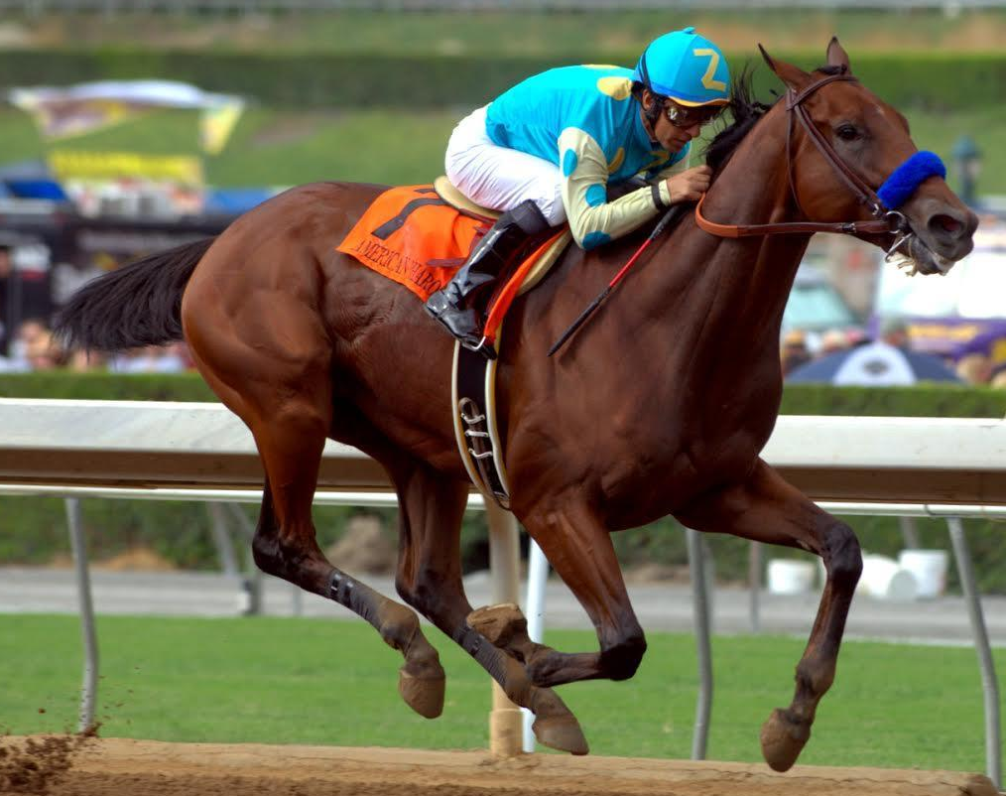
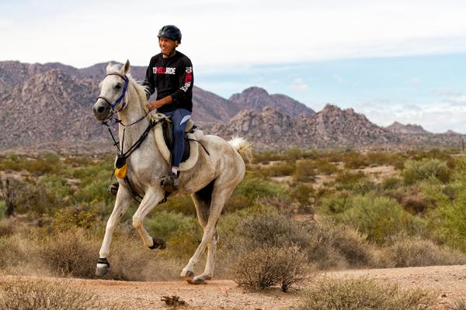
Hot-Blooded Horses
Breeds closest resembling Arab type horses
High strung and challenging temperament, fast, energetic, and strong
Often used for racing (endurance and speed)
Breeds under this group:
Arabian
Thoroughbred
Notes:
The students don’t need to differentiate between hot-blooded and warm-blooded horses, just identify the breeds

Slide 4
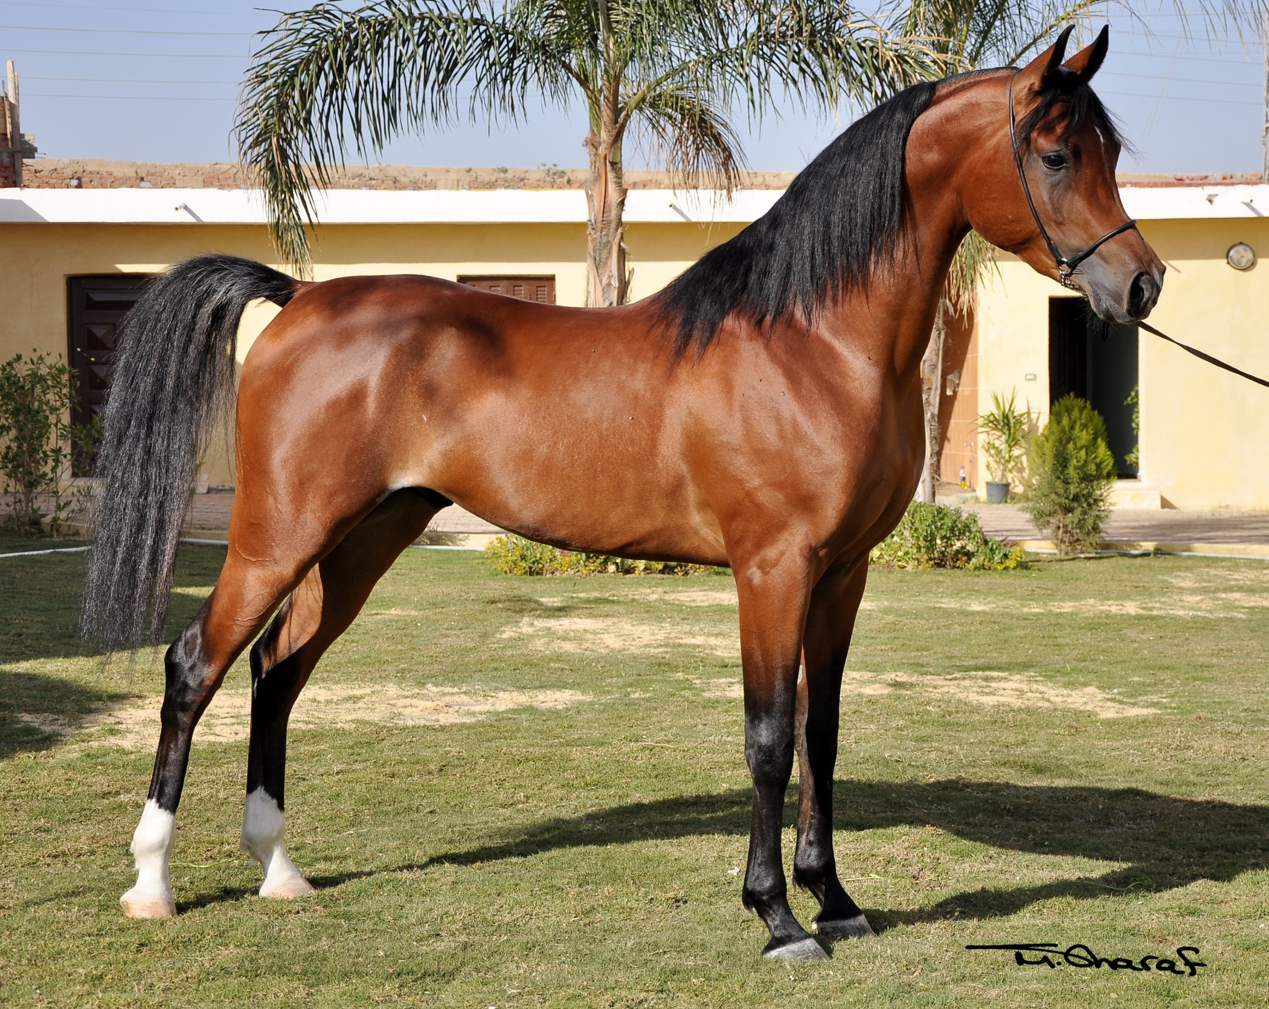
Arabian

Slide 5
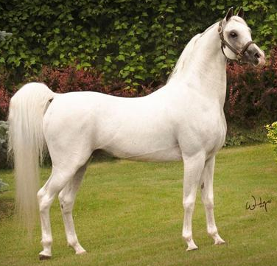
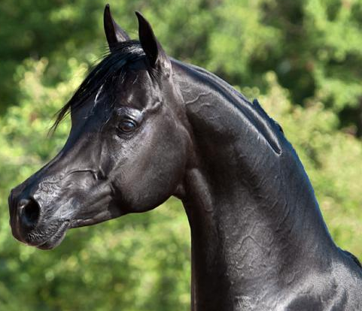
Arabian (Middle East)
Height: 14.0-15.3hh
Oldest breed on record with documented lineage
Can be chestnut, bay, gray, black, and roan
Often used for endurance racing (especially in the middle east)
Petite frame with a small, dished face. Tail has a high carriage. Short back (less vertebrae than other breeds) with a long, arching neck.

Slide 6
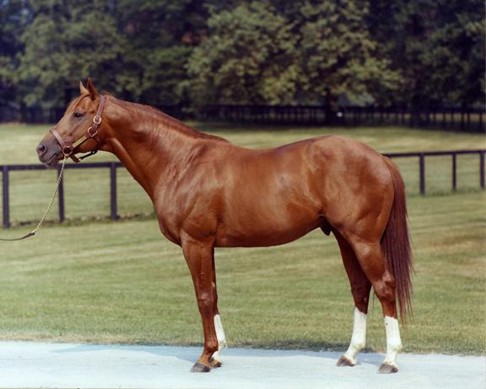
Trivia: can anyone name this famous racehorse?
Answer: Secretariat
Thoroughbred

Slide 7
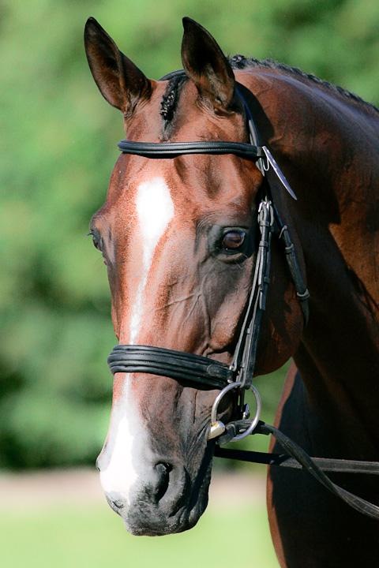
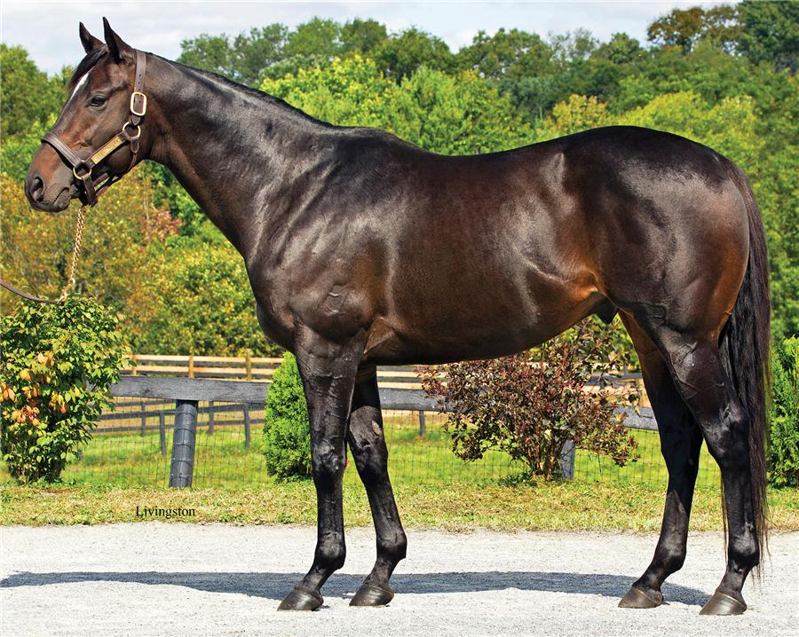
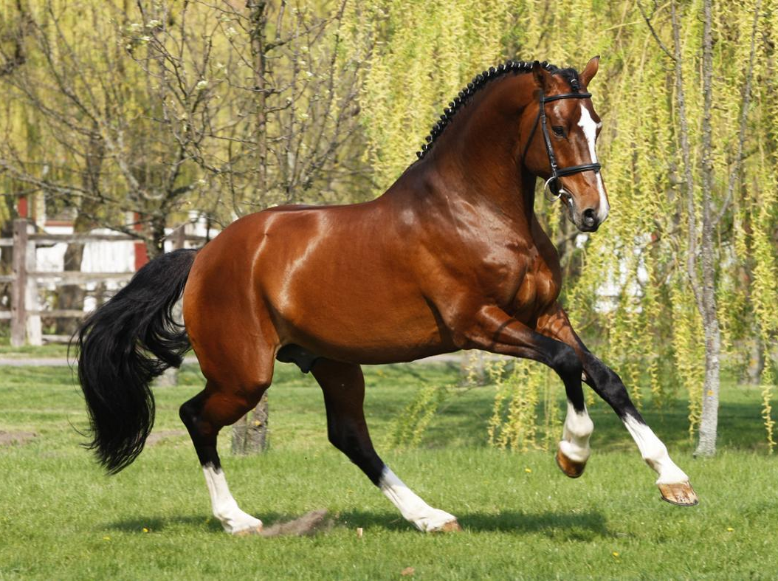
Thoroughbred (England)
Height: 15.3-17.0hh
Found in all solid colors (black is rare)
Developed for racing (track – middle distances)
Racing speeds around 40mph
Taller than the Arabian, but maintains fairly lean frame
Commonly used in many disciplines (ex. jumping, barrel racing, fox hunting, etc.)

Slide 8
Thoroughbred - Secretariat

Slide 9
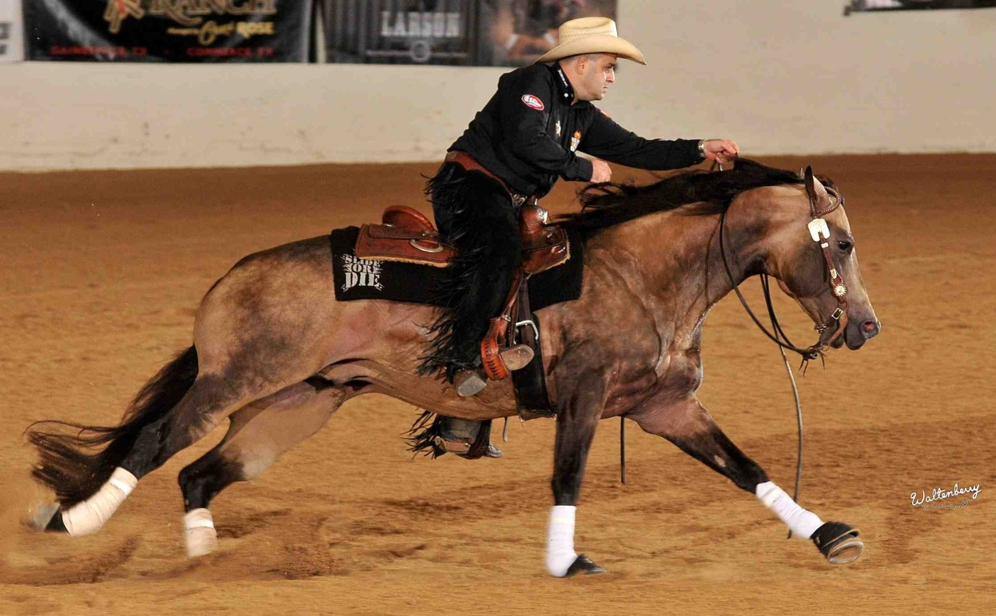
Warm-blooded Horses
Created when large, heavy war horses were crossed with the lighter/faster hot-blooded breeds
More mild temperament than hot-blooded horses and quicker/more agile than cold-blooded (draft) horses
Breeds under this group:
Appaloosa
Morgan
Paint Horse
Quarter Horse
Saddlebread
Tennessee Walking Horse
Notes:
The students don’t need to differentiate between hot-blooded and warm-blooded horses, just identify the breeds

Slide 10
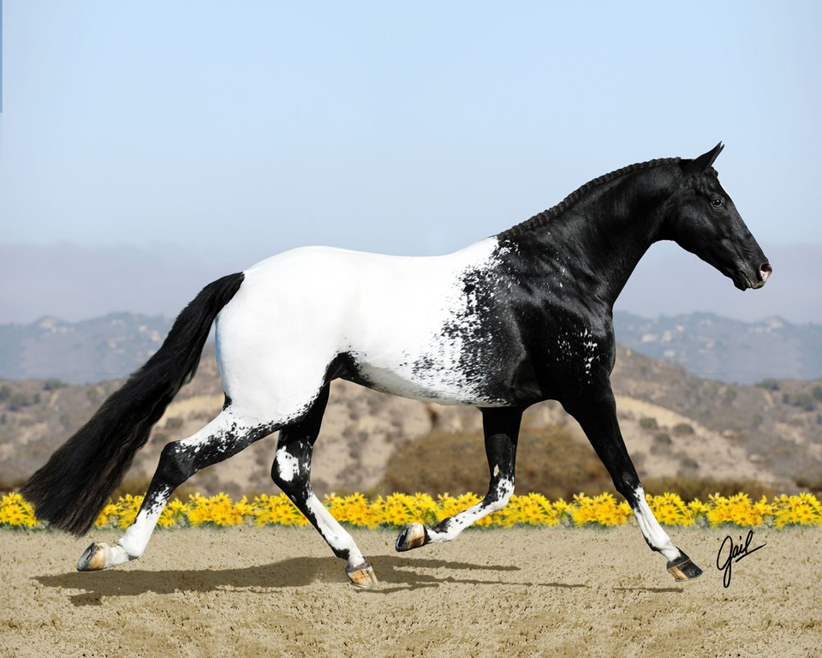
Appaloosa

Slide 11
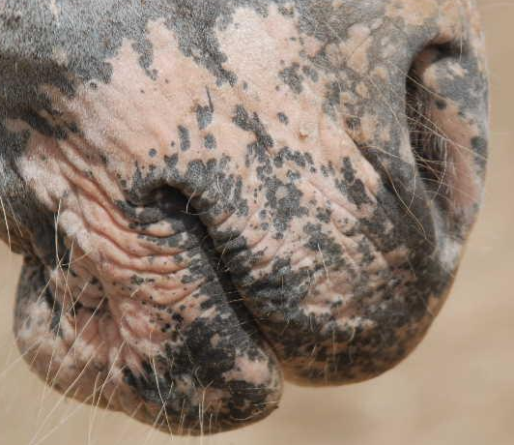
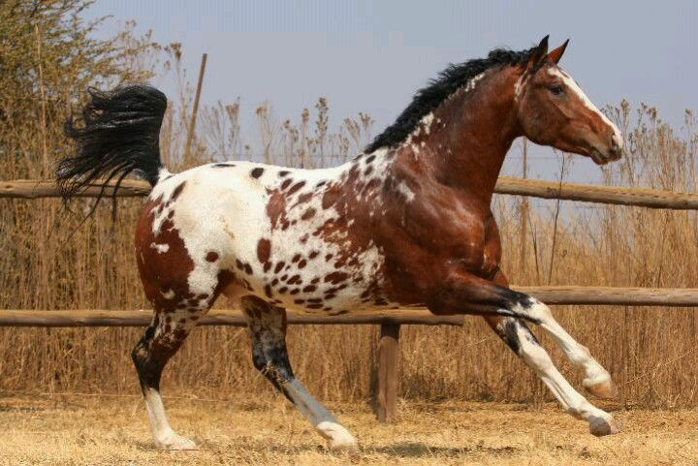
Appaloosa (USA – Native Americans)
Height: 14.2-16.0hh
Known for its spotted pattern (different than paint)
Mottled skin around the muzzle, eyes, and genitals
White sclera (membrane around the eyes)
Vertical light and dark stripes on hoofs

Slide 12
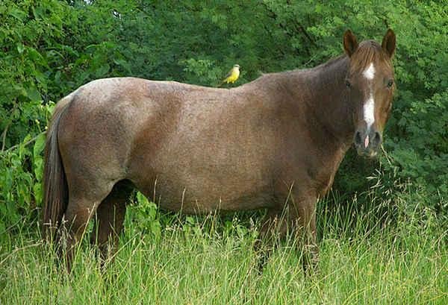
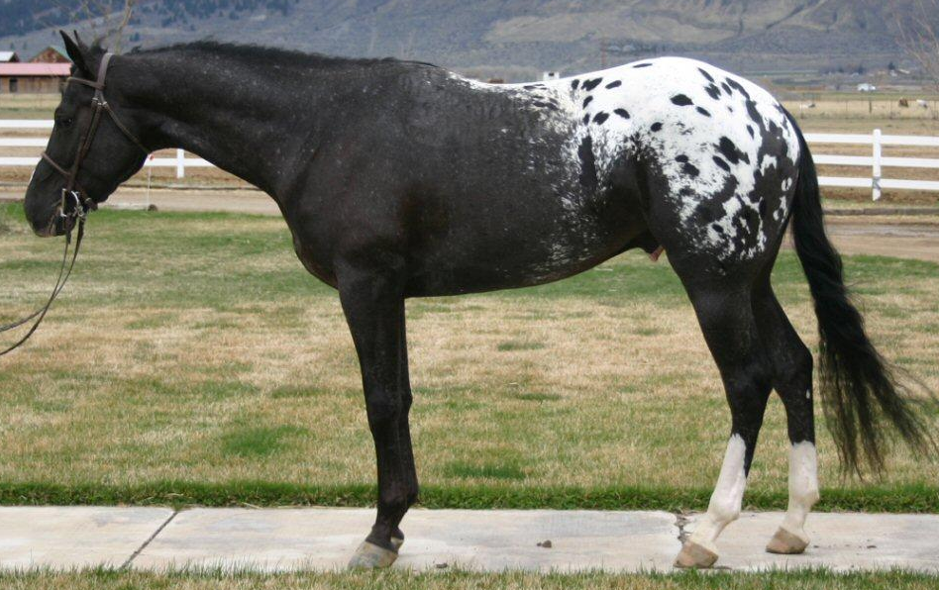
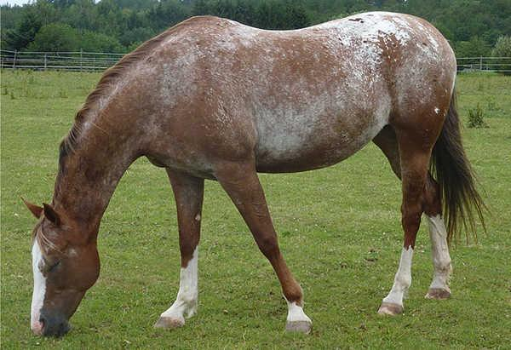
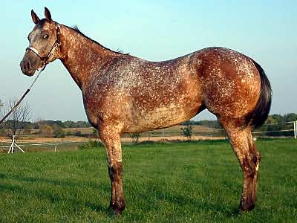
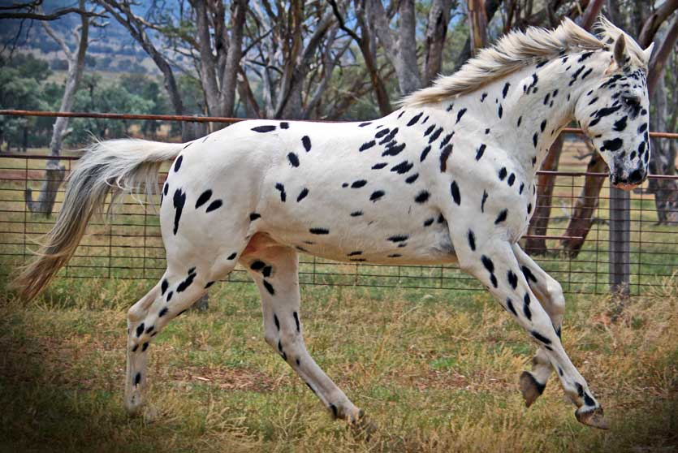
5 Appaloosa Coat Patterns:
Frost
Blanket
Marble
Snowflake
Leopard
Notes:
The students don’t need to differentiate between these coat patterns, just be able to identify all of these horses as Appaloosa’s. This slide is to help the students identify that there is a wide variety in the appaloosa coat pattern.

Slide 13
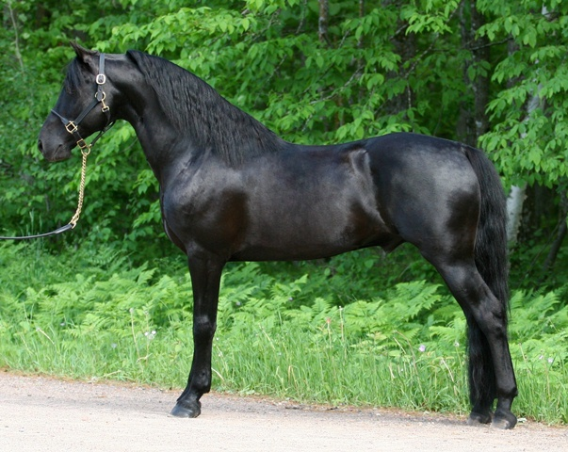
Morgan

Slide 14
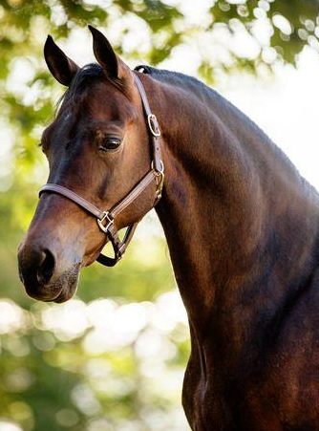
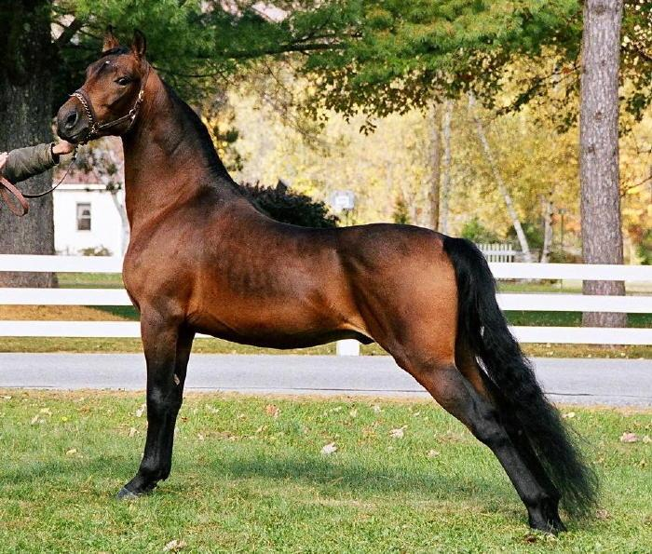
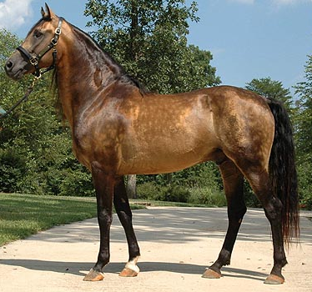
Morgan (USA)
Height: 14.1-15.2hh
All colors acceptable
Typically used for leisure/trail riding and showing
Short head with wide forehead
Strong, short back with a muscular neck

Slide 15
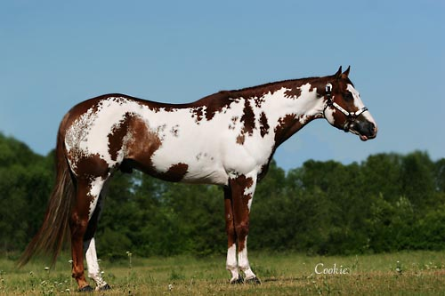
Paint

Slide 16
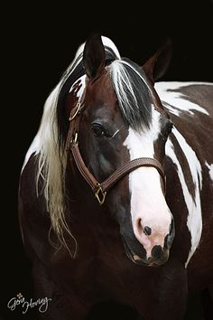
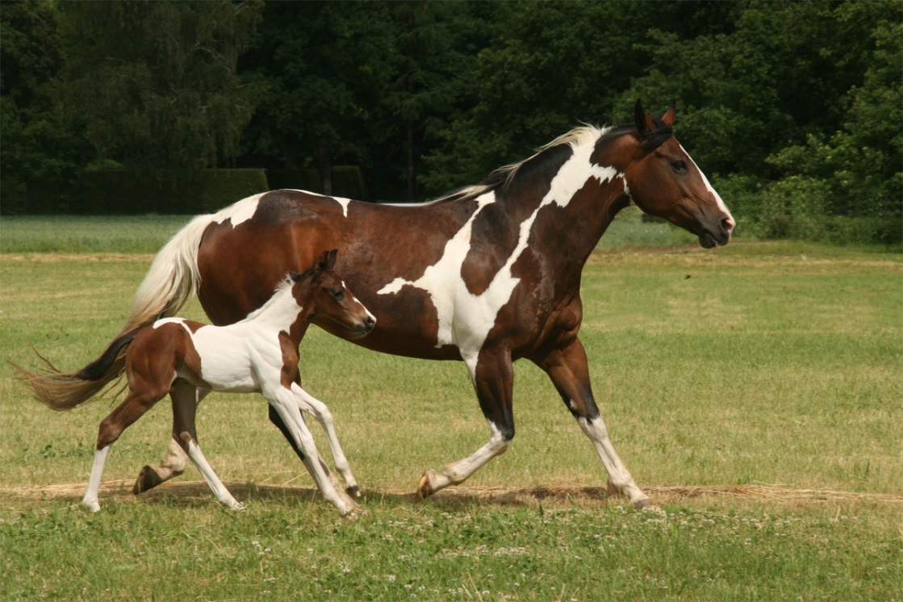
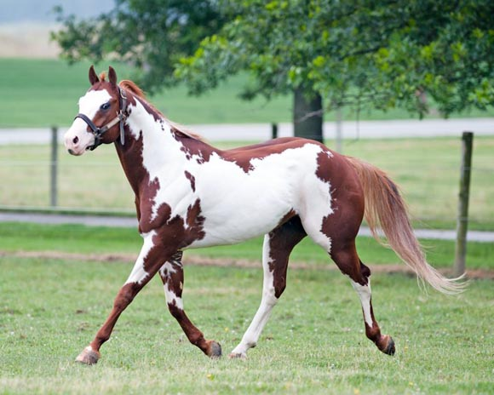
Paint (USA – Native Americans)
Height: 14.2-16.2hh
Typically used for leisure riding, trail riding, showing, and ranch work
This unique spotting pattern is a breed and also a color (therefore, other breeds can have this color)
Good cow-sense (but not as high as the Quarter horse)

Slide 17
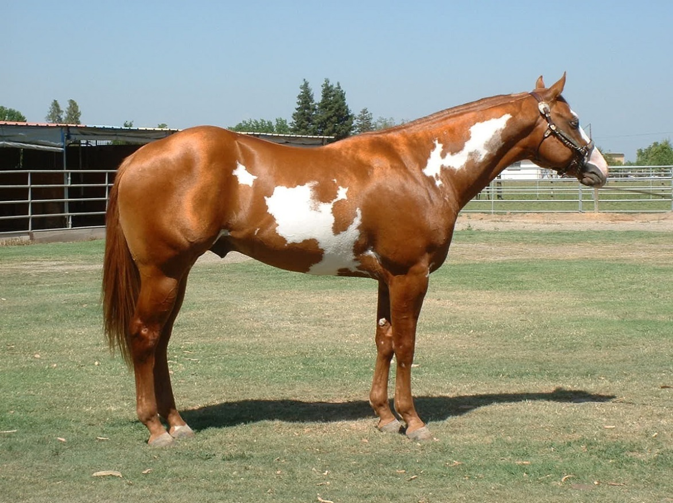
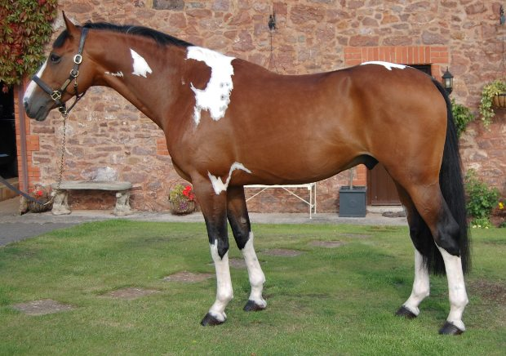
Paint Color Patterns:
Tobiano: solid color on majority of face (can have blaze, star, stripe, or snip), lots of white on the legs, white usually crosses the topline between the ears and tail
Overo: white does not cross the topline between the withers (different branches under this term so there is a wide variety in this group)
Tobiano
Overo
Notes:
Make sure the students can differentiate between the spotting patterns of appaloosas and paint horses. They do not need to differentiate between a tobiano paint and an overo paint horse.

Slide 18
Paint - Hidalgo
Notes:
The other breeds in this video clip are Arabians.

Slide 19
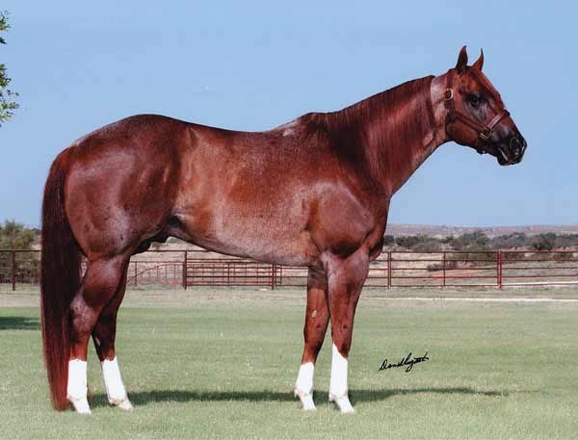
Quarter Horse

Slide 20
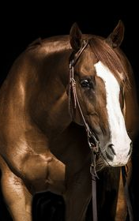
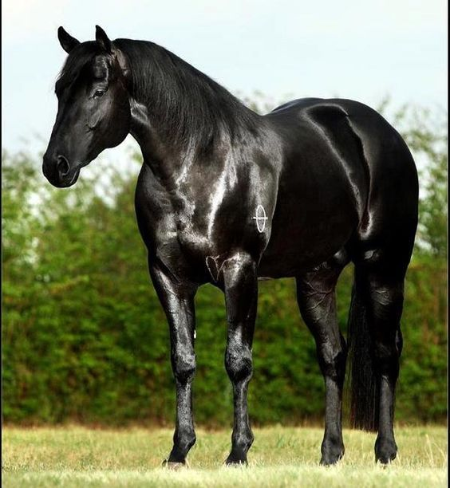
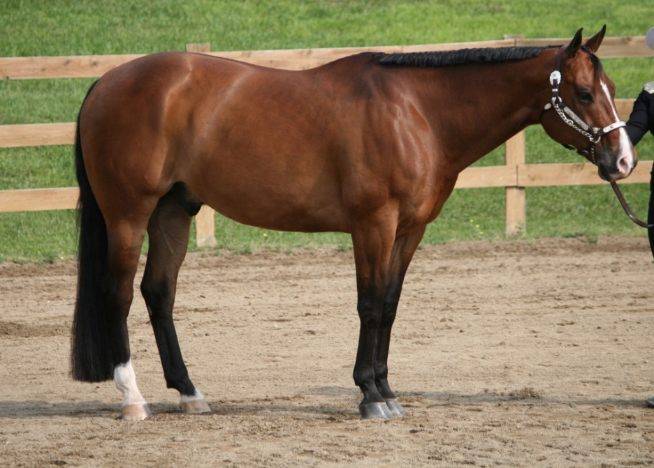
Quarter Horse (USA)
Height: 14.0-16.0hh
16 recognized coat colors (sorrel most common)
Can be used to race (track – Quarter Mile – hence the name)
Race speeds around 50 mph (faster than thoroughbreds or Arabians, they just don’t have the same stamina)
Exceptional stock horses (high cow-sense)
Muscular, powerful, quick, intelligent

Slide 21
Quarter Horse - Cutting

Slide 22
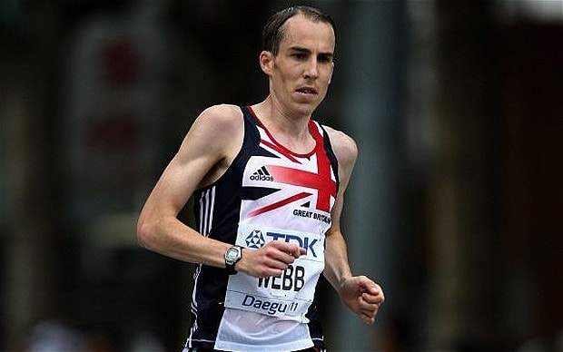
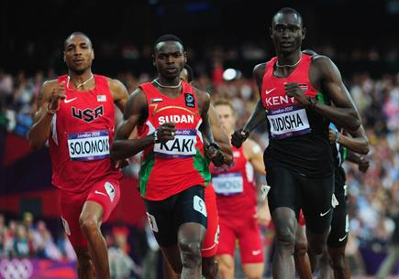
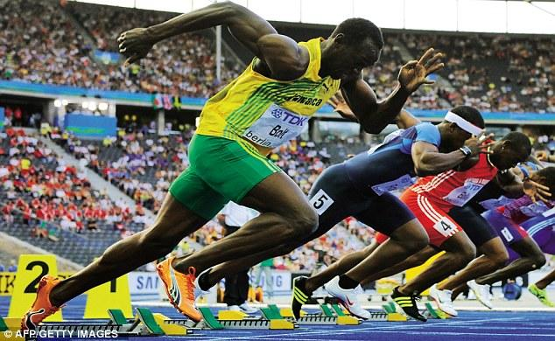
Racing Comparisons:
Arabian = Cross Country/marathon runner
High endurance, lean, low muscle mass, smaller frame
Not as fast of a sprinter
Thoroughbred = Middle distance runner
Moderate endurance, lean but also fairly muscular
Maintain fast pace over a long distance, but not as explosive and fast as a sprinter
Quarter Horse = Sprinter
Short distances, low endurance, very high muscle mass, powerful
Extremely fast and powerful but cannot maintain that speed for a long period of time

Slide 23
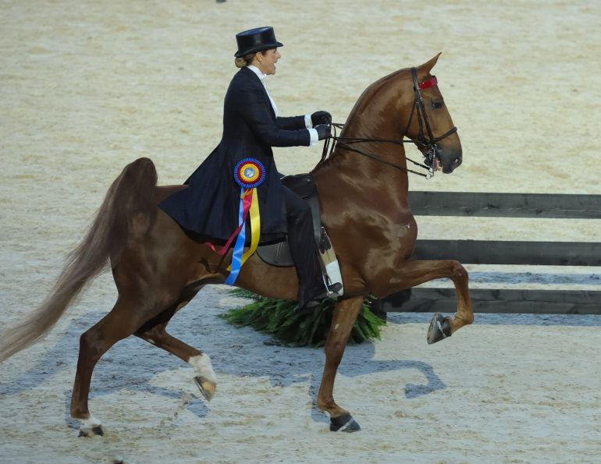
Saddlebred

Slide 24
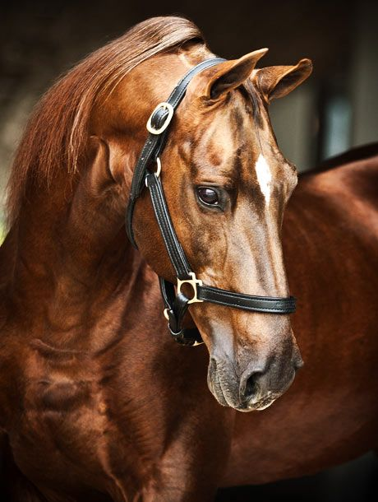
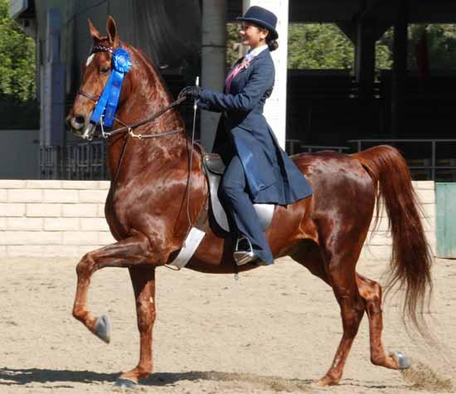
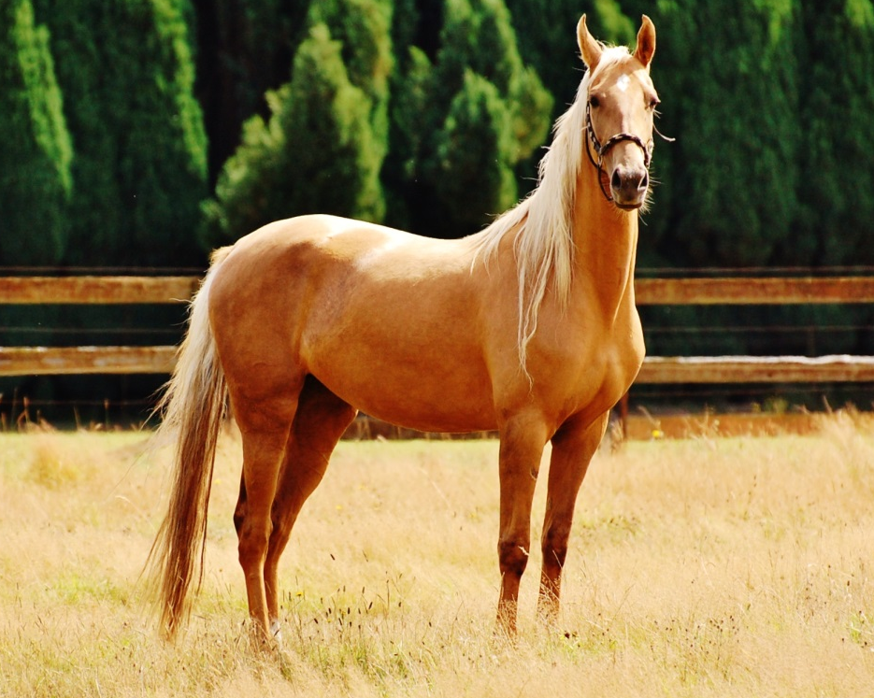
Saddlebred (USA)
Height: 15.0-17.0hh
All colors can be seen in this breed
Used for riding and driving
Most often shown in saddleseat and driving classes
Has an extra gait called the rack (all hooves hit the ground independently)

Slide 25
Saddlebred - Rack

Slide 26
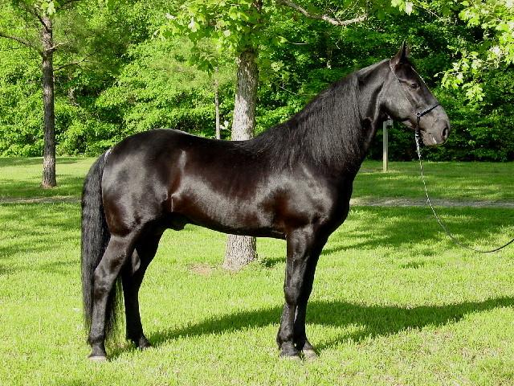
Tennessee Walking Horse

Slide 27
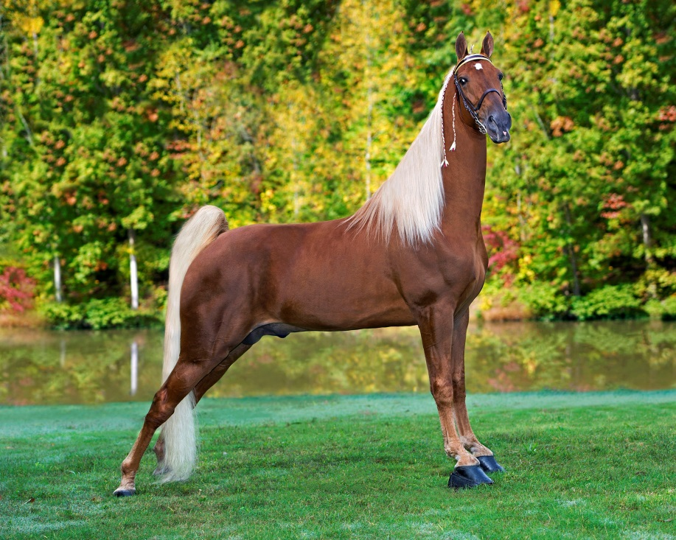
Tennessee Walking Horse (USA – Tennessee)
Height: 15.0-16.0hh
Found in black, sorrel, bay, chestnut, and gray
Has a special gait, called the running walk (in addition to the rack) where each hoof hits the ground independently
Often used as trail horses because they are smooth to ride

Slide 28
Tennessee Walking Horse – Running Walk

Slide 29
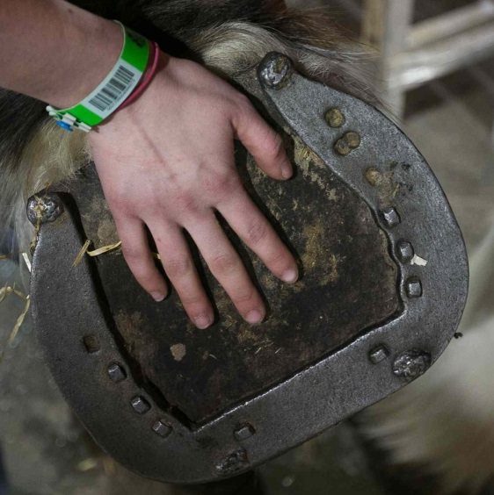
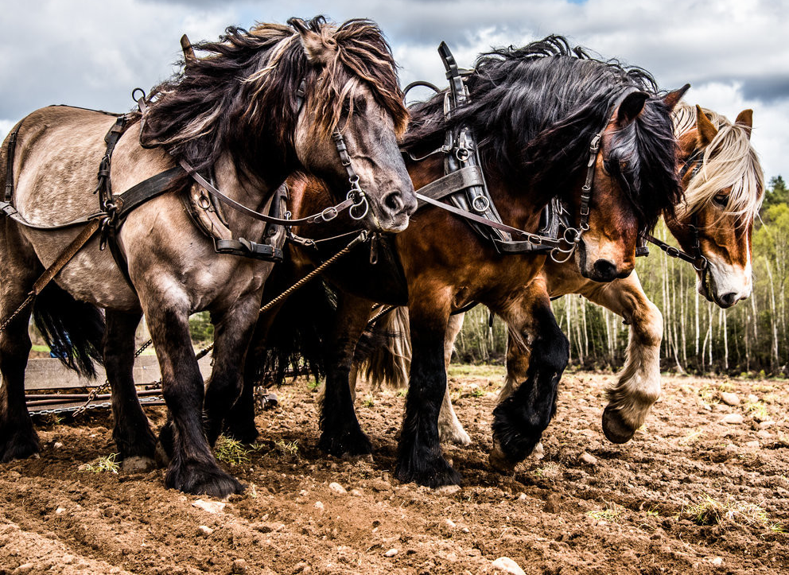
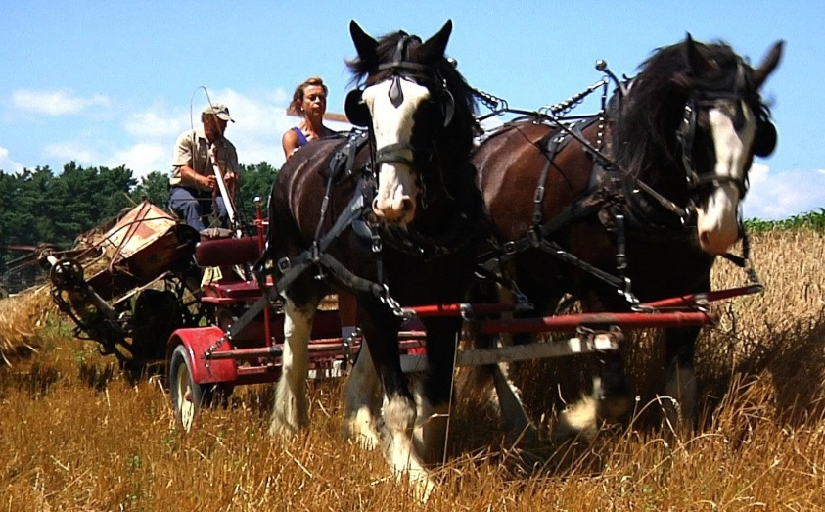
Draft Horses:
AKA heavy horses or cold-blooded horses
Tall (16-19hh) and very muscular (1,300-2,000lbs)
Large, sturdy hoofs
Bred to do work (pull carts, farm work, etc.)
Breeds under this category:
Belgian
Clydesdale
Percheron

Slide 30
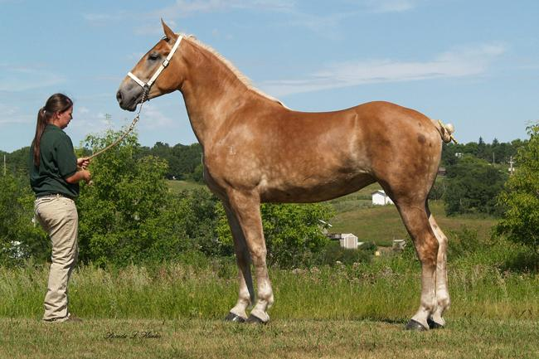
Belgian

Slide 31
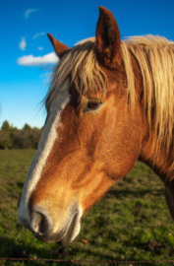
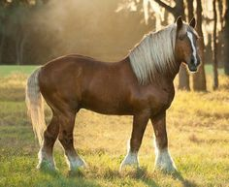
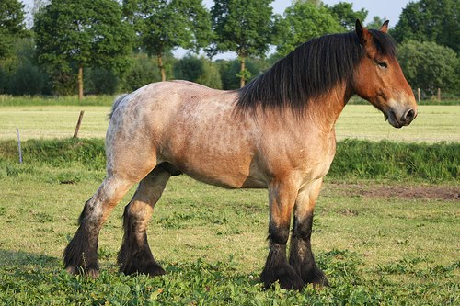
Belgian (Belgium)
Height: 16.0-18.0hh
Sorrel color - usually with a white mane and tail (most common), bay, or roan with feathering on legs
Usually used for driving and farm work (can pull 6,000-8,000lbs) for 8-10hrs a day

Slide 32
Clydesdale

Slide 33
Clydesdale (Scotland)
Height: 16.0-18.0hh
Can be bay, brown, roan, black, or gray with white feathers and white markings
Often used to pull carts (often worked in town rather than on farms)

Slide 34
Clydesdale – Commercial

Slide 35
Percheron

Slide 36
Percheron (France)
Height: 15.0-19.0hh
Gray or black coat color (often born black and turn gray by age 3)
Often used in riding in addition to draft work
Don’t have feathers on the legs like many other draft breeds

