Slide 1
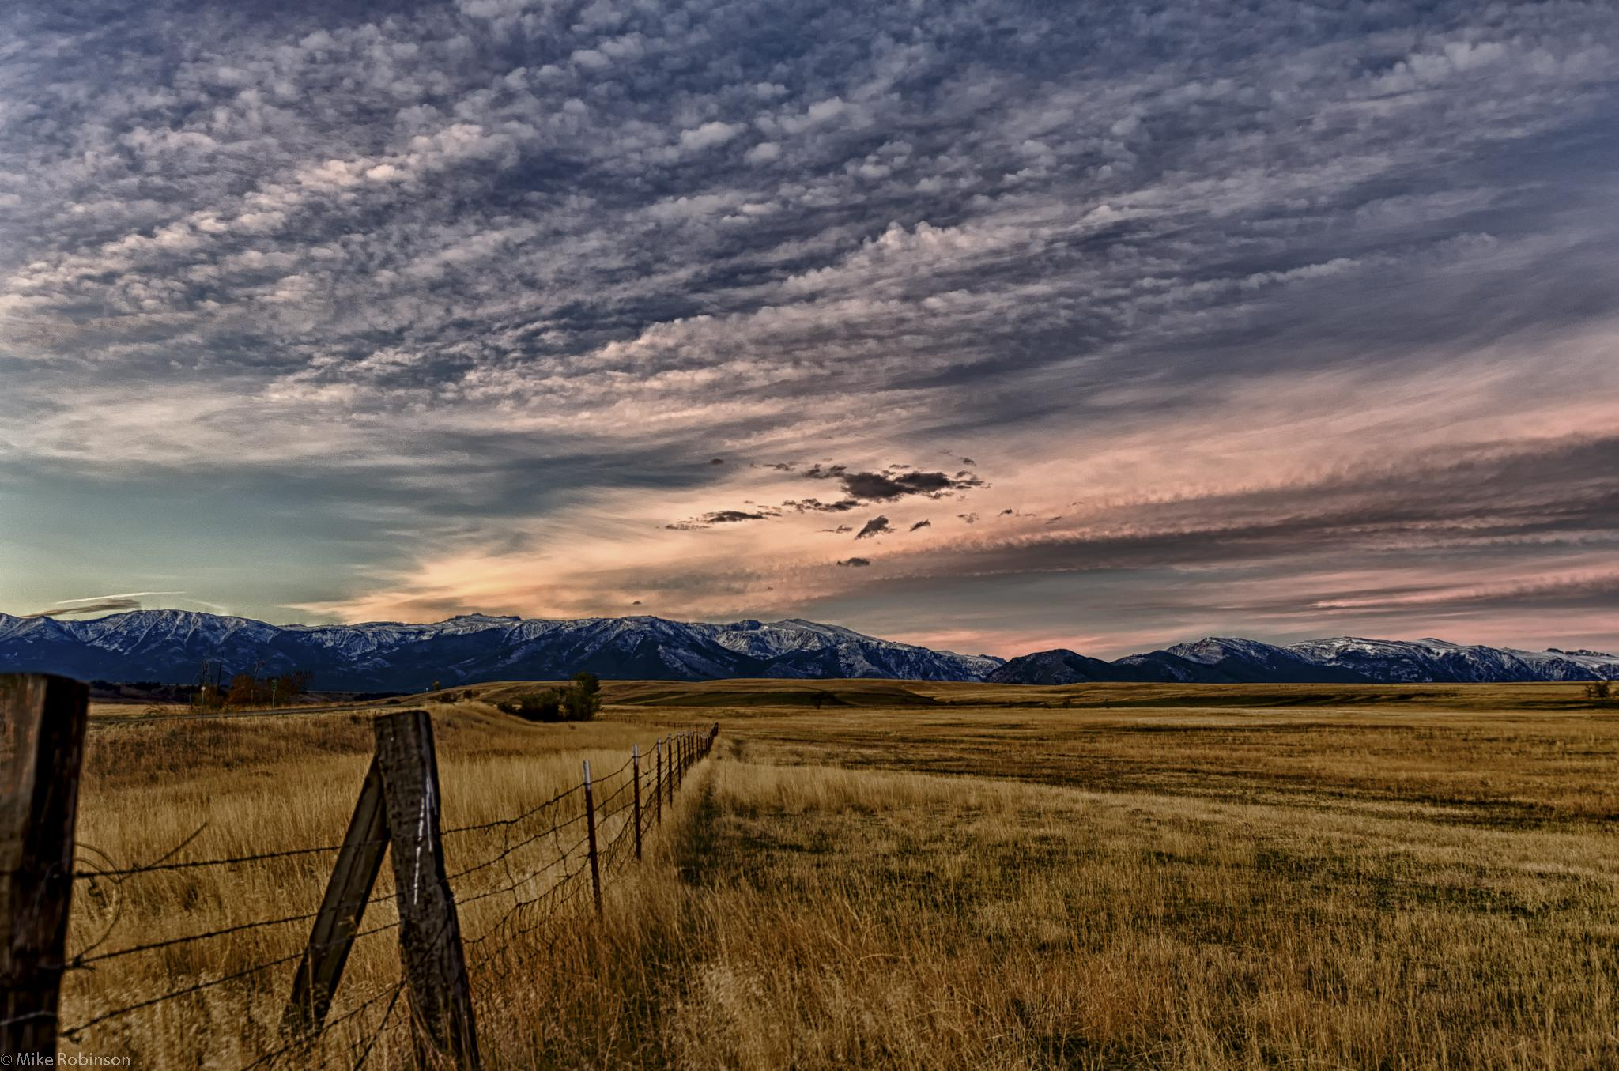
Livestock Breeds:
Cattle, goats, sheep, swine
© Partnership for Environmental Education and Rural Health at
College of Veterinary Medicine & Biomedical Sciences, Texas A&M University
Funding support from the National Institutes of Health Office of Research Infrastructure Programs (ORIP)

Slide 2
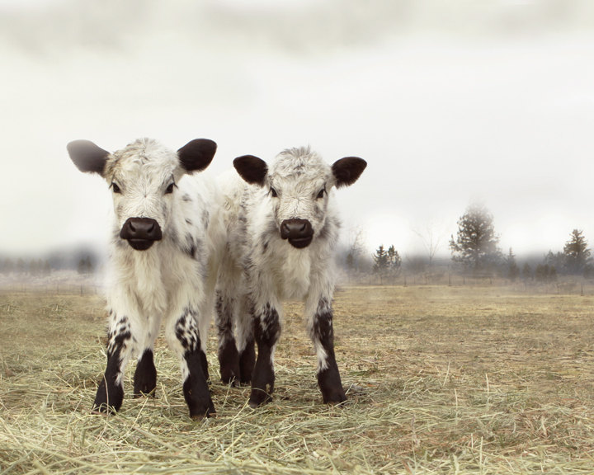
Cattle Breeds

Slide 3
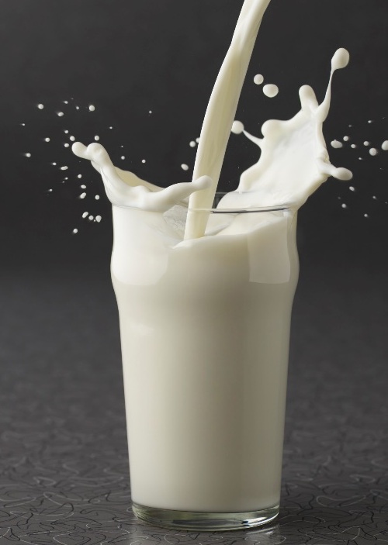
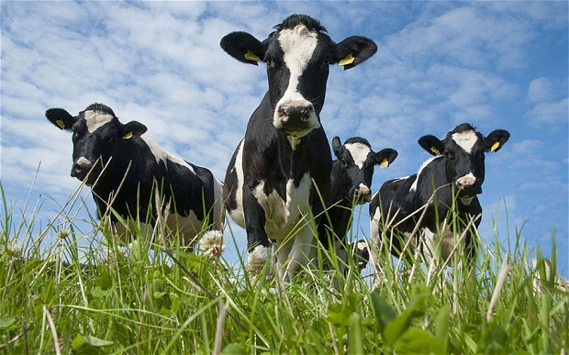
Dairy Cattle:
Dairy cattle are used to produce milk
These breeds produce a high volume of milk or have a high butterfat percentage in their milk
The cows are more valuable to the dairy farmers than the bulls (in large numbers)
There are five main breeds of dairy cattle in the US:
Ayrshire
Brown Swiss
Guernsey
Holstein
Jersey
Holstein and Jersey cattle are the two most popular breeds in the U.S.

Slide 4
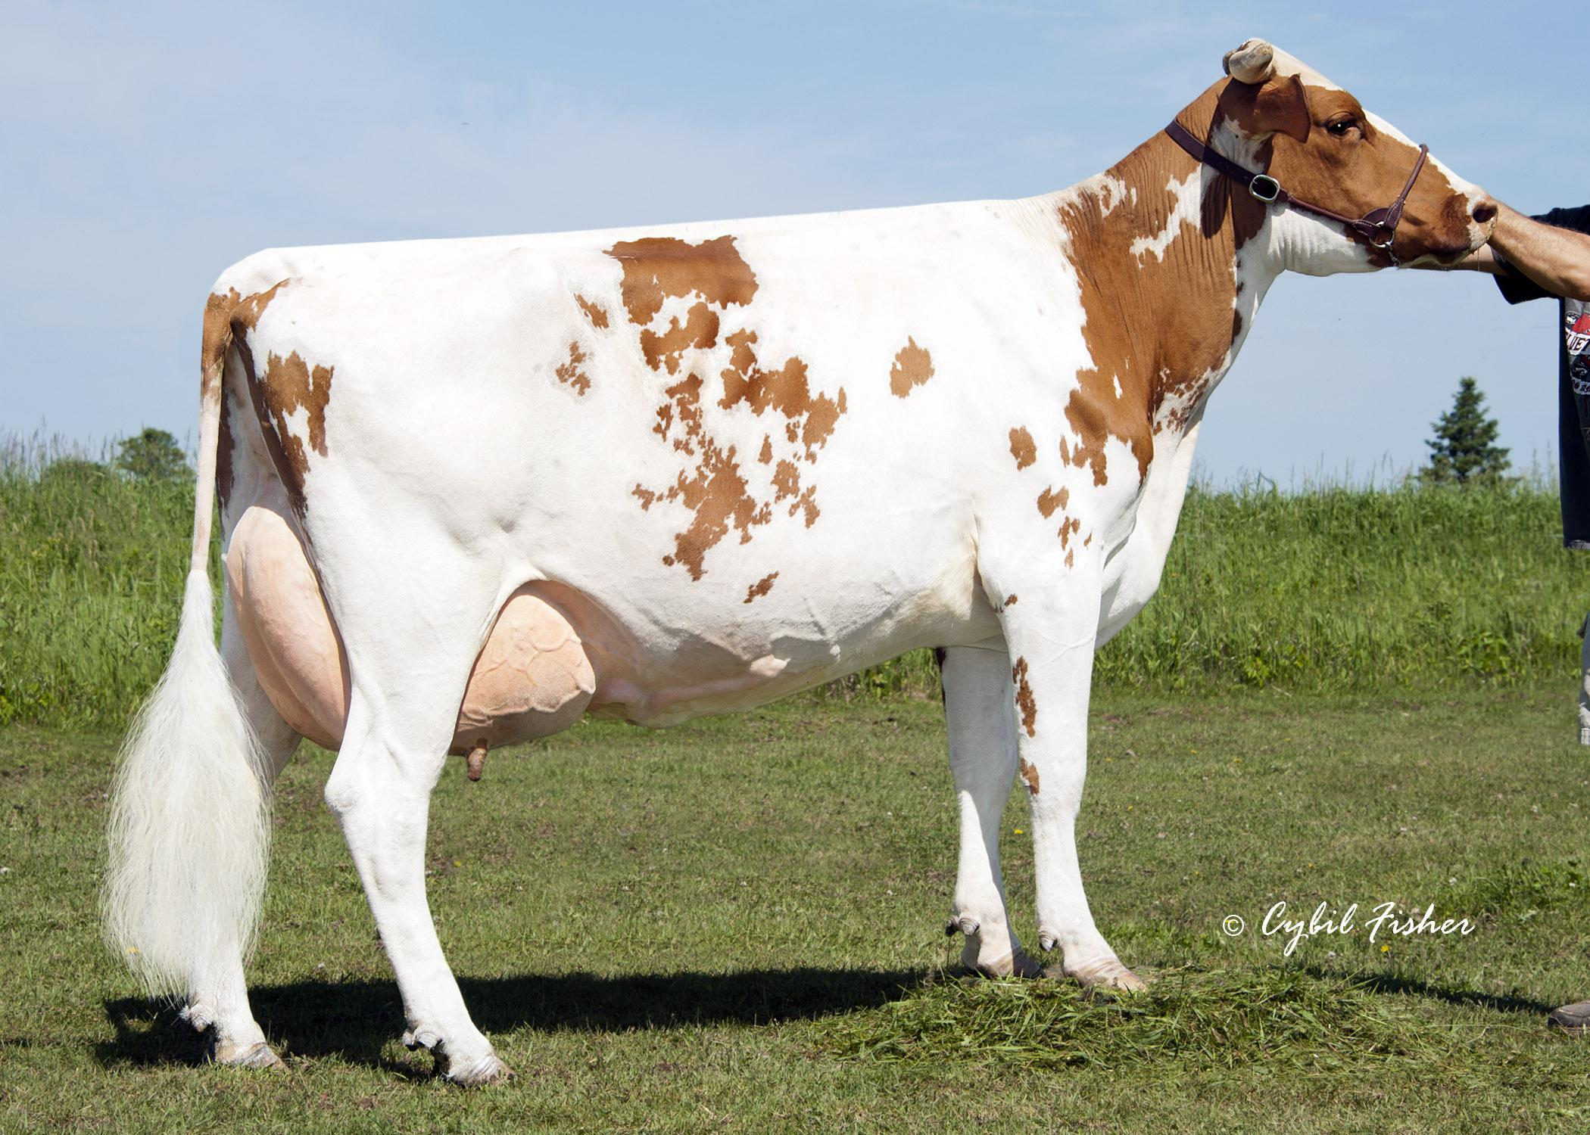
Ayrshire

Slide 5
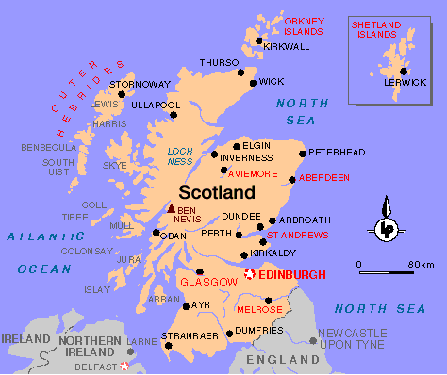
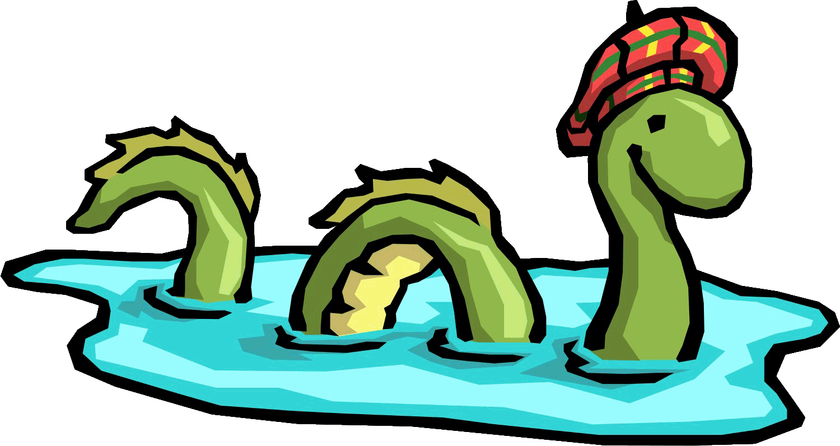
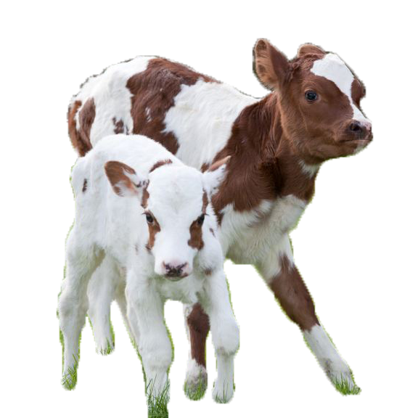
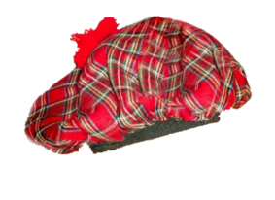
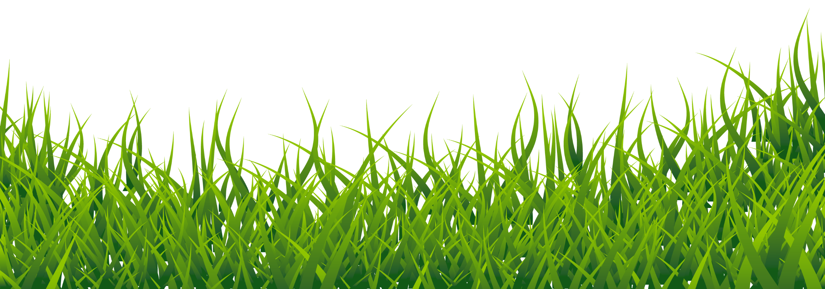
Ayrshire (Scotland)
Medium/dark red and white coat (darker than Guernsey)
Medium sized breed
Large variation in color patters (can be almost all red or almost all white)
Spots are usually jagged and small
Known for being excellent grazers
Can be used on pasture dairy’s

Slide 6
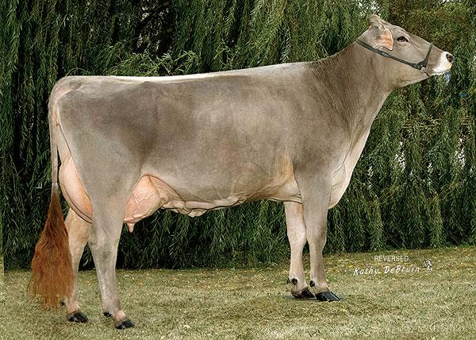
Brown Swiss

Slide 7
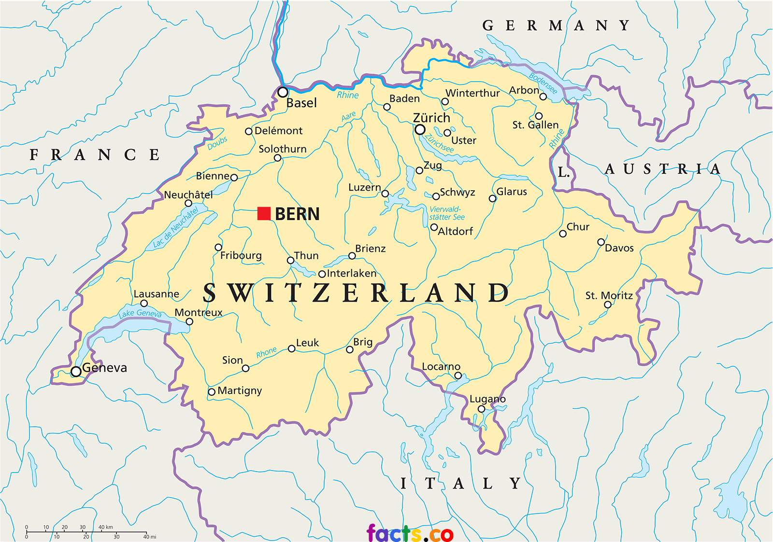
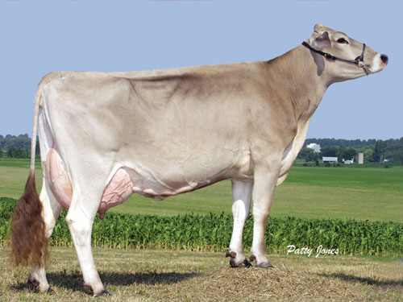
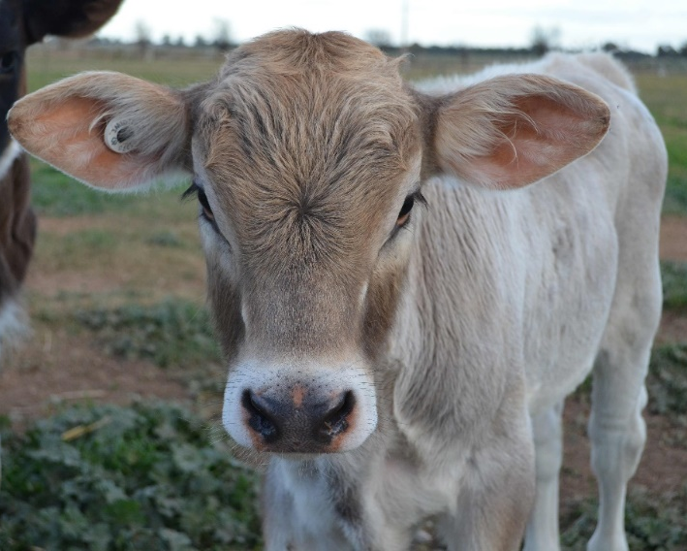
Brown Swiss (Switzerland)
Brown Swiss cows have a brown coat of various shades, often with a silvery tone (don’t have dark points like Jersey)
Large frame
Hooves, muzzle, and switch are usually black
Known for longevity
Long life expectancy
Strong legs and hooves

Slide 8
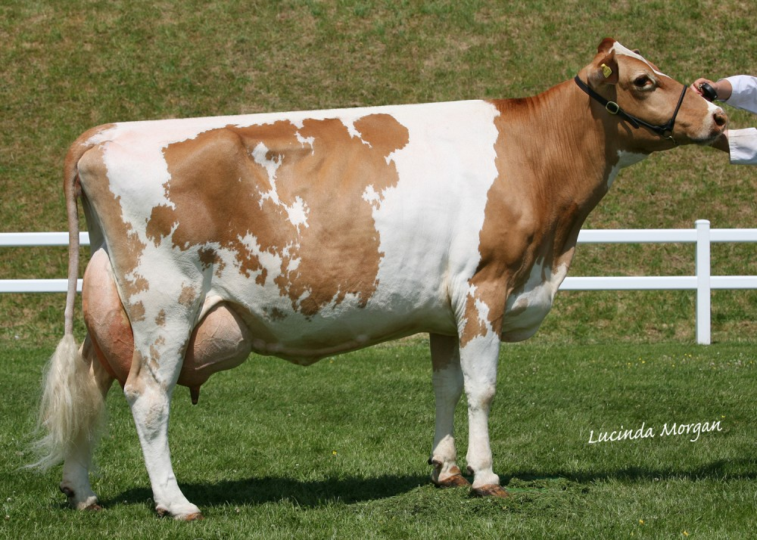
Guernsey

Slide 9
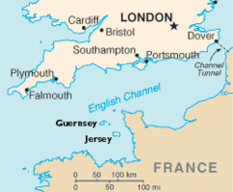
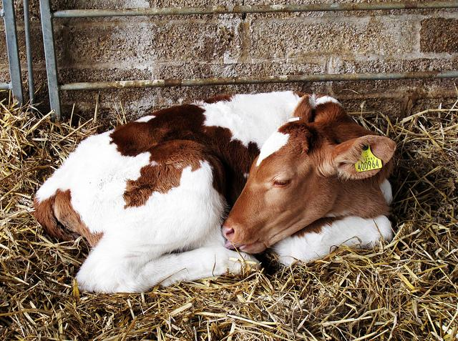
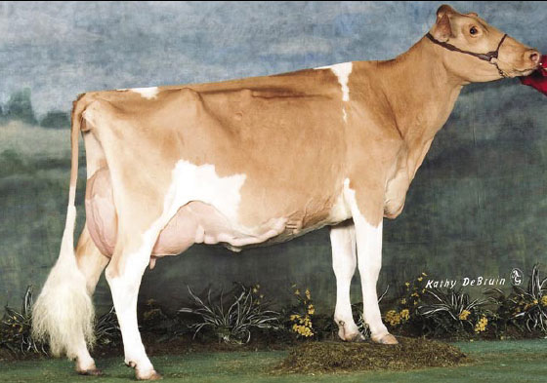
Guernsey (Isle of Guernsey – England)
Guernsey are various shades of fawn and have white markings with a white switch (lighter than Ayrshire)
Medium frame
Second highest butterfat percentage
Can be completely solid fawn color to almost all white
Known for golden colored milk
Notes:
The golden color is due to high beta-carotene concentrations (like carrots!)

Slide 10
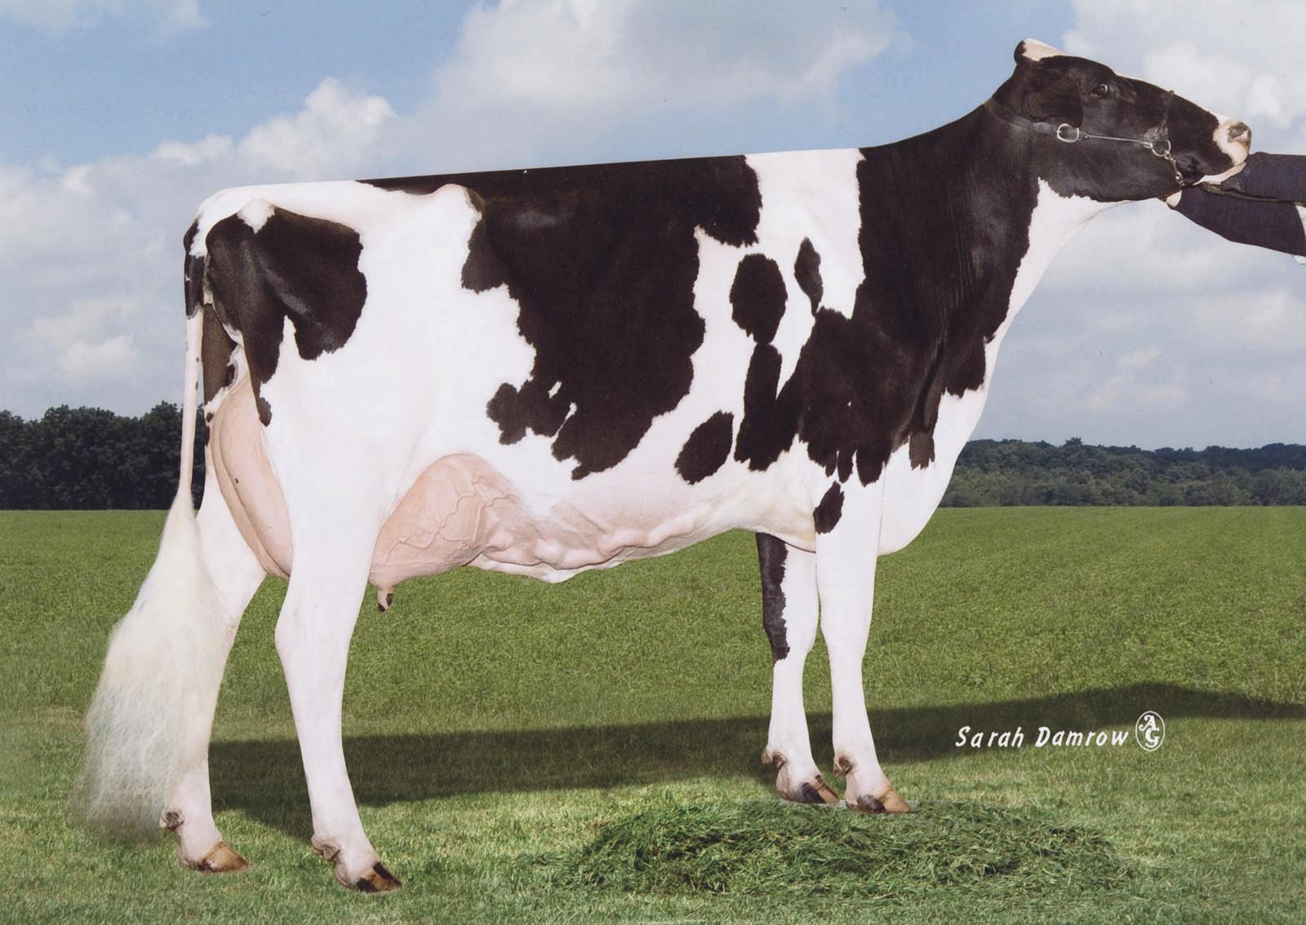
Holstein

Slide 11
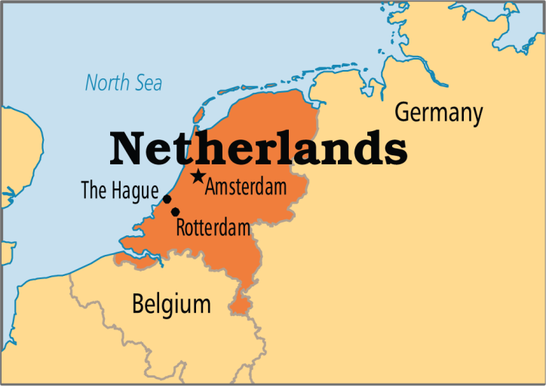
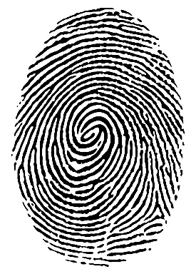
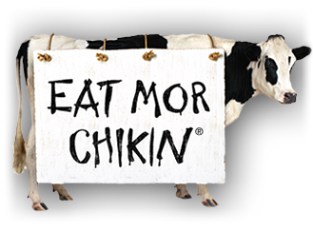
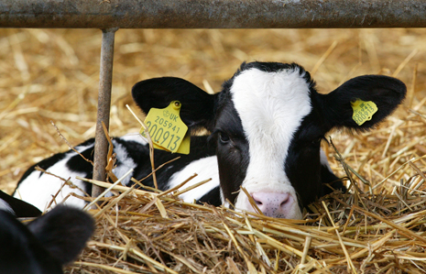
Holstein (Netherlands)
Holsteins are the black and white cows that you typically think of
Like the chick-fil-a cow!
Spotted with a unique pattern (like a thumbprint!)
Most popular milking cow
Known for volume of milk produced
approx. 20,000lbs in 305 days
Notes:
Holsteins produce more gallons of milk on average than any other breed of cattle!

Slide 12
Happy Cows Commercial

Slide 13
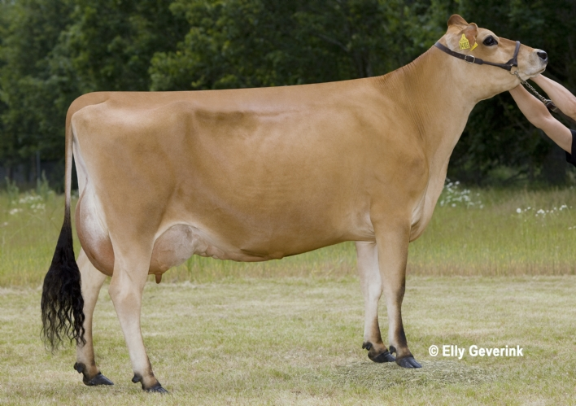
Jersey

Slide 14
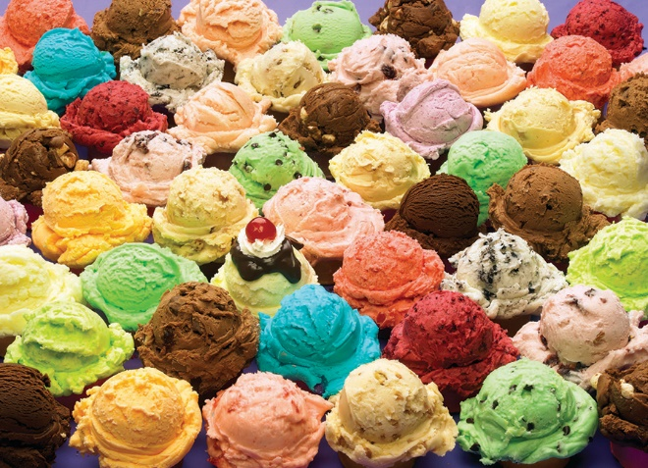
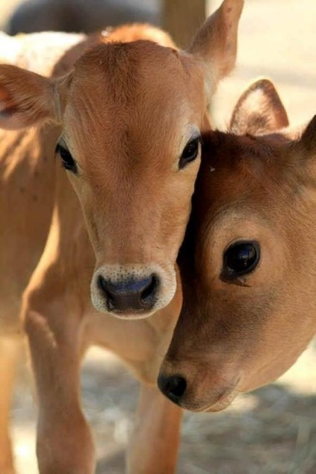
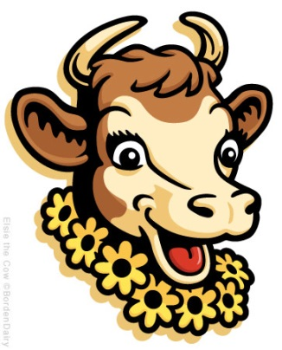
Jersey (Isle of Jersey - England)
Jersey cows are brown (light tan to dark fawn) with darker points around the head and legs
Like Borden’s Elsie!
Adapted for a warmer climate (popular in the south)
Smaller frame and feminine features (ex. big eyes)
Known for producing high butterfat content in milk (approx. 5%)
Butterfat is desirable for flavor
My high butterfat helps your ice cream taste good!

Slide 15
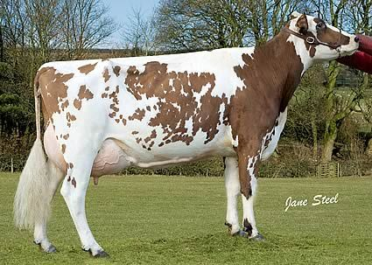
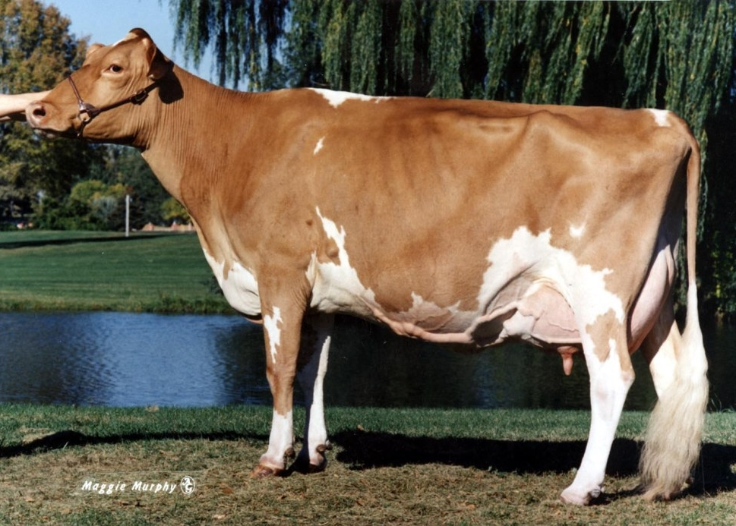
Ayrshire vs. Guernsey
Ayrshire: darker colored spots (usually a liver color)
More broken spotting
Guernsey: lighter colored spots (usually sand/tan color)
Ayrshire
Guernsey

Slide 16
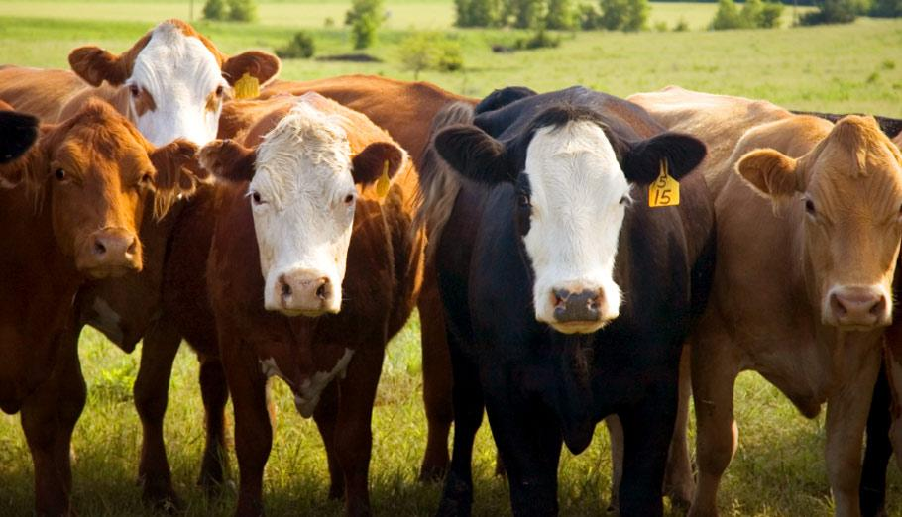
Beef Cattle:
Raised for meat (beef) production
These breeds usually have high marbling ability and easily lay on muscle/fat
There are two main types of beef cattle breeds:
Bos Taurus
British breeds
Exotic breeds
Bos Indicus

Slide 17
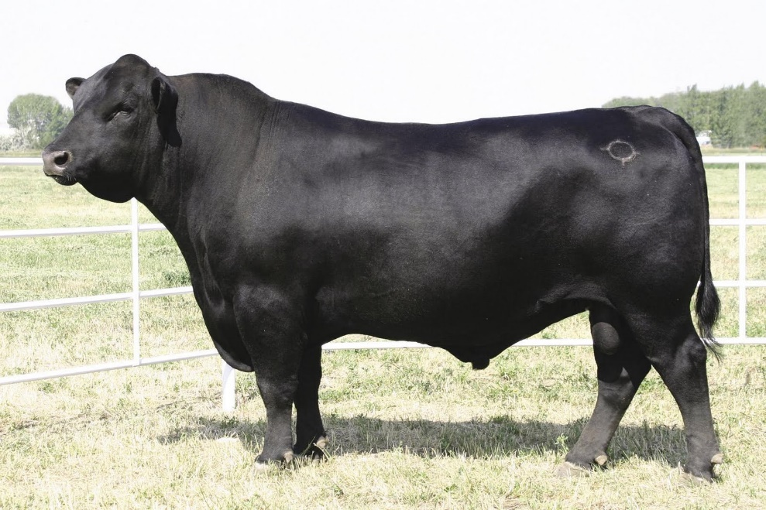
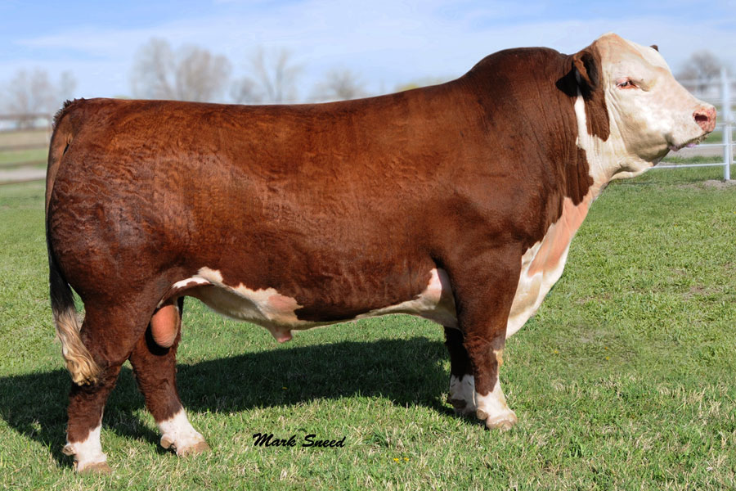
British (maternal) Breeds
These breeds fall under the Bos Taurus category
Generally smaller than exotic breeds
Developed in the British Isles
You should be able to identify the following breeds:
Angus
Hereford
Shorthorn

Slide 18
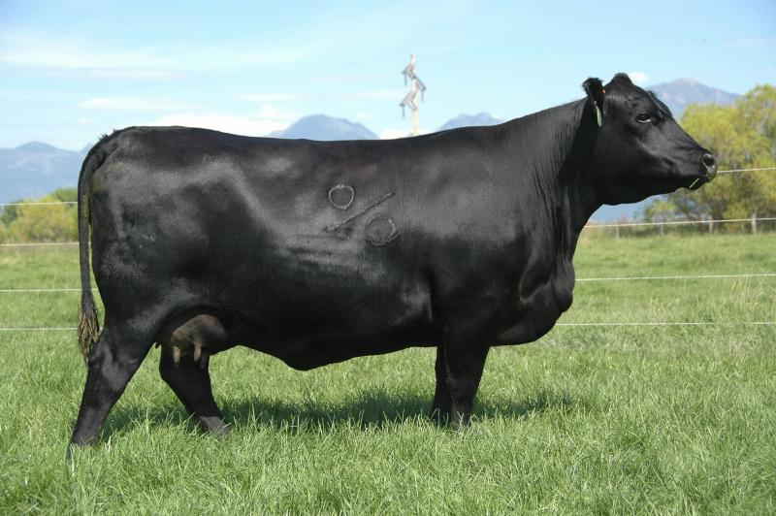
Angus

Slide 19
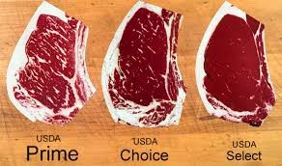
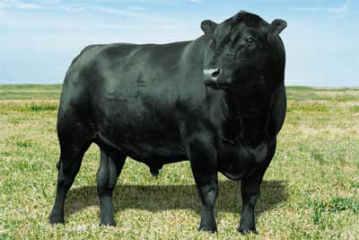
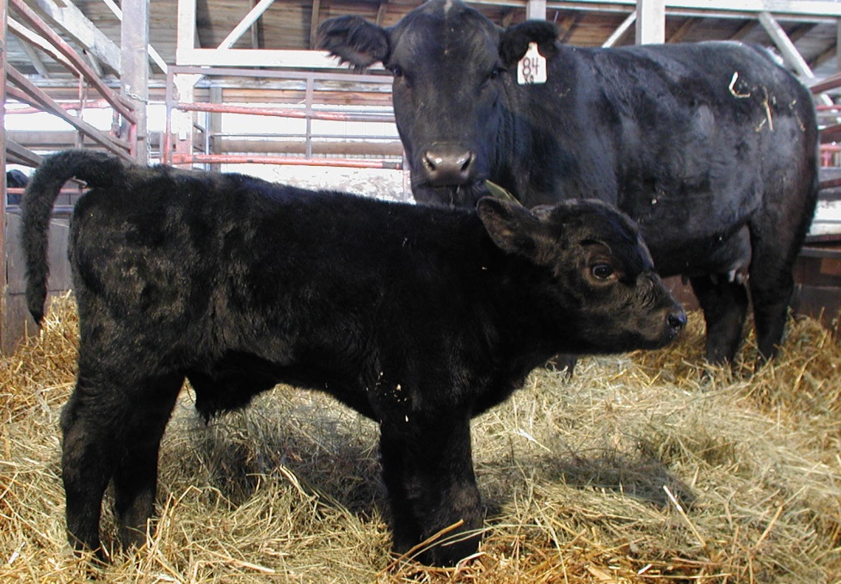
Angus (Scotland)
Marbling is a highly desirable trait in beef cattle, it increases the grade of the meat (Prime > Choice > Select)
Black coat (Red Angus is a different breed!)
ALL Naturally polled (no horns)
Superior marbling ability (hence Certified Angus Beef)
Muscular and compact

Slide 20
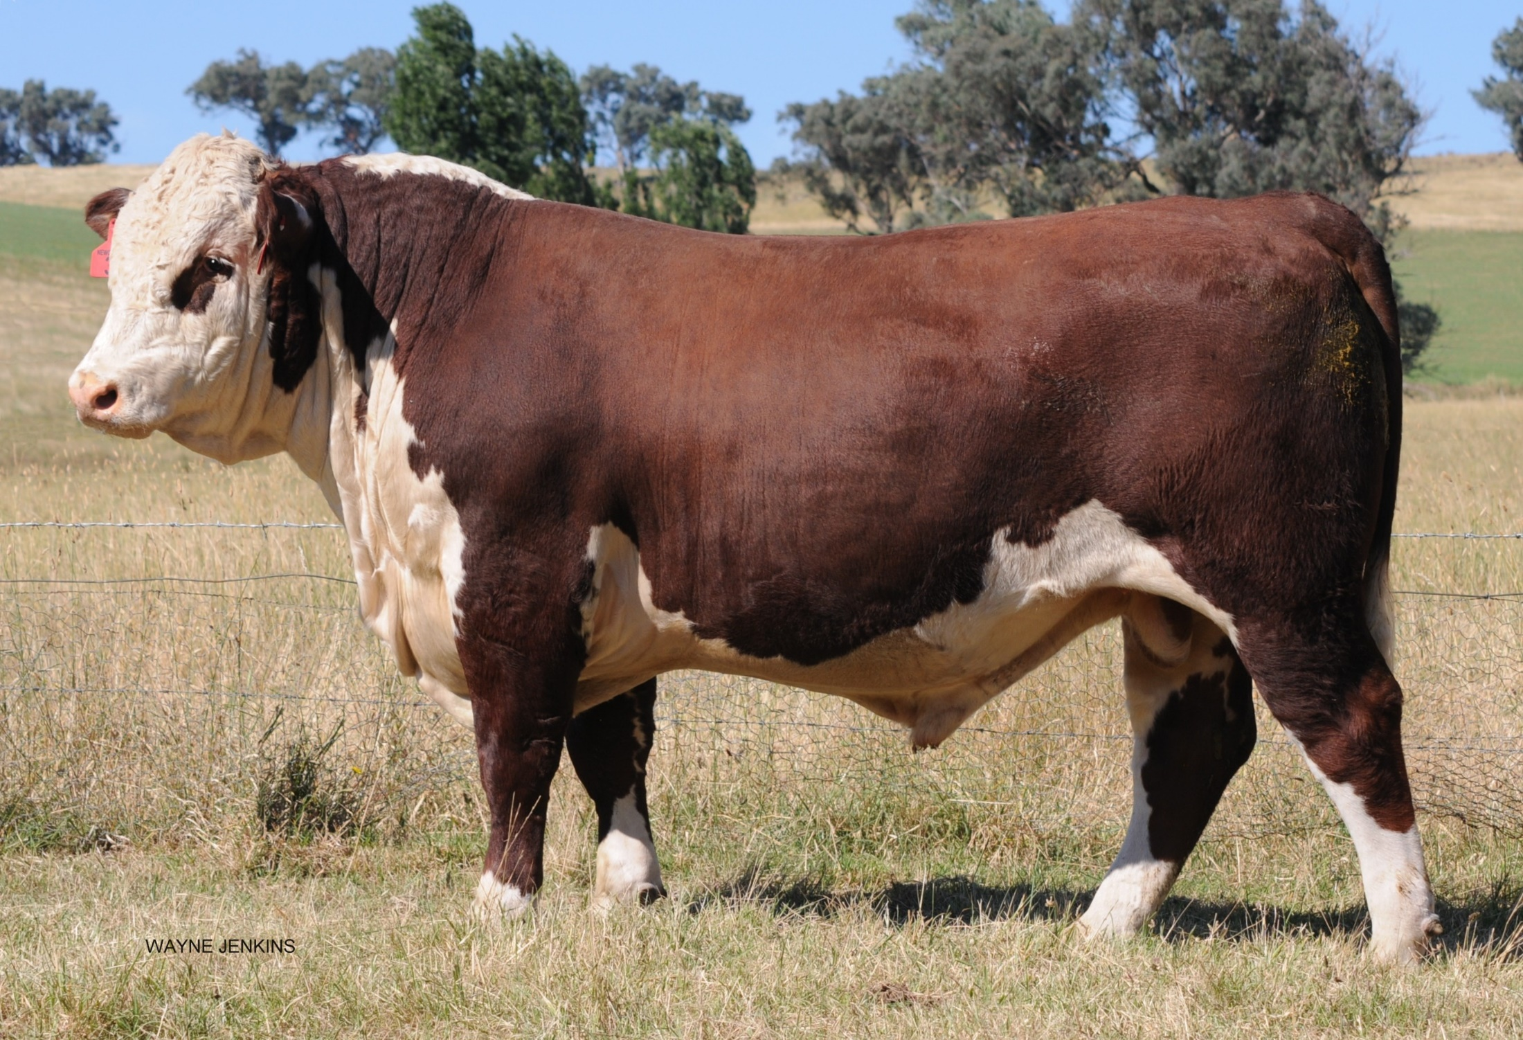
Hereford

Slide 21
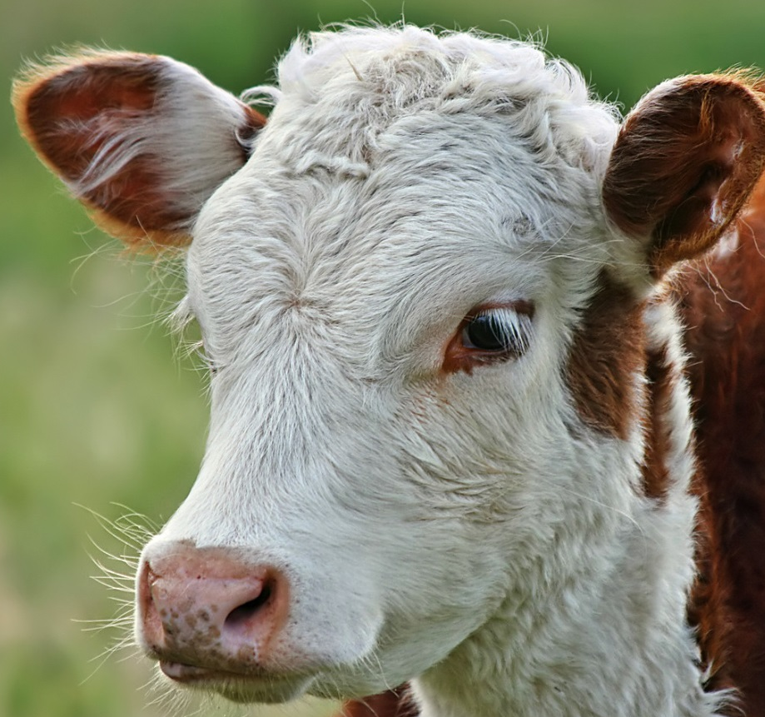
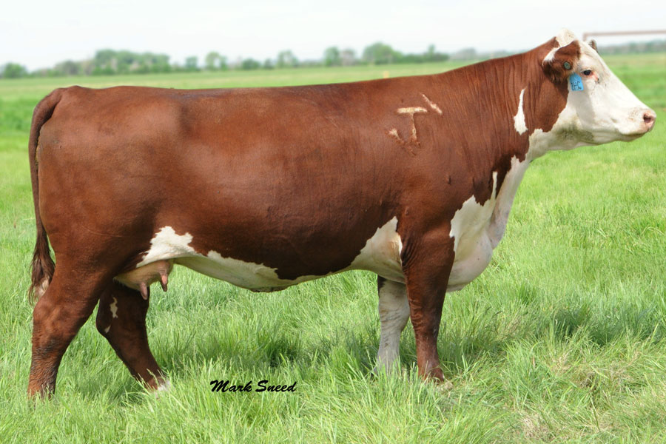
Hereford (England)
Red and white coat color
White on face, all four feet, switch, and underline
High foraging ability
Naturally horned or polled

Slide 22
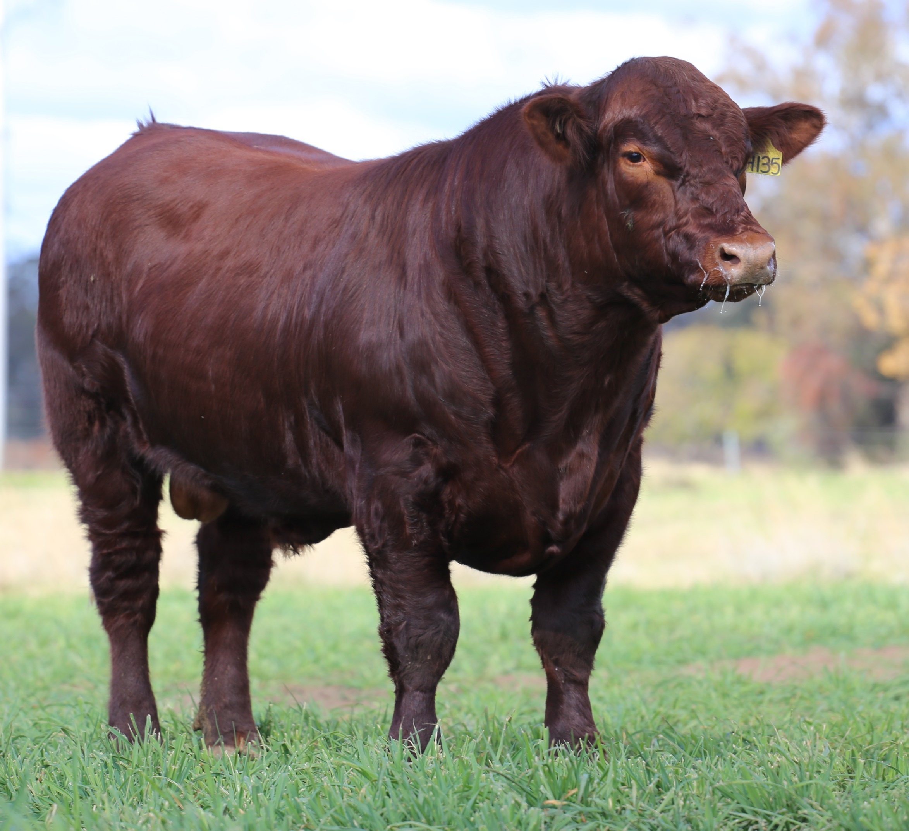
Shorthorn

Slide 23
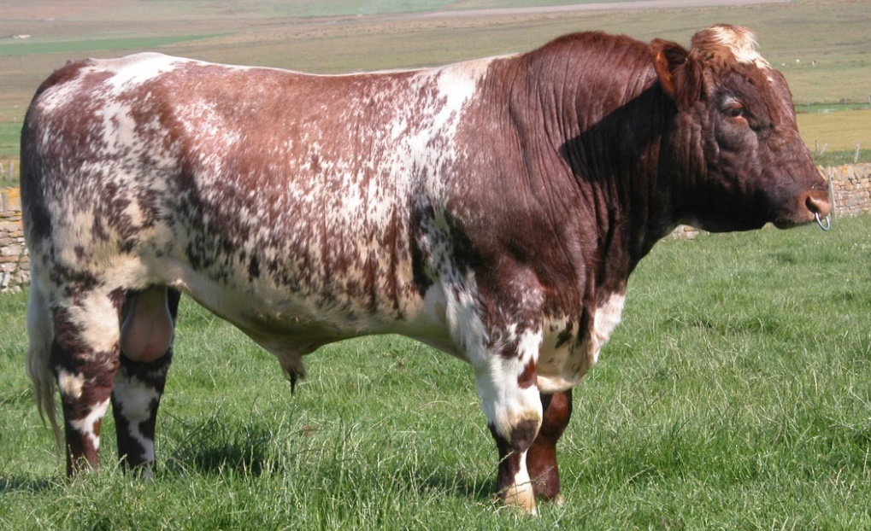
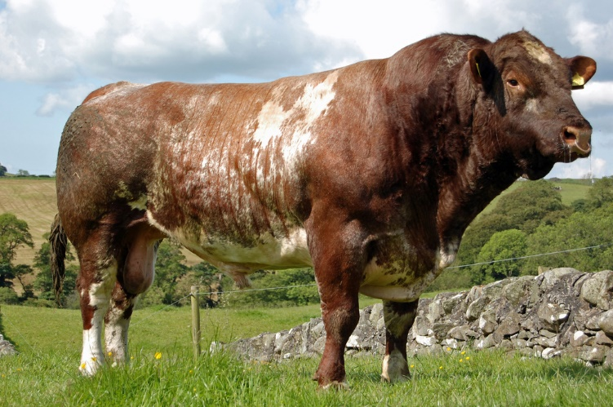
Shorthorn (England)
Red, white, or roan coat color
Naturally polled or horned
Good marbling ability

Slide 24
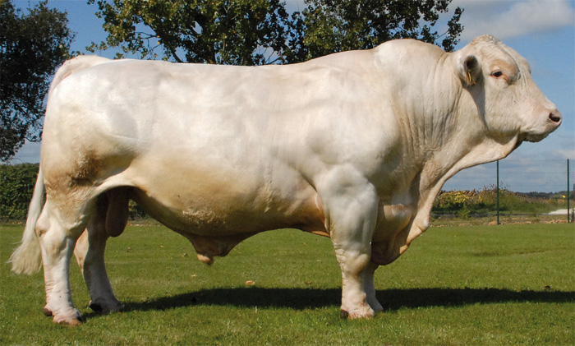
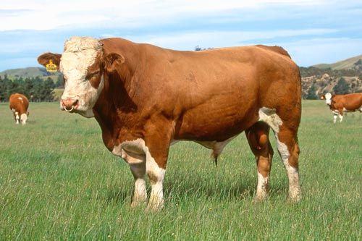
Exotic (Sire) Breeds
High growth rate and leanness
Larger in size than British breeds and produce less fat
You should be able to identify the following breeds:
Charolais
Simmental

Slide 25
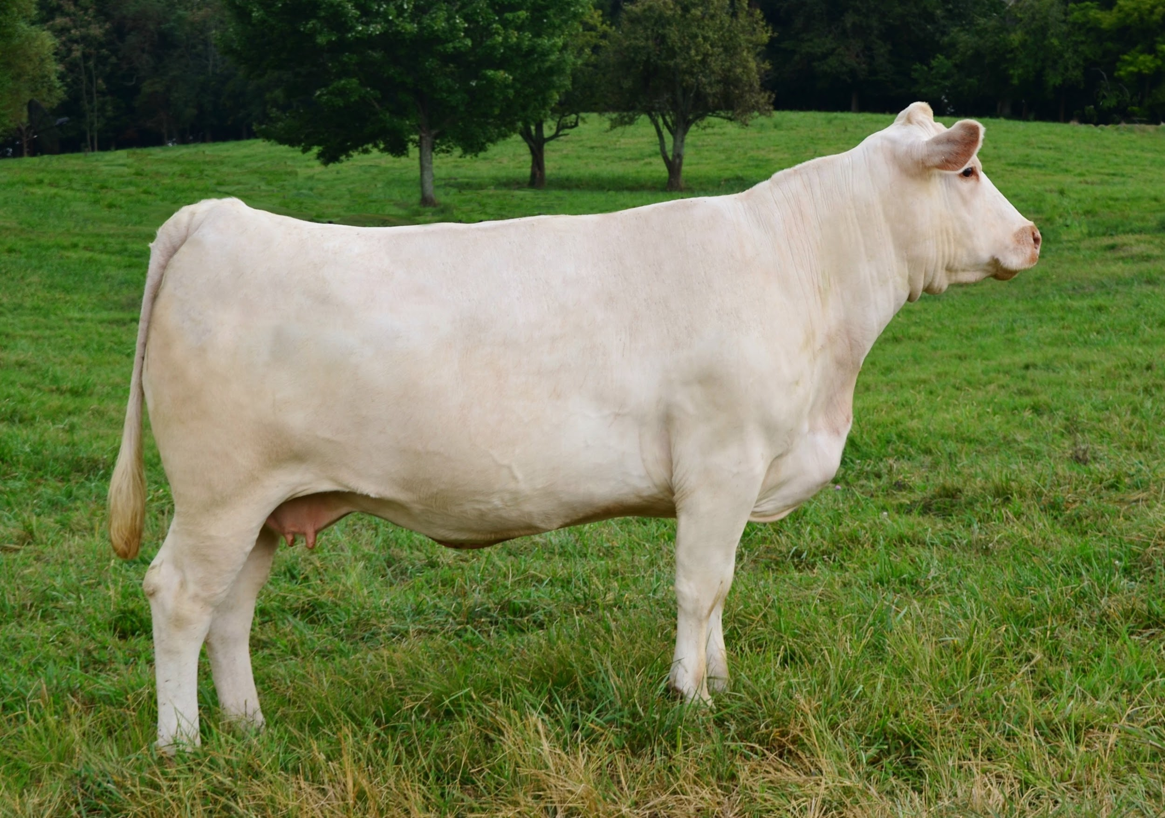
Charolais

Slide 26
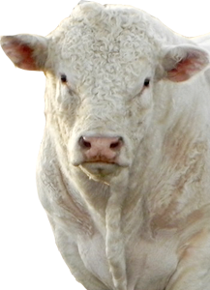
Charolais (France)
Coat is white to light straw color
Large frame with long bodies
Naturally horned or polled
White skin pigmentation with tan colored noses
Heavy muscling

Slide 27
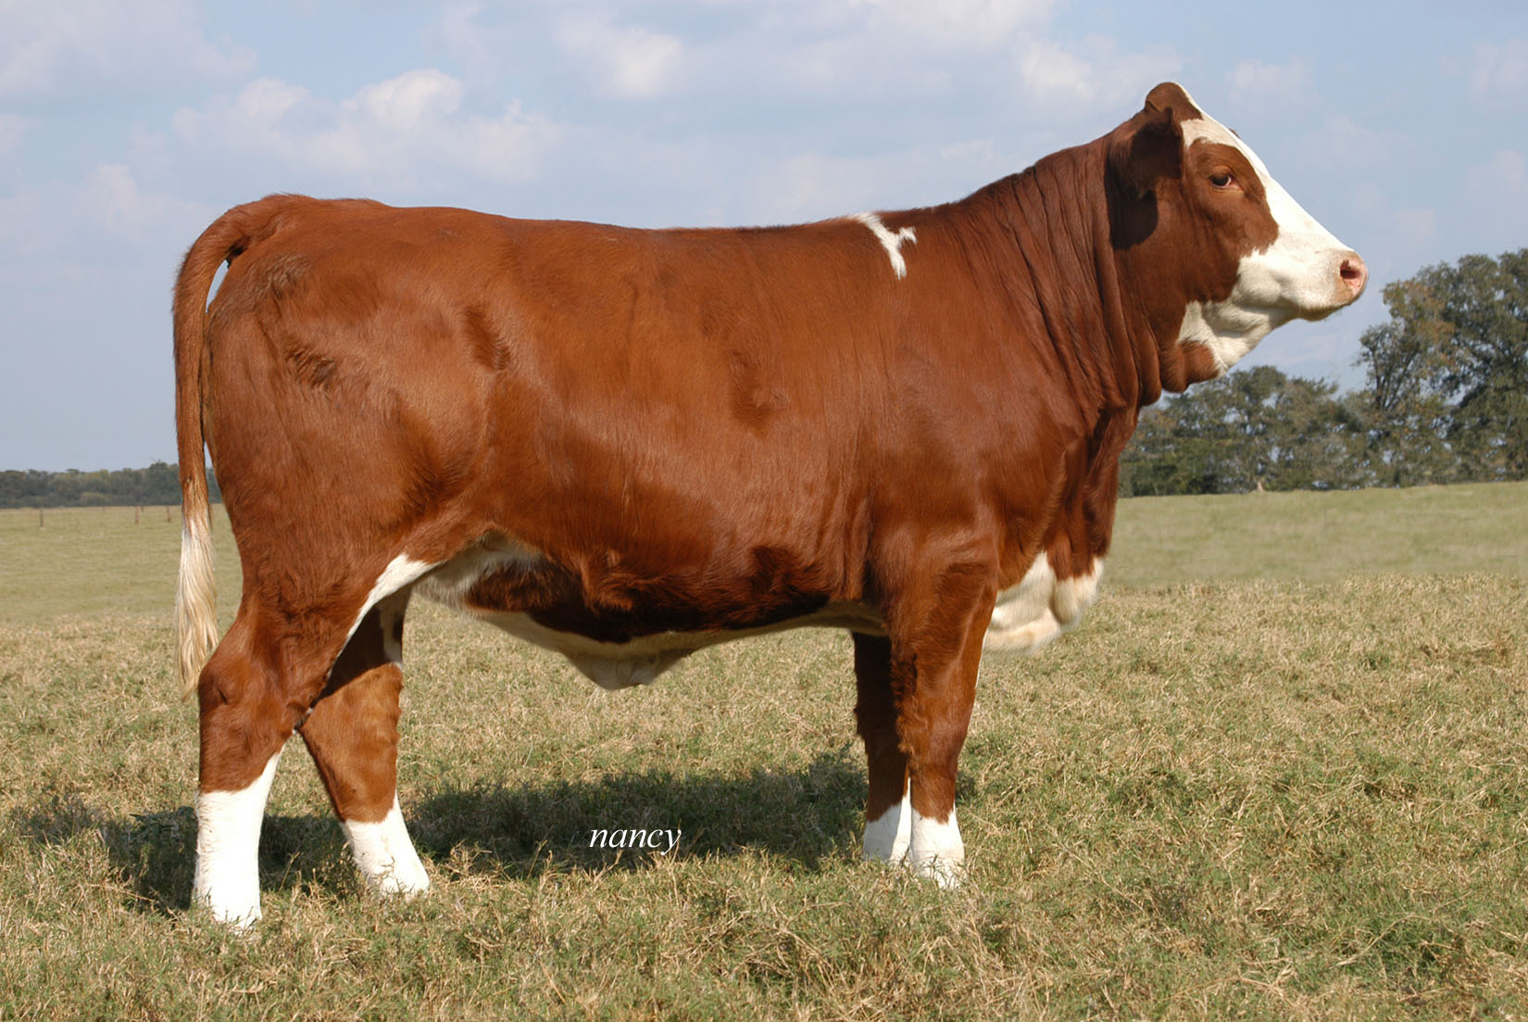
Simmental

Slide 28
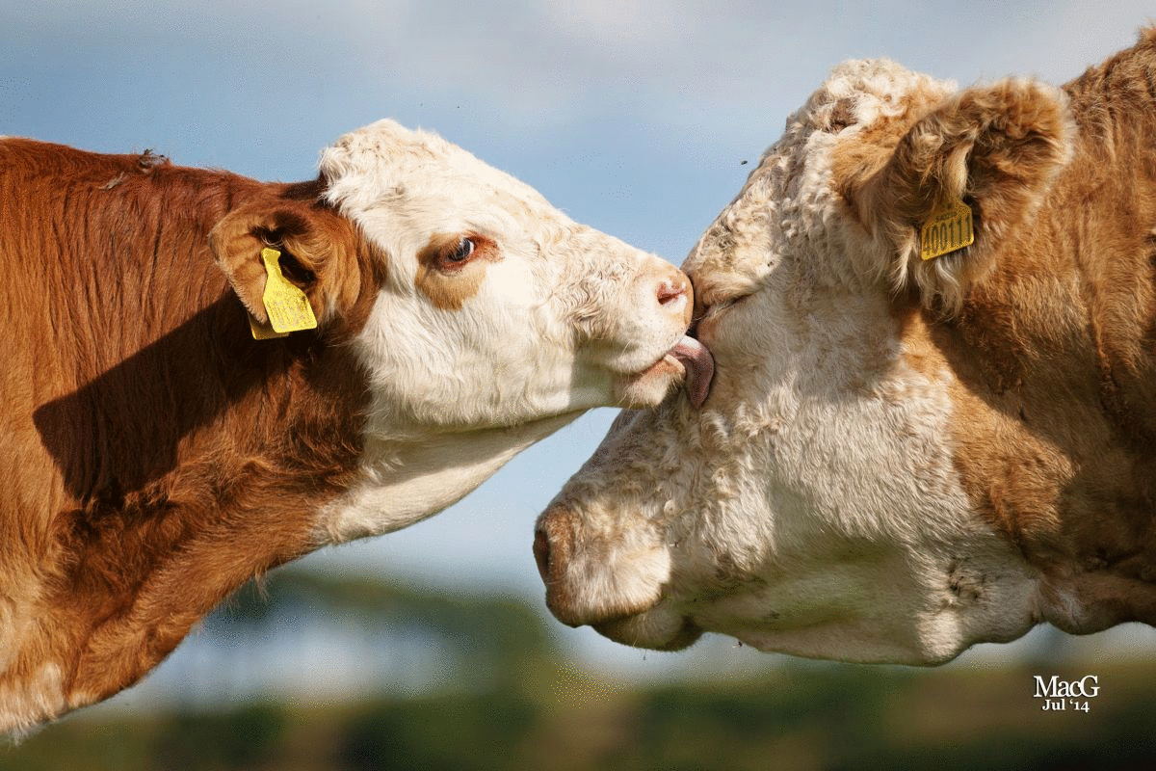
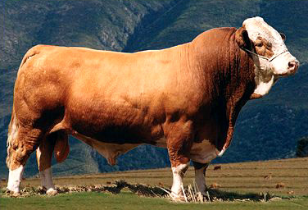
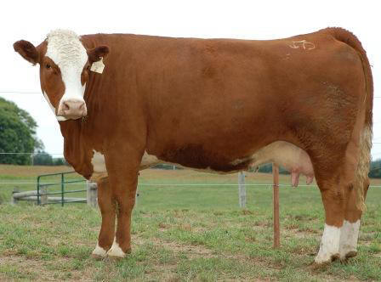
Simmental (Switzerland)
Brown, straw, or red coat color. Can be solid or have white markings/spotting on the legs, brisket, face, switch, underline, and back.
Naturally horned
Often have red pigmentation around the eyes
Notes:
Make sure the students can identify the difference between Herefords and Simmental!!!

Slide 29
Hereford vs. Simmental
Hereford: Red with white markings on the face, underline, legs, and switch
All four legs should have white on them
The white on the face should connect to the white on the underline with a white strip down the neck and brisket
White curled around the ears
Simmental: Straw to red and many have white markings (some are solid)
Will almost always have coloration around the eyes that matches the color of the body
If present, white on the face WILL NOT connect to the white on the underline down the brisket and neck

Slide 30
Bos Indicus Breeds
These breeds have humps between their withers and originated from India
Known for their heat tolerance
Lots of loose skin, especially around their neck and brisket
You should be able to identify the following breeds:
Brahman

Slide 31
Brahman

Slide 32
Brahman (USA - Texas)
Descendant from Indian cattle breeds
Gray or red coat color
Black skin pigmentation (black noses and hooves)
Lots of loose, excess skin with “hump” over withers
Extremely heat tolerant
Large, droopy ears. Naturally horned or polled

