Slide 1
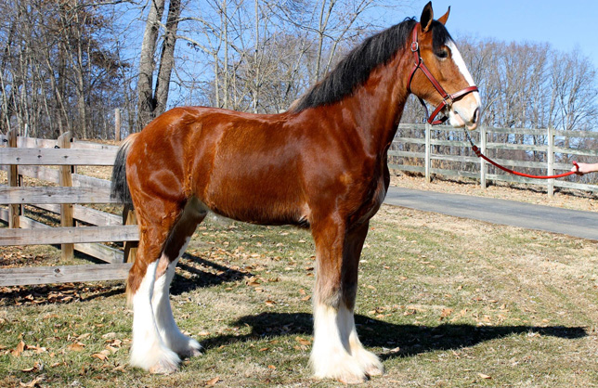

Slide 21
Clydesdale
Californian
Boer
Ramboulliet
Simmental
Shorthorn
Netherland dwarf
Hampshire
American Landrace
Nubian
Chester white
Yorkshire
Arabian
Angora
Berkshire
Southdown
Columbia
Alpine
Quarter horse
Ayrshire

