Slide 1
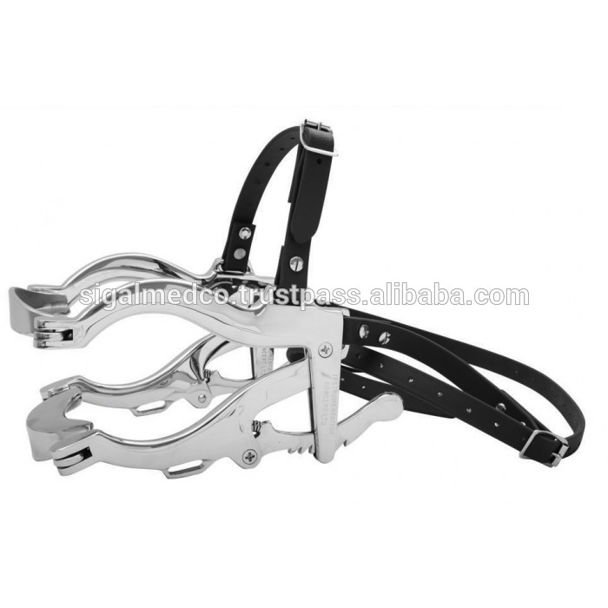
Speculum — large animal oral

Slide 2
Otoscope

Slide 3
Tonometer

Slide 4
Scissors — Littauer suture removal

Slide 5
Kidneys

Slide 6
B= Ovary, C= Uterus, D= Cervix
Identify B, C, D

Slide 7
Portuguese Water Dog

Slide 8
Mini Rex

Slide 9
Neutrophils

Slide 10
Yeast (cytology)

