Slide 1
Forceps — Halstead mosquito hemostatic

Slide 2
Forceps — Kelly

Slide 3
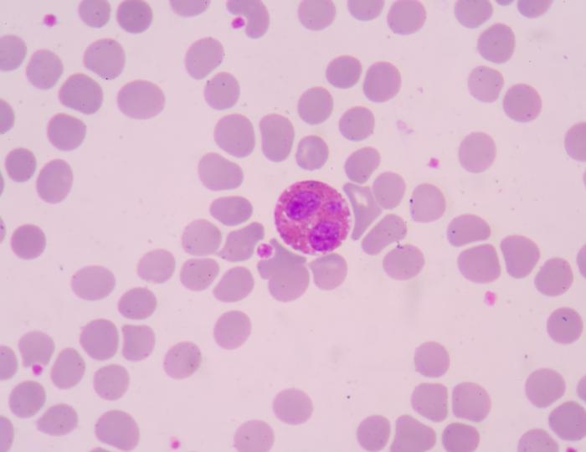
Eosinophils

Slide 4
Ruminant stomach

Slide 5
Ovaries

Slide 6
Rhodesian Ridgeback

Slide 7
Maine Coon

Slide 8
Shetland Sheepdog

Slide 9
Flea Larva

Slide 10
Tick- American Dog

Slide 11
Tick- Lonestar

Slide 12
Weimaraner

