Slide 1
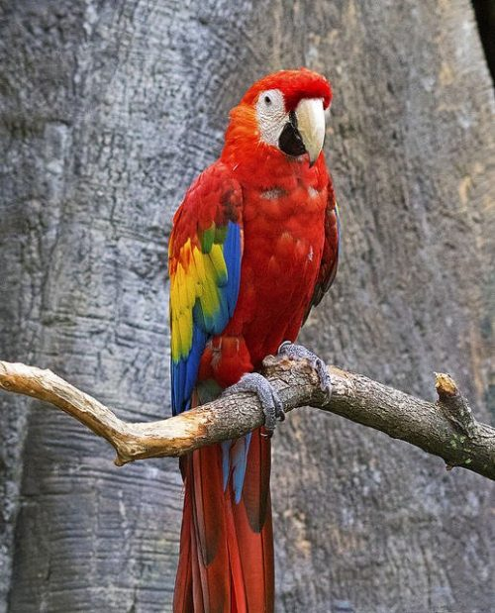
Macaw

Slide 2
Persian

Slide 3
Bull Terrier

Slide 4
Irish Setter

Slide 5
Dachshund

Slide 6
Beagle

Slide 7
Iguana

Slide 8
Gerbil

Slide 9
Hamster

Slide 10
Columbia Sheep

