Slide 1
Organ Identification
PEER Program, Texas A&M University

Slide 2
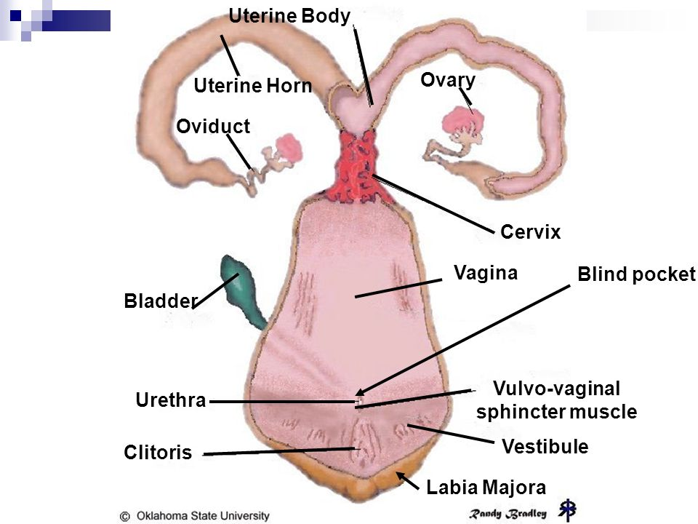
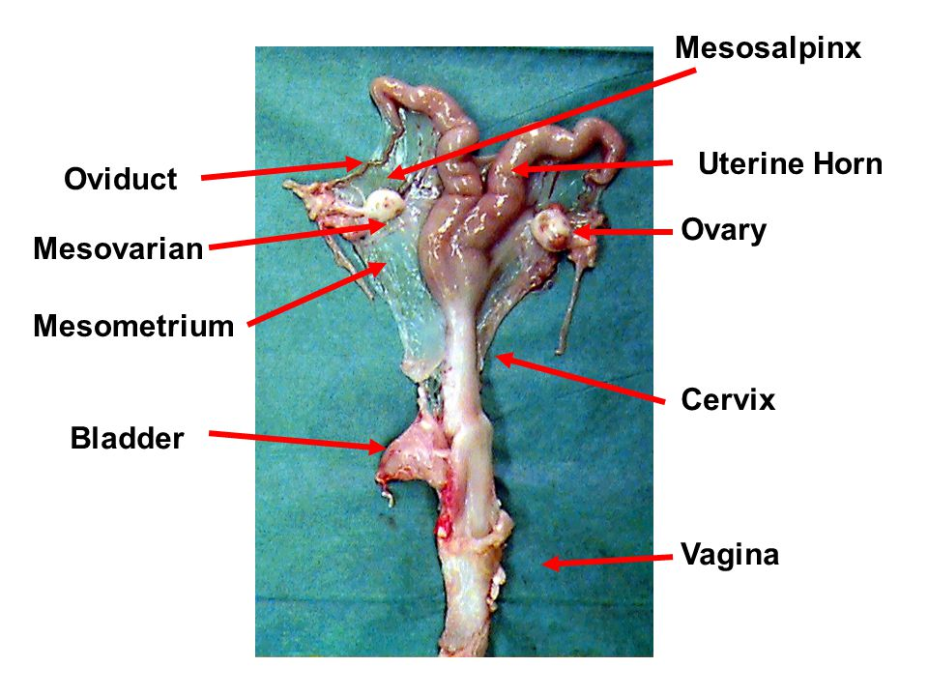
Uterine horn/horns

Slide 3
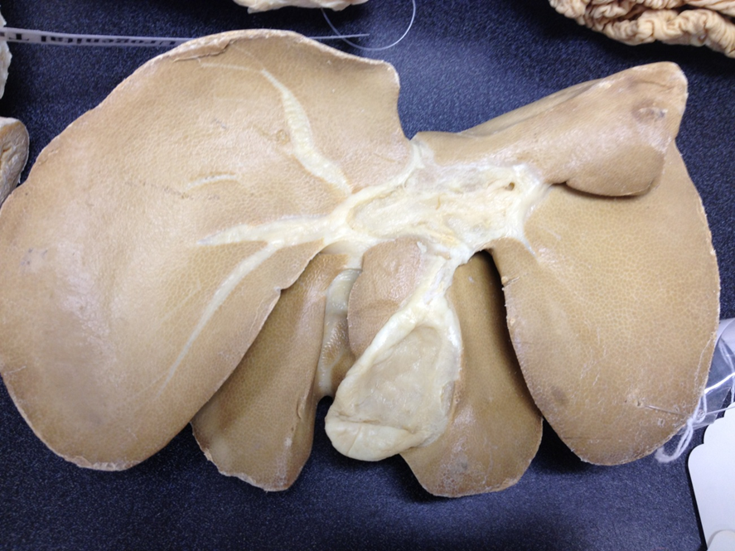
Gall Bladder

Slide 4
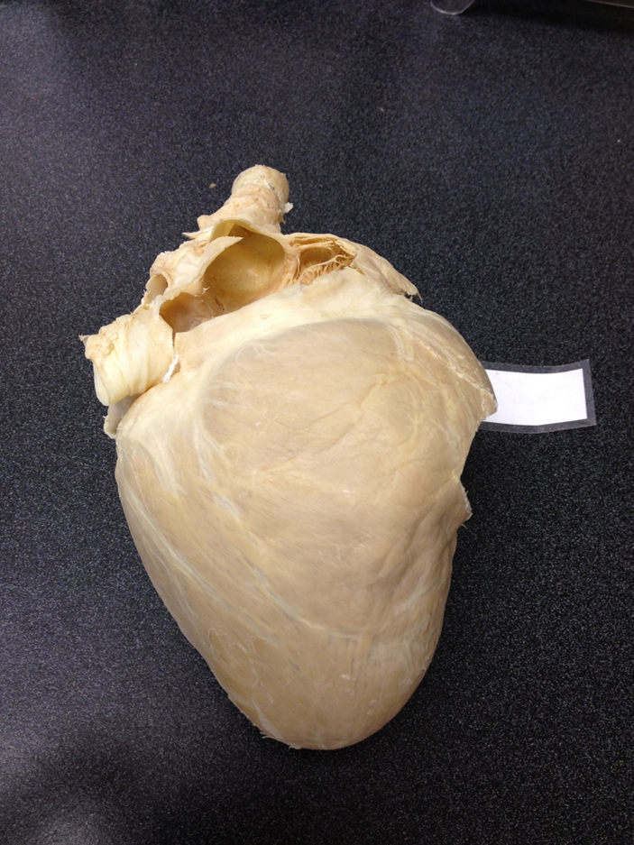
Heart

Slide 5
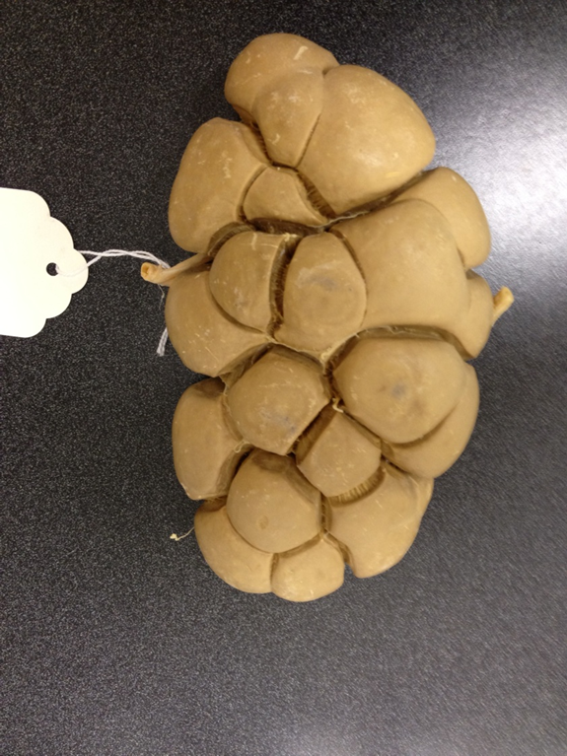
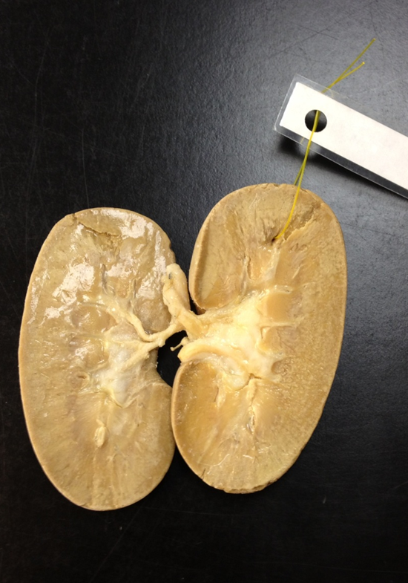
Kidney

Slide 6
Liver

Slide 7
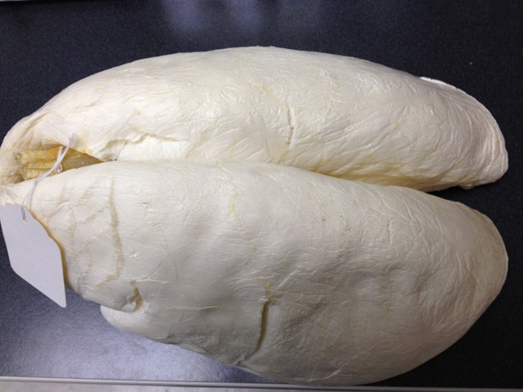
Lungs

Slide 8
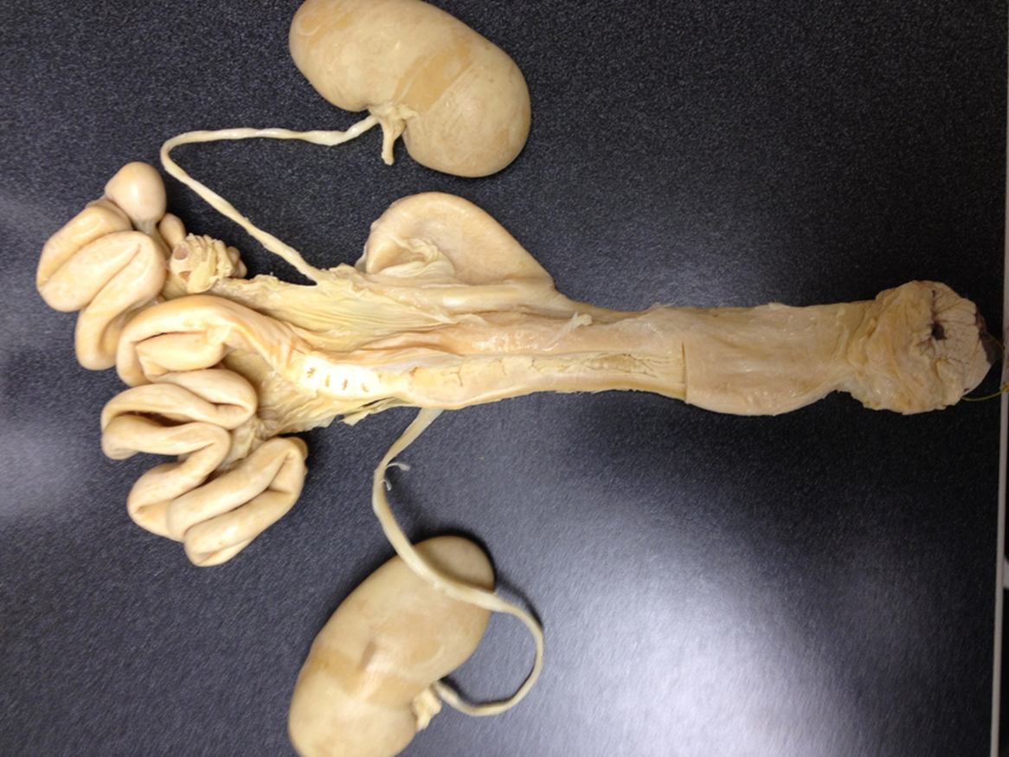
Ovary

Slide 9
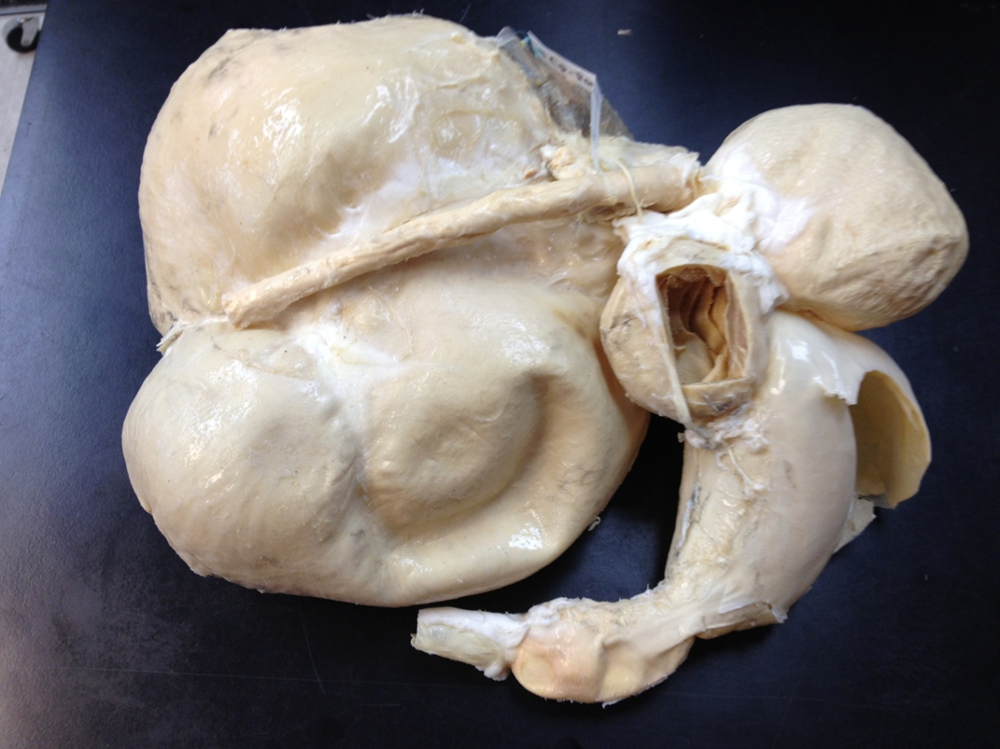
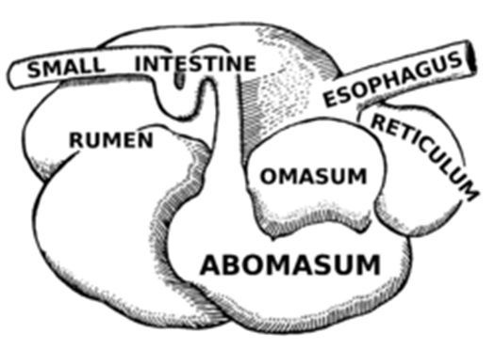
Ruminant Stomach

Slide 10
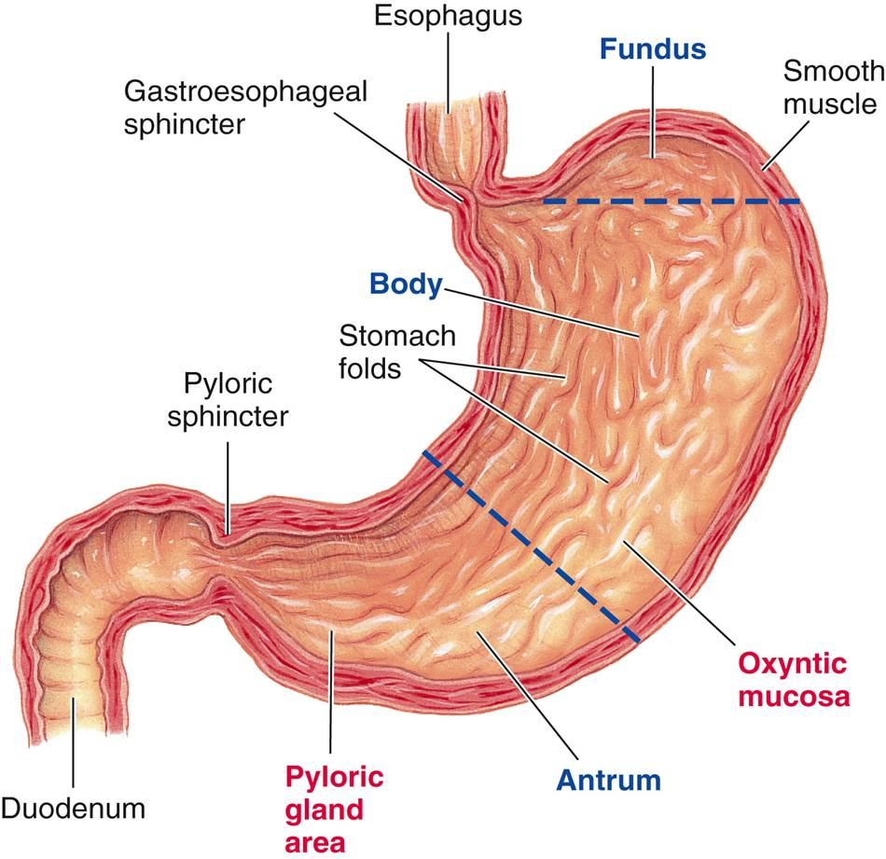
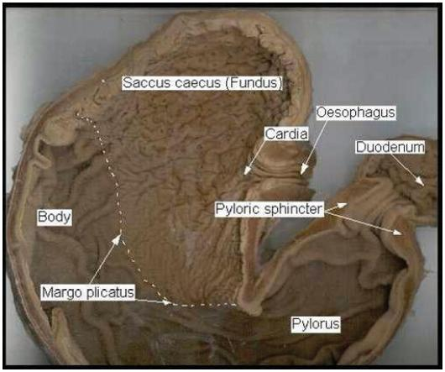
Monogastric Stomach

Slide 11
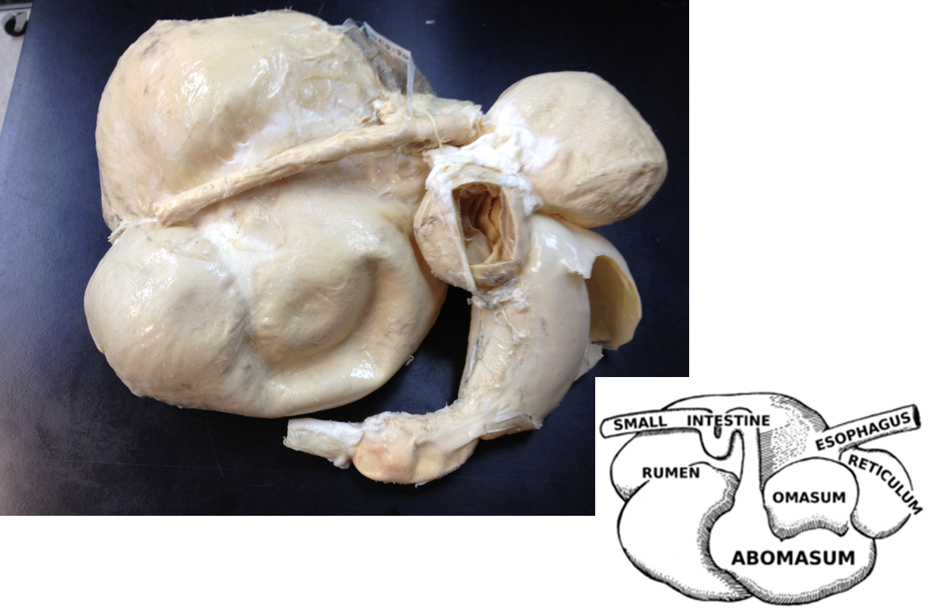
Rumen

Slide 12
Reticulum

Slide 13
Omasum

Slide 14
Abomasum

Slide 15
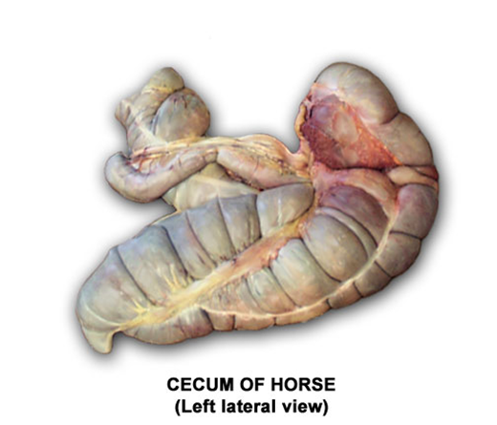
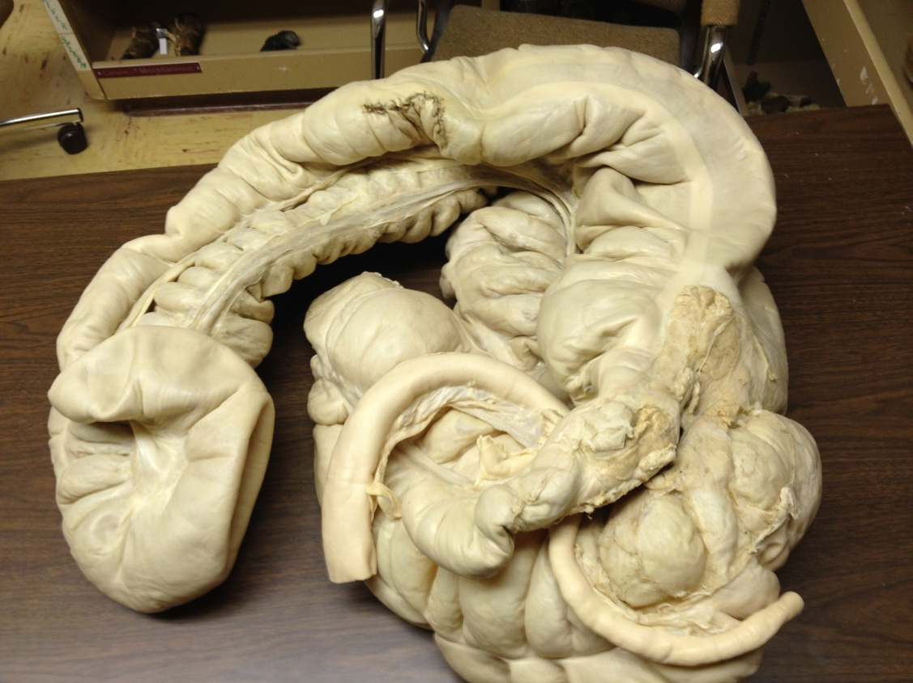
Large Intestine
Large Intestine
Cecum
Small Intestine-Duodenum
Small Intestine (Ileum) entering large intestine

Slide 16
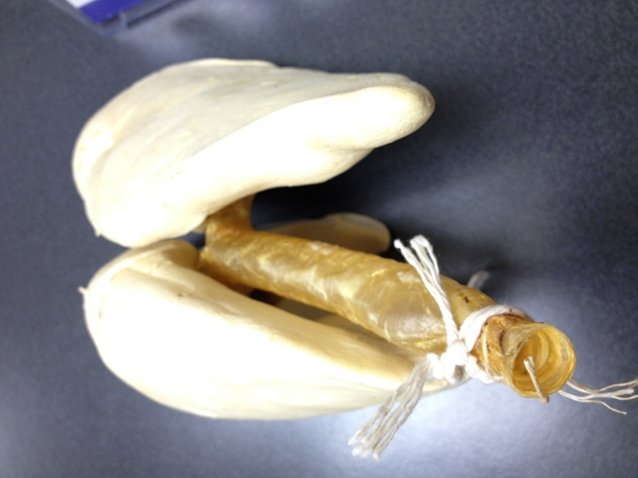
Trachea

Slide 17
Uterus

Slide 18
Cervix

Slide 19
Cecum
Large Intestine
Cecum
Small Intestine-Duodenum
Small Intestine (Ileum) entering large intestine

Slide 20
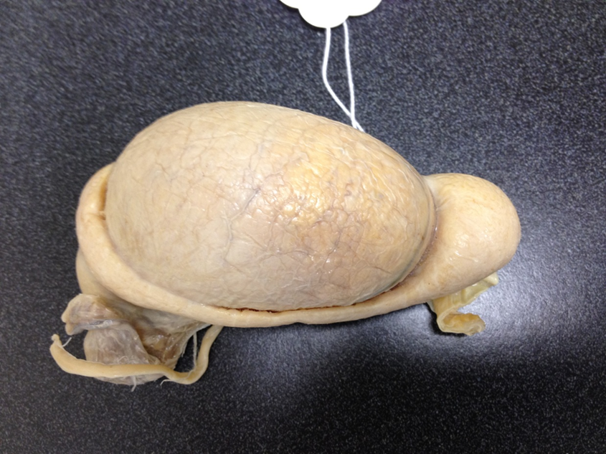
Testicle

Slide 21
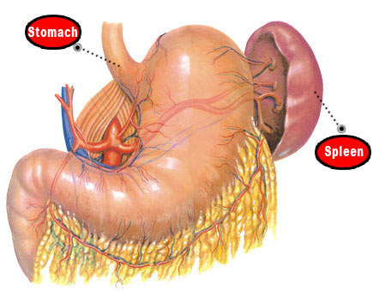
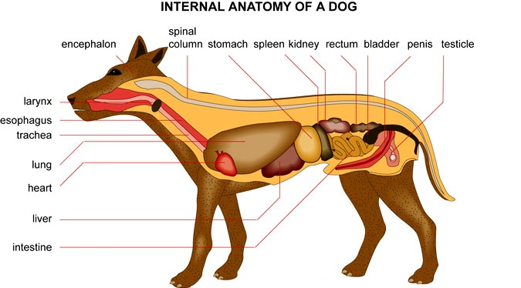
Spleen

Slide 22
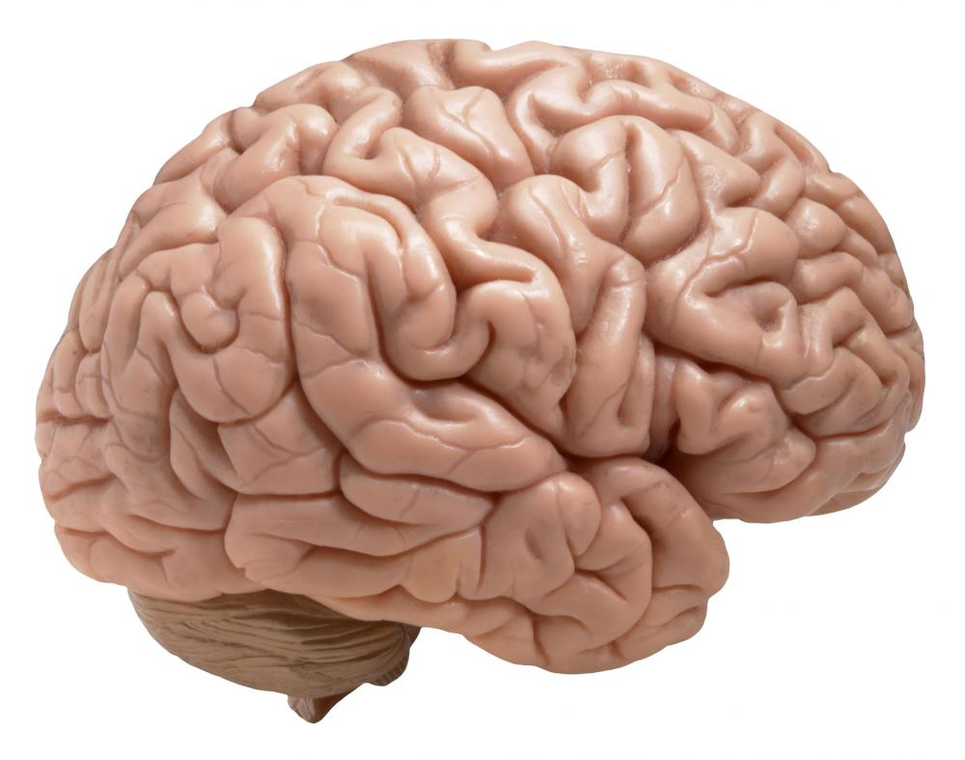
Brain

Slide 23
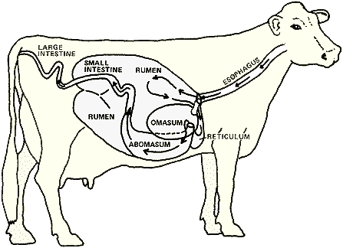
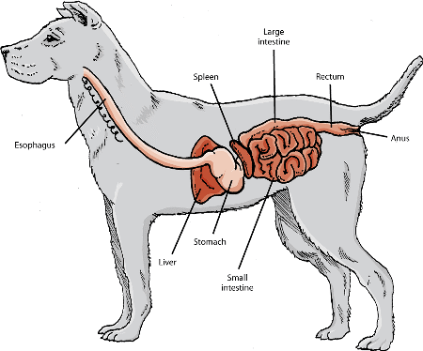
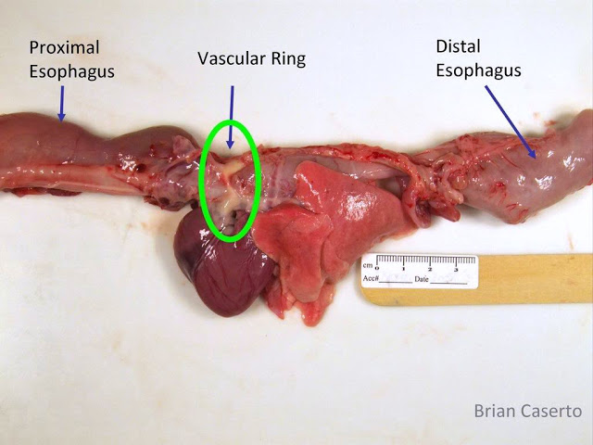
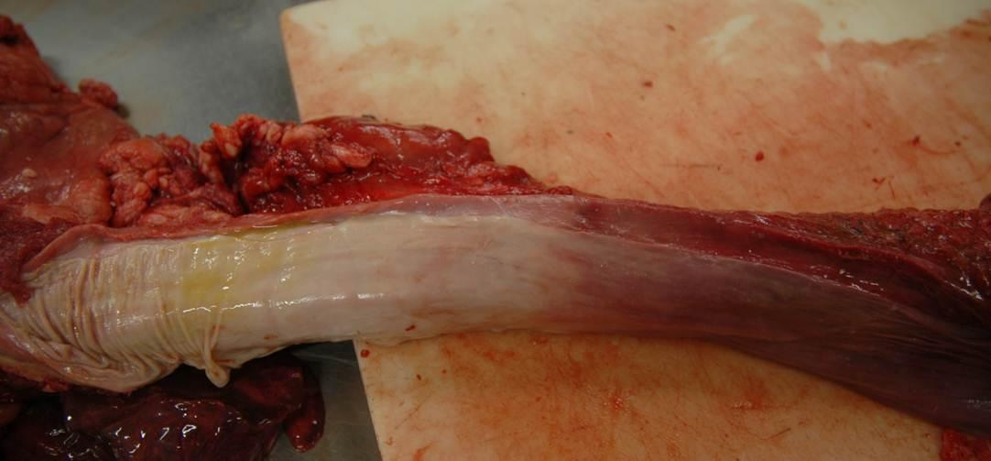
Esophagus

