Slide 1
Practice #40 TEST (Instrument Identification)
For this practice write down on a sheet of paper what you think the answer is. Grade yourself using the answer key on the last slide after you wrote your answer for each slide. Each slide is worth 5 pts. Each.

Slide 2
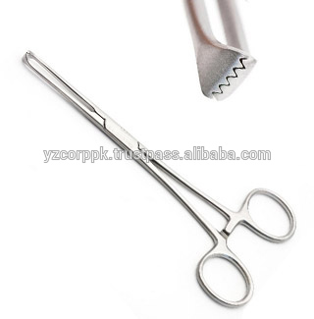

Slide 22
Answer Key
1. Allis Tissue forceps
2. Mosquito Forceps
3. Metzenbaum dissecting scissors
4. staple remover
5. pig tooth nippers
6. mayo hegar dissecting scissors
7. otoscope
8. ophthalamoscope
9. tonometer
10. suture wire cutting scissors
11. laparoscope
12. lyringoscope
13. endoscope
14. endotracheal tube
15. balling gun
16. catch pole
17. rat tooth thumb forceps
18. emasculator
19. crile forceps
20. Olsen hegar needle holder

