Slide 1
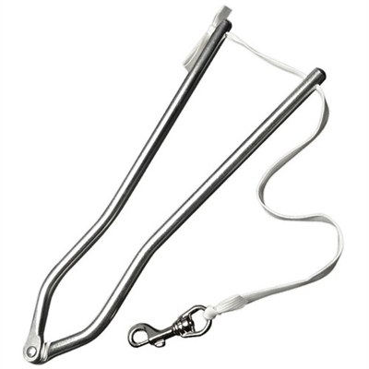
Twitch Humane

Slide 2
Vaginal Speculum

Slide 3
Rumen Magnet

Slide 4
Balling Gun

Slide 5
From Left to Right (Small Intestine, Cecum, Monogastric Stomach, Large Intestine, Liver, Gall Bladder

Slide 6
Omasum

Slide 7
Paint Horse

Slide 8
Great Pyranese

Slide 9
Guernsey

Slide 10
Whipworm

Slide 11
Cat Warble

Slide 12
Cocci

