Slide 1
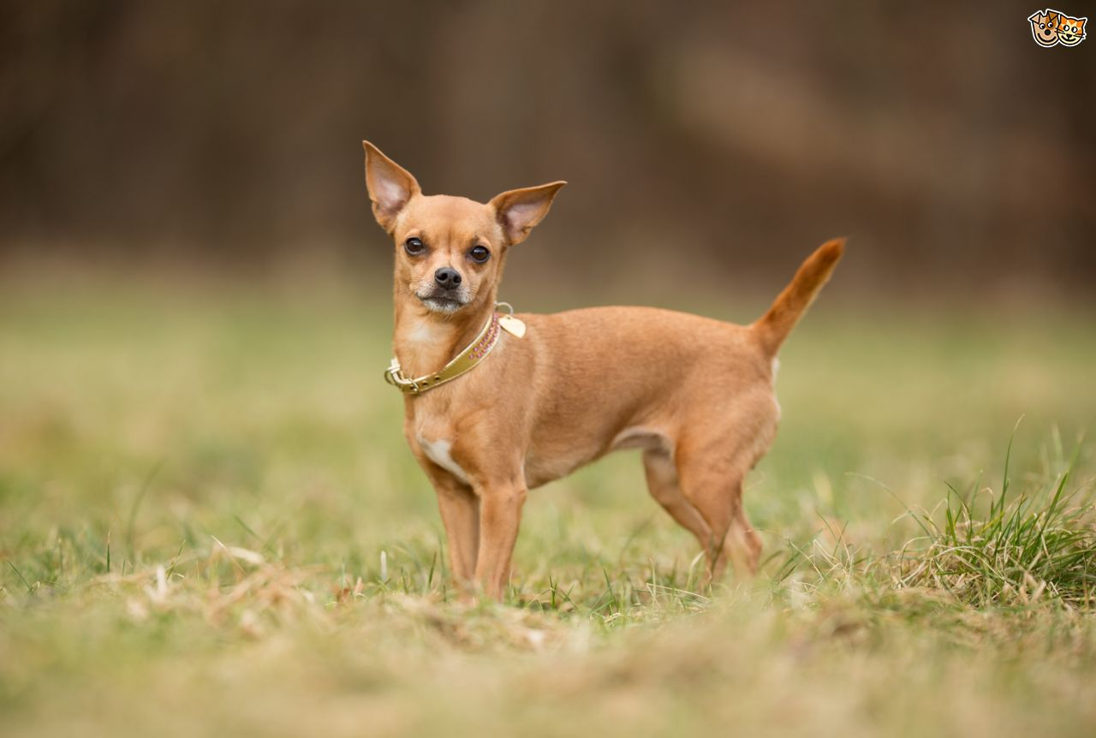
Chihuahua

Slide 2
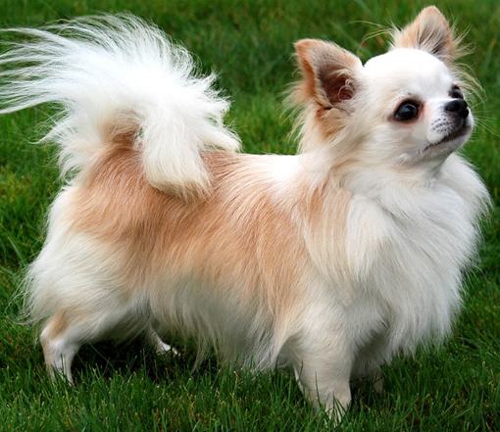
Chihuahua
AKC Recognized Colors:
9 recognized colors (there is a wide variety)
AKC Recognized Markings:
6 markings
Originated in Mexico
Terrier-like attitude (aggressive and active)
Small size, can have a short or long coat

Slide 3
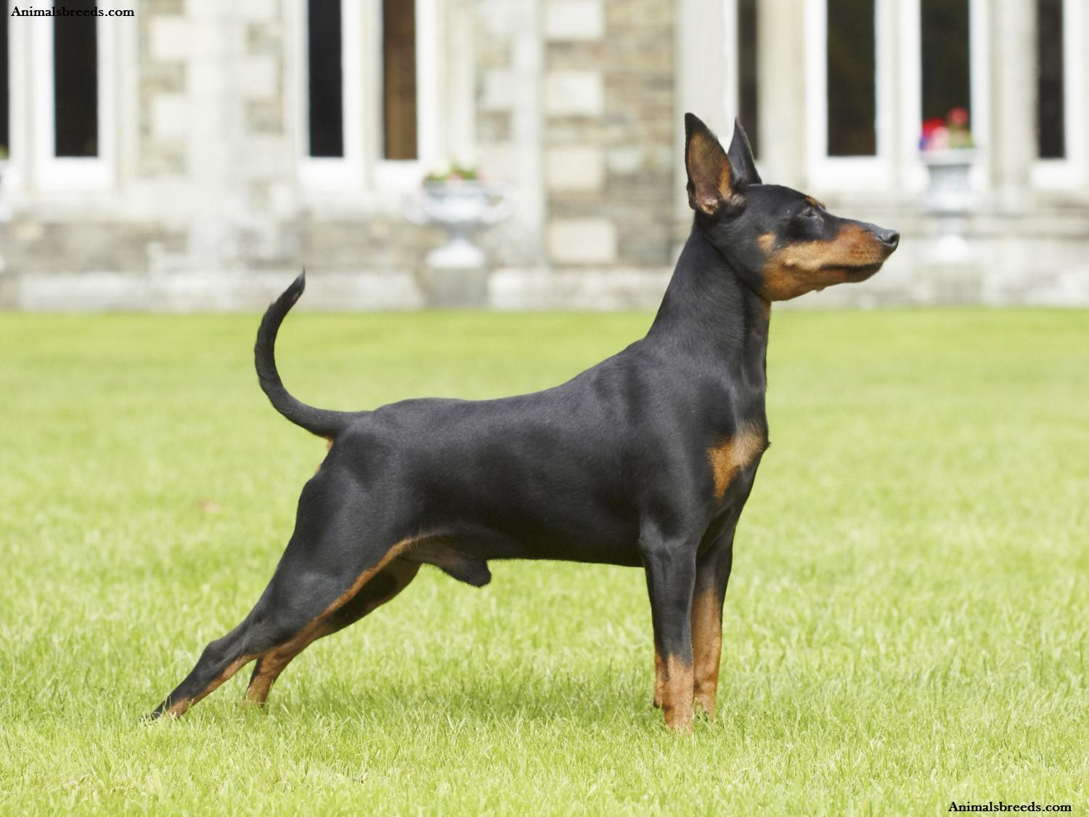
Miniature Pinscher

Slide 4
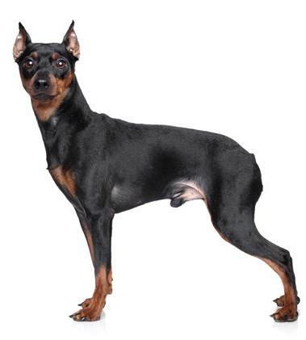
Miniature Pinscher
AKC Recognized Colors:
Black & rust
Black & tan
Chocolate & rust
Chocolate & tan
Red
Stag red
AKC Recognized Markings:
None
Min Pins originate from Germany
Used as a ratter in barns (despite their excellent ratting abilities, they are not classified as terriers)
Docked tail, erect ears, short coat

Slide 5
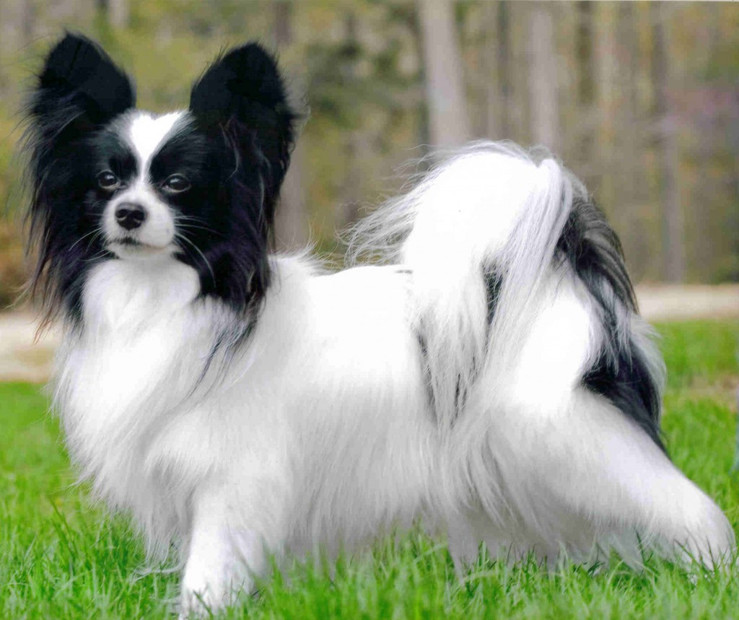
Papillon

Slide 6
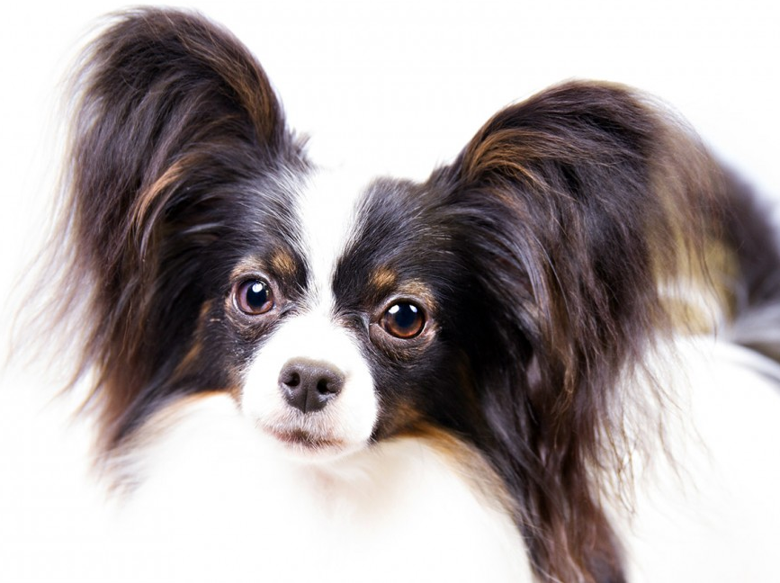
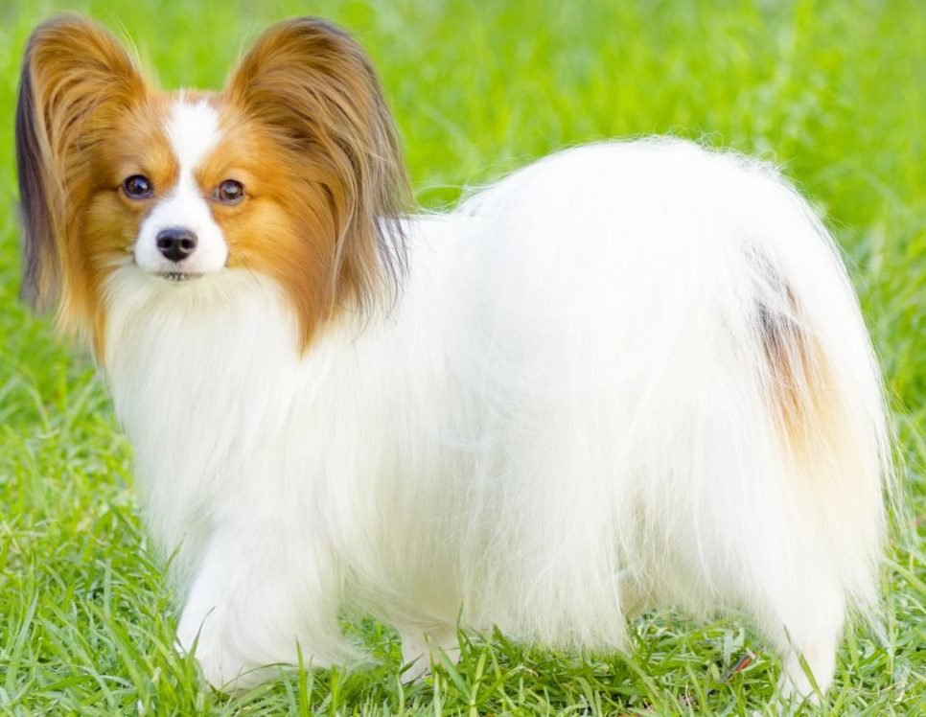
Papillon
AKC Recognized Colors:
White and black
White and lemon
White and red
White and sable
White, black, and tan
AKC Recognized Markings:
None
Originated from Spain
Papillon = “butterfly” in French (name came from its characteristic butterfly shaped ears)
Long, fine, silky coat

Slide 7
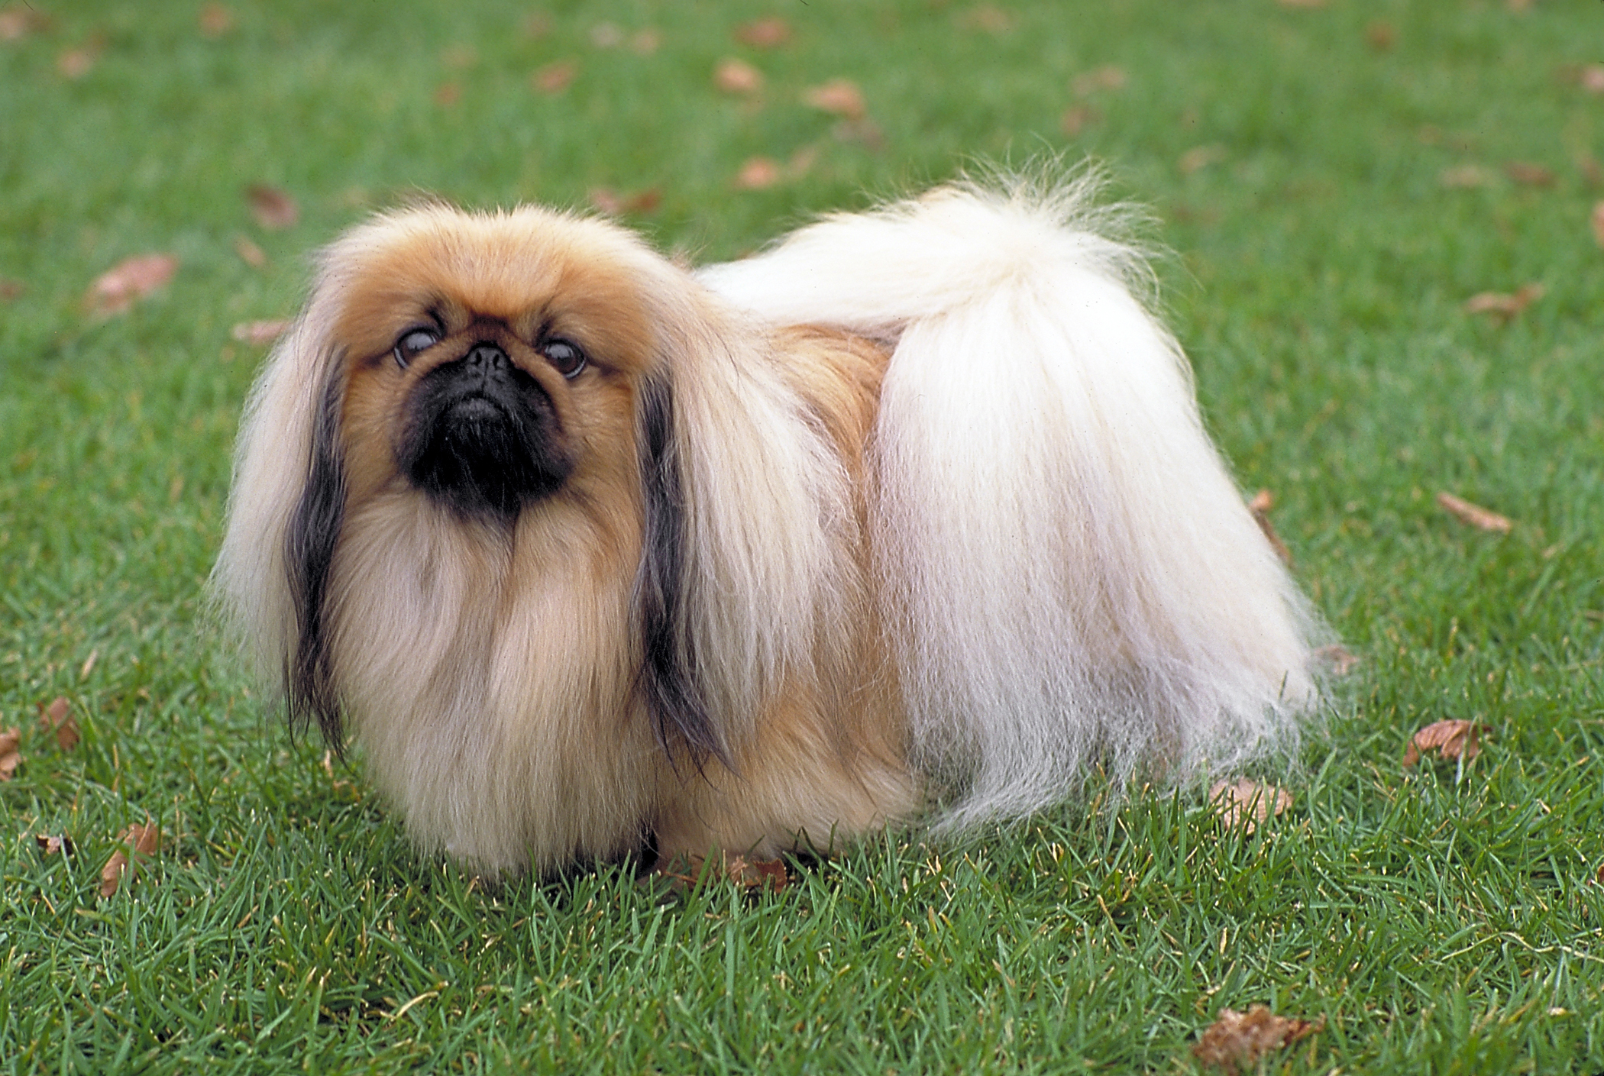
Pekingese

Slide 8
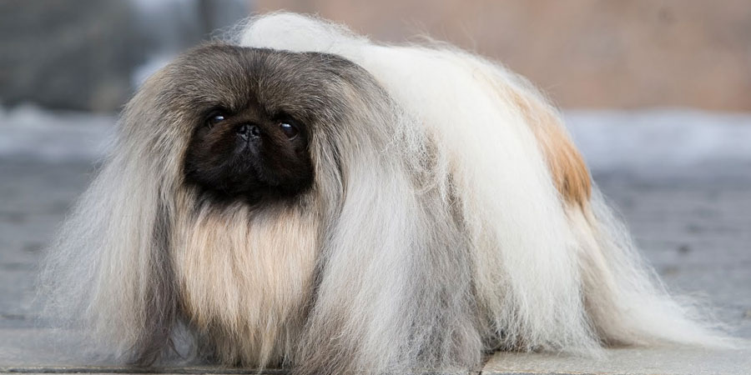
Pekingese
AKC Recognized Colors:
10 recognized colors (there is a wide variety)
AKC Recognized Markings:
Black mask
Parti-color
White
Pekes originated in China
Large head, flat face, long coat
Strong personality that likes to be in charge (despite their small size)

Slide 9
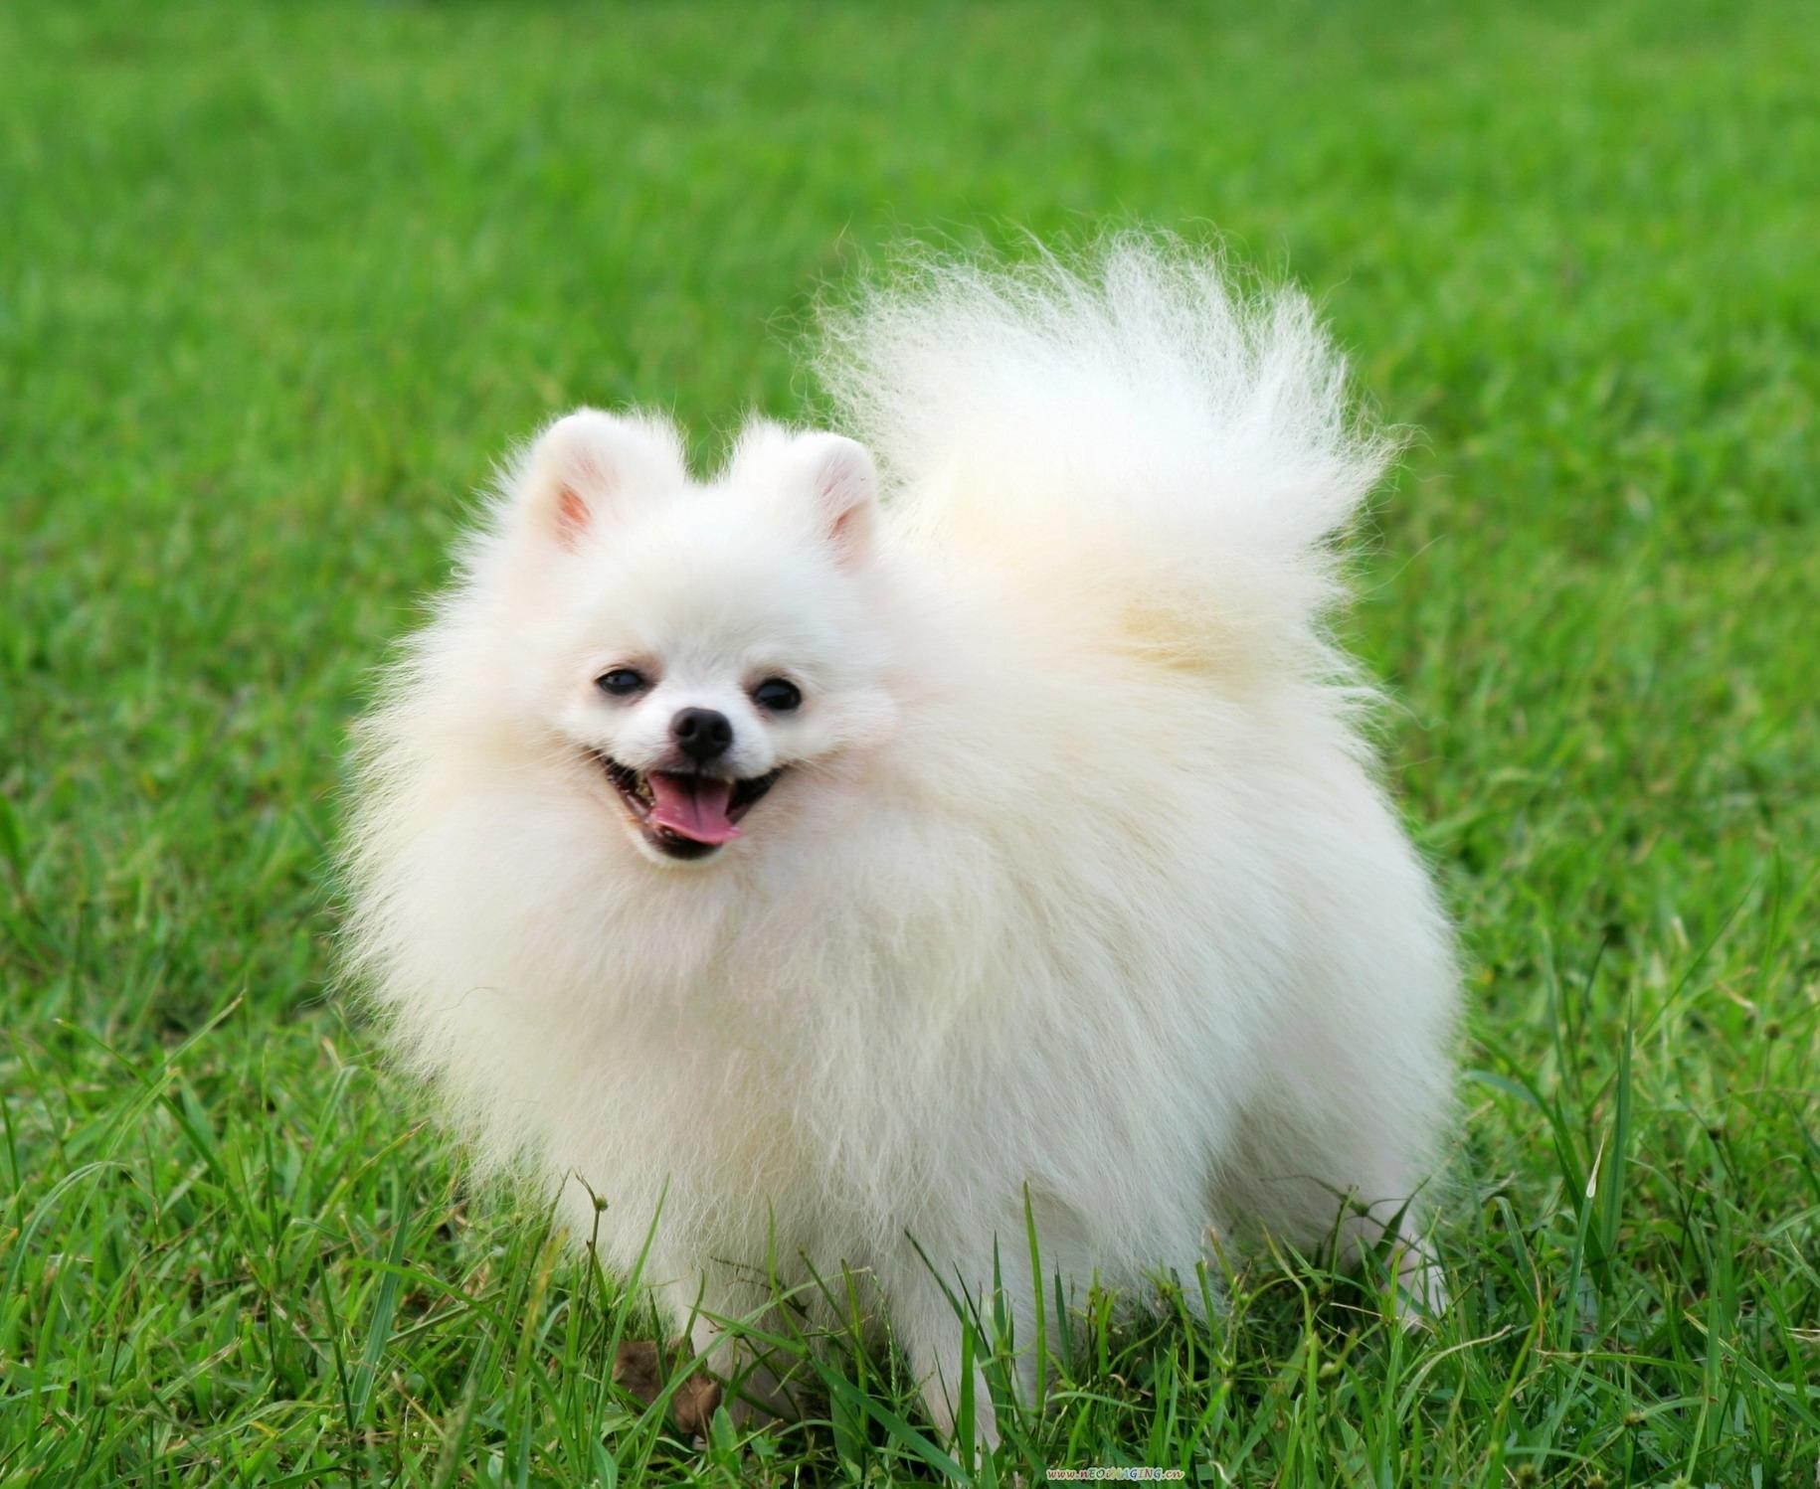
Pomeranian

Slide 10
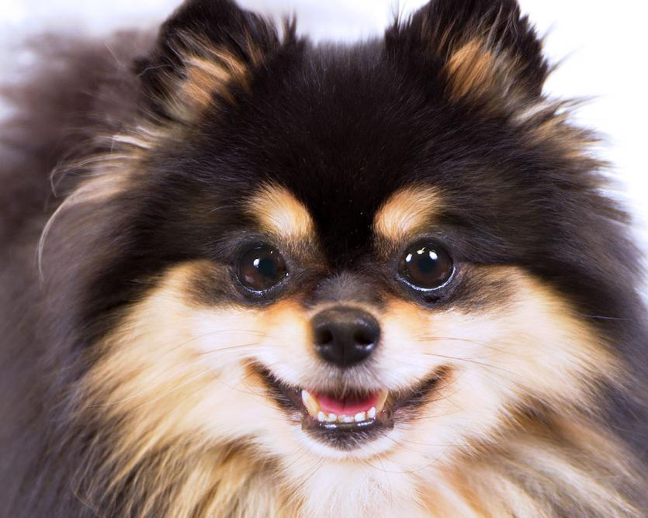
Pomeranian
AKC Recognized Colors:
18 recognized colors (there is a wide variety)
AKC Recognized Markings:
9 recognized markings
Poms originated in Pomerania (a region or Northern Europe)
Favored by Queen Victoria (Great Britain)
Small size, double-coated, short back

Slide 11
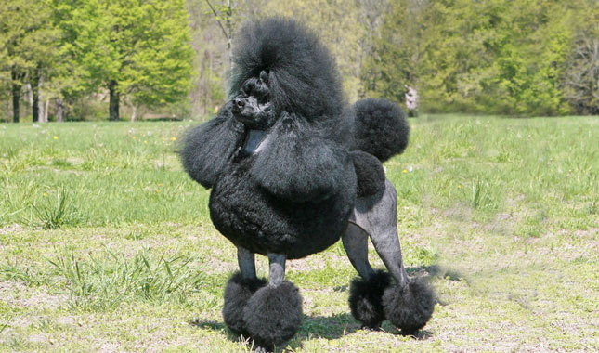
Poodle (miniature)

Slide 12
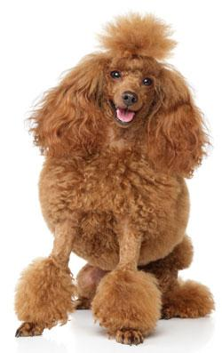
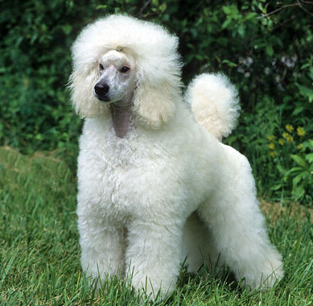
Poodle (miniature)
AKC Recognized Colors:
10 recognized colors (there is a wide variety)
AKC Recognized Markings:
None
Originated in Germany
Created by breeders who selected for smaller size
Show cuts originate from when the dogs were water dogs, it was used to keep the joints warm in cold water

Slide 13
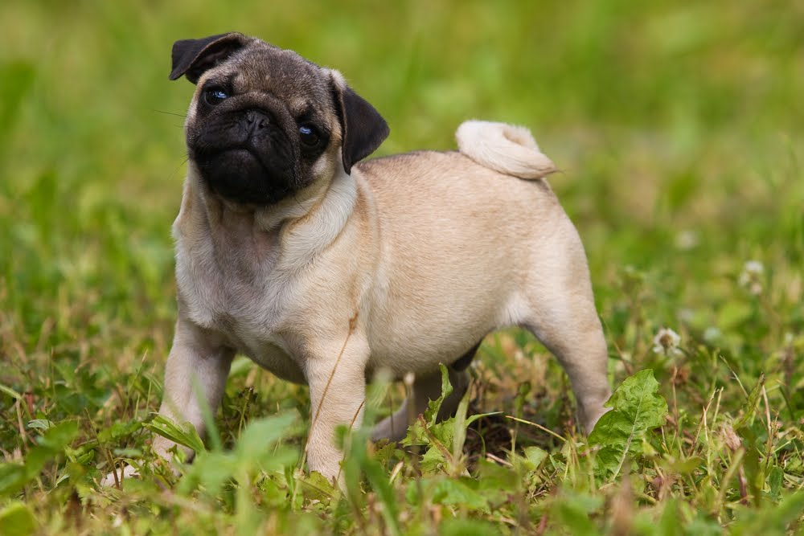
Pug

Slide 14
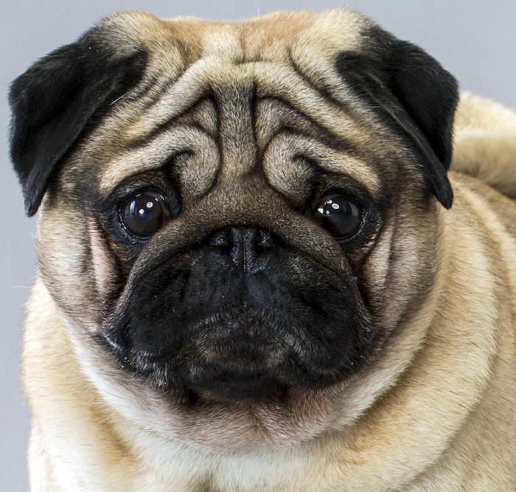
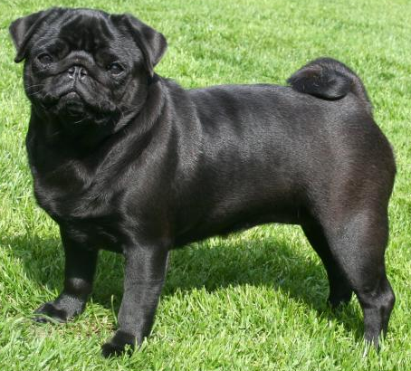
Pug
AKC Recognized Colors:
Black
Fawn
AKC Recognized Markings:
None
Originated in China
Largest of the toy breeds, curled tail
Very flat face (leads to snoring and snorting)

Slide 15
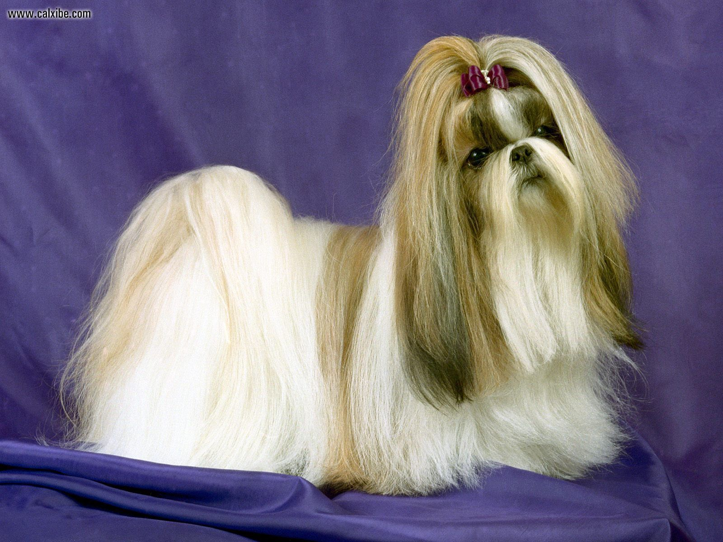
Shih Tzu

Slide 16
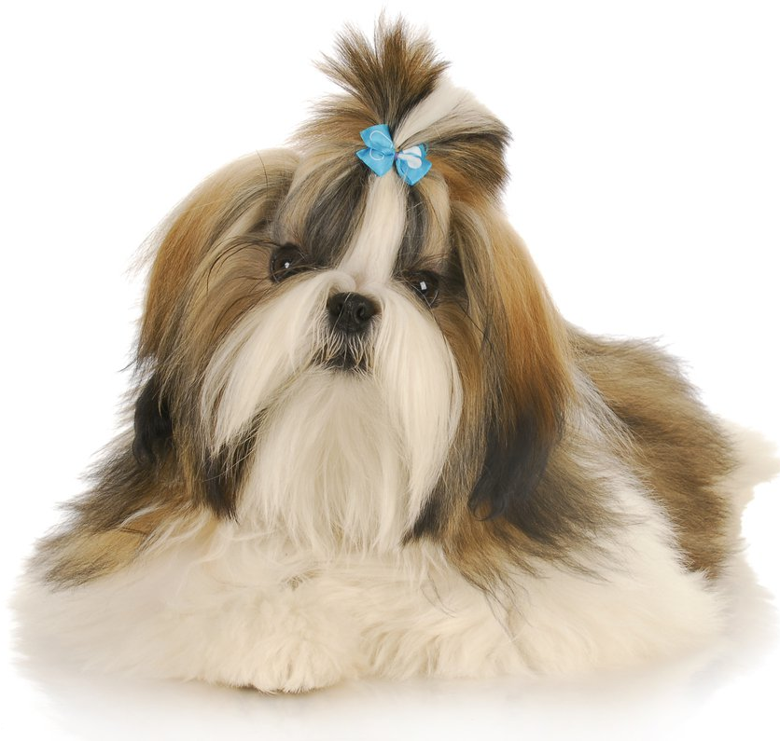
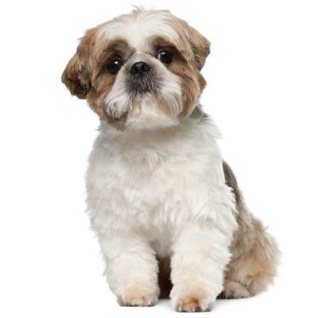
Shih Tzu (SHEED-zoo)
AKC Recognized Colors:
14 recognized colors (there is a wide variety)
AKC Recognized Markings:
Black
Black mask
Tan
Thought to originate from Tibet
Bred to do nothing (companions) and look cute doing it
Long, silky double coat, tail carried over back

Slide 17
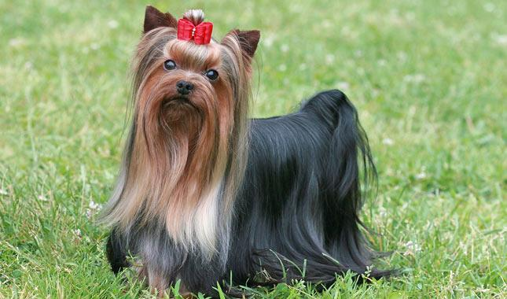
Yorkshire Terrier

Slide 18
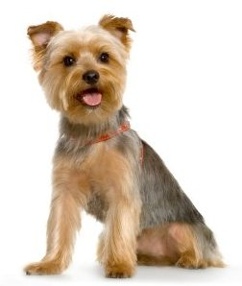
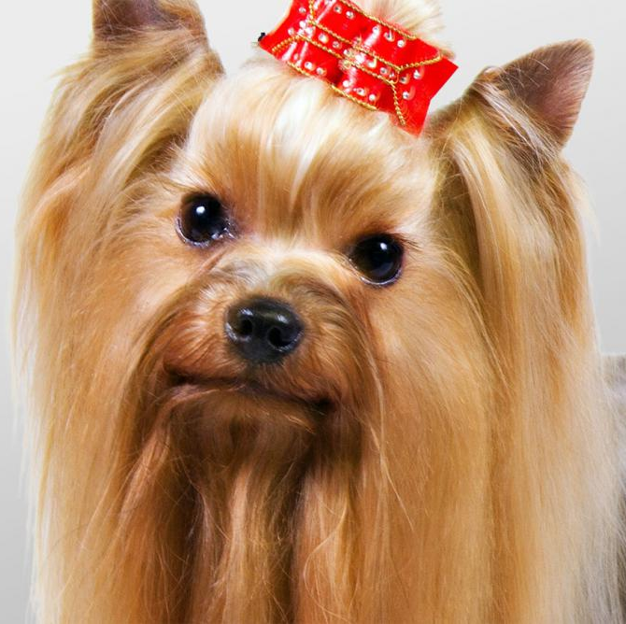
Yorkshire Terrier
AKC Recognized Colors:
Black and gold
Black and tan
Blue and gold
Blue and tan
AKC Recognized Markings:
None
Yorkies were used as ratters in England wool-mills
Fierce attitude in a small frame, glossy, fine, silky coat that is long
7th most popular breed in the USA

Slide 19
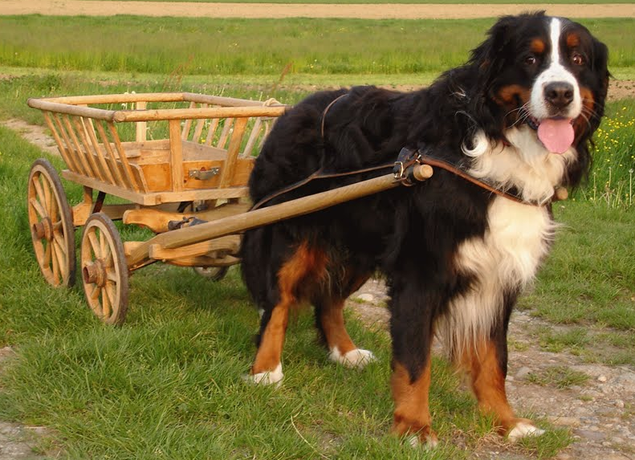
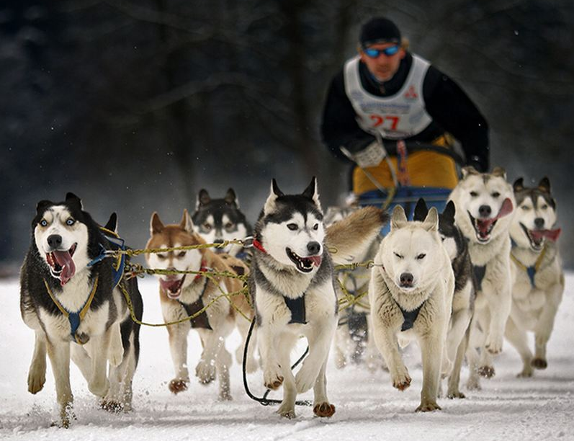
Working Group:
Bred to work! (ex. guarding, pulling sleds, rescuing people)
Large size and very strong dogs
Breeds under this group:
Bernese Mountain Dog
Boxer
Doberman Pinscher
Great Dane
Great Pyrenees
Mastiff
Newfoundland
Portuguese Water Dog
Rottweiler
Saint Bernard
Siberian Husky
Standard Schnauzer
Notes:
http://www.akc.org/dog-breeds/groups/herding/

Slide 20
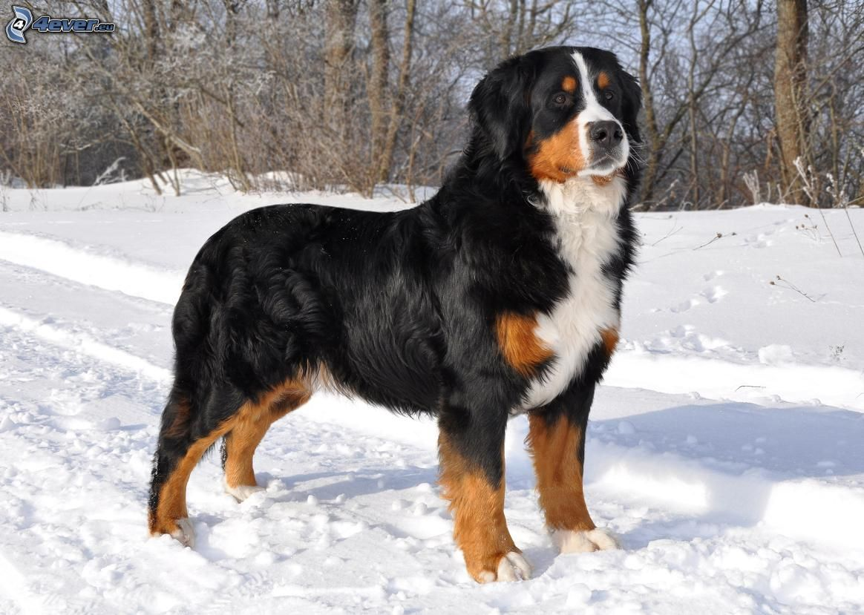
Bernese Mountain Dog

Slide 21
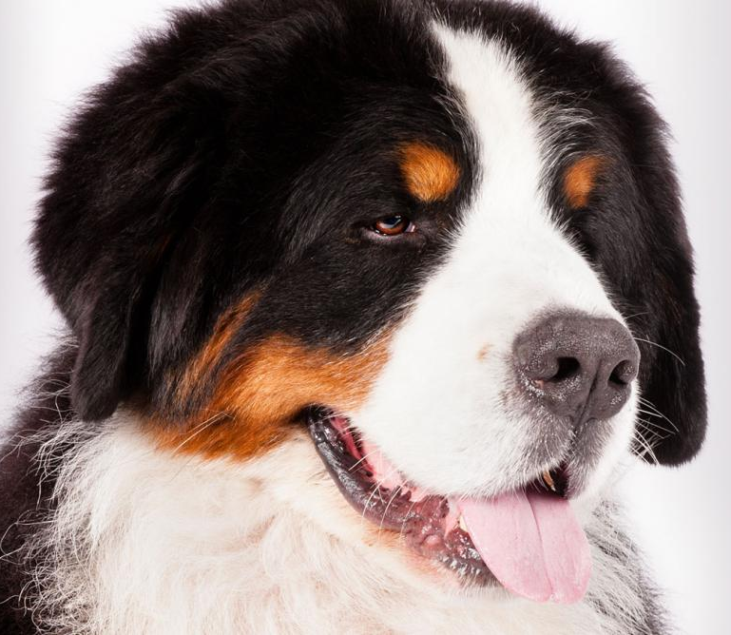
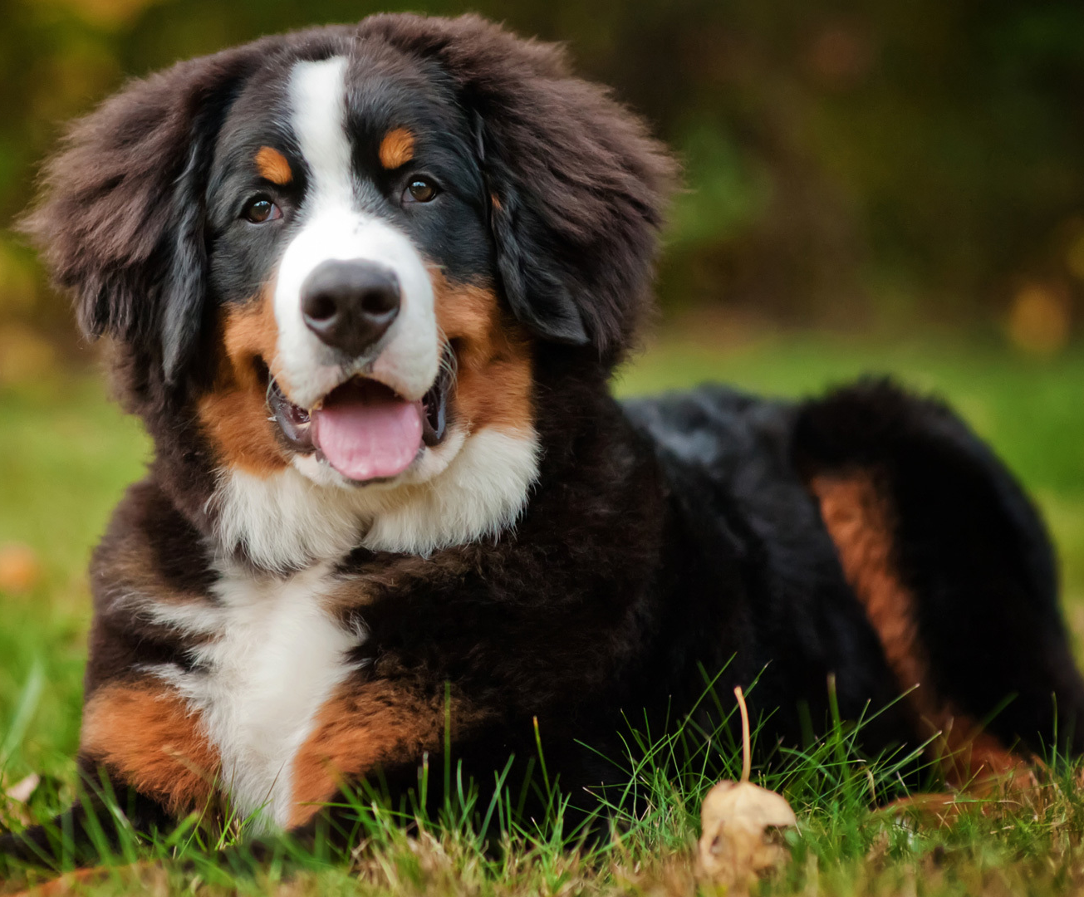
Bernese Mountain Dog
AKC Recognized Colors:
Black, rust, and white
Black, tan, and white
AKC Recognized Markings:
None
Berners originated in Switzerland
Pulled milk carts, acted as watchdogs, and drove cattle
Calm and patient temperament, large size (70-120lbs)

Slide 22
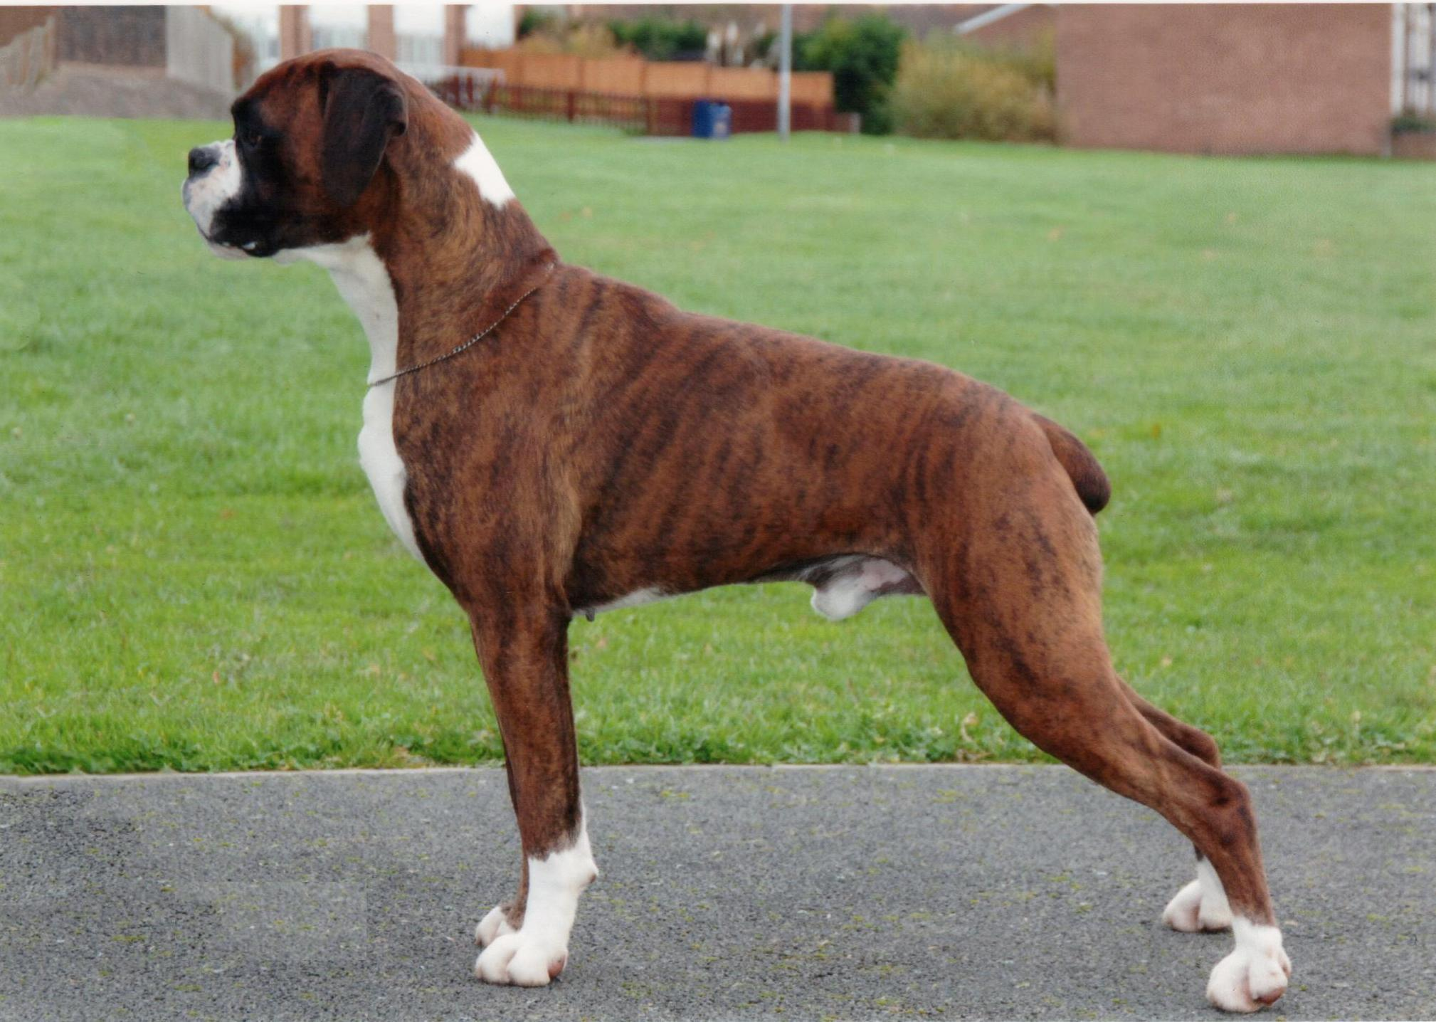
Boxer

Slide 23
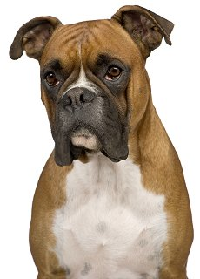
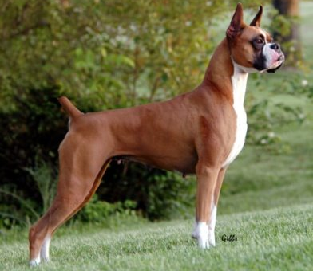
Boxer
AKC Recognized Colors:
Brindle
Fawn
AKC Recognized Markings:
Black mask
Black mask, white markings
White markings
Originated in Germany
Sweet but stubborn temperament, docked tail, medium size
10th most popular breed in America

Slide 24
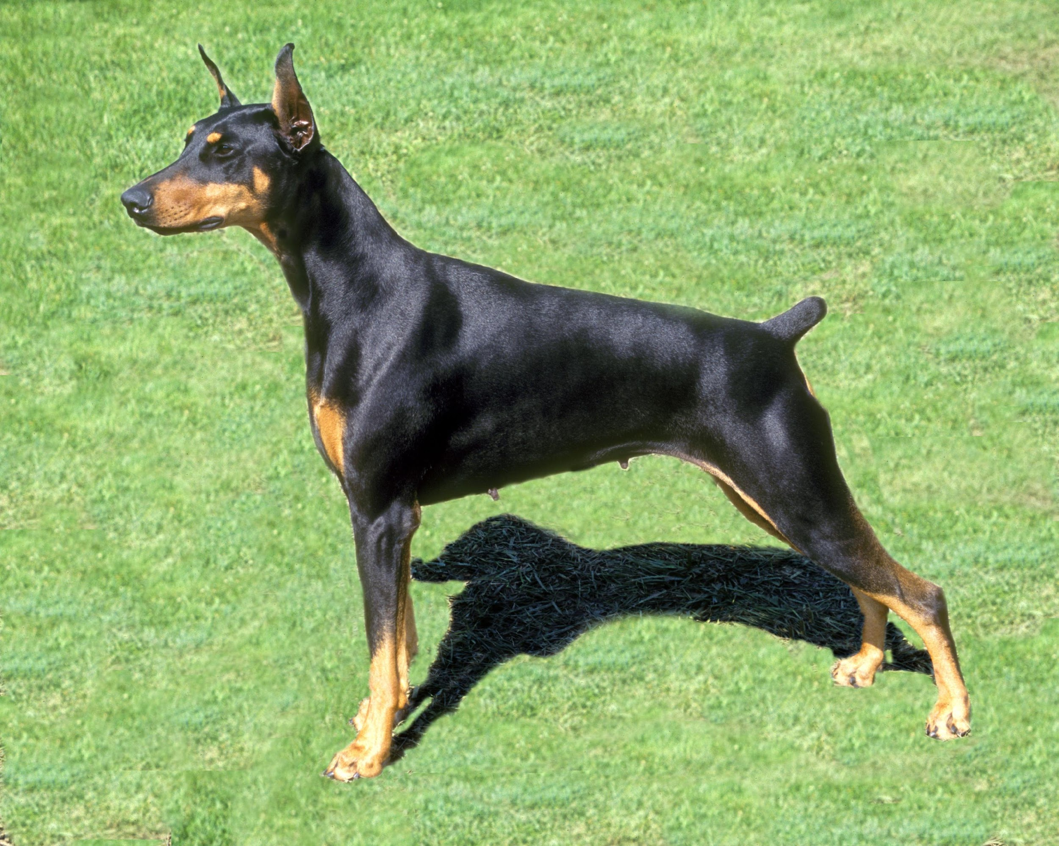
Doberman Pinscher

Slide 25
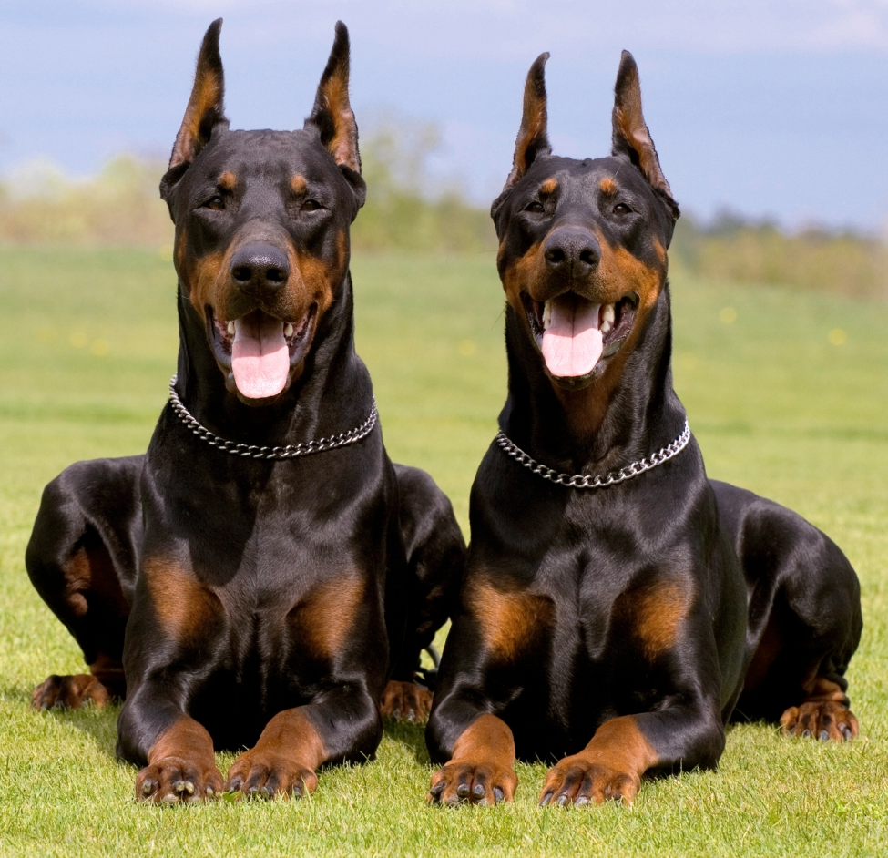
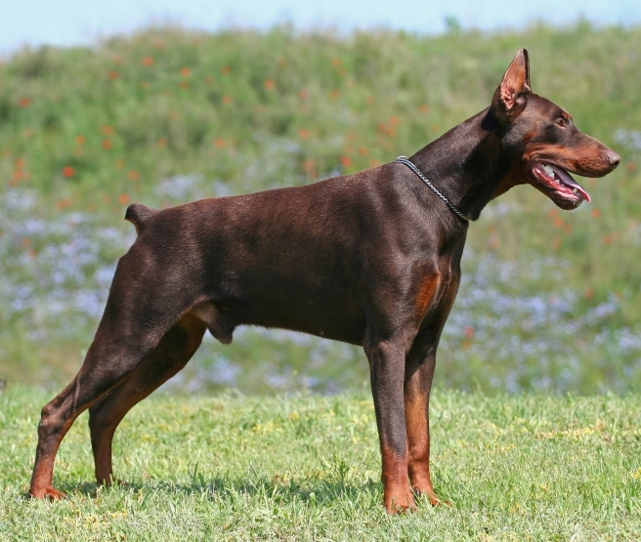
Doberman Pinscher
AKC Recognized Colors:
Black & rust
Blue & rust
Fawn & rust
Red & rust
AKC Recognized Markings:
None
Dobies originated in Germany
Used as a guard dog
Intelligent and reliable personality, dark body color with rust points, docked tail, erect ears (usually cropped)

Slide 26
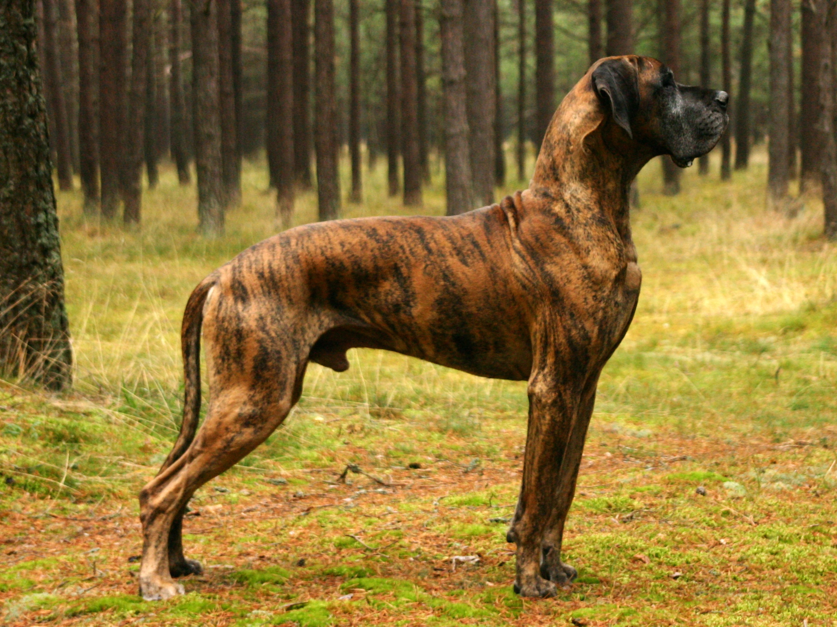
Great Dane

Slide 27
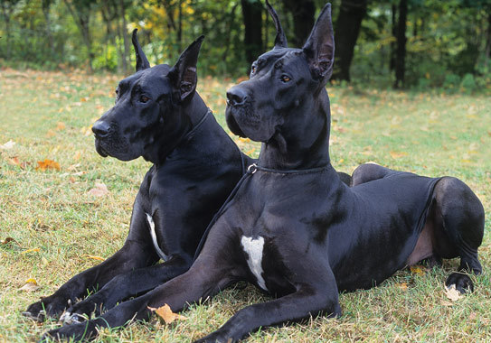
Great Dane
AKC Recognized Colors:
9 recognized colors (there is a wide variety)
AKC Recognized Markings:
Black markings
Black mask
White markings
Danes originated in Germany
Designed to hunt boar
One of the largest breeds (110-190lbs), powerful, muscular frame, short coat

Slide 28
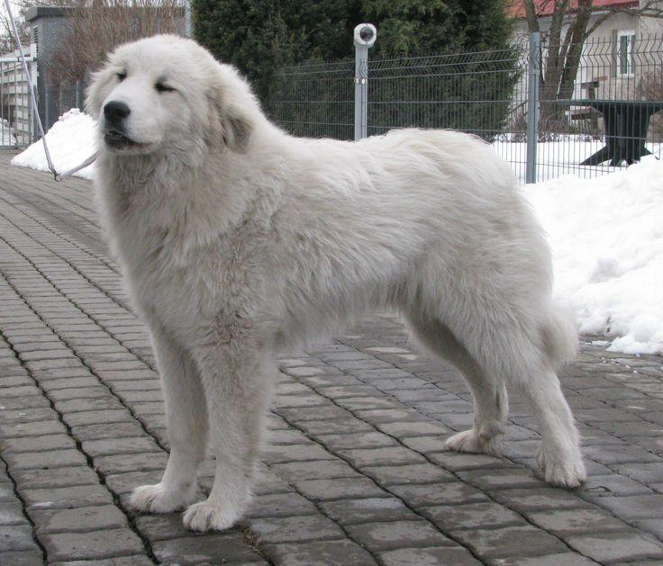
Great Pyrenees

Slide 29
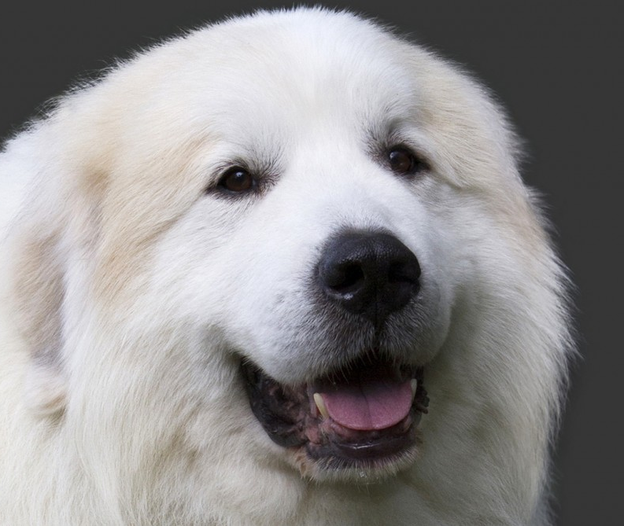
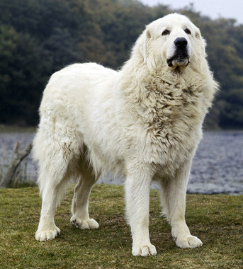
Great Pyrenees
AKC Recognized Colors:
White
AKC Recognized Markings:
Badger
Gray
Reddish brown
Tan
Originated in France
Often used for pulling carts and guarding flocks of sheep from predators (large breed)
Descendants of mastiff-type dogs

Slide 30
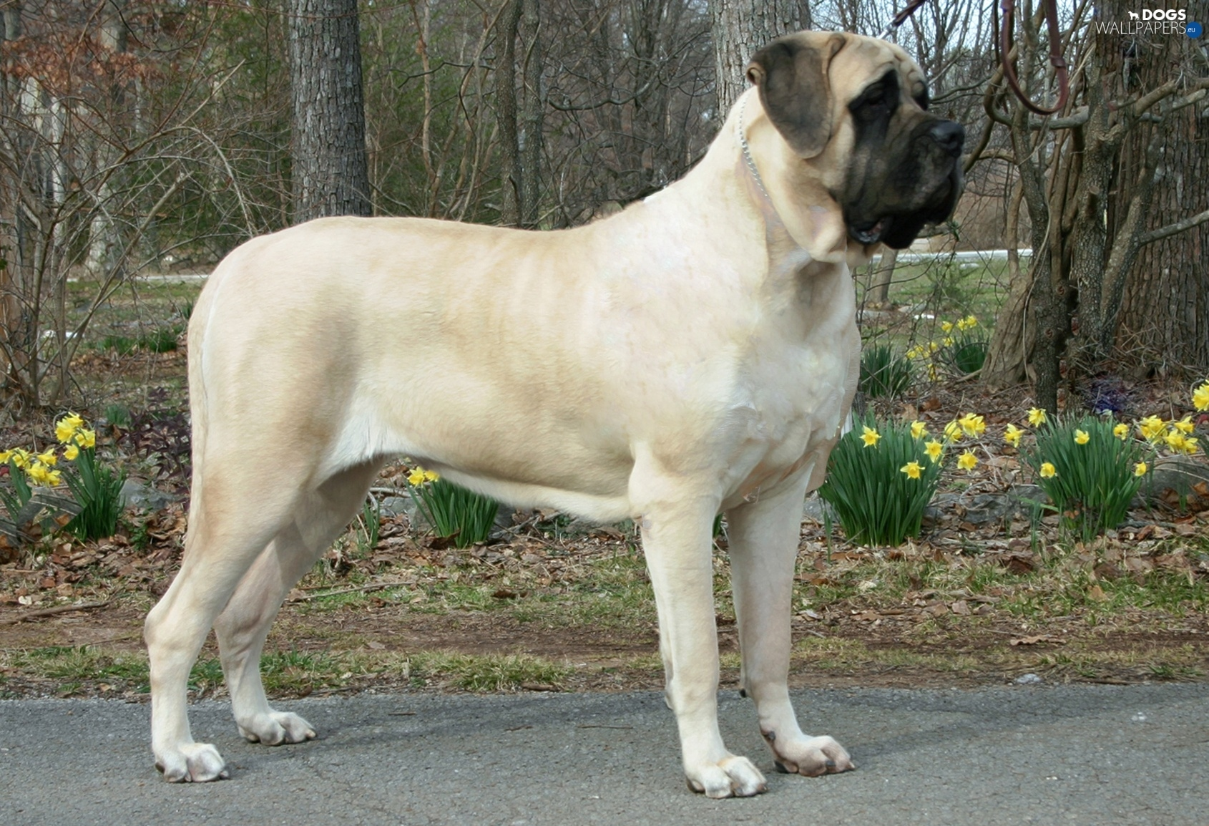
Mastiff

Slide 31
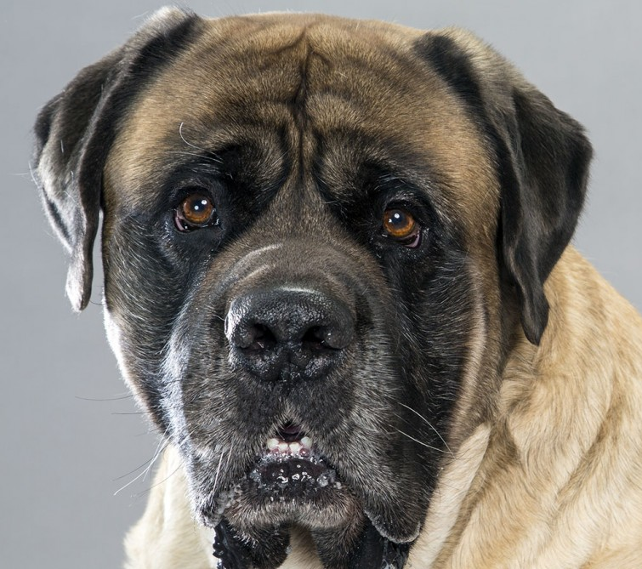
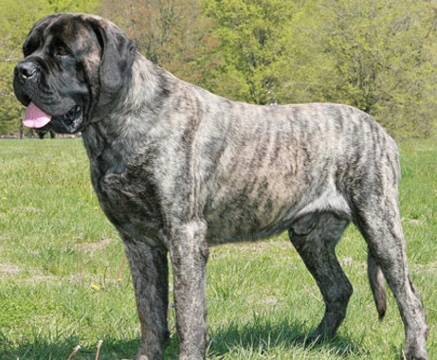
Mastiff
AKC Recognized Colors:
Apricot
Brindle
Fawn
AKC Recognized Markings:
Black mask
Originated in Central Asia, but the ones we see today originated in England (sometimes called an English Mastiff)
Old breed used to protect estates, hunt, and fight
Large breed, sturdy frame

Slide 32
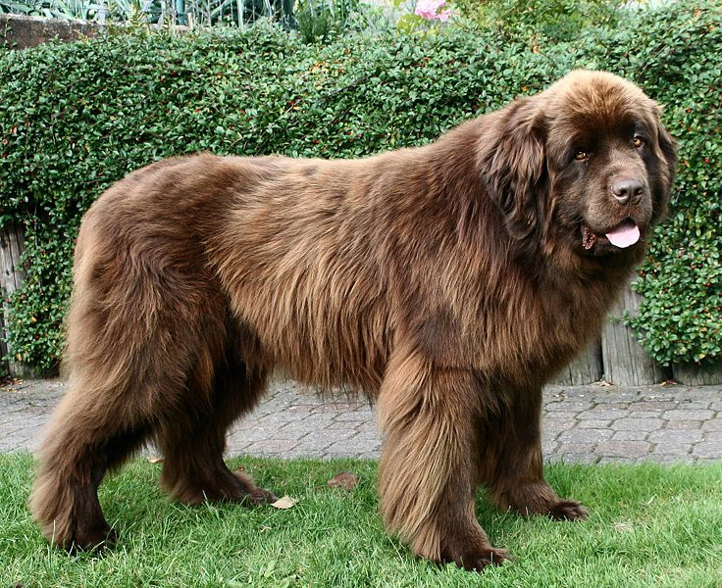
Newfoundland

Slide 33
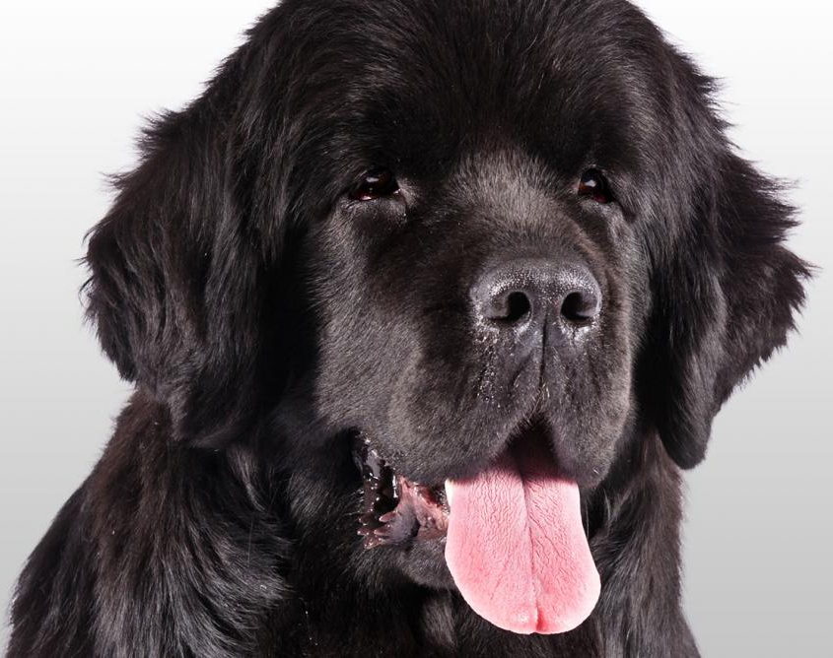
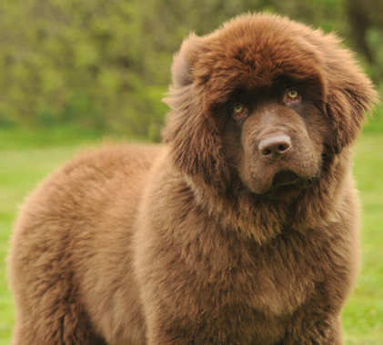
Newfoundland
AKC Recognized Colors:
Black
Brown
Gray
White & black
AKC Recognized Markings:
None
Newfies originated in Newfoundland
Known for their sweet disposition and friendly nature
Loves to swim (make excellent lifeguards), large size, heavy coat, muscular, and strong

Slide 34
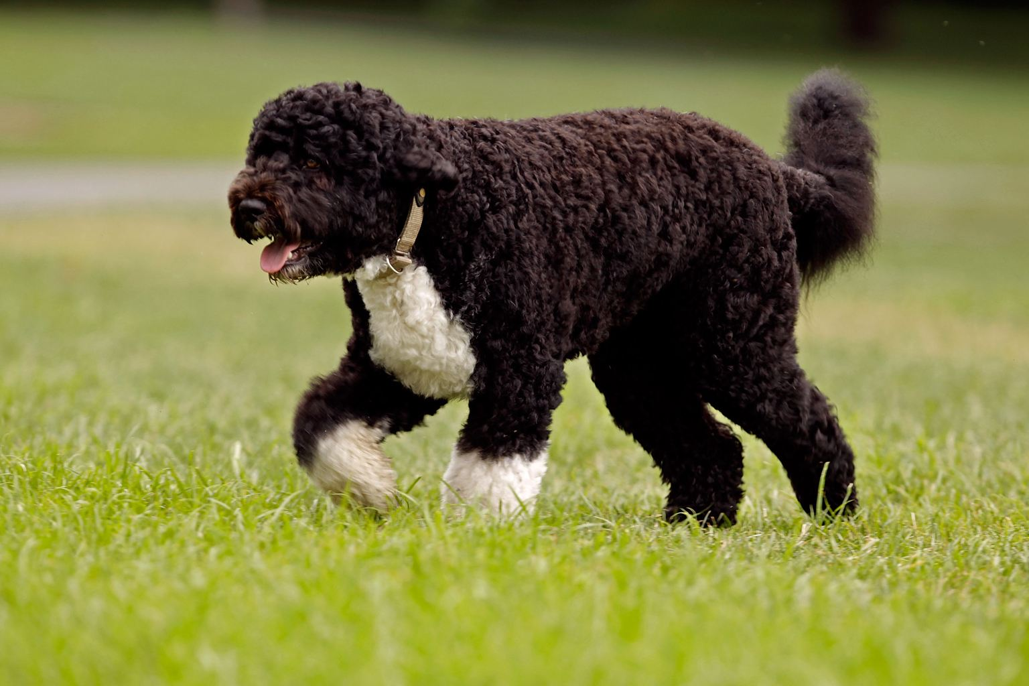
Portuguese Water Dog

Slide 35
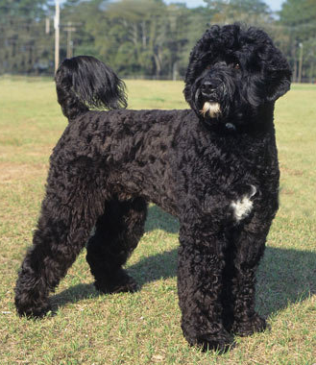
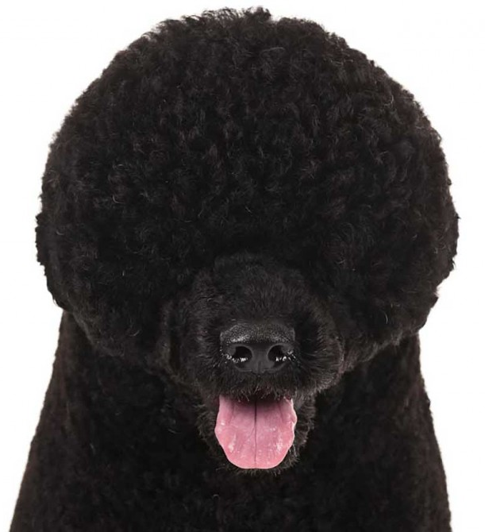
Portuguese Water Dog
AKC Recognized Colors:
Black
Brown
White
AKC Recognized Markings:
White
Porties originated in Portugal
This breed loves water and is a coastal retriever (was important in the fishing industry)
Thick, curly/wavy coat

Slide 36
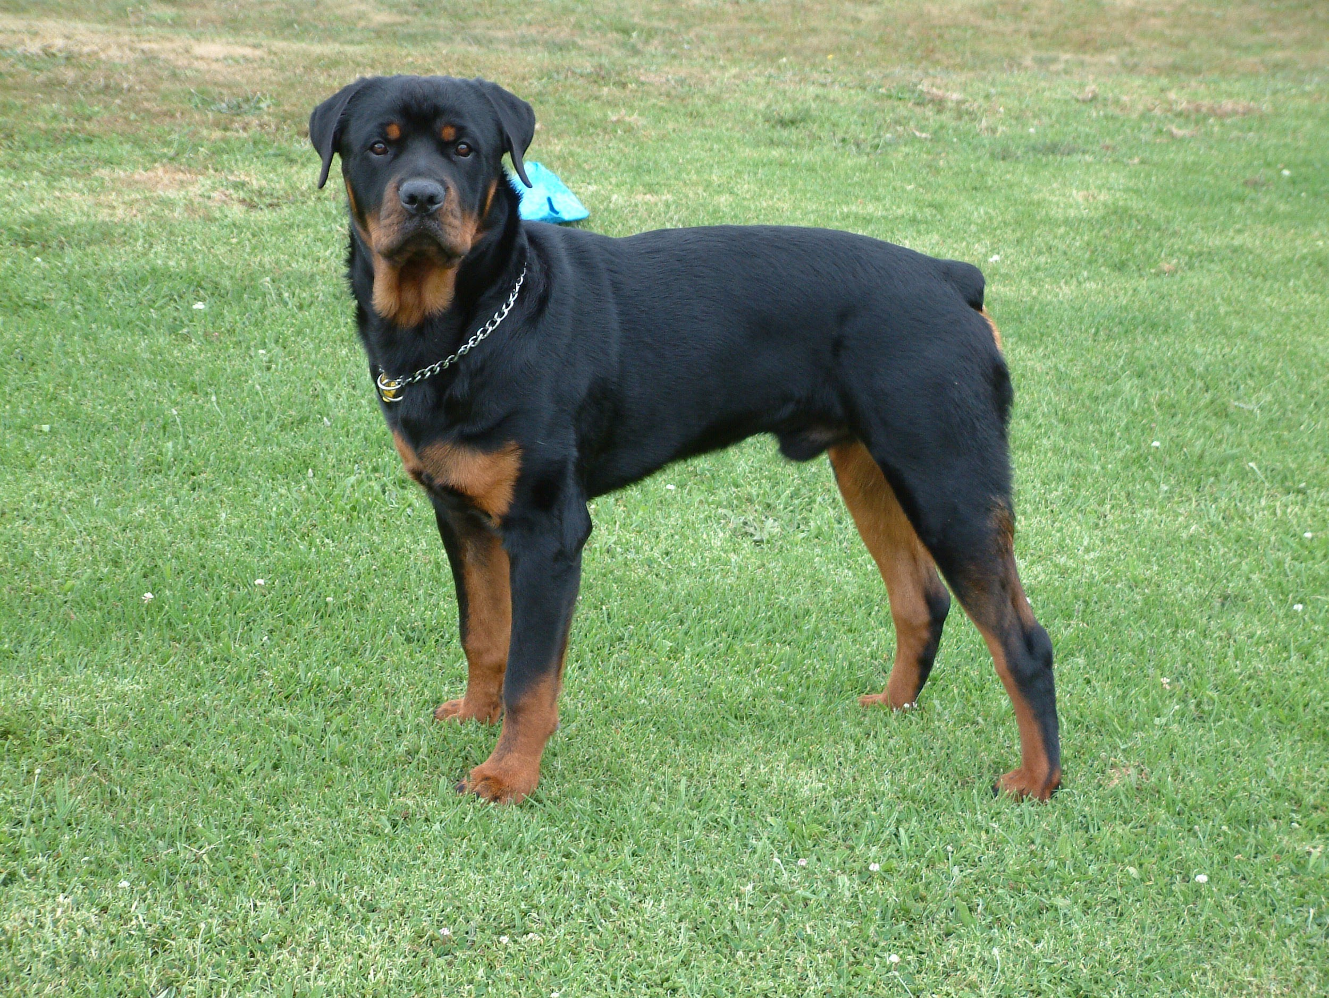
Rottweiler

Slide 37
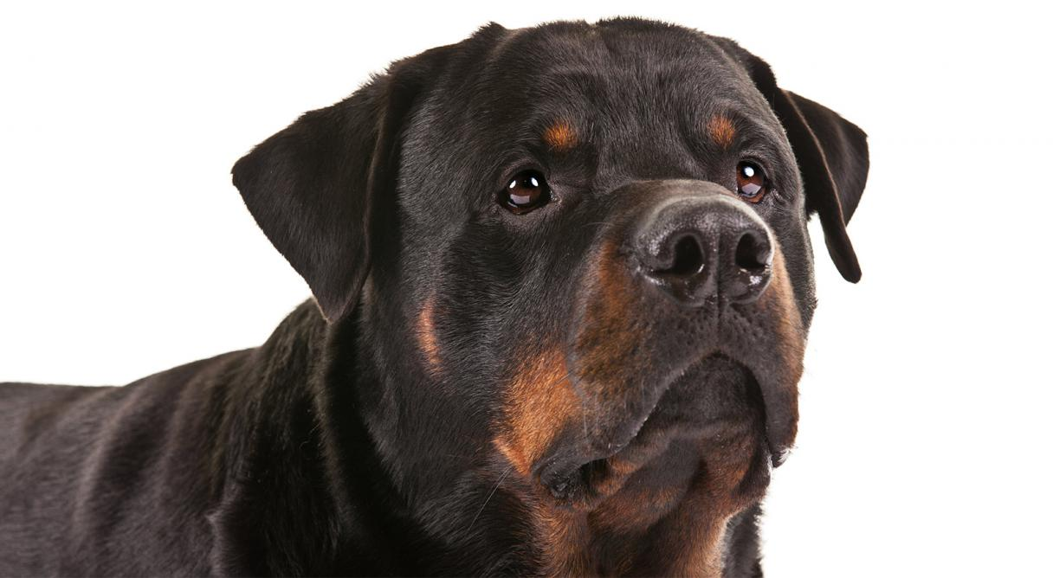
Rottweiler
AKC Recognized Colors:
Black and mahogany
Black and rust
Black and tan
AKC Recognized Markings:
None
Rotties originated in Europe during roman times and saved by the Germans
Large head and muscular body
Used by butchers to protect them from robbers and drive cattle to the market

Slide 38
St. Bernard

Slide 39
St. Bernard
AKC Recognized Colors:
9 recognized colors (there is a wide variety)
AKC Recognized Markings:
Black mask
Saints originated in the Swiss valleys
Used to pull carts, guard livestock, and alert the family to danger
Very large breed (130-180lbs) with a short or long coat

Slide 40
Siberian Husky

Slide 41
Siberian Husky
AKC Recognized Colors:
Agouti & white
Black & white
Grey & white
Red & white
Sable & white
White
AKC Recognized Markings:
Black points
Piebald
Pinto
Originated in America
Designed to pull sleds quickly and over long distances
Many (not all) members of this breed have blue eye(s)

Slide 42
Standard Schnauzer

Slide 43
Standard Schnauzer
AKC Recognized Colors:
Black
Pepper & salt
AKC Recognized Markings:
None
Originated in Germany
All purpose dogs that guarded livestock, killed vermin, and protected the family
Medium size with a beard, feathered coat, and docked tail. Ears can be erect or lay down.

